Slide 1
DCLAB Final Project 卡拉ok評分系統
Team09 吳睿哲 謝兆和 鐘民憲

Slide 2
Introduction
Goal:
A karaoke machine which can
1.Read several songs from SD card(including
original ver., only BGM ver. and only vocal ver.)
2.Play the mixture of BGM and user’s voice.
3.Real time display the score in percentage form.

Slide 3
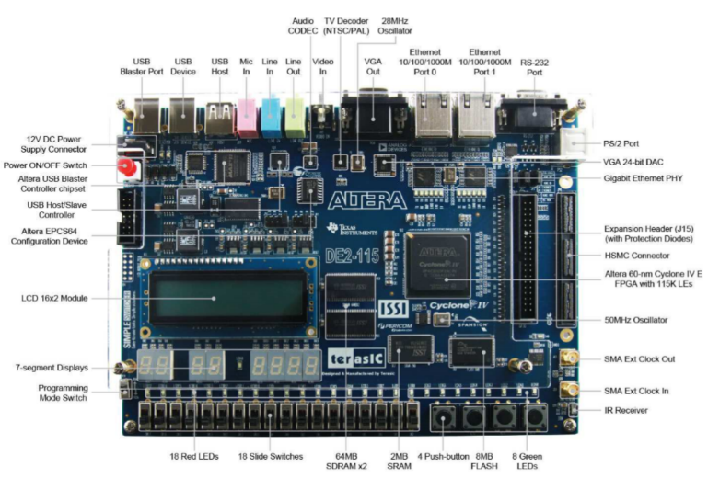
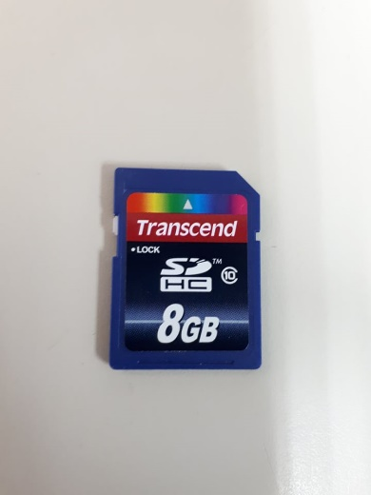
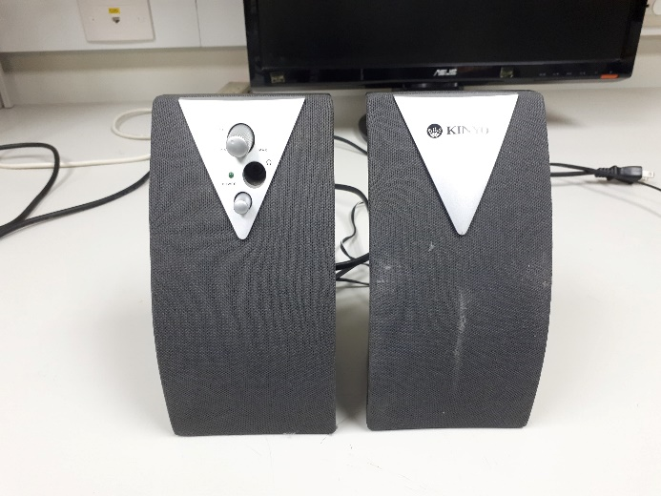
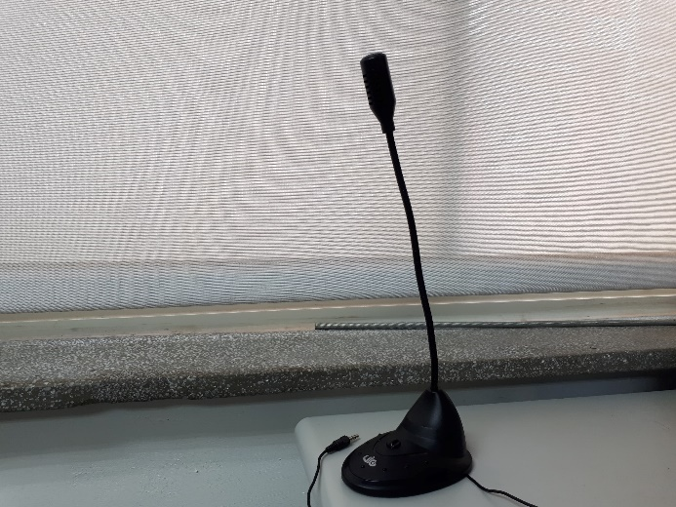
Equipment

Slide 4
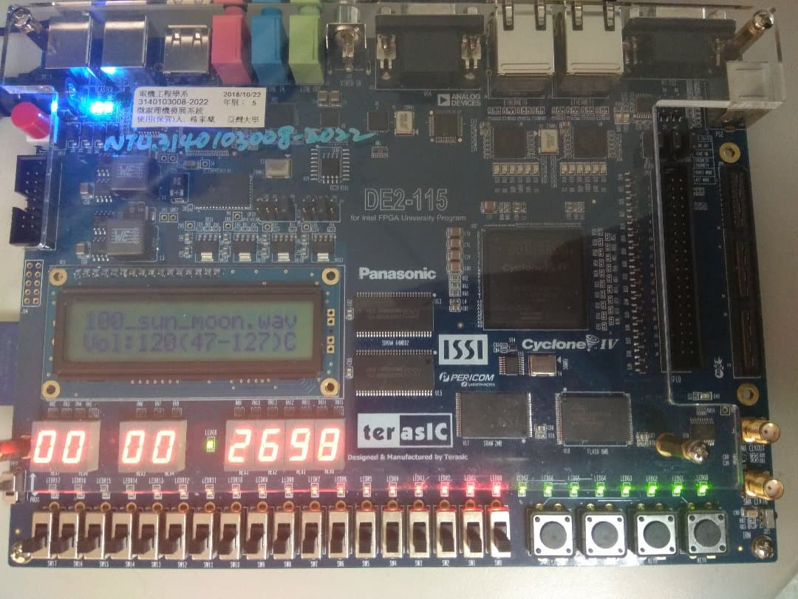
Operation Manual
“Listening mode”
Display the name of song and current volume
Show the play time
SD Card
Volume up
Volume down
Real time volume
Switch between mixed song or BGM
Repeat
Next Song
Change mode

Slide 5
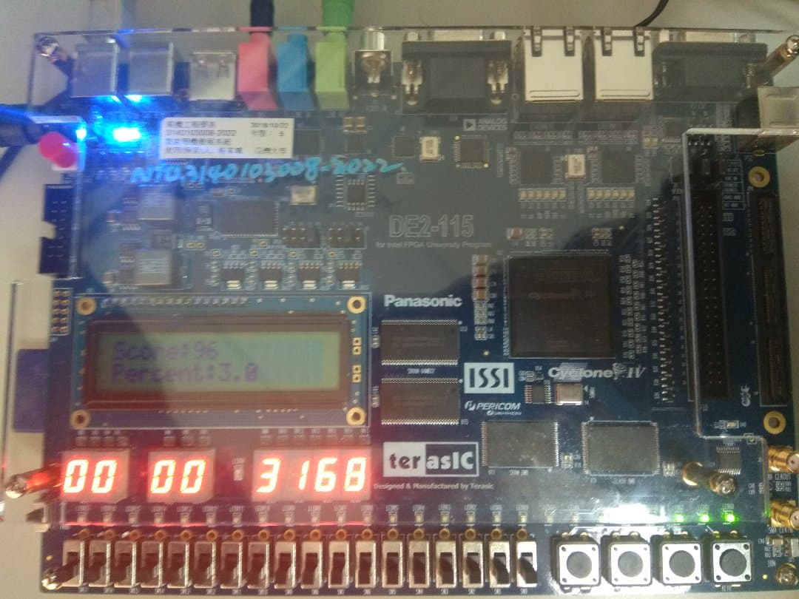
Operation Manual
“Karaoke mode”
Display the accumulated score and percentage accuracy
Show the play time
SD Card
Volume up
Volume down
Real time volume
Switch between mixed song or BGM
Repeat
Next Song
Change mode

Slide 6
Operation Manual
1.Insert SD card into DE2-115 board.
2.Machine will automatically enter the
“listening” mode.
3.Switch SW1 to choose between original song
and BGM.
4.Press KEY0 to enter “karaoke” mode. The
song being played will be the same as in
“listening” mode.

Slide 7
Operation Manual
5.In “listening” mode, LCD will display the
name of the song and the volume, 7-segment
will display the playing time.
6.In “karaoke” mode, LCD will display the
accumulated score and percentage accuracy
in real time.
7.Press KEY3 can change the song.
8.Press KEY1 to lower the volume and press KEY2
to increase the volume.

Slide 8
SD Card and Files Requirement
SD card format:FAT16/FAT32
File format: WAV(place under root directory)
Sample rate:32k
Stereo and 16bits per channel

Slide 9
WAV file header
Positions | Sample Value | Description
1 - 4 | "RIFF" | Marks the file as a riff file
5 - 8 | File size (integer) | Size of the overall file in
9 -12 | "WAVE" | File Type Header
13-16 | "fmt " | Format chunk marker
17-20 | 16 | Length of format data as listed above
21-22 | 1 | Type of format (1 is PCM)
23-24 | 2 | Number of Channels
25-28 | 44100 | Sample Rate
29-32 | 176400 | (Sample Rate * BitsPerSample * Channels) / 8.
33-34 | 4 | (BitsPerSample * Channels) / 8.1 - 8 bit mono2 - 8 bit stereo/16 bit mono4 - 16 bit stereo
35-36 | 16 | Bits per sample
37-40 | "data" | "data" chunk header.
41-44 | File size (data) | Size of the data section.

Slide 10




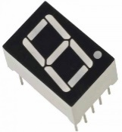
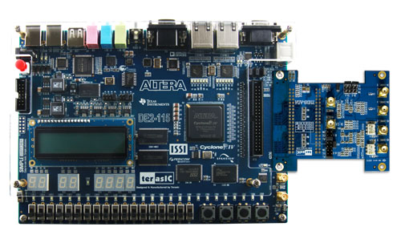
Module Hierarchy
WM
8731
NIOS II Processor
SD Card Driver
DSP & Scorer
LCD
Controller

Slide 11
Qsys IP Core
clk_50//global clock
cpu
timer
onchip_memory//store the instruction
aptll//clock for other chip or driver
jtag_uart
//handle communication
when programming
I2c//initialize audio chip
sd_clk,sd_cmd,sd_dat
//deal with sd card
score_0
//dsp & scorer
key
sw
seg7
ledg,ledr
lcd

Slide 12
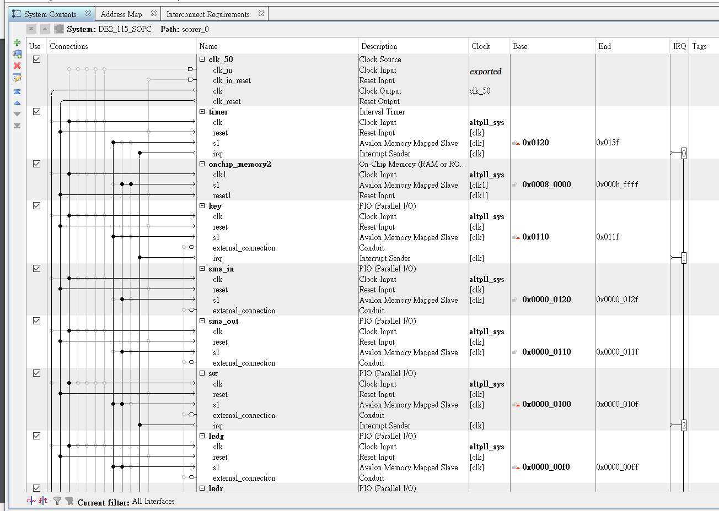
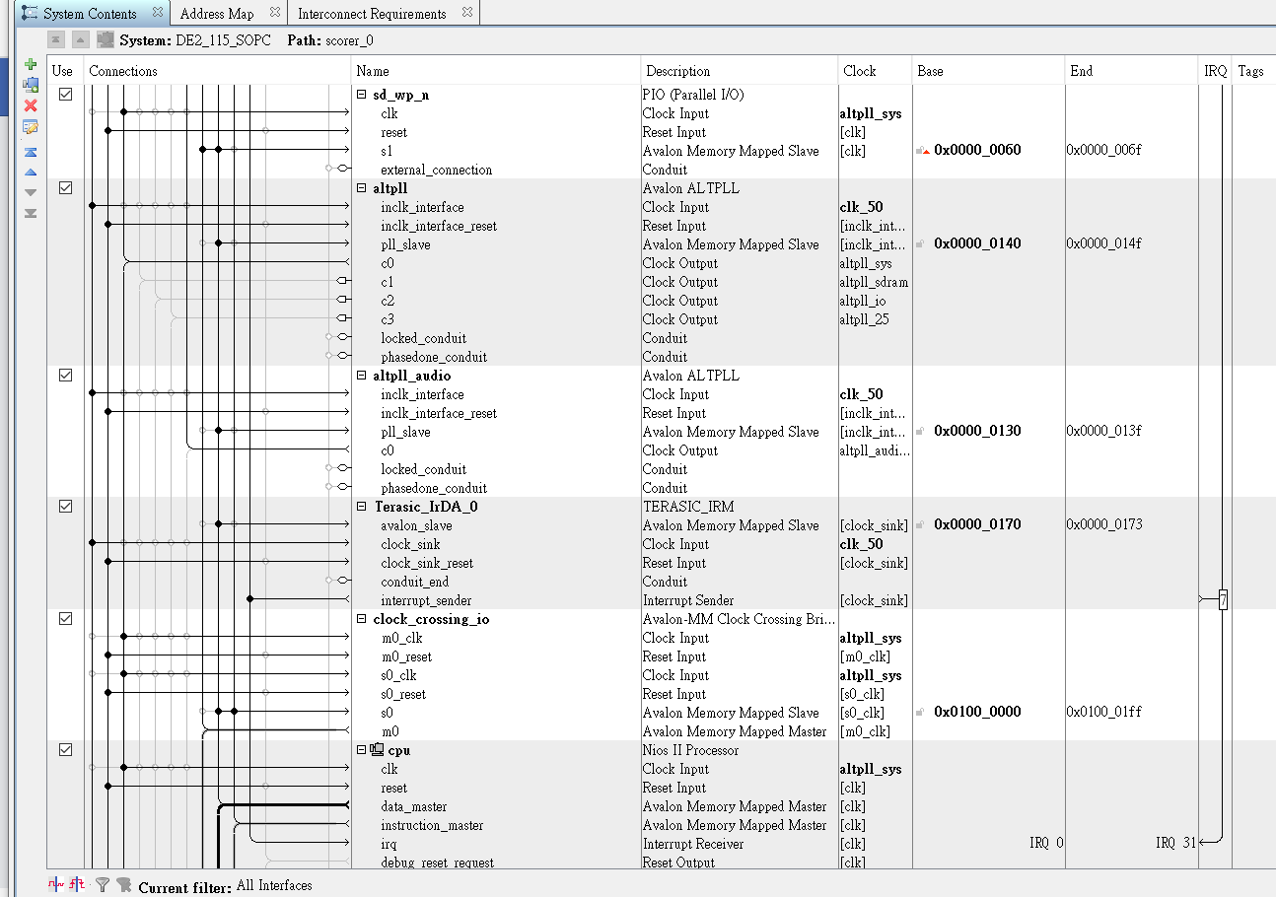
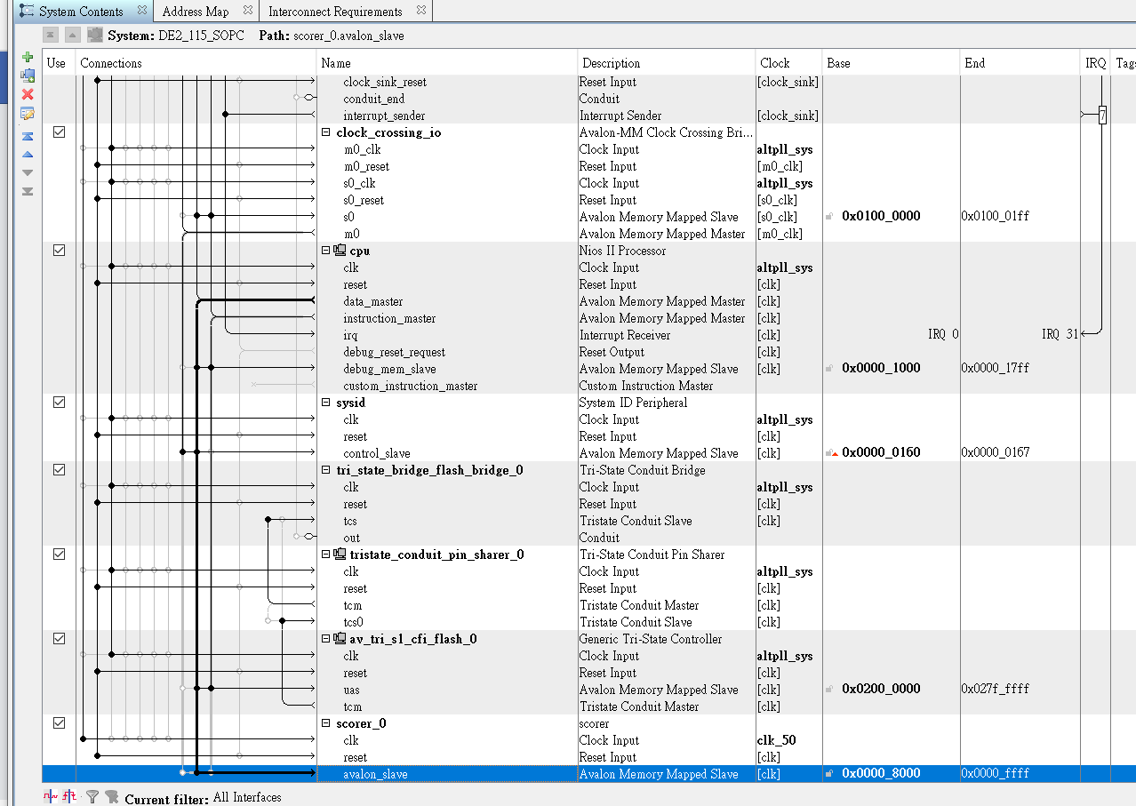
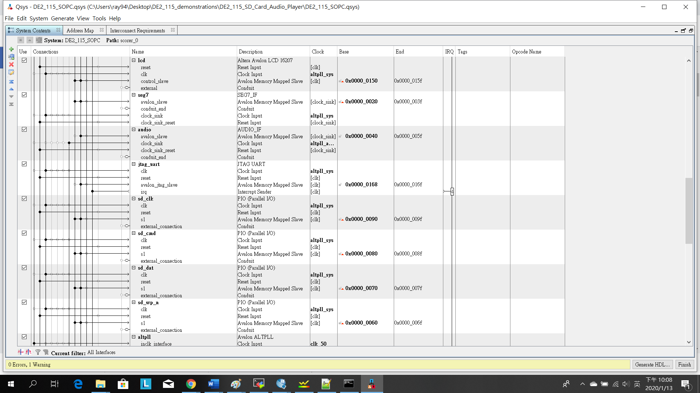
Qsys

Slide 13
Nios II
A 32-bit embedded-processor architecture designed specifically for the Altera family of FPGA integrated circuits.
System-on-a-Programmable-Chip(SOPC).
C language.
More easier for IP core control. For example, print anything on LCD only with one line of code.

Slide 14
Nios II
Difficulty:
1.Plenty of included files with plenty of
unfamiliar function calls.
2.Since our DSP & Scorer are written in Verilog,
we need to first create a self-defined IP core
based on it and then use the register address
to communicate with the module.
3.Totally self-study.

Slide 15
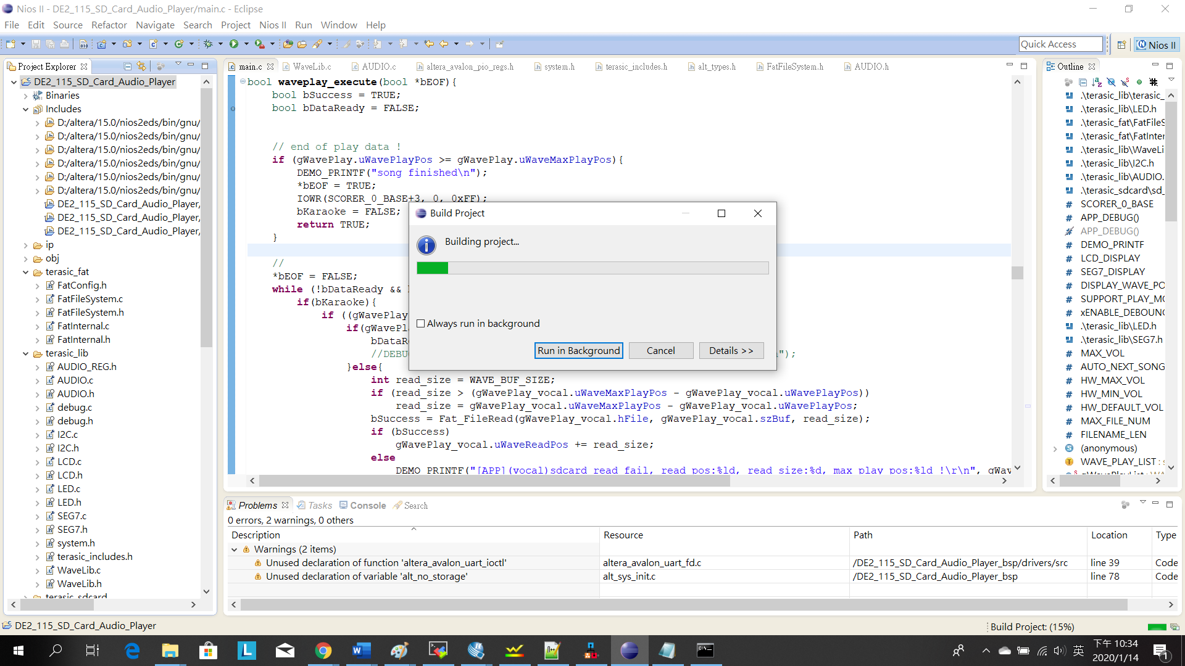
Nios II

Slide 16
Initialization (Audio Codeic, SD controller)
read SD card & build playlist
Key 2 up
Key 1 down
Play song (listening mode)
Key 0
Key 3
Switch 1
Song end
Play song (karaoke mode)
&
Call scorer
Volume adjustment
Change between
bgm and original
Next song

Slide 17
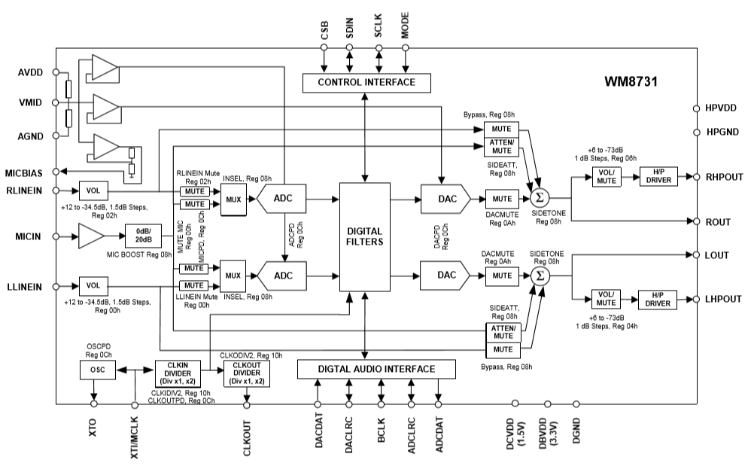
Audio Codec

Slide 18
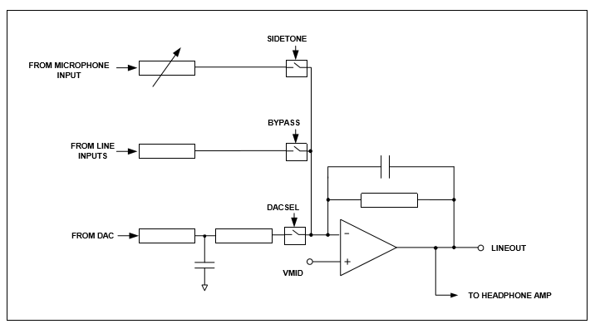
Audio Codec
Analogue Audio Path Control
Register | Bit[8] | Bit[7] | Bit[6] | Bit[5] | Bit[4] | Bit[3] | Bit[2] | Bit[1] | Bit[0]
000_0100 | 0 | SIDEATT[1:0] |  | SIDE TONE | DAC SEL | BY PASS | INSEL | MUTEMIC | MIC BOOST

Slide 19
The Scoring Machine
Detect the first derivative of the time-domain signal to determine the beat.
The time domain resolution is 0.0625 second.
Until now, we can only detect beat, not frequency, due to technical failure.

Slide 20
The DSP module problem
I read the document and applied the FFT IP core to the scoring machine. There were quite a lot of bugs, though. The control signals of the scoring machine was complicated, and connecting every submodule to the top module was a mess. Also,
Until now, we still cannot use the FFT IP core. Instead, we compare the average energy of 2048 consecutive signal points on time domain.
We will elaborate the original concept in the following slides.

Slide 21
DSP and Scoring Concept
Module Hierarchy
- fft_n_ifft(top module)
- evaluate(Comparison of two signals)
- scoring(Accumulate the score)
- fft_n_ifft_fft_ii_0
(Fast Fourier Transform for SD card signal and
microphone signal)

Slide 22

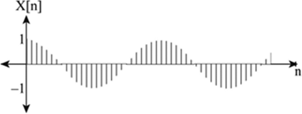

DSP and Scoring Concept
Evaluate
Base frequency
Total Score and Percentage
Calculator
FFT
Sample signal
0/1
FFT
Test signal
Base frequency
Sample & test signal both have left and right channel, each containing 16 bits

Slide 23
DSP and Scoring Concept
Evaluate:
Fourier transform the discrete signal into frequency domain.
Use the FFT_ii IP core available in Qsys.
The module has time resolution of roughly 1/16 sec and frequency resolution of roughly 16Hz. (The sampling frequency is 32kHz, and the size of point of this FFT module is 2048.)

Slide 24
DSP and Scoring Concept
If the base frequency of the sample signal is 0.25/0.5/1/2/4 times of that of the test signal, then the output is 1, otherwise 0.
Allow error less than a semitone, more tolerant for lower pitch due to the limit of frequency resolution.

Slide 25
DSP and Scoring Concept
Scoring:
1.Denominator will increase by 1 once a segment of
signal is evaluated. The denominator is equal to
the total length of the song that contains vocal part.
2.Nominator will increase according to the output of the
evaluator.
3.Therefore, we can get the percentage of frequency
accuracy from the start point to the current time point.
The percentage is rounded to the first digit.

Slide 26
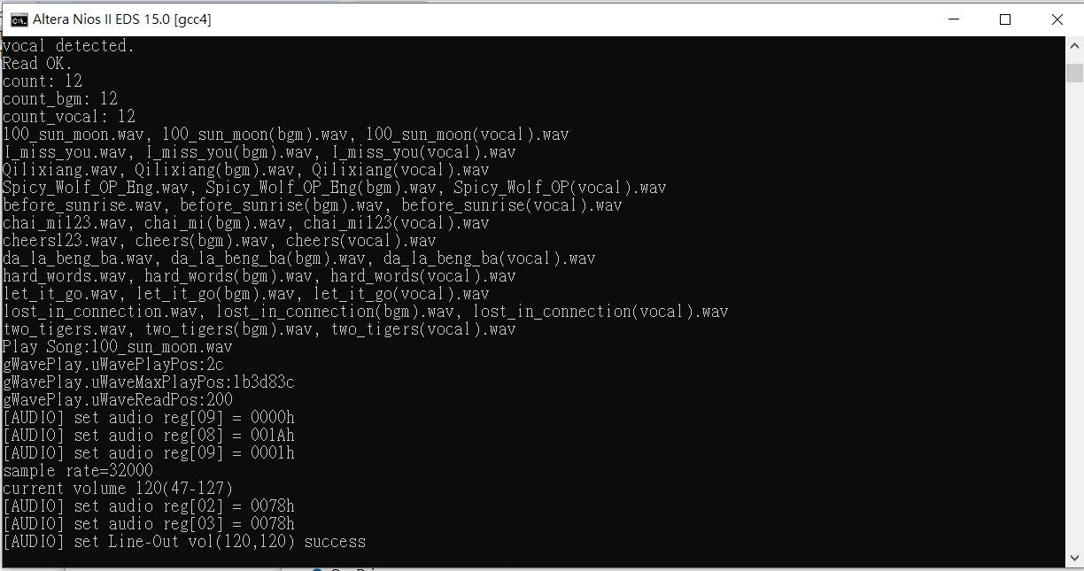
Demo Time
https://youtu.be/obytSkAKaL0

Slide 27
The End

