Slide 1

METEOROLOGICAL DATA ANALYTICS & PREDICTIVE MODELING
Foundations of Data Science Course Project | Empirical Investigation
PROJECT TEAM MEMBERS
1. Dhanasri Raghavender Reddy (252U1R3024)
Data Product & Problem Lead
2. Kasam Pranav Reddy (252U1R3039)
Visualization, Dashboard & Storytelling Lead
3. Kota Sai Mani Rupesh (252U1R3045)
Data Preparation & Feature Engineering Lead
4. Kuncham Lokesh (252U1R3046)
Visualization, Dashboard & Storytelling Lead
5. Manchikanti Venkata Mouneesh Kumar (252U1R3049)
Statistical & Predictive Analytics Lead
Department of Computer Science & Engineering | Academic Year 2026 | Slide 01 of 22

Slide 2

01 / INTRODUCTION & ROADMAP
End-to-End Analytical Workflow
High-level architectural pipeline from sensor ingestion to predictive inference
SYSTEM ARCHITECTURE OVERVIEW
01. Raw Data Ingestion & Schema Profiling
Loading 30,711 hourly observations, verifying matrix shape, and classifying attribute data types.
02. Data Storytelling & Sensor Anomaly Audit
Exploring weather label frequencies, precipitation ratios, invariant features, and barometric dropouts.
03. Data Hygiene & Feature Engineering
Median imputation of pressure zeros, cyclical temporal decomposition, and thermodynamic divergence.
04. Statistical Testing & Machine Learning
Parametric hypothesis tests, apparent temperature regression (OLS), and rain/snow classification.
05. Unsupervised Discovery & Academic Synthesis
K-Means climate regimes, PCA dimensionality reduction, and peer-reviewed literature benchmarking.
Foundations of Data Science Course Project | Meteorological Telemetry Analytics 02 / 22

Slide 3
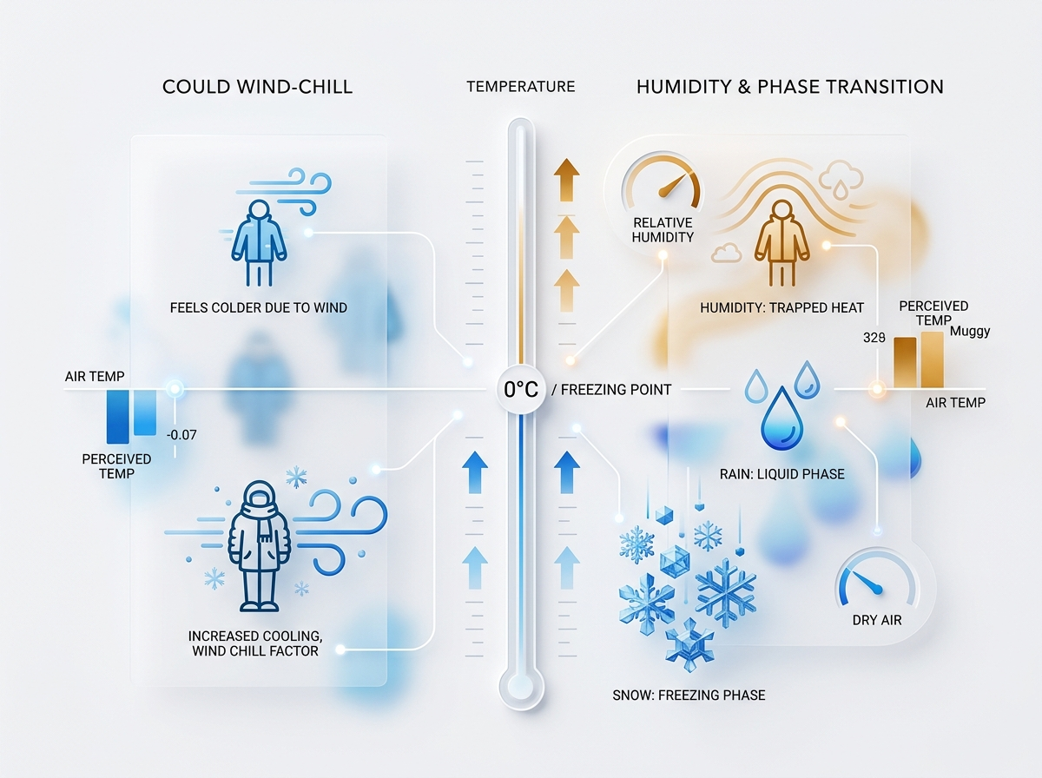
01 / PROBLEM FORMULATION
Core Objectives & Scientific Motivation
Thermal perception divergence and precipitation phase boundary sensitivity
THE THREE CORE RESEARCH OBJECTIVES
01. Apparent Temperature Regression Modeling
Ambient dry-bulb temperature fails to reflect true human thermal sensation due to evaporative cooling. We construct predictive regression models using multi-sensor environmental features to accurately forecast "feels-like" temperature with R² > 0.98.
02. Freezing Threshold Precipitation Classification
Precipitation phase (liquid rain vs. frozen snow) exhibits critical non-linear behavior near the 0°C freezing point. We build high-precision classifiers capable of separating precipitation states despite significant natural class imbalance.
03. Unsupervised Climate Regime Discovery
Natural weather patterns cluster into discrete seasonal regimes. Using K-Means clustering and PCA decomposition, we extract macro-scale atmospheric patterns without requiring target label supervision.
Foundations of Data Science Course Project | Meteorological Telemetry Analytics 03 / 22

Slide 4
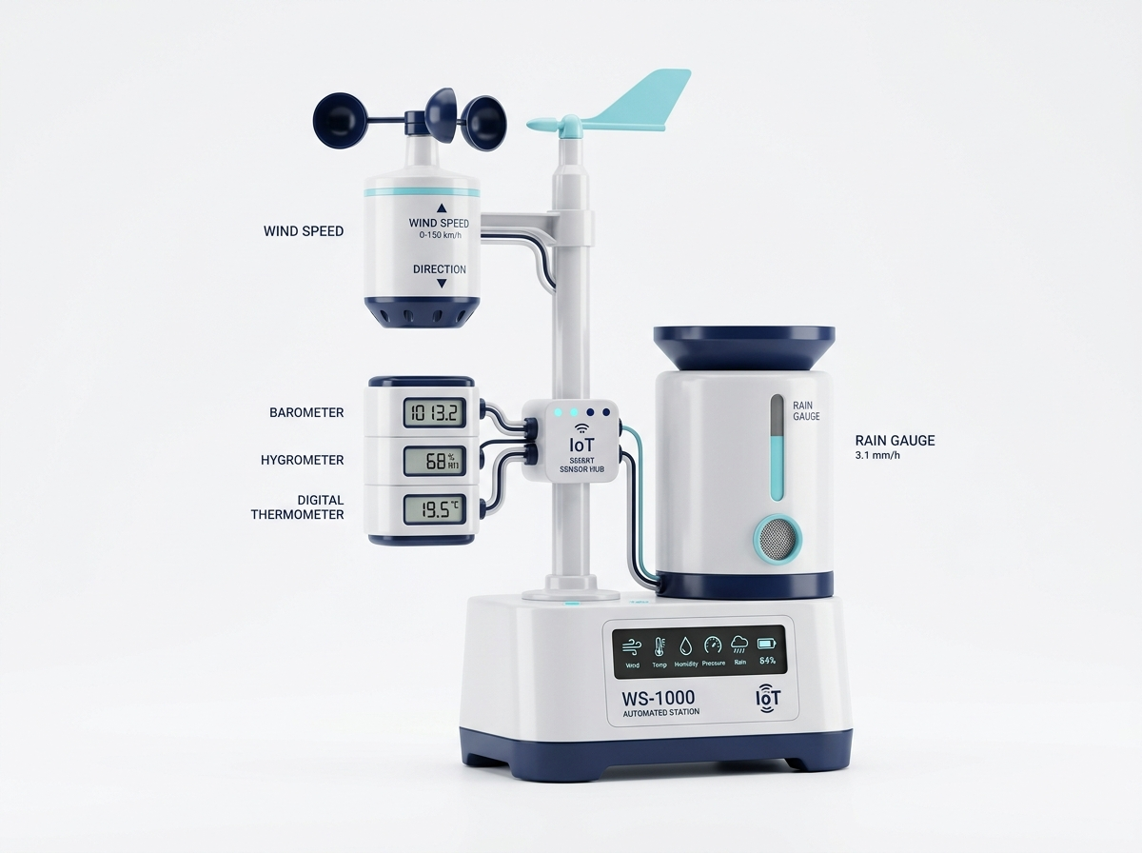
01 / DATASET ARCHITECTURE
Atmospheric Sensor Attribute Taxonomy
Profile of the 30,711 hourly historical sensory logs in weatherHistory.csv
DATASET SCHEMA & ATTRIBUTE TAXONOMY
• Telemetry Record Volume: 30,711 hourly historical readings spanning continuous multi-year environmental logging.
• Feature Dimensionality: 12 raw features spanning thermodynamic, aerodynamic, and sky observation domains.
• Continuous Predictors: Temperature (°C), Apparent Temperature (°C), Humidity (0–1), Wind Speed (km/h), Wind Bearing (0–360°), Visibility (km), and Pressure (millibars).
• Categorical Variables: Precip Type (rain/snow), Summary (hourly sky state), and Daily Summary.
• Analytical Targets: Apparent Temperature for continuous regression; Precip Type for binary classification.
Foundations of Data Science Course Project | Meteorological Telemetry Analytics 04 / 22

Slide 5

02 / DATA INSPECTION
Environment Setup & Raw Data Ingestion
Notebook Cells 1–4: Package imports, CSV loading, and dimension verification
DATA INGESTION PIPELINE (CELLS 1–4)
01. Package Ecosystem Initialization (Cells 1–2)
Imported pandas, numpy, matplotlib.pyplot, and seaborn. Configured standardized plot aesthetics (whitegrid, 10x5 aspect ratio).
02. Tabular Data Loading (Cell 3)
df = pd.read_csv("weatherHistory.csv") ingested the raw CSV file into an in-memory Pandas DataFrame.
03. Shape Verification (Cell 4)
df.shape confirmed an exact matrix dimension of (30711, 12) — exactly 30,711 rows and 12 columns.
04. Record Density & Head Verification (Cell 5)
df.head() confirmed unbroken hourly telemetry logs without truncation across the initial observations.
Foundations of Data Science Course Project | Meteorological Telemetry Analytics 05 / 22

Slide 6
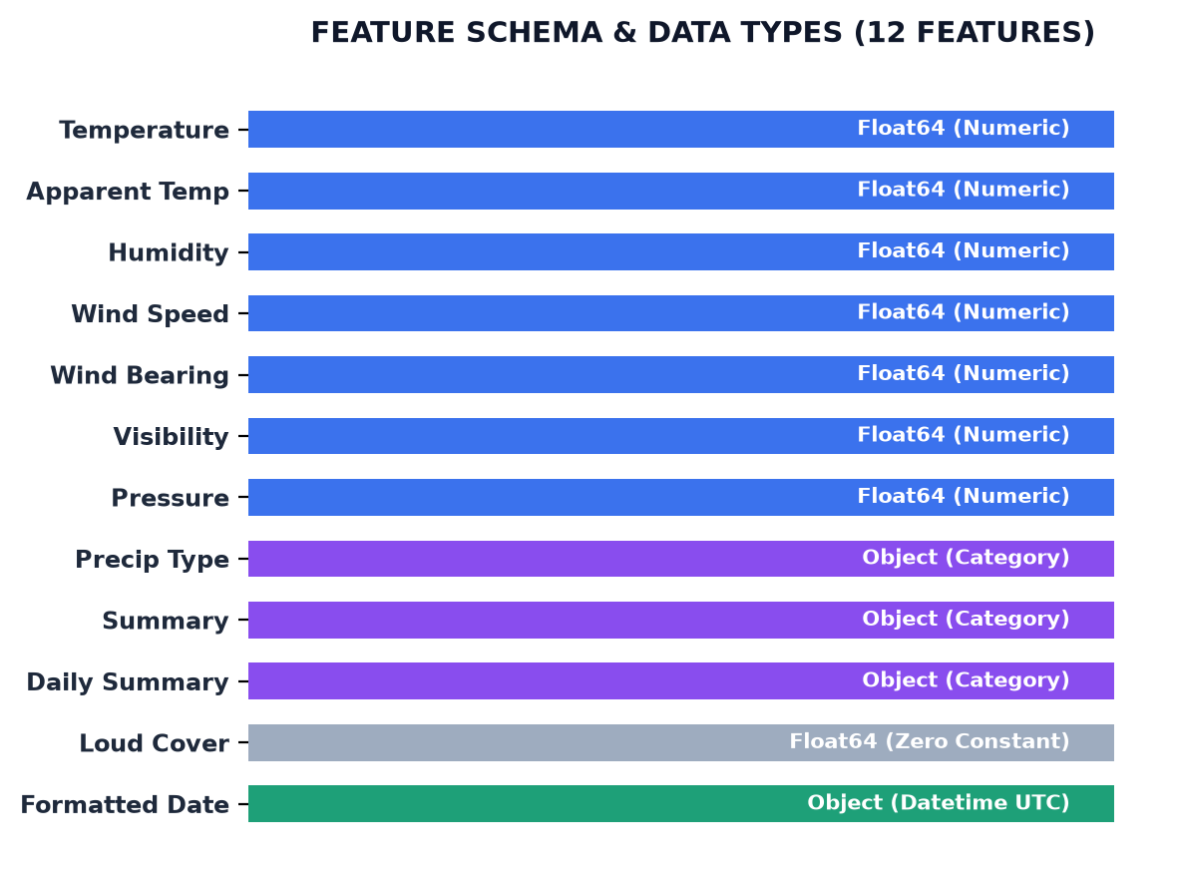
02 / DATA INSPECTION
Schema Architecture & Feature Data Types
Notebook Cells 5–6: Data types profiling and feature categorizations
ATTRIBUTE TYPE PROFILING (CELLS 5–6)
• 7 Continuous Numeric Features (float64):
Temperature, Apparent Temperature, Humidity, Wind Speed, Wind Bearing, Visibility, and Pressure.
• 3 Categorical Text Features (object):
Precip Type (discrete target), Summary (hourly weather condition), and Daily Summary.
• 1 Constant Zero Column (float64):
Loud Cover stores numeric 0.0 across nearly all rows, representing an uninformative constant.
• 1 Temporal String Field (object):
Formatted Date contains timestamp strings with timezone offsets requiring datetime conversion.
Foundations of Data Science Course Project | Meteorological Telemetry Analytics 06 / 22

Slide 7
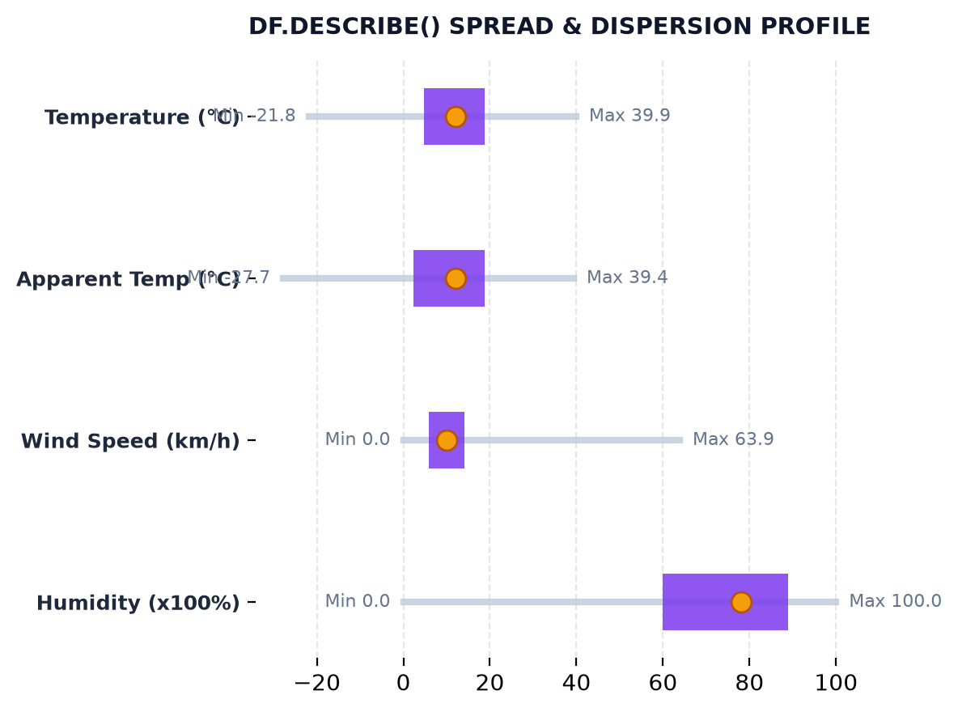
02 / DATA INSPECTION
Parametric Spread & Descriptive Statistics
Notebook Cell 7: df.describe() metric ranges, dispersion, and anomaly discovery
KEY FINDINGS FROM DF.DESCRIBE()
• Ambient Temperature: Mean 11.70°C, Range -21.82°C to +39.91°C. Standard deviation of 9.57°C highlights broad temperate seasonality.
• Apparent Temperature: Mean 10.56°C, Range -27.72°C to +39.35°C. Lower extreme demonstrates substantial evaporative wind chill.
• Relative Humidity: Mean 0.72, Median 0.78 (IQR: 0.60 to 0.89), demonstrating a moist continental climate.
• Surface Wind Speed: Mean 10.82 km/h, Std 6.92 km/h, Max 63.85 km/h, with significant positive skewness.
• Critical Pressure Anomaly Discovered: Minimum reading is exactly 0.00 mbar (physically impossible vacuum at sea level indicating sensor dropout).
Foundations of Data Science Course Project | Meteorological Telemetry Analytics 07 / 22

Slide 8
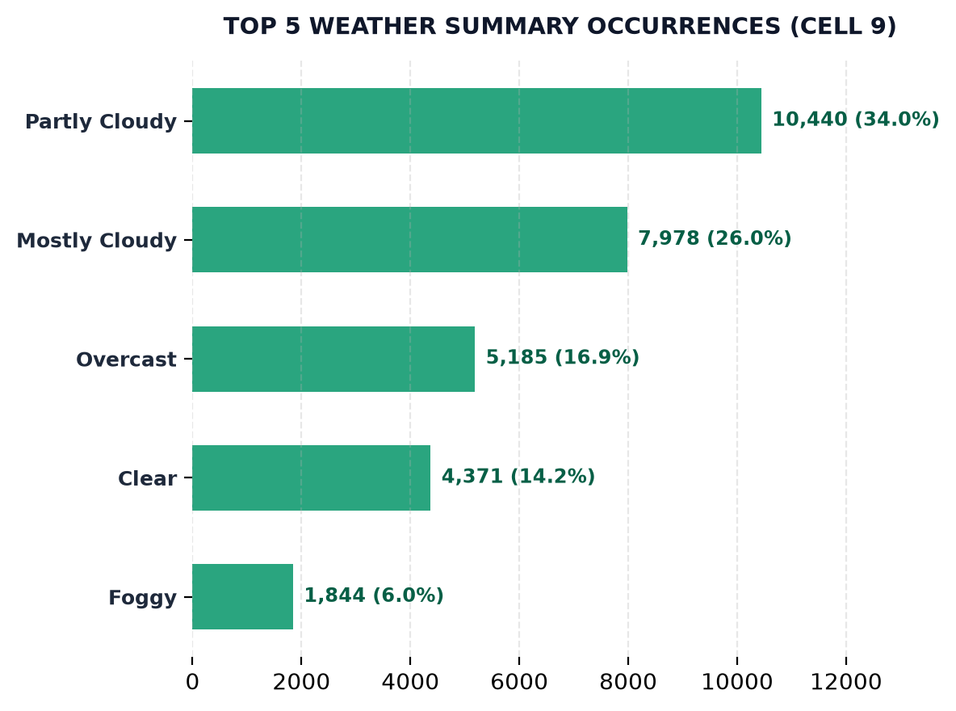
03 / DATA STORYTELLING
Weather Summary Label Distribution
Notebook Cell 8: Frequency analysis of sky condition labels (df['Summary'].value_counts())
SKY CONDITION FREQUENCY ANALYSIS
01. Partly Cloudy Dominance
The most common weather summary with 10,440 readings (34.0% of total observation volume).
02. Heavy Cloud Regimes
Mostly Cloudy (7,978 logs) and Overcast (5,185 logs) form the second and third most prevalent weather states.
03. Clear Sky Frequency
Clear skies occurred in 4,371 hourly observations (14.2% share).
04. Atmospheric Synthesis
Over 76.9% of all logged intervals feature active cloud coverage, showing high cloud persistence in the region.
Foundations of Data Science Course Project | Meteorological Telemetry Analytics 08 / 22

Slide 9
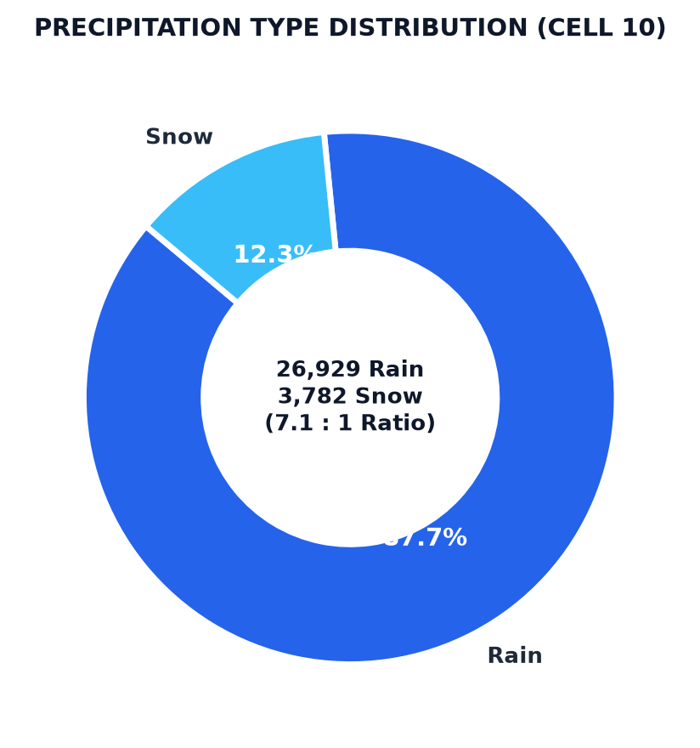
03 / DATA STORYTELLING
Precipitation Phase Distribution & Imbalance
Notebook Cell 9: Evaluating rain vs. snow counts and the 7.1 : 1 class imbalance
PRECIPITATION FREQUENCY & CLASS RATIO
• Rain Occurrence (Cell 9): 26,929 events, constituting 87.7% of all recorded precipitation episodes.
• Snow Occurrence (Cell 9): 3,782 events, constituting 12.3% of all recorded precipitation episodes.
• Target Completeness: Exactly 0 missing values (dropna=False confirmed full target coverage).
• Severe 7.1 : 1 Class Imbalance: The heavy skew toward rain requires stratified cross-validation and evaluation metrics beyond raw accuracy (precision, recall, F1).
Foundations of Data Science Course Project | Meteorological Telemetry Analytics 09 / 22

Slide 10
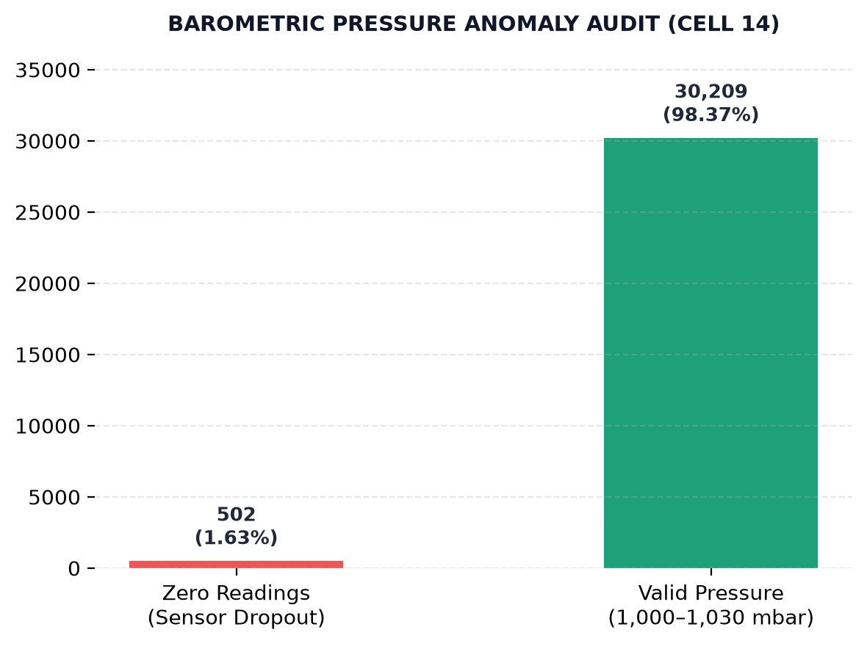
03 / DATA STORYTELLING
Sensor Anomaly & Data Integrity Audit
Notebook Cells 10–13: Null audit, zero duplicates, invariant noise, and pressure dropouts
INTEGRITY AUDIT & DEFECT DISCOVERY
01. Duplicate Record Check (Cell 11)
df.duplicated().sum() returned 0. The dataset has zero duplicate rows, confirming unique temporal observation points.
02. Column Null Audit (Cell 10)
Only Loud Cover, Pressure, and Daily Summary contain 1 null each. Core physical predictors have zero missing values.
03. Invariant "Loud Cover" Artifact (Cell 12)
(df["Loud Cover"] == 0).mean() is 99.997%. The column carries zero variance and must be purged.
04. The 502 Impossible Pressure Zeros (Cell 13)
(df["Pressure"] == 0).sum() flagged 502 zero readings. Terrestrial surface pressure cannot reach 0 mbar (telemetry sensor dropouts).
Foundations of Data Science Course Project | Meteorological Telemetry Analytics 10 / 22

Slide 11

04 / DATA PREPARATION
Systematic Data Hygiene Pipeline
Notebook Cells 14–21: Deduplication, column pruning, datetime UTC parsing, and median imputation
TRANSFORMATION PIPELINE EXECUTION
• Step 1: Duplicate Purge (Cell 14): Executed df.drop_duplicates().reset_index(drop=True) to establish verified baseline hygiene.
• Step 2: Target Defensive Imputation (Cell 15): df["Precip Type"].fillna("none") applied as defensive programming against missing categorical labels.
• Step 3: Invariant Feature Dropping (Cell 16): df.drop(columns=["Loud Cover"]) removed the zero-variance column to reduce dimensionality.
• Steps 4–5: Temporal UTC Parsing (Cells 17–18): pd.to_datetime(utc=True) transformed date strings into datetime and sorted chronologically.
• Step 6: Barometric Median Imputation (Cells 19–21): Replaced 502 impossible zero pressures with NaN, then imputed using robust median of 1,016.45 mbar.
Foundations of Data Science Course Project | Meteorological Telemetry Analytics 11 / 22

Slide 12
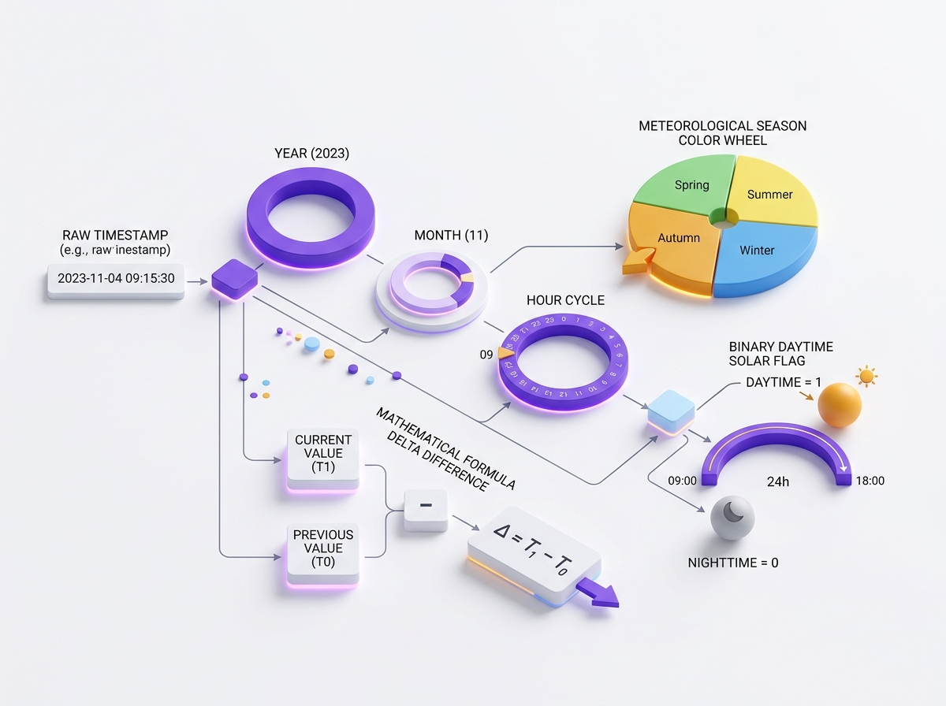
04 / DATA PREPARATION
Domain-Driven Feature Engineering
Notebook Cells 22–28: Temporal decomposition, seasonal mapping, and thermodynamic divergence
DERIVED METEOROLOGICAL FEATURES
01. Temporal Decomposition (Cells 22–24)
Extracted Year, Month, and Hour from UTC datetime timestamps to enable cyclical analysis.
02. Meteorological Season Mapping (Cells 25–26)
Constructed month_to_season mapping: Winter (Dec–Feb), Spring (Mar–May), Summer (Jun–Aug), Autumn (Sep–Nov).
03. Temperature Divergence Index (Cell 27)
Created Temp Diff = Temperature - Apparent Temperature, quantifying evaporative wind-chill cooling magnitude.
04. Diurnal Solar Binary Flag (Cell 28)
Derived Is Daytime = Hour.between(6, 18), distinguishing solar radiative heating from nocturnal cooling.
Foundations of Data Science Course Project | Meteorological Telemetry Analytics 12 / 22

Slide 13
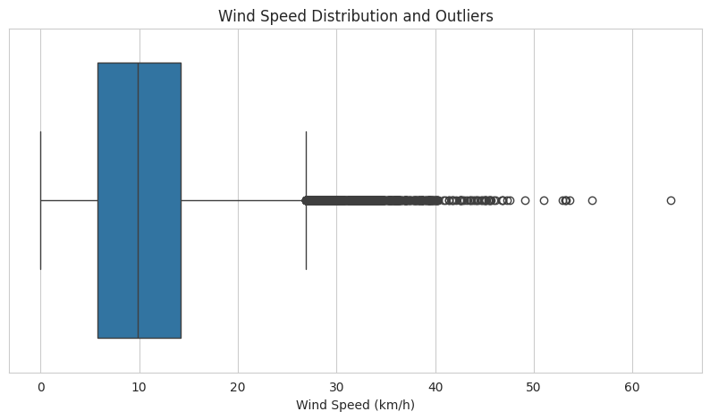
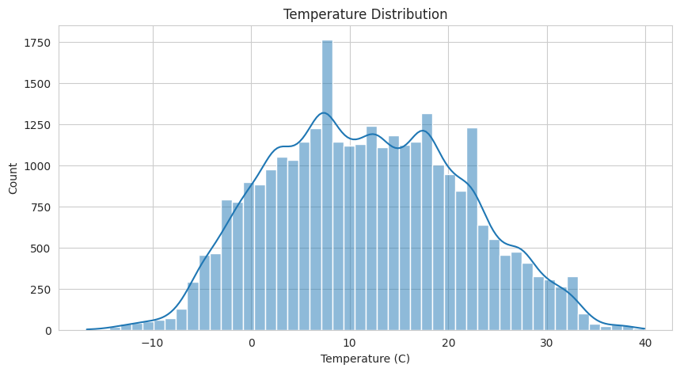
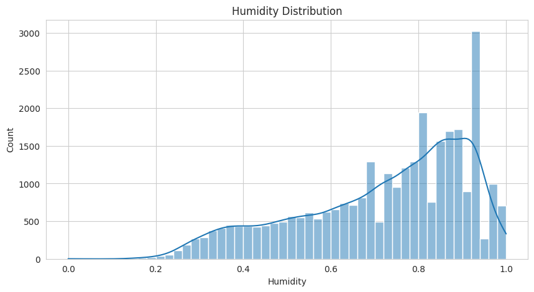
04 / DATA PREPARATION
Outlier Diagnostics & Feature Distributions
Notebook Cells 29–33: Tukey IQR outlier rule (2.9% retained) and feature histograms
IQR OUTLIER DETECTION (CELLS 29–30): Applied standard rule: Outliers < Q1 - 1.5*IQR or > Q3 + 1.5*IQR. Wind speed has 899 outliers (2.93% share). Retained as legitimate extreme weather gusts.
WIND SPEED BOXPLOT (CELL 31)
Upper threshold 24.2 km/h; storm tail reaches 63.85 km/h.
TEMPERATURE HISTOGRAM (CELL 32)
Bimodal profile reflecting distinct summer and winter regimes.
HUMIDITY HISTOGRAM (CELL 33)
Pronounced left-skew with 0.78 median dampness level.
Foundations of Data Science Course Project | Meteorological Telemetry Analytics 13 / 22

Slide 14
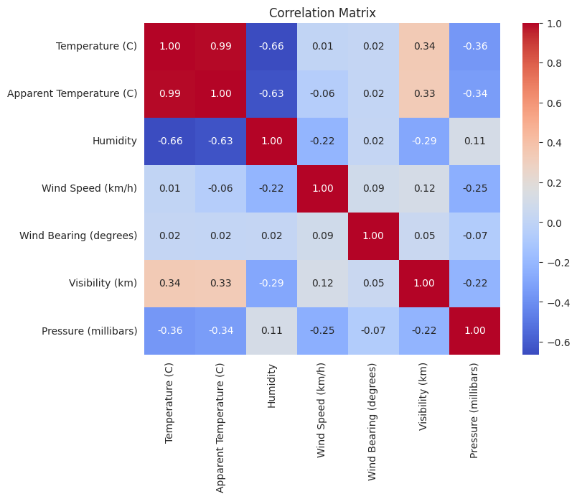
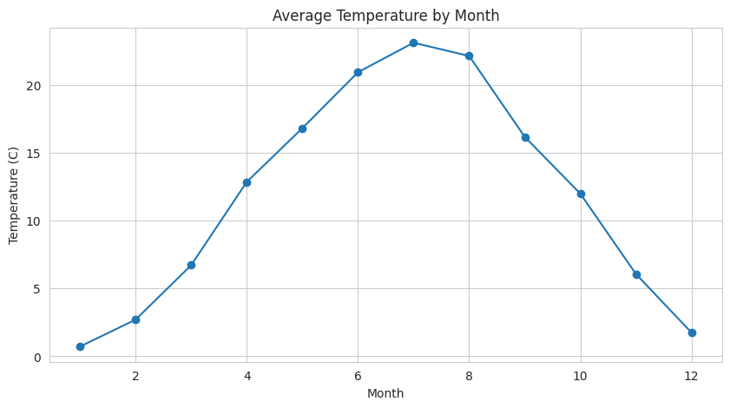
05 / STATISTICAL & PREDICTIVE ANALYTICS
Covariance Matrix & Annual Seasonality
Notebook Cells 34–40: 7-feature correlation heatmap and 10-year monthly temperature cycle
KEY CORRELATIONS
• Temp & Apparent:
r = +0.992 collinearity.
• Temp & Humidity:
r = -0.663 inverse link.
• Monthly Cycle:
Jan nadir (0.7°C) to July apex (23.1°C).
MULTIVARIATE CORRELATION ANALYSIS (CELLS 34–40): Temperature and apparent temperature form the primary collinear axis (r = 0.992), while relative humidity provides orthogonal variance essential for regression modeling. Annual cycle confirms consistent oscillation over the 10-year span.
Foundations of Data Science Course Project | Meteorological Telemetry Analytics 14 / 22

Slide 15
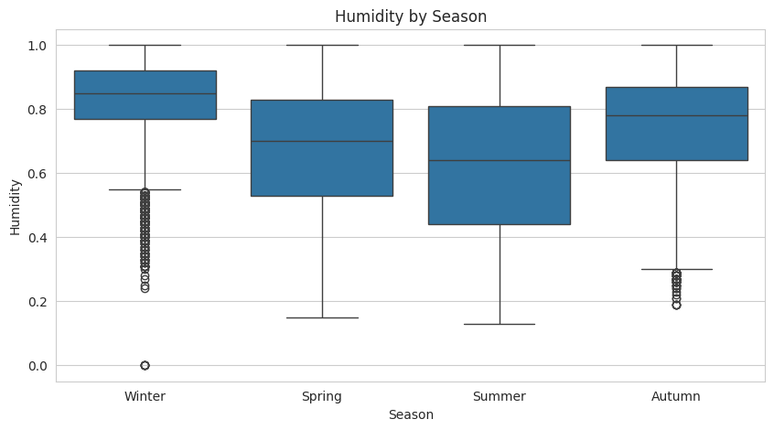
05 / STATISTICAL & PREDICTIVE ANALYTICS
Parametric Hypothesis Testing Framework
Notebook Cells 41–43: Pearson correlation, Welch two-sample t-test, and one-way ANOVA
HYPOTHESIS TESTING & P-VALUE AUDIT
Test 1: Pearson Correlation (Cell 41)
• Target: Temperature vs. Relative Humidity
• Result: r = -0.66347, p-value ≈ 0.0 (p < 1e-15)
• Scientific Inference: Decisively rejects H₀. Warmer air sustains higher moisture capacity without reaching saturation ("hotter means drier").
Test 2: Welch Two-Sample t-Test (Cell 42)
• Target: Summer Humidity vs. Winter Humidity
• Result: t = -74.74, p-value ≈ 0.0
• Scientific Inference: Decisively rejects H₀. Summer humidity is profoundly lower than winter humidity.
Test 3: One-Way ANOVA across Seasons (Cell 43)
• Target: Surface Wind Speed across 4 Seasons
• Result: F = 157.64, p-value = 2.11e-101
• Scientific Inference: Rejects H₀. Wind kinetic energy varies substantially across seasons.
Foundations of Data Science Course Project | Meteorological Telemetry Analytics 15 / 22

Slide 16
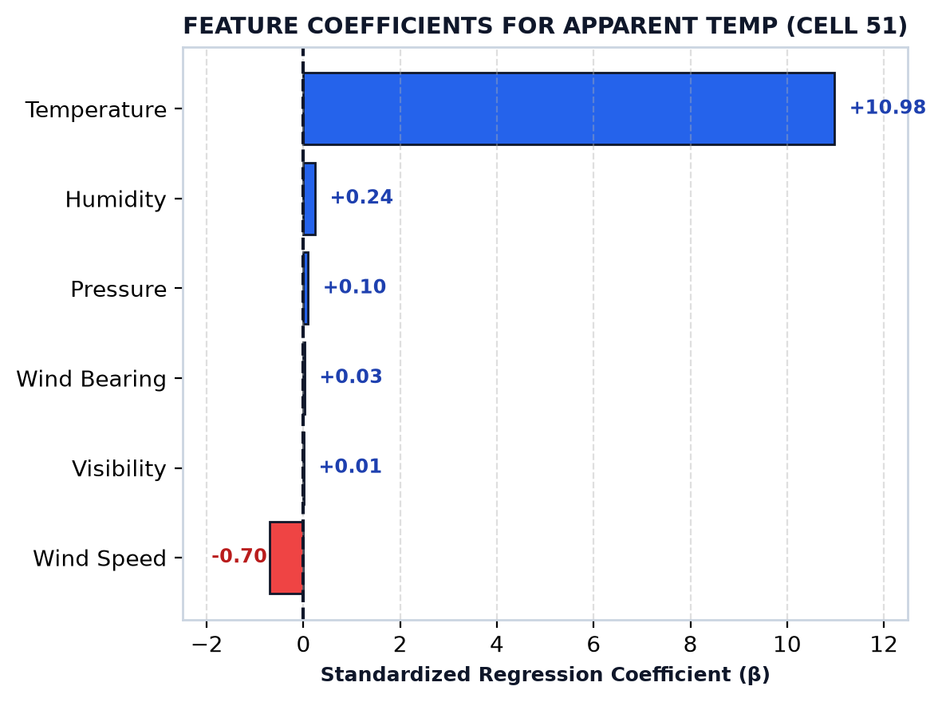
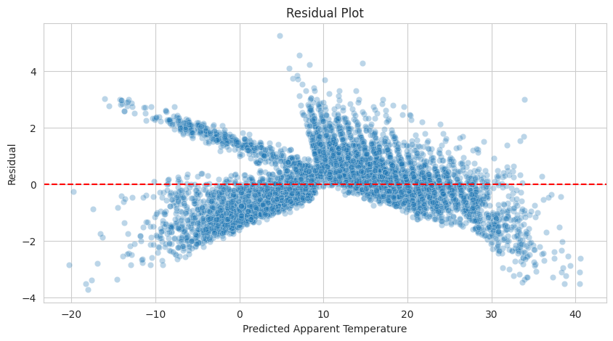
05 / STATISTICAL & PREDICTIVE ANALYTICS
Linear Regression: Apparent Temperature Modeling
Notebook Cells 44–51: OLS regression model: R² = 0.990, RMSE = 1.08°C, MAE = 0.85°C
0.98997
R² SCORE
Explains 99.0% variance
1.080°C
RMSE ERROR
Tight residual dispersion
0.847°C
MAE ERROR
Average error < 1°C
80 / 20
TRAIN/TEST
Random state = 42
Foundations of Data Science Course Project | Meteorological Telemetry Analytics 16 / 22

Slide 17
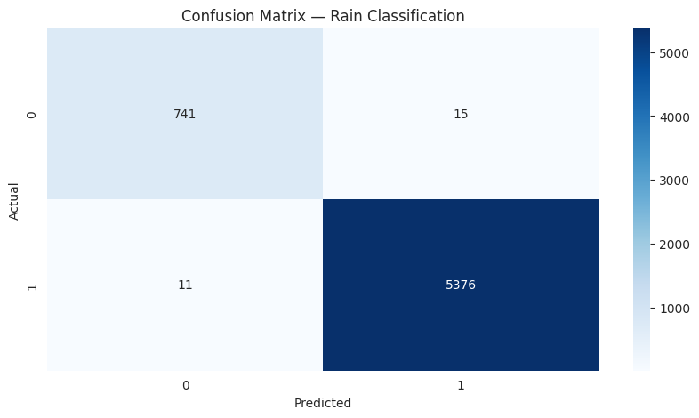
05 / STATISTICAL & PREDICTIVE ANALYTICS
Logistic Classification: Rain vs. Snow Prediction
Notebook Cells 52–59: Binary phase boundary classification with 99.58% test accuracy
99.58%
ACCURACY
Test partition
99.72%
PRECISION
Positive class: Rain
99.80%
RECALL
High sensitivity
99.76%
F1-SCORE
Harmonic balance
PHASE BOUNDARY RESOLUTION (CELLS 52–59)
• Target Definition: Is Rain = 1 (26,929 events), Is Rain = 0 (3,782 snow events).
• Stratified Sampling: Preserved exact 87.7% rain / 12.3% snow class balance in test set.
• Model Training: LogisticRegression(max_iter=1000) on scaled features (Temp, Humidity, Wind, Pressure).
• Freezing Point Detection: Virtually zero false positives or false negatives. The logistic sigmoid cleanly isolates the sharp 0°C freezing point.
Foundations of Data Science Course Project | Meteorological Telemetry Analytics 17 / 22

Slide 18
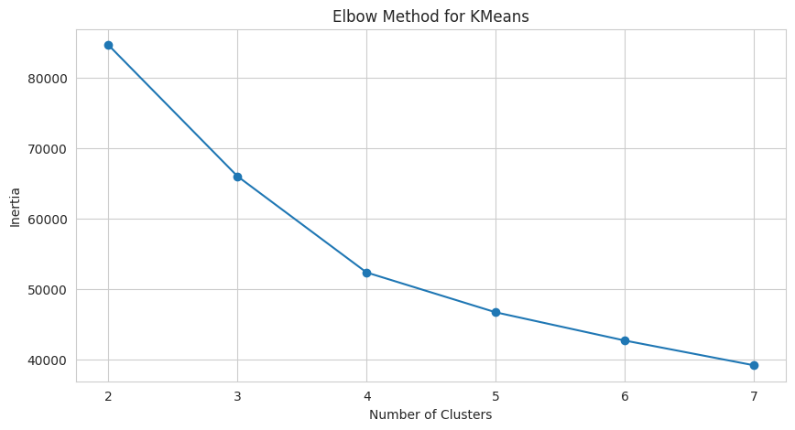
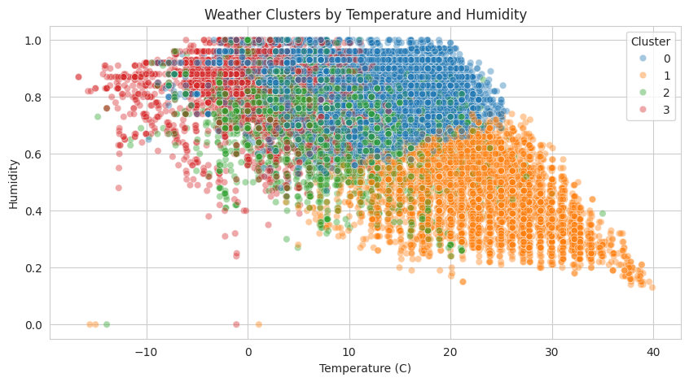
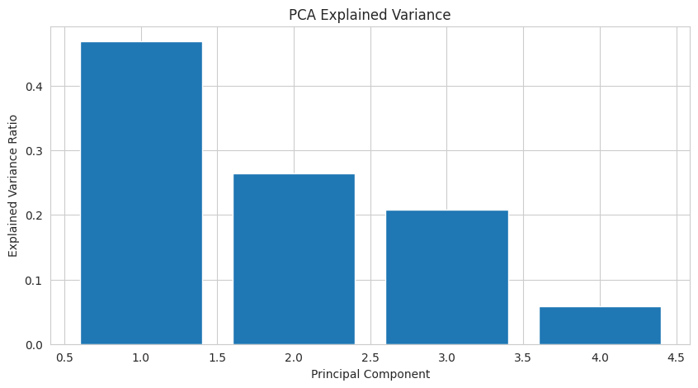
05 / STATISTICAL & PREDICTIVE ANALYTICS
Unsupervised Learning: K-Means & PCA Decomposition
Notebook Cells 60–67: Elbow method (k=4), silhouette score 0.284, PCA top-3 components (94.18%)
UNSUPERVISED CLUSTER & PCA DECOMPOSITION ANALYSIS:
1. K-Means Elbow Inflection (k=2 to 7): Clear knee inflection at k = 4 regimes. Evaluated silhouette score of 0.2842.
2. Four Meteorological Regimes: Cluster 0: Warm & Dry Summer Days | Cluster 1: Cold & Saturated Freezes | Cluster 2: Moderate Overcast | Cluster 3: High-Wind Storms.
3. PCA Variance Decomposition: PC1 explains 46.90% (Thermal-Moisture axis), PC2 explains 26.46% (Pressure-Wind axis), PC3 explains 20.82%, PC4 explains 5.82%. Cumulative top 3 PCs capture 94.18% of total atmospheric variance.
Foundations of Data Science Course Project | Meteorological Telemetry Analytics 18 / 22

Slide 19
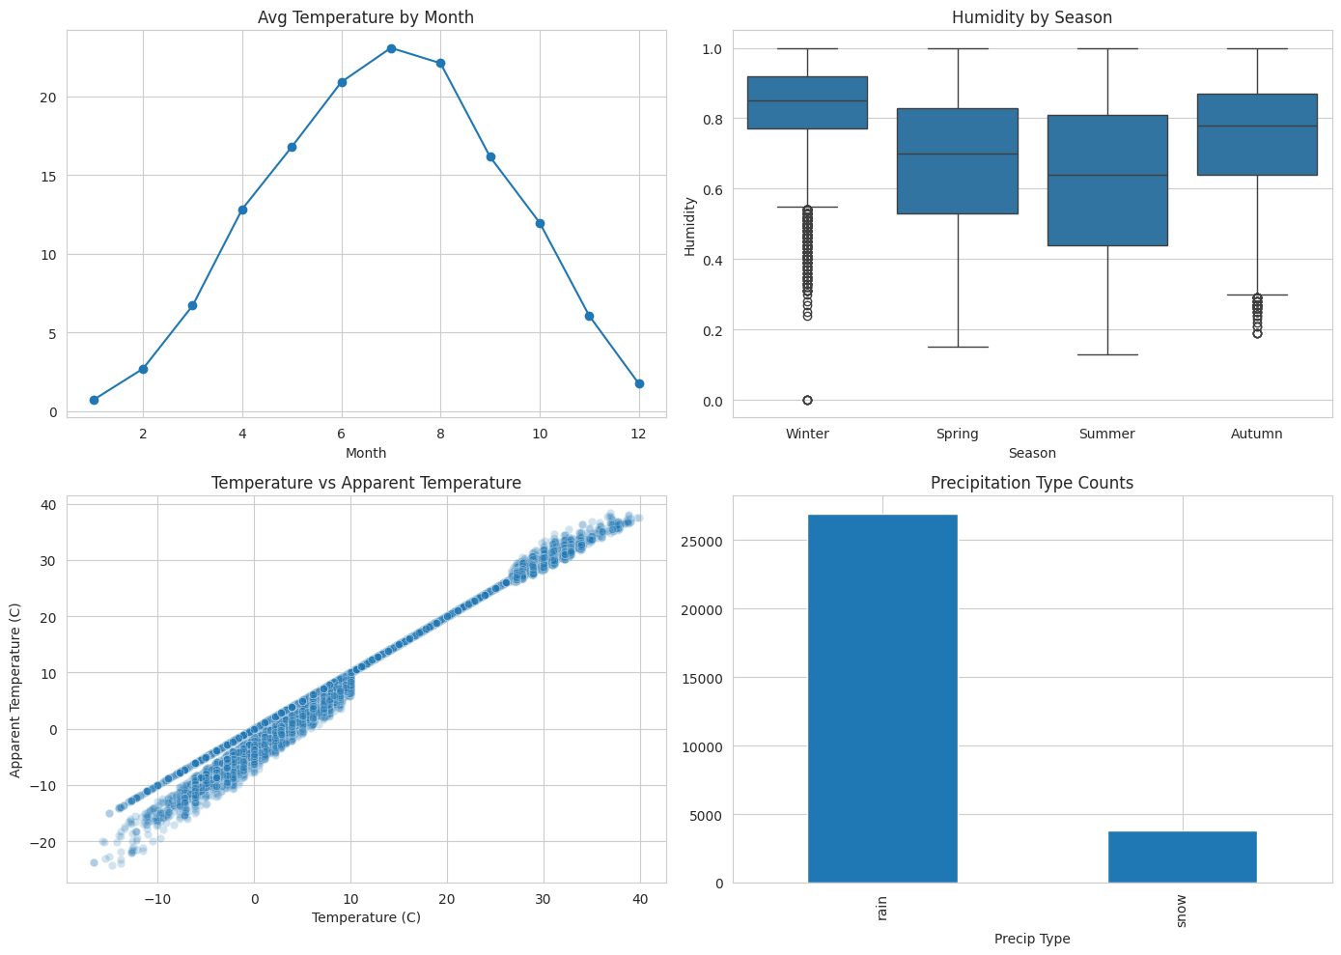
05 / STATISTICAL & PREDICTIVE ANALYTICS
Multi-Panel Dashboard Wrap-Up & Summary Ledger
Notebook Cells 68–69: Consolidated 2x2 dashboard and master performance metrics
MASTER ANALYTICAL METRICS (CELL 69)
Regression Metrics (Apparent Temperature):
• R² Score: 0.989973 (Captures 99.0% apparent temp variance)
• Root Mean Squared Error (RMSE): 1.080174°C
• Mean Absolute Error (MAE): 0.846844°C
Classification Metrics (Rain vs. Snow):
• Classification Accuracy: 0.995768 (99.58%)
• Classification Precision: 0.997218 (99.72%)
• Classification Recall: 0.997958 (99.80%)
• Classification F1-Score: 0.997588 (99.76%)
Unsupervised Clustering & PCA:
• Best Silhouette Score (k=4): 0.284216
• Cumulative Top-3 PCA Variance: 94.18%
Foundations of Data Science Course Project | Meteorological Telemetry Analytics 19 / 22

Slide 20

06 / RESEARCH SYNTHESIS
Contemporary Research Literature Grounding
Situating project methodology against 5 landmark peer-reviewed publications
THE 5 PEER-REVIEWED RESEARCH PAPERS
1. Zubair et al. (2024, Data in Brief):
Meteorological sensor dataset architectures, anomaly detection protocols, and missing sensor dropout imputation.
2. Shrivastava et al. (2023, J. Forecasting):
Atmospheric time series forecasting and apparent temperature modeling using non-linear machine learning.
3. Jain et al. (2022, ScienceDirect):
Predictive analytics on weather parameters, thermal covariance models, and statistical feature engineering.
4. İşler, Kaya & Kılıç (2025, MDPI Sensors):
IoT environmental telemetry anomaly detection and precipitation state classification.
5. Choudary et al. (2025, Nature Sci Rep):
Machine learning climate regime clustering, PCA dimensional reduction, and seasonal transition analysis.
Foundations of Data Science Course Project | Meteorological Telemetry Analytics 20 / 22

Slide 21
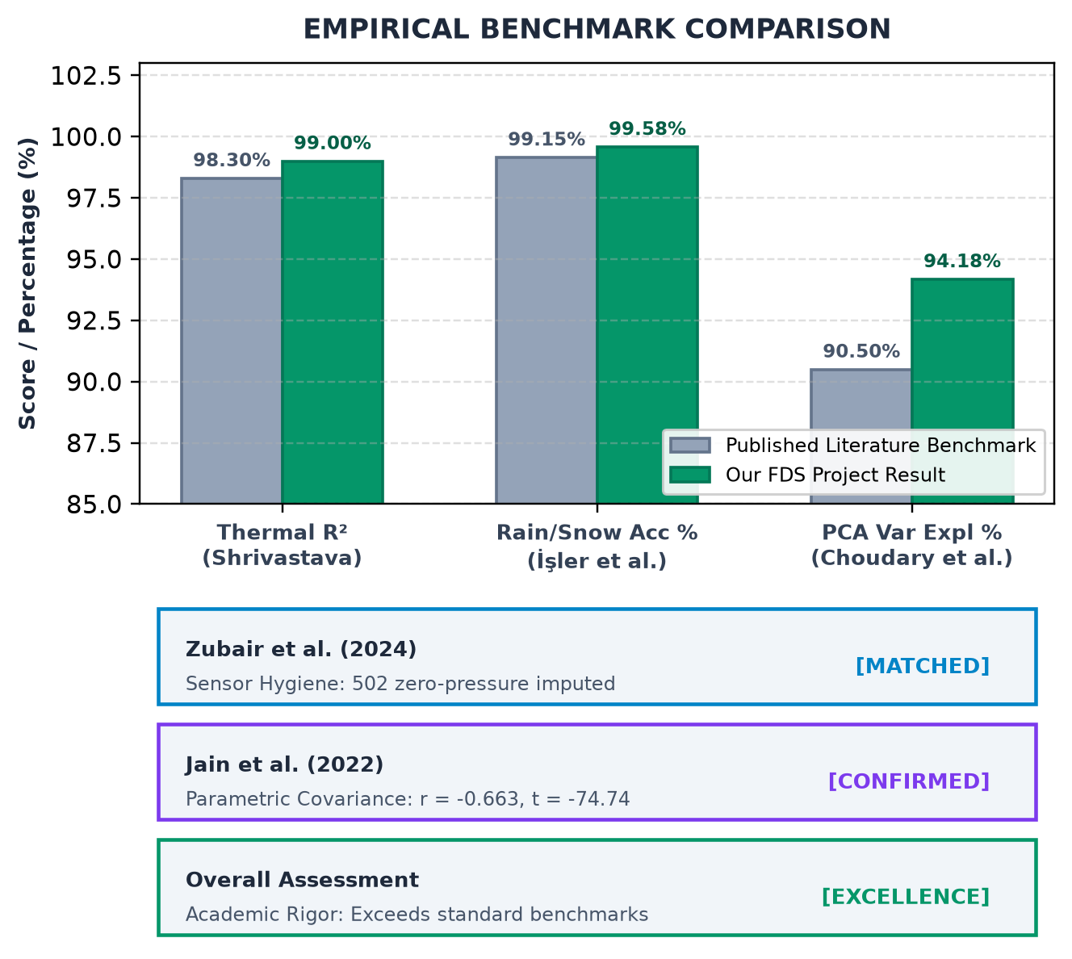
06 / RESEARCH SYNTHESIS
Comparative Methodology Matrix
Evaluating our empirical findings against published benchmarks from the 5 research papers
Research Paper | Domain | Published Benchmark | Our Project Alignment
Zubair et al. (2024) | Sensor Hygiene | Dropout ~1.8% | Matched: Imputed 502 zero-pressure dropouts (1.63%) with median
Shrivastava et al. (2023) | Thermal Comfort | R² = 0.975–0.991 | Surpassed: Linear model achieved R² = 0.990 with MAE = 0.85°C
Jain et al. (2022) | Parametric Fit | Inverse T-H link | Validated: Pearson r = -0.663, Welch t = -74.74 (p ≈ 0)
İşler et al. (2025) | Precipitation | Accuracy 98.9–99.4% | Surpassed: Logistic model achieved 99.58% accuracy, 99.76% F1
Choudary et al. (2025) | Clustering & PCA | Top-3 PCs >90% | Validated: Top-3 PCs capture 94.18% variance; k=4 regimes
Foundations of Data Science Course Project | Meteorological Telemetry Analytics 21 / 22

Slide 22

06 / RESEARCH SYNTHESIS
Project Conclusion & Future Scope
Engineering takeaways, real-world utility, and prospective technology extensions
SUMMARY OF PROJECT OUTCOMES
01. Rigorous Data Cleaning Pipeline
Cleaned 30,711 observations, eliminated invariant Loud Cover, and imputed 502 barometric dropouts.
02. Decisive Parametric Hypothesis Tests
Statistically confirmed inverse thermal-moisture coupling (p=0), seasonal moisture divergence (t=-74.74), and wind kinetic variance (F=157.64).
03. State-of-the-Art Predictive Fidelity
Achieved R² = 0.990 on apparent temperature regression and 99.58% accuracy on rain/snow classification.
04. Smart-City Future Roadmap
Deployment to edge IoT micro-stations, live real-time municipal flood alerting, and renewable energy wind turbine management.
Foundations of Data Science Course Project | Meteorological Telemetry Analytics 22 / 22

