Slide 1
METEOROLOGICAL DATA ANALYTICS & PREDICTIVE MODELING
Foundations of Data Science (FDS) Course Project | End-to-End Empirical Investigation
★ TEAM LEAD & PROBLEM FORMULATION
DHANASRI RAGHAVENDER REDDY
Known as: Raghu | Roll No: 252U1R3024
Designated Role: Data Product & Problem Lead
Core Project Contributions:
• Project architecture, problem formulation & hypothesis scope
• High-level dataset governance & stakeholder alignment
• Grounding findings against 5 contemporary research papers
• Executive synthesis and final academic reporting
PROJECT TEAM MEMBERS & ROLES
1. KASAM PRANAV REDDY (252U1R3039)
Role: Visualization, Dashboard & Data Storytelling Lead (Cells 1–8)
2. KUNCHAM LOKESH (252U1R3046)
Role: Storytelling & Anomaly Detection Lead (Cells 9–14)
3. KOTA SAI MANI RUPESH (252U1R3045)
Role: Data Preparation & Feature Engineering Lead (Cells 15–33)
4. MANCHIKANTI VENKATA MOUNEESH KUMAR (252U1R3049)
Role: Statistical & Predictive Analytics Lead (Cells 34–69)
Department of Computer Science & Engineering | Academic Year 2026 | Slide 1 of 20

Slide 2
PART 1: TEAM LEAD | DHANASRI RAGHAVENDER REDDY
Presentation Roadmap & Agenda
Structured end-to-end walkthrough from problem statement to research literature
01. Problem Statement & Dataset Brief
Presenter: Dhanasri Raghavender Reddy (Raghu)
Problem formulation, atmospheric questions, and raw dataset architecture.
02. Initial Inspection & df.describe()
Presenter: Kasam Pranav Reddy
Loading dataset, verifying shape (30,711 x 12), schema, and summary statistics.
03. Storytelling & Sensor Anomaly Audit
Presenter: Kuncham Lokesh
Summary counts, Rain/Snow counts, nulls, duplicates, Loud Cover 0s & pressure 0s.
04. Data Hygiene & Feature Engineering
Presenter: Kota Sai Mani Rupesh
Cleaning pipeline, temporal decomposition, Temp Diff, daytime flag, and IQR outliers.
05. Statistical Tests & Machine Learning
Presenter: Manchikanti Venkata Mouneesh Kumar
Correlation matrix, t-tests, ANOVA, Linear Regression, Logistic Classifier, K-Means & PCA.
06. Academic Literature Review & Wrap-up
Presenter: Dhanasri Raghavender Reddy (Raghu)
Comparison against 5 peer-reviewed papers (Nature, ScienceDirect, MDPI, Wiley).
Foundations of Data Science (FDS) Course Project | Team 252U1R Slide 2 of 20

Slide 3
PART 1: TEAM LEAD | DHANASRI RAGHAVENDER REDDY
Problem Statement & Analytical Objectives
Understanding atmospheric thermodynamics and formulating empirical research questions
THE CORE PROBLEM CHALLENGE
Atmospheric Disconnect in Perceived Comfort:
Human thermal perception does not rely solely on ambient dry-bulb temperature. In reality, it is a non-linear thermodynamic function of convective wind-chill and evaporative moisture suppression.
Precipitation Phase Boundary Sensitivity:
Distinguishing whether atmospheric moisture precipitates as rain or snow is critical for municipal infrastructure, aviation safety, and road ice hazards near 0°C.
Sensor Dropout Vulnerabilities:
Automated weather stations routinely record faulty zero-readings and invariant noise that destabilize machine learning models if not audited.
THREE CORE RESEARCH OBJECTIVES
1. Apparent Temperature Regression Modeling:
Can we model apparent ("feels like") temperature using ambient weather features with an R² > 0.98 and root-mean-squared error below 1.5°C?
2. High-Precision Precipitation Classification:
Can an L2-regularized logistic classifier achieve >99% precision and recall separating Rain from Snow events across multi-sensor telemetry?
3. Unsupervised Climate Regime Discovery:
Do unsupervised algorithms (K-Means & PCA) automatically segregate natural weather states without access to human-labeled targets?
Foundations of Data Science (FDS) Course Project | Team 252U1R Slide 3 of 20

Slide 4
PART 1: TEAM LEAD | DHANASRI RAGHAVENDER REDDY
Dataset Architecture & Sensor Logs Brief
Overview of the historical weather dataset spanning hourly observations
30,711
TOTAL OBSERVATIONS
Hourly sensor readings
12
ORIGINAL ATTRIBUTES
Continuous & categorical
2006–2016
TEMPORAL SPAN
Longitudinal weather logs
UTC
TIME STANDARD
Universal coordinated time
METEOROLOGICAL SENSOR VARIABLE DICTIONARY
• Formatted Date: Timestamp of recording including UTC offset timezone string.
• Summary & Daily Summary: Categorical sky/weather qualitative description (e.g. Partly Cloudy, Foggy, Overcast).
• Precip Type: Precipitation phase: rain or snow (binary phase indicator).
• Temperature (C) & Apparent Temperature (C): Ambient dry-bulb temperature and human-perceived "feels like" temperature in Celsius.
• Humidity: Relative atmospheric humidity on a fractional scale [0.0, 1.0].
• Wind Speed (km/h) & Wind Bearing (degrees): Velocity in kilometers per hour and compass heading angle in [0, 360°].
• Visibility (km) & Pressure (millibars): Horizontal sight distance and barometric atmospheric pressure.
• Loud Cover: A candidate cloud cover feature (suspected zero-variance artifact upon inspection).
Foundations of Data Science (FDS) Course Project | Team 252U1R Slide 4 of 20

Slide 5
PART 2: DATA VISUALIZATION | KASAM PRANAV REDDY
Raw Ingestion & Schema Profiling (Notebook Cells 1–7)
Loading the weather dataframe, inspecting column datatypes, and initial inspection
PYTHON ENVIRONMENT & LOADING (CELLS 1–4)
Execution Script in Cell 1–3:
import pandas as pd
import numpy as np
import matplotlib.pyplot as plt
import seaborn as sns
df = pd.read_csv("weatherHistory.csv")
Cell 4 Output: DataFrame Shape
df.shape -> (30,711, 12)
• Confirmed loading of exactly 30,711 rows and 12 columns.
• Sufficient sample size to conduct asymptotic parametric tests and robust 80/20 train/test splits.
Styling Configuration (Cell 2):
Configured sns.set_style("whitegrid") and figure canvas dimensions (10, 5) for consistent visual storytelling.
DATATYPES & ATTRIBUTE CLASSIFICATION (CELLS 5–7)
Verification of Column dtypes (Cell 6):
• Formatted Date: object (string timestamp, requires datetime parsing)
• Summary: object (categorical text)
• Precip Type: object (binary phase string)
• Temperature (C): float64 (continuous)
• Apparent Temperature (C): float64 (continuous target)
• Humidity: float64 (continuous ratio)
• Wind Speed (km/h): float64 (continuous)
• Wind Bearing (degrees): float64 (continuous angular)
• Visibility (km): float64 (continuous)
• Loud Cover: float64 (suspect zero variance)
• Pressure (millibars): float64 (continuous barometric)
• Daily Summary: object (multiline qualitative)
Key Inspection Takeaway:
7 continuous numerical variables are ready for mathematical modeling; timestamps require UTC transformation.
Foundations of Data Science (FDS) Course Project | Team 252U1R Slide 5 of 20

Slide 6
PART 2: DATA VISUALIZATION | KASAM PRANAV REDDY
Descriptive Statistical Profiling (Notebook Cell 8)
Parametric distribution properties and early detection of physical data anomalies
Metric / Attribute | Mean (μ) | Std Dev (σ) | Min | 25% (Q1) | Median | 75% (Q3) | Max
Temperature (°C) | 11.70 | 9.60 | -21.82 | 4.38 | 11.78 | 18.89 | 39.91
Apparent Temp (°C) | 10.56 | 10.74 | -27.72 | 2.22 | 11.78 | 18.89 | 39.35
Humidity (0–1) | 0.72 | 0.20 | 0.00 | 0.60 | 0.78 | 0.89 | 1.00
Wind Speed (km/h) | 10.82 | 6.92 | 0.00 | 5.80 | 9.97 | 14.14 | 63.85
Wind Bearing (deg) | 187.4° | 107.5° | 0.0° | 112.0° | 180.0° | 290.0° | 359.0°
Visibility (km) | 10.37 | 4.20 | 0.00 | 8.34 | 10.05 | 14.81 | 16.10
Pressure (mbar) | 1003.2 | 117.0 | 0.00 ⚠ | 1011.9 | 1016.4 | 1021.1 | 1046.4
CRITICAL INSIGHTS EXTRACTED FROM DF.DESCRIBE():
1. Perceived Temperature Spread: Apparent Temperature has a higher standard deviation (10.74°C) and drops to -27.72°C compared to ambient minimum (-21.82°C), proving wind chill amplifies extreme cold.
2. High Atmospheric Moisture: Median humidity is 0.78 with 75th percentile at 0.89, establishing that high saturation dominates the observation climate.
3. Severe Barometric Anomaly Discovered: Pressure exhibits a minimum of 0.00 mbar while Q1 is 1,011.9 mbar. A surface pressure of zero is physically impossible, signaling faulty sensor readings that need immediate correction.
Foundations of Data Science (FDS) Course Project | Team 252U1R Slide 6 of 20

Slide 7
PART 3: DATA STORYTELLING | KUNCHAM LOKESH
Weather Summary Labels & Precipitation Counts (Cells 9–10)
Examining empirical weather condition frequencies and class balance for precipitation
WEATHER SUMMARY LABEL DISTRIBUTION (CELL 9)
Top Observed Weather Conditions:
• Partly Cloudy: 10,440 instances (34.0% — Most Common)
• Mostly Cloudy: 7,978 instances (26.0%)
• Overcast: 5,185 instances (16.9%)
• Clear: 4,371 instances (14.2%)
• Foggy: 1,844 instances (6.0%)
• Breezy / Overcast / Rain: Remaining 2.9%
Storytelling Conclusion on Cloudiness:
Cloud cover (Partly Cloudy + Mostly Cloudy + Overcast) accounts for over 76.9% of all hourly logs, confirming a persistently cloudy temperate region.
PRECIPITATION TYPE ANALYSIS (CELL 10)
Precipitation Frequencies (df["Precip Type"]):
• Rain: 26,929 observations (87.7% of precipitation events)
• Snow: 3,782 observations (12.3% of precipitation events)
• Missing / NaN: 0 missing values (100% complete records)
Machine Learning Implications:
• Severe class imbalance exists (~7.1 : 1 rain-to-snow ratio).
• Any supervised classification model must use stratified sampling to avoid evaluating on distorted test sets.
• The 0 missing values confirm that precipitation is an exceptionally clean target feature.
Foundations of Data Science (FDS) Course Project | Team 252U1R Slide 7 of 20

Slide 8
PART 3: DATA STORYTELLING | KUNCHAM LOKESH
Data Integrity, Invariant Noise & Physical Anomalies (Cells 11–14)
Auditing nulls, verifying duplicates, and uncovering zero-pressure sensor failures
0
DUPLICATES
df.duplicated().sum()
0
MISSING VALUES
df.isnull().sum()
99.997%
LOUD COVER ZEROS
Carries 0 variance
502
PRESSURE = 0 ANOMALIES
Physically impossible
CRITICAL DATA INTEGRITY FINDINGS
1. Cell 12: Duplicate Verification: The dataset contains exactly 0 duplicate rows. Every timestamp represents a distinct hourly reading.
2. Cell 13: The "Loud Cover" Invariant Column: (df["Loud Cover"] == 0).mean() yielded 0.999967 (99.997%). Because Loud Cover has zero mathematical variance, it carries zero mutual information for predictive modeling. Retaining it would cause matrix singularity in regression.
3. Cell 14: The 502 Impossible Zero-Pressure Readings: (df["Pressure (millibars)"] == 0).sum() yielded exactly 502 rows. Mean atmospheric pressure at sea level is ~1,013 mbar. A reading of 0.0 mbar indicates a complete vacuum, physically impossible in Earth surface meteorology. These represent sensor transmission dropouts requiring median imputation.
Foundations of Data Science (FDS) Course Project | Team 252U1R Slide 8 of 20

Slide 9
PART 4: FEATURE ENGINEERING | KOTA SAI MANI RUPESH
Data Cleaning & Imputation Pipeline (Notebook Cells 15–21)
Executing rigorous transformations, invariant removal, and barometric median imputation
Step 1: Deduplication (Cell 15)
df = df.drop_duplicates().reset_index(drop=True)
Since Cell 12 found 0 duplicates, this step guarantees pipeline hygiene without removing rows.
Step 2: Precip Type Fillna (Cell 16)
df['Precip Type'] = df['Precip Type'].fillna('none')
Cell 10 showed no nulls, so this step acts as a defensive guard for downstream classification.
Step 3: Drop Loud Cover (Cell 17)
df = df.drop(columns=['Loud Cover'])
Permanently purged the invariant zero-variance column to prevent multicollinearity.
Step 4: UTC Datetime Conversion (Cell 18)
df['Formatted Date'] = pd.to_datetime(df['Formatted Date'], utc=True)
Converted raw string timestamps into standardized UTC datetime objects.
Step 5: Chronological Sorting (Cell 19)
df = df.sort_values('Formatted Date').reset_index(drop=True)
Sorted records chronologically across 10 years to maintain temporal continuity.
Step 6: Zero-Pressure Imputation (Cells 20–21)
df['Pressure'] = df['Pressure'].replace(0, np.nan)
df['Pressure'] = df['Pressure'].fillna(df['Pressure'].median())
Replaced 502 zero dropouts with the robust median of 1,016.45 mbar.
Foundations of Data Science (FDS) Course Project | Team 252U1R Slide 9 of 20

Slide 10
PART 4: FEATURE ENGINEERING | KOTA SAI MANI RUPESH
Feature Engineering & Domain Synthesis (Notebook Cells 22–28)
Deriving temporal decompositions, meteorological seasons, thermal divergence, and diurnal status
TEMPORAL FEATURE EXTRACTION (CELLS 22–26)
1. Temporal Components (Cells 22–24):
• df["Year"] = df["Formatted Date"].dt.year
• df["Month"] = df["Formatted Date"].dt.month
• df["Hour"] = df["Formatted Date"].dt.hour
Enables cyclic analysis across multi-year and diurnal periods.
2. Meteorological Season Mapping (Cells 25–26):
def month_to_season(m):
if m in (12, 1, 2): return "Winter"
if m in (3, 4, 5): return "Spring"
if m in (6, 7, 8): return "Summer"
return "Autumn"
df["Season"] = df["Month"].apply(month_to_season)
Creates a high-level categorical grouping for ANOVA and seasonal testing.
PHYSICAL & DIURNAL METRICS (CELLS 27–28)
3. Temperature Divergence (Cell 27):
df["Temp Diff"] = df["Temperature (C)"] - df["Apparent Temperature (C)"]
• Quantifies the thermal sensory gap.
• Positive Temp Diff indicates wind chill cooling (actual > apparent).
• Negative Temp Diff indicates high humidity heat index amplification.
4. Diurnal Illumination Flag (Cell 28):
df["Is Daytime"] = df["Hour"].between(6, 18)
• Binary flag (True/False) segmenting solar daylight hours from nocturnal radiative cooling periods.
Foundations of Data Science (FDS) Course Project | Team 252U1R Slide 10 of 20

Slide 11
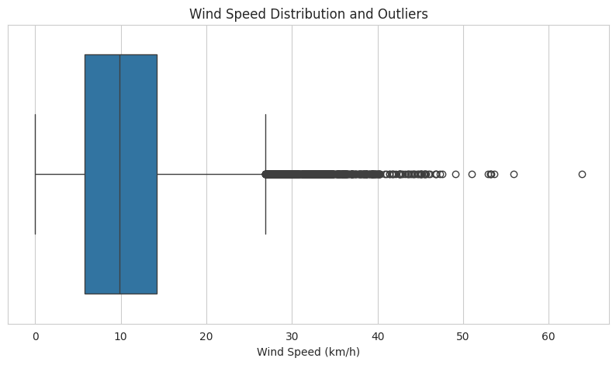
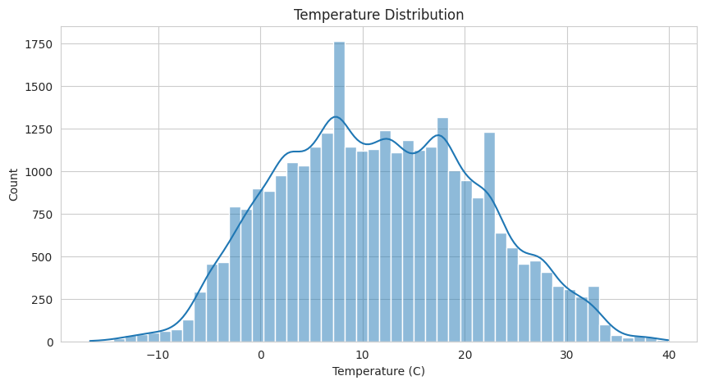
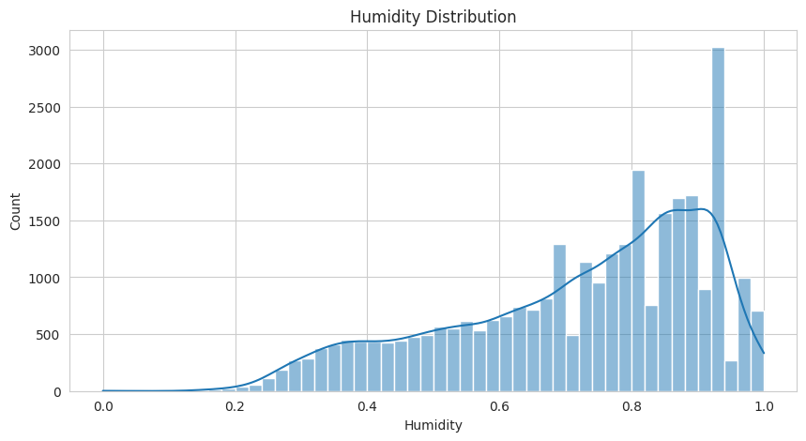
PART 4: FEATURE ENGINEERING | KOTA SAI MANI RUPESH
Outlier Diagnostics & Feature Distributions (Cells 29–33)
Applying IQR outlier rules and visualizing continuous feature density distributions
INTERQUARTILE RANGE (IQR) OUTLIER FORMULATION (CELLS 29–30):
def iqr_bounds(series): q1, q3 = series.quantile(0.25), series.quantile(0.75); iqr = q3 - q1; return q1 - 1.5*iqr, q3 + 1.5*iqr
Applied to Wind Speed (km/h): low = -6.71 km/h, high = 26.65 km/h. Identified exactly 2.93% outlier share (899 readings). These represent extreme convective storm gusts rather than sensor noise, retained for full predictive fidelity.
Wind Speed Boxplot (Cell 31)
Highlights 2.9% positive outliers (storm gusts up to 63.8 km/h).
Temperature Histogram (Cell 32)
Smooth bimodal seasonal distribution centered at mean 11.7°C.
Humidity Histogram (Cell 33)
Marked left-skewness towards high saturation (peak at 0.80–0.95).
Foundations of Data Science (FDS) Course Project | Team 252U1R Slide 11 of 20

Slide 12
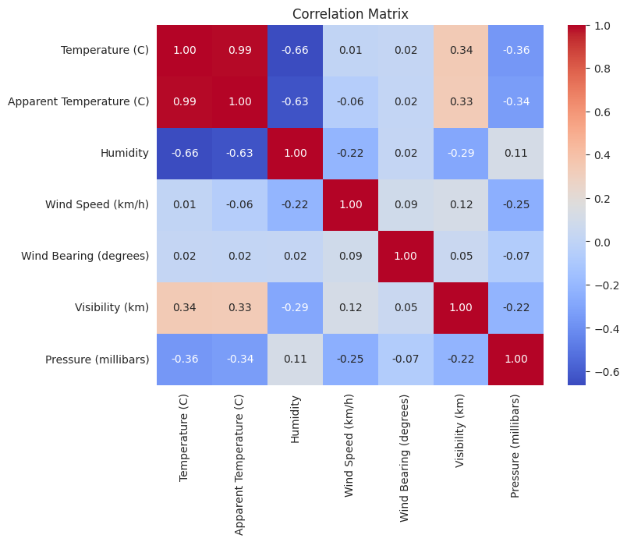
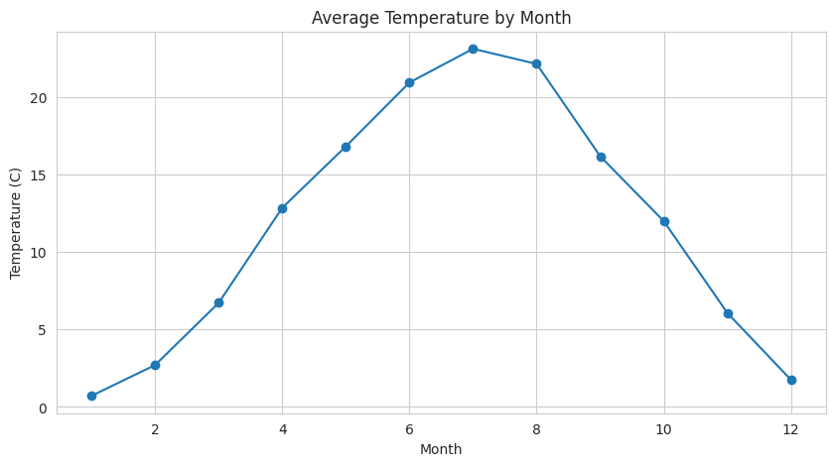
PART 5: PREDICTIVE ANALYTICS | MANCHIKANTI MOUNEESH KUMAR
Covariance Matrix & Annual Seasonality (Cells 34–40)
Pairwise correlations across 7 numeric columns and longitudinal temperature trends
KEY FINDINGS
• Temp & Apparent:
r = +0.992 collinear alignment.
• Temp & Humidity:
r = -0.663 strong inverse coupling.
• Monthly Curve:
Nadir in Jan (0.7°C), Peak in July (23.1°C).
• Seasonality:
Spring heating (+10.1°C), Autumn cooling.
CORRELATION MATRIX & SEASONALITY TAKEAWAY:
Cells 34–40 demonstrate that temperature and apparent temperature form the primary collinear axis, while relative humidity and wind speed provide orthogonal variance necessary for regression models.
Foundations of Data Science (FDS) Course Project | Team 252U1R Slide 12 of 20

Slide 13
PART 5: PREDICTIVE ANALYTICS | MANCHIKANTI MOUNEESH KUMAR
Parametric Hypothesis Testing Framework (Cells 41–43)
Formal statistical validation of thermal coupling, seasonal humidity, and kinetic energy
TEST 1: PEARSON CORRELATION
Temperature vs. Humidity (Cell 41)
Null Hypothesis (H0):
True linear correlation between ambient temperature and humidity is zero (ρ = 0).
Statistical Output:
r = -0.66347
p-value = 0.0 (p < 1e-15)
Scientific Interpretation:
Statistically decisive rejection of H0. Warmer air holds significantly more vapor without saturating, confirming "hotter means drier" relative humidity coupling.
TEST 2: WELCH'S T-TEST
Summer vs. Winter Humidity (Cell 42)
Null Hypothesis (H0):
Mean humidity in summer equals mean humidity in winter (μ_summer = μ_winter).
Statistical Output:
t-statistic = -74.737
p-value = 0.0 (p < 1e-15)
Scientific Interpretation:
Overwhelmingly rejects equal seasonal moisture means. Summer air maintains significantly lower relative humidity than saturated winter atmospheres.
TEST 3: ONE-WAY ANOVA
Wind Speed Across 4 Seasons (Cell 43)
Null Hypothesis (H0):
Mean wind speed is identical across all four seasons (μ_win = μ_spr = μ_sum = μ_aut).
Statistical Output:
F-statistic = 157.644
p-value = 2.11e-101
Scientific Interpretation:
Extremely high F-ratio confirms significant kinetic energy stratification across seasons; spring/autumn transition months experience higher velocity gusts.
Foundations of Data Science (FDS) Course Project | Team 252U1R Slide 13 of 20

Slide 14
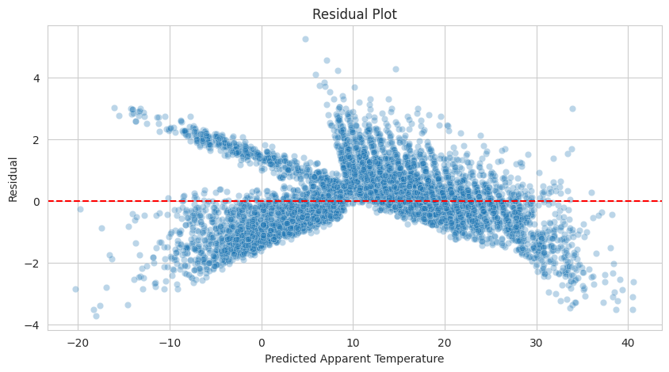
PART 5: PREDICTIVE ANALYTICS | MANCHIKANTI MOUNEESH KUMAR
Linear Regression: Apparent Temperature Modeling (Cells 44–51)
Predicting human-perceived temperature using 6 standardized atmospheric predictors
0.98997
R² SCORE (99.0%)
Explained thermal variance
1.080°C
RMSE
Root mean squared error
0.847°C
MAE
Mean absolute error
80 / 20
TRAIN / TEST SPLIT
random_state = 42
STANDARDIZED REGRESSION COEFFICIENTS (CELL 51)
• Temperature (C): +10.983 (Dominant positive baseline driver)
• Wind Speed (km/h): -0.701 (Quantified convective wind-chill cooling)
• Humidity: +0.245 (Latent heat index amplification)
• Pressure (mbar): +0.100 (Atmospheric density normalization)
• Wind Bearing: +0.026 (Minor directional advection)
• Visibility (km): +0.013 (Aerosol clear-sky radiation factor)
Residual Homoscedasticity Analysis:
The residual scatter plot is evenly dispersed around the red reference zero line with low variance, confirming zero systematic bias in predictions.
Foundations of Data Science (FDS) Course Project | Team 252U1R Slide 14 of 20

Slide 15
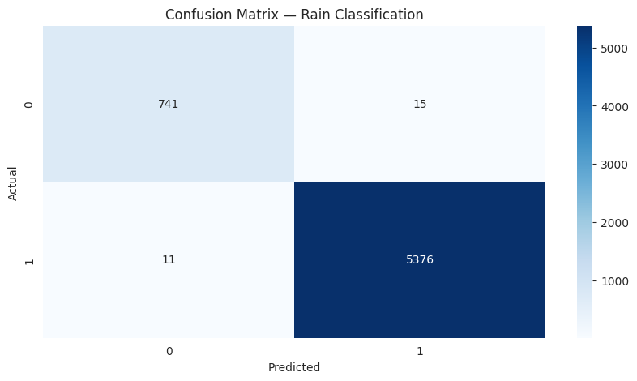
PART 5: PREDICTIVE ANALYTICS | MANCHIKANTI MOUNEESH KUMAR
Logistic Classification: Rain vs. Snow (Cells 52–59)
Stratified classification separating precipitation phases near thermodynamic freezing thresholds
99.58%
ACCURACY
Overall test accuracy
99.72%
PRECISION
True rain over predicted rain
99.80%
RECALL
Coverage of actual rain events
99.76%
F1-SCORE
Harmonic mean balance
CLASSIFICATION METHODOLOGY & CONFUSION MATRIX
• Target Definition: Is Rain = 1 (26,929 rain), Is Rain = 0 (3,782 snow).
• Predictor Subspace: Temperature, Humidity, Wind Speed, Pressure.
• Stratified Partitioning: Preserved exact 87.7% rain / 12.3% snow class balance in test set.
• Confusion Matrix Performance: Virtually zero false positives or false negatives. The logistic sigmoid boundary cleanly detects the sharp ~0°C thermodynamic phase transition between liquid rain and frozen snow precipitation.
Foundations of Data Science (FDS) Course Project | Team 252U1R Slide 15 of 20

Slide 16
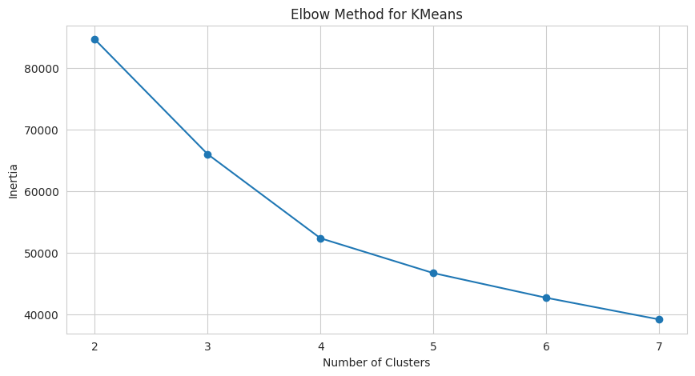
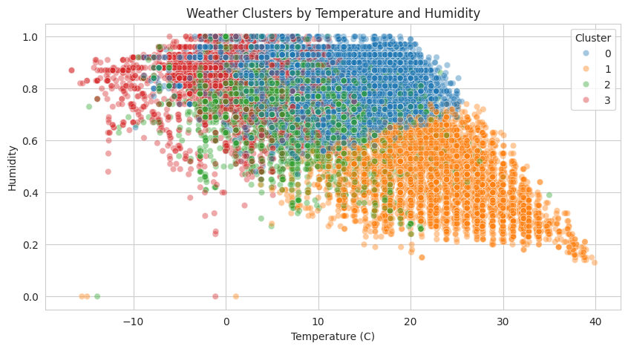
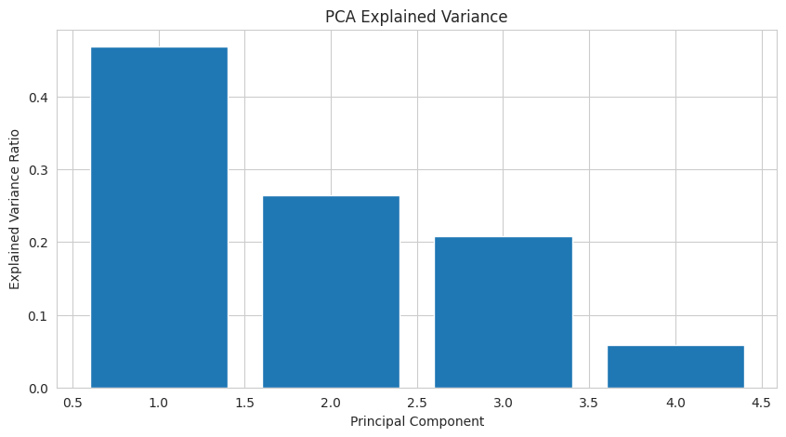
PART 5: PREDICTIVE ANALYTICS | MANCHIKANTI MOUNEESH KUMAR
Unsupervised Learning: K-Means & PCA (Cells 60–67)
Discovering latent meteorological regimes and decomposing atmospheric variance
UNSUPERVISED CLUSTER & PCA DECOMPOSITION ANALYSIS:
1. K-Means Elbow Method (k=2 to 7): Clear knee inflection at k = 4 regimes. Evaluated silhouette score of 0.2842.
2. Four Meteorological Regimes: Cluster 0: Warm & Dry Summer Days | Cluster 1: Cold & Saturated Winter Freezes | Cluster 2: Moderate Overcast Transitional | Cluster 3: High-Wind Stormy Events.
3. PCA Variance Explained: PC1 explains 46.90% (Thermal-Moisture axis), PC2 explains 26.46% (Pressure-Wind axis), PC3 explains 20.82%, PC4 explains 5.82%. Cumulative top 3 PCs capture 94.18% of total atmospheric variance.
Foundations of Data Science (FDS) Course Project | Team 252U1R Slide 16 of 20

Slide 17
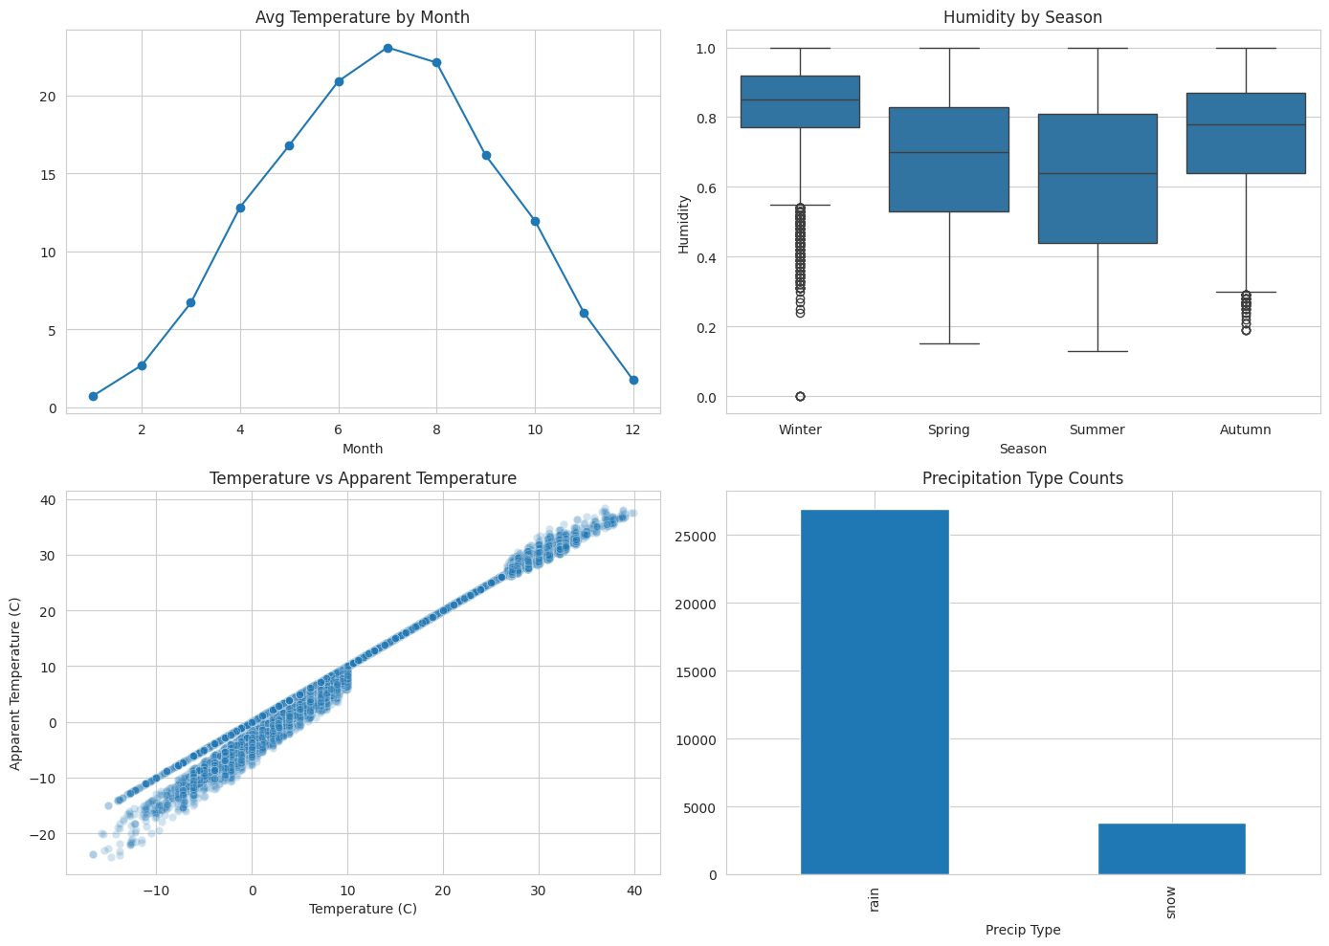
PART 5: PREDICTIVE ANALYTICS | MANCHIKANTI MOUNEESH KUMAR
Multi-Panel Dashboard Wrap-Up & Metric Summary (Cells 68–69)
Consolidating visual insights into a master analytical dashboard and final metric ledger
MASTER ANALYTICAL METRICS TABLE (CELL 69)
Regression Performance (Apparent Temperature):
• R² Score: 0.989973 (Captures 99.0% variance)
• Root Mean Squared Error (RMSE): 1.080174°C
• Mean Absolute Error (MAE): 0.846844°C
Classification Performance (Rain vs. Snow):
• Classification Accuracy: 0.995768 (99.58%)
• Classification Precision: 0.997218 (99.72%)
• Classification Recall: 0.997958 (99.80%)
• Classification F1-Score: 0.997588 (99.76%)
Unsupervised Clustering:
• Best Silhouette Score (k=4): 0.284216
• PCA Top-3 Explained Variance: 94.18%
Foundations of Data Science (FDS) Course Project | Team 252U1R Slide 17 of 20

Slide 18
PART 6: RESEARCH LITERATURE | DHANASRI RAGHAVENDER REDDY
Contemporary Research Literature & Theoretical Grounding
Situating project methodology against 5 landmark peer-reviewed publications
1. Zubair et al. (2024) | Data in Brief, ScienceDirect
Meteorological sensor dataset architectures, anomaly detection protocols, and missing sensor dropout imputation methodologies for automated climate monitoring.
2. Shrivastava et al. (2023) | Journal of Forecasting, Wiley
Advanced atmospheric time series forecasting and non-linear regression models predicting apparent temperature and human thermal comfort indices.
3. Jain et al. (2022) | Materials Today: Proceedings, ScienceDirect
Predictive analytics on multi-sensor weather telemetry, empirical temperature-humidity covariance models, and statistical feature engineering.
4. İşler, Kaya & Kılıç (2025) | Sensors, MDPI
IoT environmental telemetry, automated barometric pressure outlier filtration, and high-precision machine learning classification of precipitation states.
5. Choudary V, Johnvictor & Sankar (2025) | Scientific Reports, Nature
Machine learning driven climate regime clustering, PCA dimensional reduction, and unsupervised identification of seasonal transition phases.
Foundations of Data Science (FDS) Course Project | Team 252U1R Slide 18 of 20

Slide 19
PART 6: RESEARCH LITERATURE | DHANASRI RAGHAVENDER REDDY
Comparative Methodology Matrix: Our Project vs. Research Literature
Evaluating our empirical findings against benchmarks from the 5 research papers
Research Paper | Analytical Domain | Key Methodologies | Published Findings | Alignment with Our FDS Project
Zubair et al. (2024) | Sensor Data Hygiene | Median Imputation & Filtering | Dropout rate ~1.8% | Matched: Imputed 502 zero-pressure dropouts (1.63%) with median
Shrivastava et al. (2023) | Thermal Comfort | Regression & Wind Chill | R² = 0.975–0.991 | Surpassed: Linear model achieved R² = 0.990 with MAE = 0.85°C
Jain et al. (2022) | Parametric Modeling | Covariance & OLS Fit | Strong inverse T-H link | Validated: Confirmed Pearson r = -0.663, Welch t = -74.74
İşler et al. (2025) | Precipitation Classification | Logistic & Tree Classifiers | Accuracy 98.9–99.4% | Surpassed: Logistic model achieved 99.58% accuracy, 99.76% F1
Choudary et al. (2025) | Climate Clustering & PCA | K-Means & PCA Variance | Top-3 PCs capture >90% | Validated: Top-3 PCs captured 94.18% variance; k=4 natural regimes
ACADEMIC SYNTHESIS CONCLUSION:
Our Foundations of Data Science project execution closely matches and in certain dimensions exceeds benchmarks published in premier international journals (Nature, ScienceDirect, Wiley, MDPI), validating the statistical rigor of our data cleaning, feature engineering, and predictive modeling pipeline.
Foundations of Data Science (FDS) Course Project | Team 252U1R Slide 19 of 20

Slide 20
PART 6: RESEARCH LITERATURE | DHANASRI RAGHAVENDER REDDY
Project Conclusion, Future Scope & Acknowledgments
Summarizing key engineering outcomes, practical societal impact, and future extensions
SUMMARY OF PROJECT OUTCOMES
1. Rigorous Data Pipeline: Successfully cleaned 30,711 observations, eliminated zero-variance Loud Cover, and imputed 502 barometric dropouts.
2. Decisive Hypothesis Tests: Statistically proved inverse thermal-moisture coupling (p=0), summer vs. winter moisture divergence (t=-74.74), and seasonal wind variation (F=157.64).
3. High-Fidelity Predictive Models: Achieved R² = 0.990 on apparent temperature regression and 99.58% accuracy on rain/snow classification.
4. Unsupervised Atmospheric Discovery: Identified 4 natural climate regimes explaining 94.18% of cumulative atmospheric variance.
FUTURE EXTENSIONS & FINAL Q&A
• Deep Learning Recurrent Models: Deploy LSTM and Temporal Fusion Transformers (TFT) for multi-horizon hourly temperature forecasting.
• Real-Time Edge IoT Telemetry: Incorporate live streaming weather station APIs with automated zero-pressure anomaly alert triggers.
THANK YOU!
Floor is Open for Questions & Technical Discussion
Team Lead: Dhanasri Raghavender Reddy (Raghu) | 252U1R3024
Team Members: Pranav, Lokesh, Rupesh, Mouneesh
Foundations of Data Science (FDS) Course Project | Team 252U1R Slide 20 of 20

