Slide 1
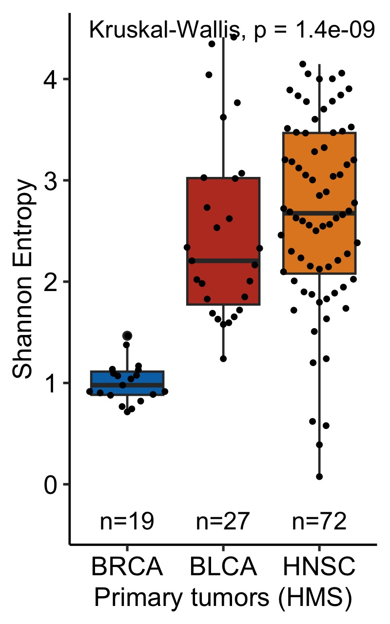
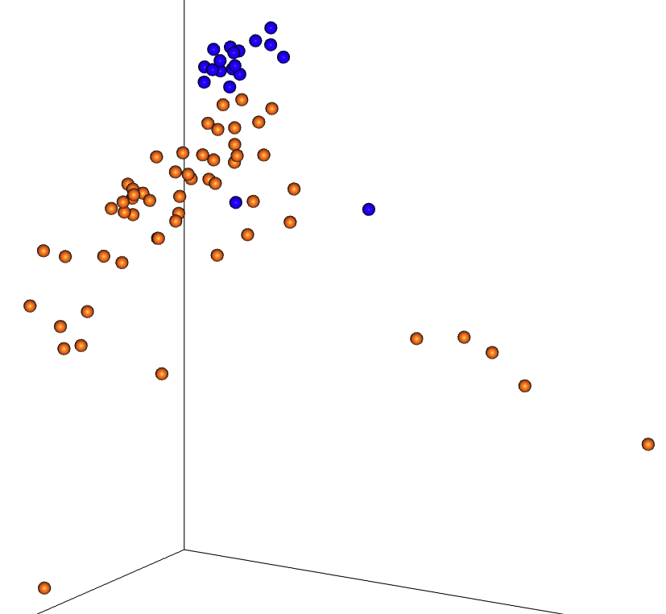
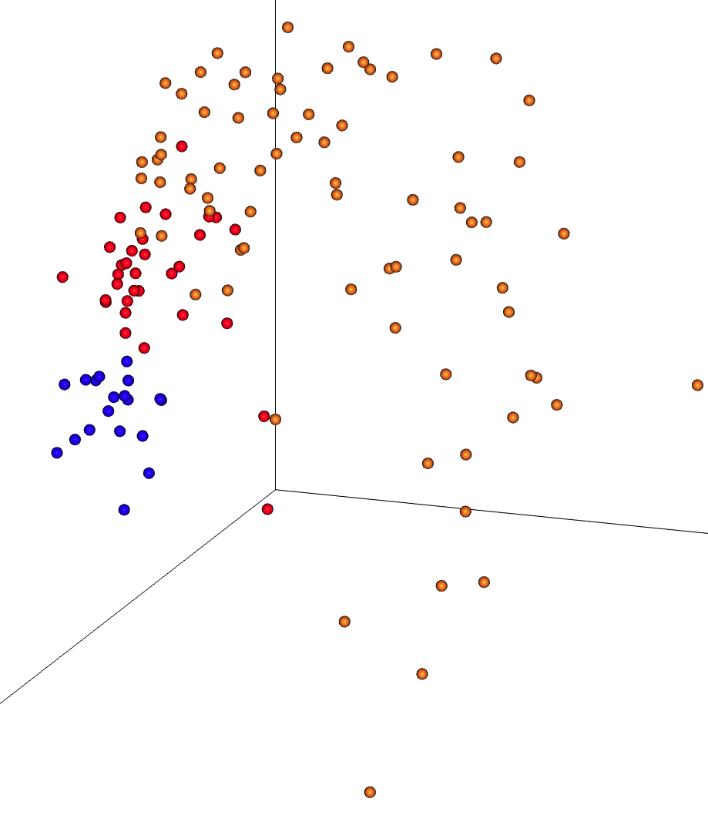
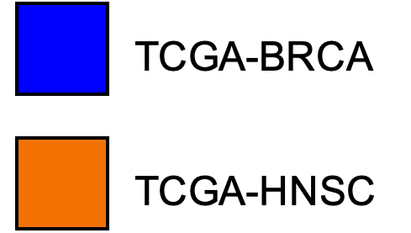
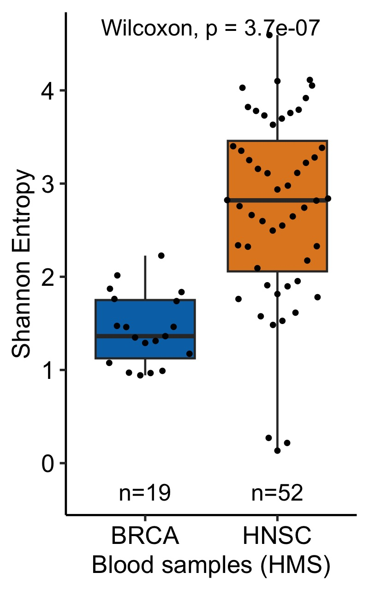
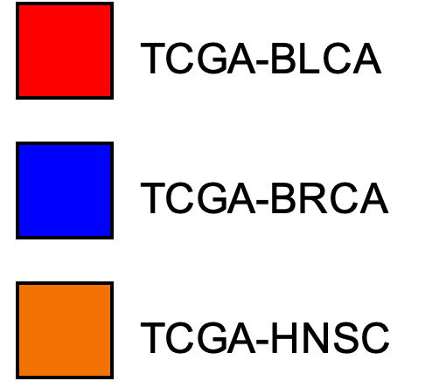
A
C
TCGA Harvard Medical School – Blood Samples
PERMANOVA: F=24.1, R²=0.25, p=0.001
TCGA HMS | BLCA | BRCA | HNSC
Primary tumors | 51 | 19 | 85
Blood samples | - | 19 | 76
D
Axis 2 (33.80%)
TCGA Harvard Medical School – Primary Tumors
PERMANOVA: F=41.3, R²=0.40, p=0.001
B
Axis 2 (20.40%)
E
Axis 3 (3.11%)
Axis 1 (63.09%)
Reference
Axis 1 (78.22%)
F
G
Reference
BLCA
BRCA
HNSC
BRCA
HNSC
BLCA
48 | 0 | 2
0 | 19 | 0
3 | 0 | 83
BRCA
17 | 3
2 | 73
Predicted
Predicted
BRCA
Axis 3 (1.38%)
HNSC
HNSC
Notes:
Re-analysis of the data provided by Gihawi et al. 2023 bioRxiv reveal cancer type-specific microbiomes.
(A) The breakdown of samples derived from TCGA’s Harvard Medical School (HMS), which contributed the most samples of any sequencing center among their samples (284 of 728, 39.0%). To avoid the need for batch correction, samples were analyzed using raw data from Gihawi et al. 2023 in subsets from a single sequencing center (here, HMS), sequencing platform (Illumina HiSeq), and experimental strategy (WGS). The data were not transformed in any way other than removing the Homo genus counts since it was included in their KrakenUniq mappings.
(B) Aitchison-based Principal Coordinates Analysis (RPCA) on the raw data, excluding Homo counts, across all primary tumors (PTs) from HMS. RPCA does not require rarefaction and none was used. PERMANOVA with 999 iterations was run to estimate effect sizes of cancer type separation, which was significant (inset values, p=0.001). Colors reflect cancer types and are uniform across all subpanels of this figure.
(C) After RPCA, Shannon entropies were calculated on all PT samples from HMS using raw data (excluding Homo counts) rarefied to the first quartile of sample counts (600 reads/sample). A Kruskal-Wallis test showed significant differences in Shannon diversity among cancer types (p=1.4e-9).
(D) RPCA was then applied to all blood derived normal (BDN) samples from HMS using raw data (excluding Homo counts). RPCA does not require rarefaction and none was used. PERMANOVA with 999 iterations was run to estimate effect sizes of cancer type separation, which was significant (inset values, p=0.001).
(E) After RPCA, Shannon entropies were calculated on all BDN samples from HMS using raw data (excluding Homo counts) rarefied to the first quartile of sample counts (400 reads/sample). A Kruskal-Wallis test showed significant differences in Shannon diversity among cancer types (p=3.7e-7).
(F) Having found cancer type-specific differences, we evaluated if multiclass machine learning could discriminate between cancer types using the raw data (excluding Homo counts) from all HMS PT samples. Gradient boosting machines were applied with 10-fold cross-validation such that every sample was left out once, and their predictions were used to generate a confusion matrix. The mean balanced accuracy was 97.59% in comparison to the no information rate (NIR) of 54.84% (p<2.2e-16).
(G) 10-fold cross-validation using gradient boosting machines on HMS BDN samples. The balanced accuracy was 92.8% in comparison to the NIR of 80% (p=4.4e-5).

