Slide 1
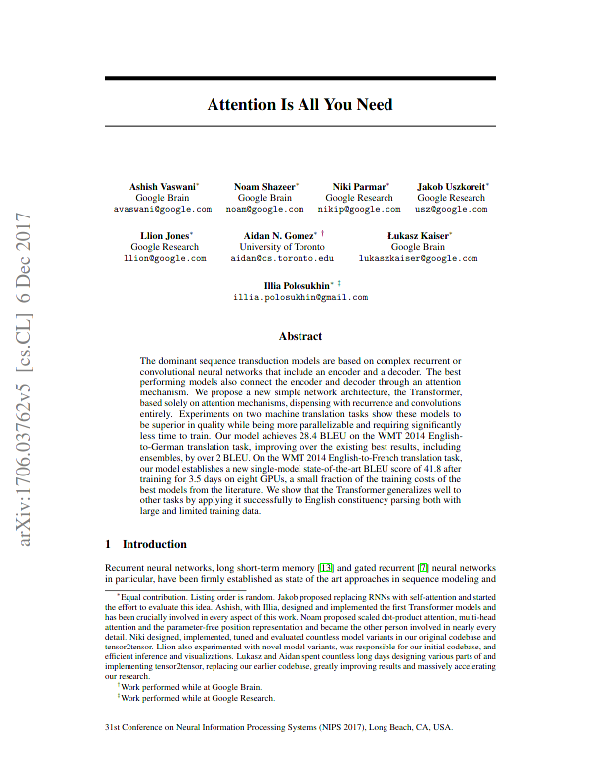
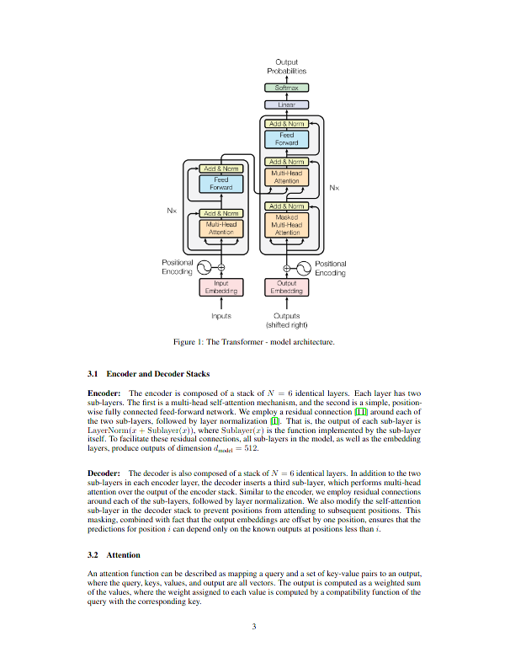
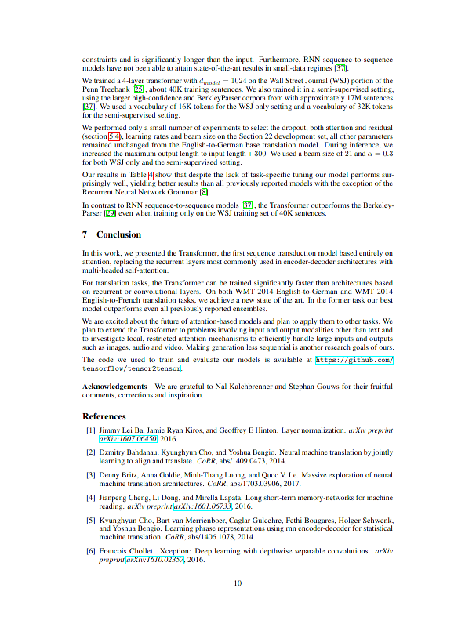
How to read scientific papers
6
Always:
1. Figures + captions
2. Abstract
3. Conclusion
Want to know more?
4. Introduction
5. Methods
Want to know all?
6. read full paper
Only if required:
7. Equations
1
2
3
4
5
https://linkedin.com/in/dennisbakhuis
Attention is all you need - Vaswani et al. 2017

