Slide 1
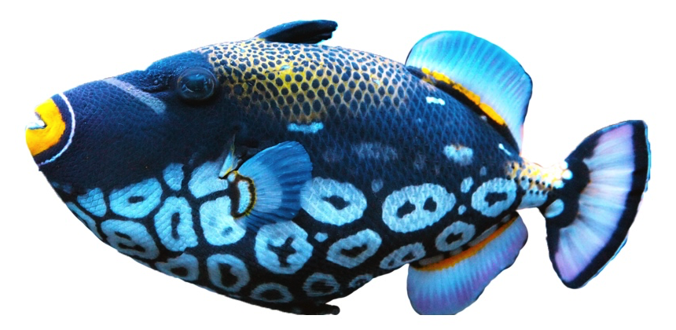
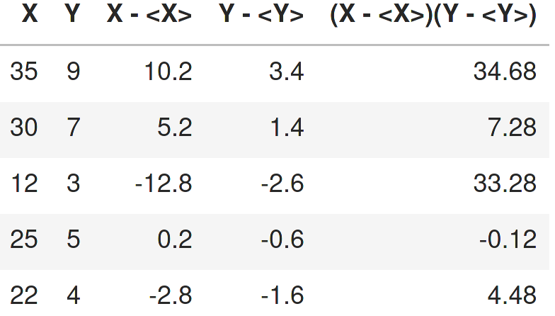
X
Size [cm]
Y
Weight [Kg]
$$σ\left(X, Y\right)=19.9$$

