Slide 1


Slide 2
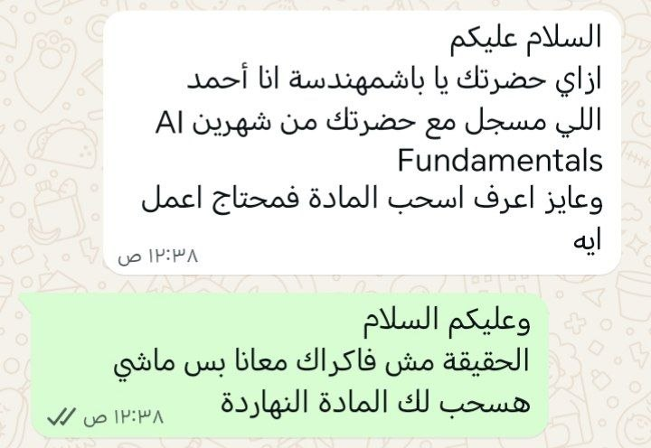

Slide 3
BRIGHTPEAK ACADEMY
Academic Management Assistant
An AI assistant for students, instructors, and admins built on the Model Context Protocol (MCP), with every request mediated by a secure server that stands between the LLM and the database.
MCP SERVER • GEMINI LLM • SQLITE

Slide 4
WALKTHROUGH
"Show me student #1's profile"
1
Gemini Client
Receives the user's natural-language request
2
Gemini decides
“I need student data” → picks a tool
3
MCP Agent
call_tool(“get_student_profile”, {student_id: 1})
4
MCP Server
Validates the input and checks authorization
5
SQLite
Executes the query and returns the student's data
6
Gemini
Formats the final, natural-language answer
Gemini never queries SQLite directly — it only ever decides which tool to call. The MCP Server is the one actually touching the database.
BRIGHTPEAK ACADEMY • MCP AI ASSISTANT
3

Slide 5
THE IDEA
The LLM never touches the database
Every request flows through an MCP Server, which owns authorization, tool execution, resource access, and input validation.
User
Gemini (LLM)
MCP Server
Database
➔
➔
➔
Asks a natural-language question
Decides which tool to call
Authorizes, validates, executes
SQLite — returns the data
MCP SERVER RESPONSIBILITIES
Access control & authorization
Executing tools
Reading resources
Validating every input
Protecting the database
BRIGHTPEAK ACADEMY • MCP AI ASSISTANT
2

Slide 6
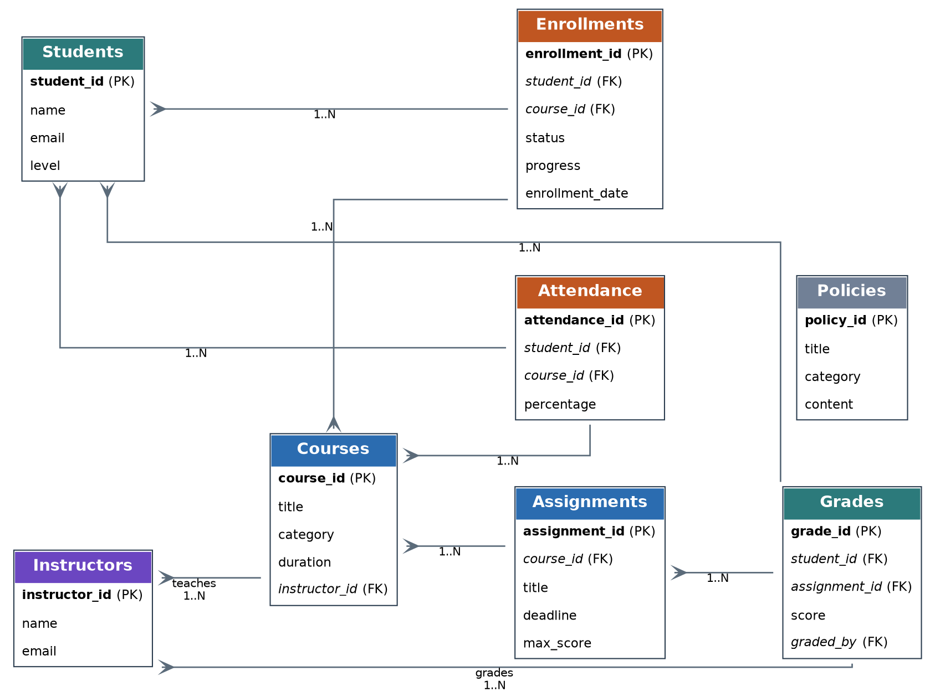
DATA LAYER
Database Design
SQLite, modeled around 8 core entities and their relationships.
Students
Courses
Instructors
Enrollments
Assignments
Grades
Attendance
Policies
+ ERD.png · schema.sql · seed.sql
BRIGHTPEAK ACADEMY • MCP AI ASSISTANT
4

Slide 7
ARCHITECTURE
8 Required MCP Features
1
2
3
4
Capability Negotiation
Notifications
Elicitation
Resources
Server announces capabilities on connect; client verifies them
Role changes push tools/list_changed — no reconnect needed
Sensitive writes pause for explicit human confirmation
Policies (attendance, scholarship...) exposed as static resources
5
6
7
8
Prompts
Progress Tracking
Defensive Tool Design
Transport
Ready-made templates like “Draft Warning Email”
Long report generation streams 10% → 50% → 100%
Every tool: JSON Schema + validation + authorization
stdio for dev, Streamable HTTP for multi-campus deployment
BRIGHTPEAK ACADEMY • MCP AI ASSISTANT
5

Slide 8
MCP TOOLS
Two Tiers of Tools
Write tools stay hidden until a session authenticates — then the server pushes a live tool list update.
R
Read-Only Tools
W
Write Tools
Available to every session, including front-desk / unauthenticated
Unlocked only after authenticate_staff (instructor or registrar)
•
get_student_profile
record_grade → elicits on large overrides
•
get_student_enrollments
•
get_student_attendance
update_attendance
•
get_student_grades
change_enrollment_status → elicits past 14-day window
•
generate_academic_advisory (sampling)
•
generate_course_report (progress)
Every write tool re-derives ownership from the database and re-validates input server-side — it never trusts the caller's claims.
BRIGHTPEAK ACADEMY • MCP AI ASSISTANT
6

Slide 9
HUMAN-IN-THE-LOOP
Elicitation & Sampling in Action
ELICITATION
SAMPLING
Pause for confirmation before risky writes
The client's own model writes the narrative
Grade override
generate_academic_advisory combines a student's grades, attendance, and enrollment status into raw facts — then asks the connected client's model (via sampling/createMessage) to turn them into a short, encouraging advisory note.
Score crosses the scholarship threshold, or overrides an existing grade by 15+ points
Late withdrawal
Graceful degradation
Dropping a student past the 14-day no-penalty enrollment window
If the connected client doesn't declare sampling support, the tool returns the raw facts instead of failing outright.
BRIGHTPEAK ACADEMY • MCP AI ASSISTANT
7

Slide 10
SUPPORTING FEATURES
Progress, Resources & Prompts
1
2
3
Progress Tracking
Resources
Prompts
generate_course_report walks every enrolled student and reports real intermediate progress instead of leaving the client blocked on a long-running call.
Static reference data — Attendance, Scholarship, and Academic Integrity policies — served via resources/list + resources/read, kept out of the tool namespace.
Ready-made, parameterised templates for common staff tasks, so every client gets the same carefully-worded instructions.
10% → 50% → 100%
policy://all
draft_attendance_warning()
BRIGHTPEAK ACADEMY • MCP AI ASSISTANT
8

Slide 11
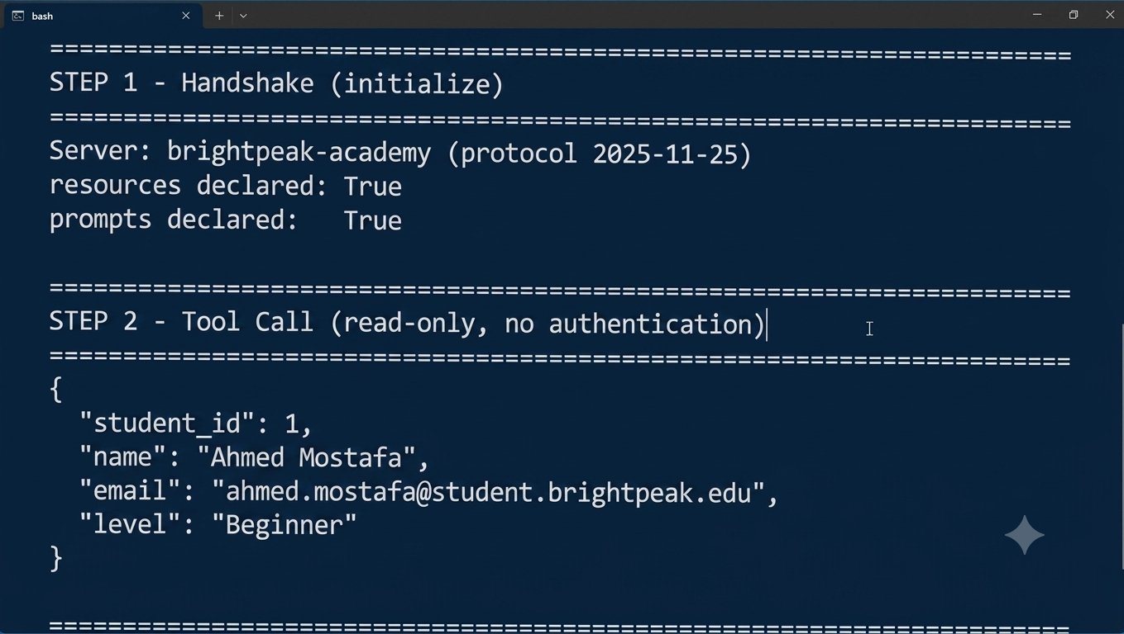

Slide 12
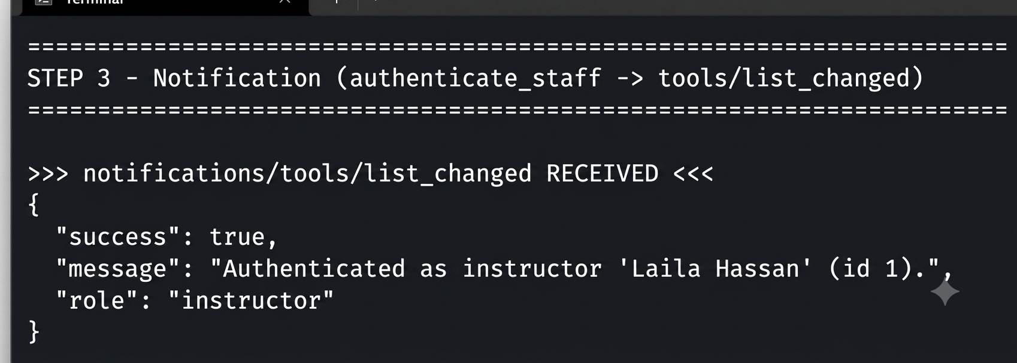
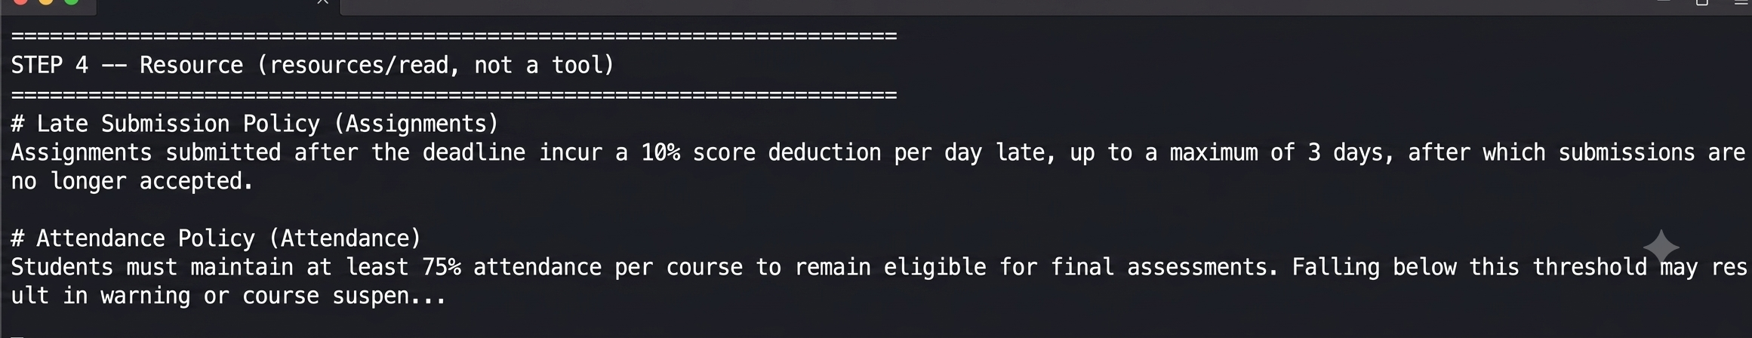

Slide 13
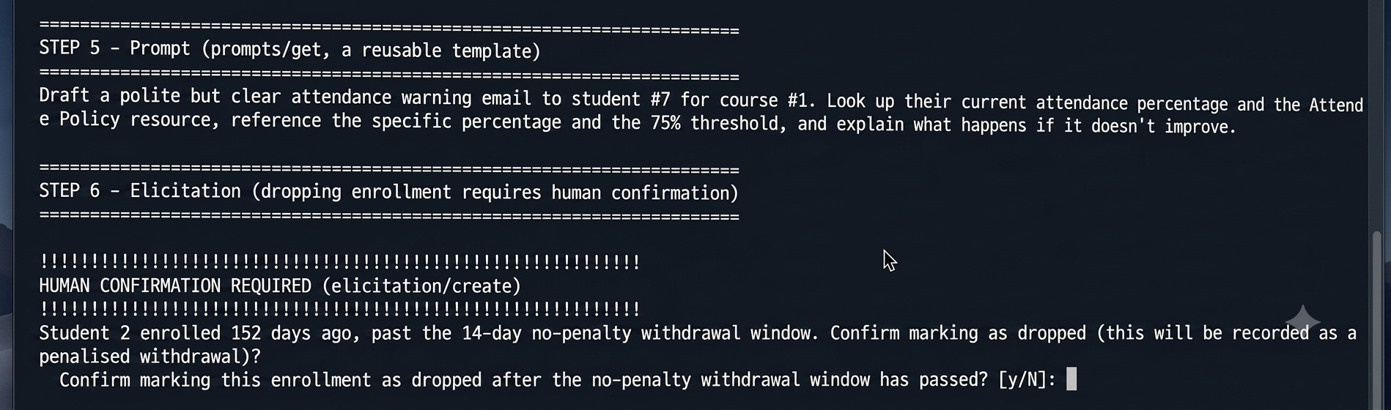
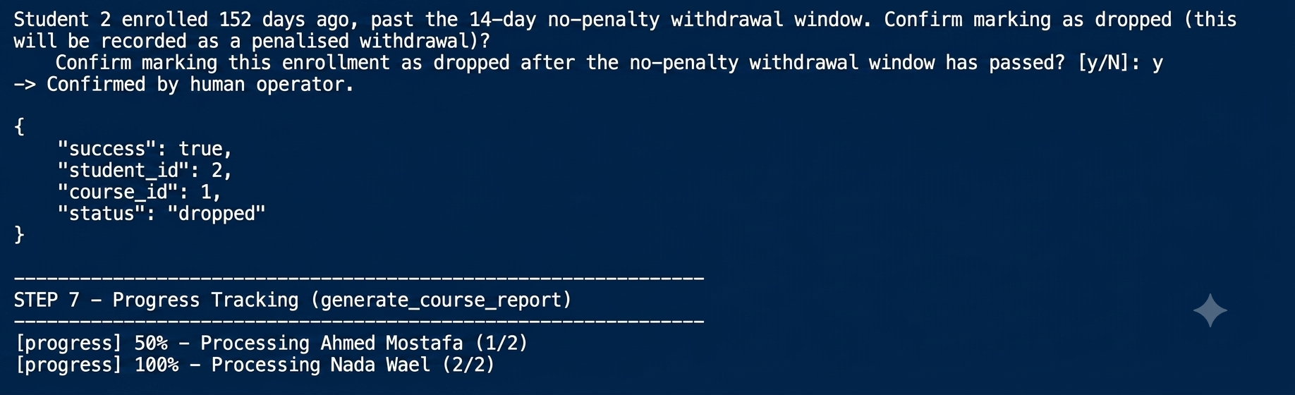

Slide 14
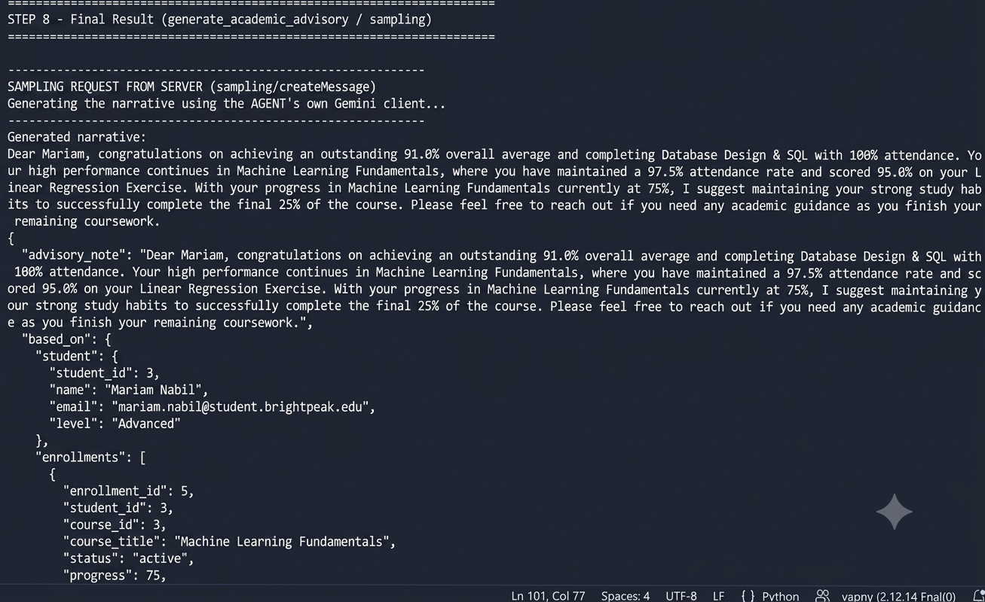

Slide 15
BRIGHTPEAK ACADEMY
Phase 2 — Memory & RAG Extension
Extending the same assistant with persistent memory and retrieval-augmented reasoning over the full policy manuals.
MEMORY SYSTEM • RAG PIPELINE • CONTEXT MANAGEMENT

Slide 16
MEMORY SYSTEM
A promote-or-drop pipeline for durable context
Live conversation flows through short-term buffers before durable facts get promoted into long-term memory.
Short-Term
Scratchpad
Router
Episodic
➔
➔
➔
Rolling buffer, returns evicted items
Plan / sub-goal state — never pruned
Promote-or-drop: forget or episodic
Persistent SQLite episodes
BEYOND THE FLOW
Semantic memory — versioned facts, expiration & supersession
Consolidation layer promotes recurring facts
Recall & verification run on every turn
Router logs its reasoning for every decision
Fully integrated into the MCP agent loop
BRIGHTPEAK ACADEMY • MCP AI ASSISTANT
9

Slide 17
PHASE 2 MOTIVATION
Two Failures Real Usage Exposed
Once staff used the Phase 1 assistant day to day, the same two gaps kept recurring.
1
The Memory Gap
2
The Knowledge Gap
Advisors re-explain the same student's scholarship risk, attendance warnings, and preferred track every new session.
Policy manuals are too detailed for policy:// resources and not searchable at the passage level.
•
The agent forgets everything once a session ends
Attendance thresholds & Protocol 4.2b special arrangements
•
No persistent view of a student across visits
•
Repeated context costs staff time on every call
Late-submission ladders and integrity sanctions
•
Scholarship risk & track preference re-explained each time
No multi-hop reasoning across scattered documents
•
No durable record of prior advisory notes
•
Fixed with Short-Term, Episodic & Semantic memory
Neither problem could be solved by adding more MCP tools — both needed dedicated subsystems: a memory system and a RAG pipeline.
BRIGHTPEAK ACADEMY • MCP AI ASSISTANT
10

Slide 18
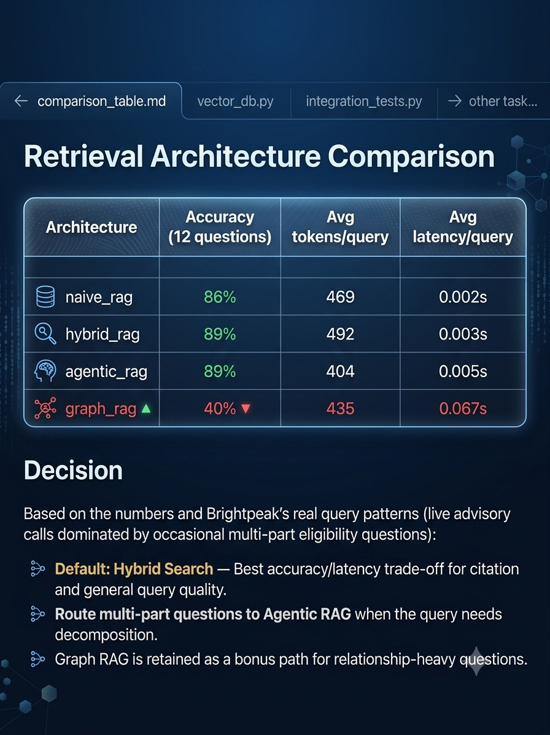

Slide 19
Context Window Management — Strategy Comparison
6 test cases × 4 strategies, evaluated in context_eval/ — owned by Ahmed.
83.3%
Zone-Based Pruning wins — highest accuracy (5/6 passed) with an 11.2% token reduction.
Strategy Reduction Latency
Sliding Window 22.9% 0.006 ms
Obs. Masking −4.6% 0.014 ms
Recursive Summary −3.1% 0.020 ms
Zone Pruning 11.2% 0.085 ms
Brightpeak Academy Assistant · Phase 2
5

Slide 20
EVALUATION RESULTS
The Numbers Behind Every Decision
CONTEXT MANAGEMENT
RETRIEVAL (RAG)
6 test cases × 4 strategies — zone-based pruning wins
12 domain questions scored across 4 architectures
83.3% accuracy
Hybrid Search and Agentic RAG both reach 89% accuracy — Hybrid is the fast default, Agentic is reserved for multi-part, decomposition-heavy questions. Naive RAG trails at 86%.
Zone-Based Pruning — highest accuracy (5/6 passed), 11.2% token reduction, 0.085ms latency
66.7% accuracy
Graph RAG — optional path
Sliding Window, Observation Masking & Recursive Summary all tie — none beat simple pruning
Wins on relationship-heavy questions (q11) but needs tighter entity linking; kept available, not the default.
BRIGHTPEAK ACADEMY • MCP AI ASSISTANT
12

Slide 21
RAG PIPELINE
Turning policy manuals into searchable knowledge
7 detailed policy & handbook documents are chunked, embedded, and indexed for passage-level retrieval.
Documents
Chunker
Embedder
Vector DB
➔
➔
➔
7 policy & handbook files
Heading-aware, with overlap
Vectorizes every chunk
HNSW ANN index + metadata filter
FIVE RETRIEVAL ARCHITECTURES
Naive RAG — baseline retrieve-then-generate
Hybrid Search — vector + BM25 fused scores
Agentic RAG — multi-hop retrieve, grade, rewrite
Self-RAG — relevance & support verification
Graph RAG (bonus) — policy entity graph
BRIGHTPEAK ACADEMY • MCP AI ASSISTANT
11

Slide 22
THE SHIPPING DECISION
Driven by the Evaluation Table, Not Intuition
1
2
3
Default
Multi-part questions
Relationship queries
Hybrid Search — fast, accurate citation and general policy lookups while staff wait on a call.
Routed automatically to Agentic RAG for decomposition-heavy, multi-condition eligibility questions.
Graph RAG is available on demand for entity/threshold-linked reasoning — not used as the default path.
Hybrid Search
Agentic RAG
Graph RAG (optional)
BRIGHTPEAK ACADEMY • MCP AI ASSISTANT
13

Slide 23
Secure, structured, and student-first
Brightpeak Academy's assistant proves that an LLM can be genuinely useful in a sensitive domain — academic records — without ever holding the keys to the database itself.
MCP Protocol
Gemini LLM
SQLite
Python (FastMCP)
Thank you.
BRIGHTPEAK ACADEMY • MCP AI ASSISTANT
10

Slide 24



