Slide 1
Rental Car Management
By U3D Team
1.

Slide 2
Table of Content
System Overview
System Structure
The main process
Demo

Slide 3
1. System Overview
Purpose: Build a system program that manage all information related rental car.
Idea:

Slide 4
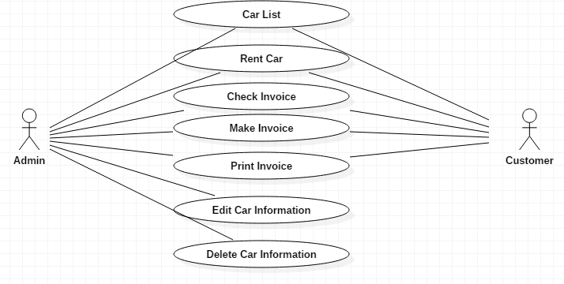
1. System Overview
Use case diagram

Slide 5
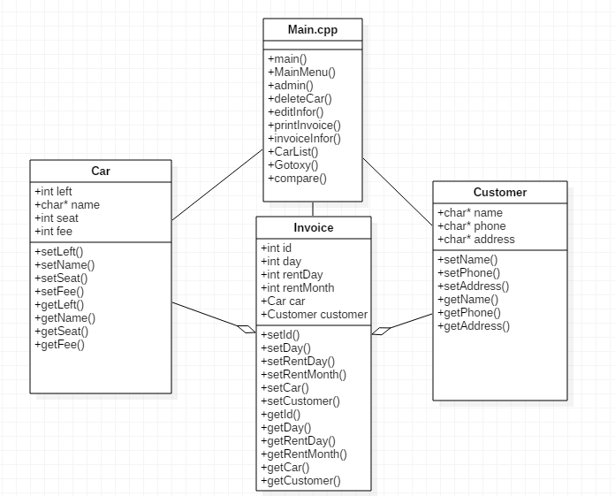
2. System Structure

Slide 6
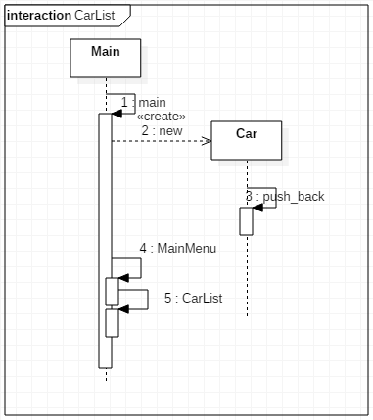
3. The main process
3.1. Car list

Slide 7
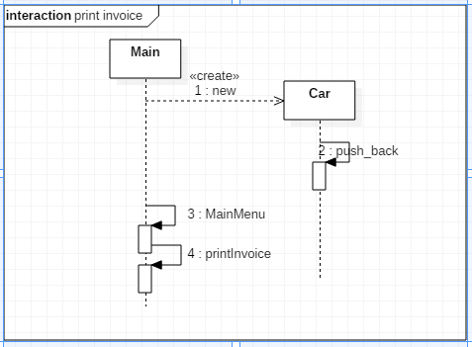
3. The main process
Check invoice

Slide 8
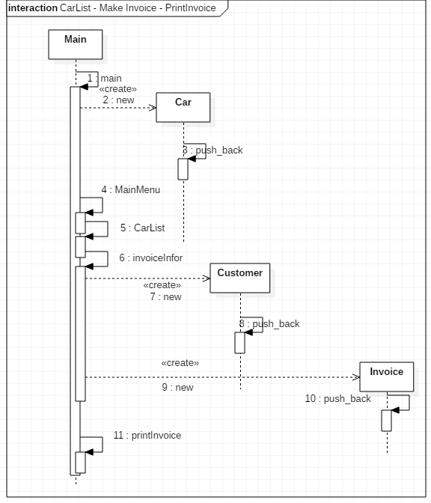
3. The main process
Car List - Make Invoice – Print Invoice

Slide 9
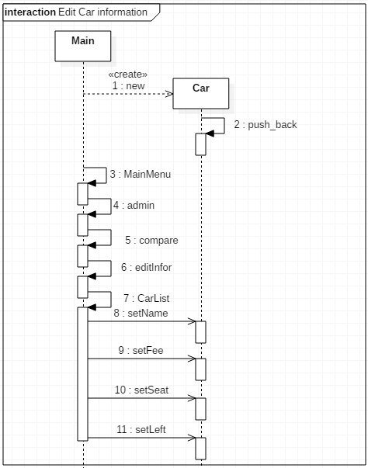
3. The main process
Edit car information

Slide 10
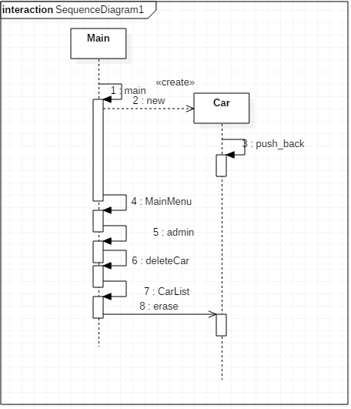
3. The main process
Delete Car Information

Slide 11
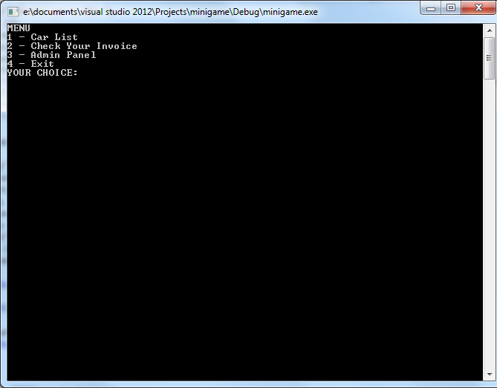
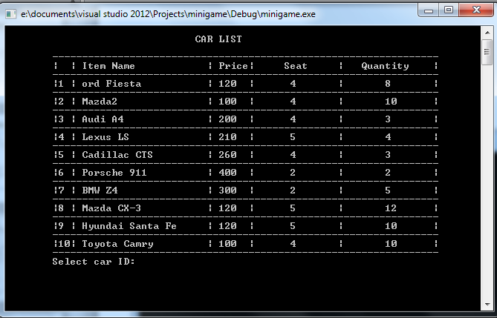
4. Demo

Slide 12
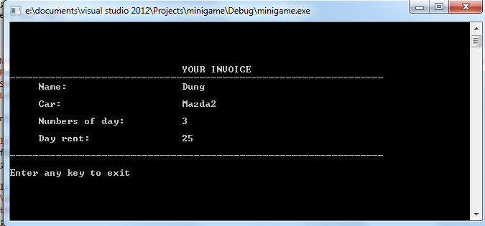
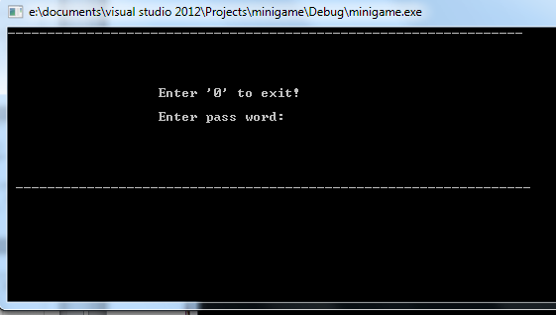

Slide 13
