Slide 1
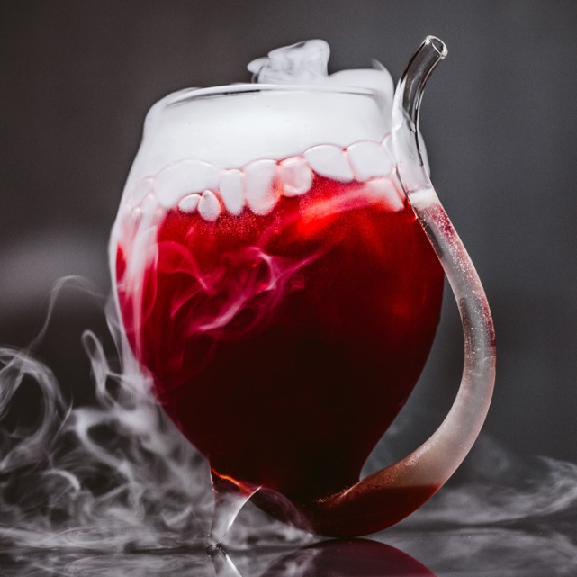
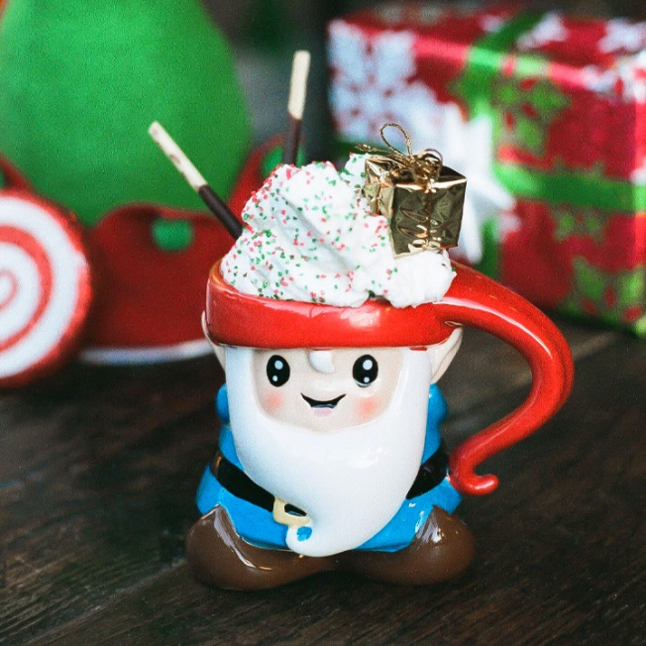
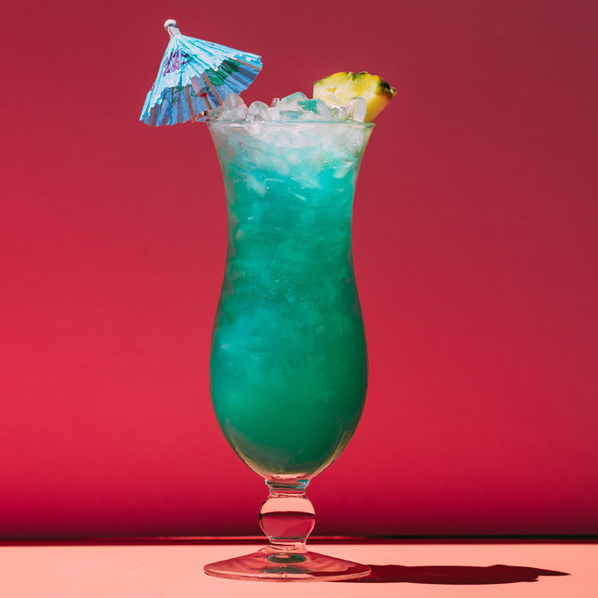
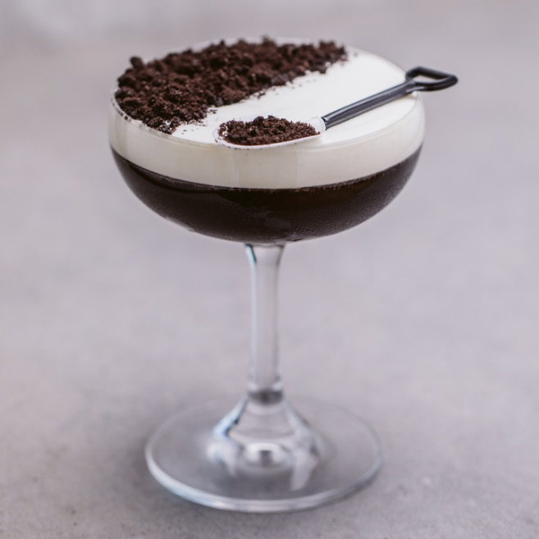
Cocktails
Štepán Beneš
Marek Kučera
Lukáš Matta

Slide 2

Introduction
Recommending cocktails based on their characteristic
Can be used by:
Bartenders searching for inspiration
Eshop selling alcohol
People trying new stuff

Slide 3
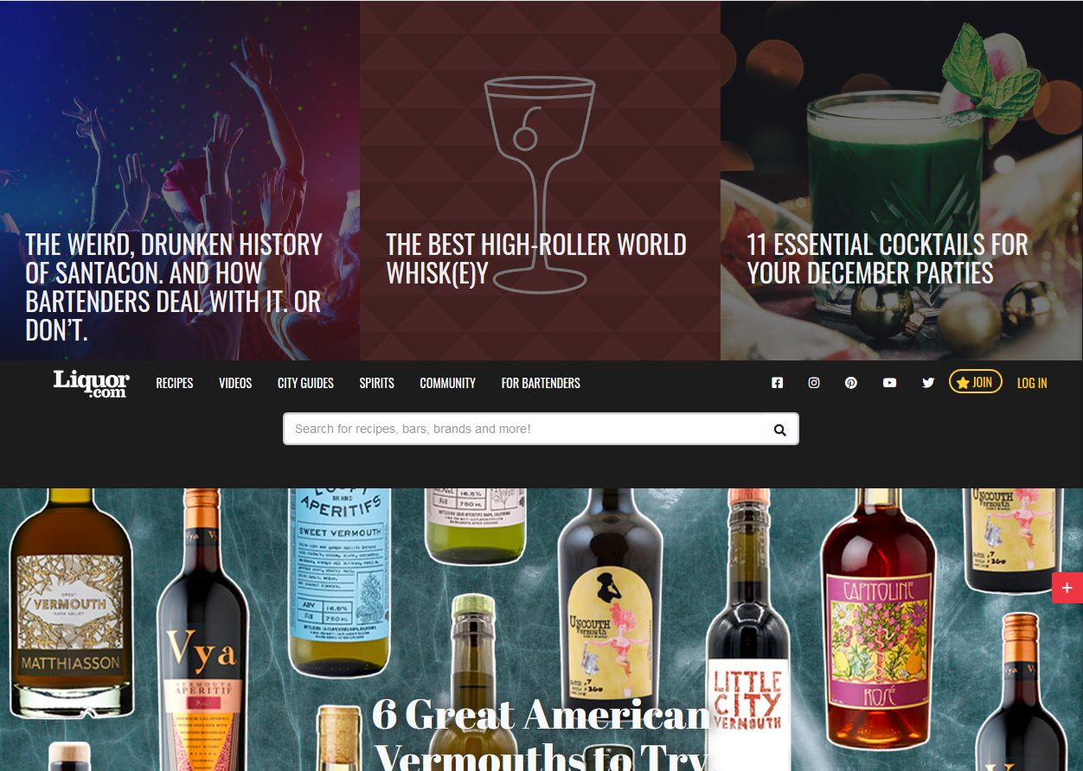
Dataset
https://www.liquor.com 2300 recipes

Slide 4
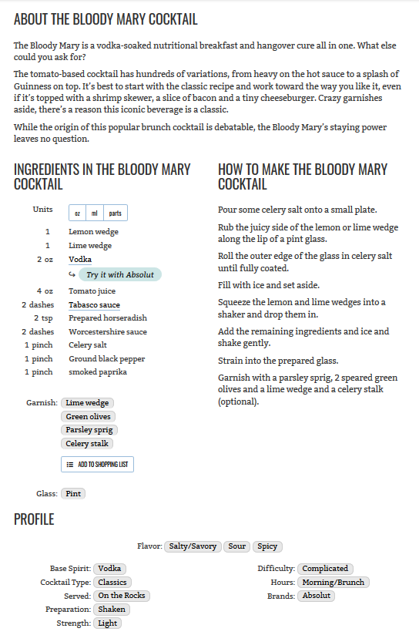
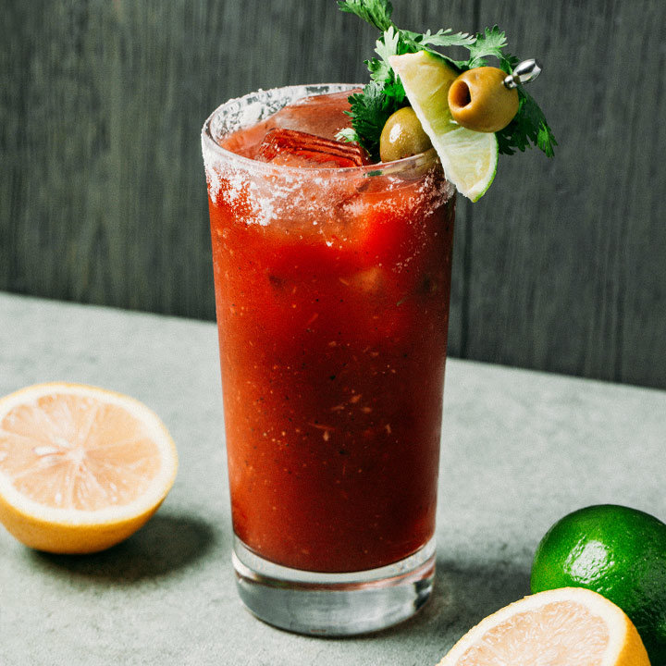
Recipe
Notes:
Describe the distribution of values – fairly equal # of base spirits, …

Slide 5
Scrapping

Slide 6
Recommending
Content-Based (TF-IDF)
User profile – drinks
Top 30 for each drink => a big list
A big list => randomly sampled into final list
Notes:
We’re using basic TF-IDF – 5 more or less similar methods – differ in keywords used .., user profile consists of the drinks he likes, recommendation takes every drink and outputs a list of top30 (passed the eye test the best) similar drinks, then randomly select desired count to display – ensures high % for drinks similar to multiple from profile and also some exploration

Slide 7
Profile-based
Recommends ‘twists’
Understands innate similarity
Maybe a bit too similar
Notes:
Works really good with exploring twists - drinks with slight alternations. Catches onto what makes the drinks similar. But the results might be a bit too similar – poor exploration. Also damned duplicates.

Slide 8
Description-based
Can pick unusual similarities
Some innate similarity
in how cocktails are made
Missing descriptions
Unrelated drinks mentioned
Notes:
Can pick up onto unusual similarities – same book, same series of drinks .. First problem – some drinks were missing descriptions … Another – descriptions mention unrelated drinks

Slide 9
Combined
Best of both worlds .. In theory
Sometimes unrelated results appear
Notes:
Combined keywords from both .. Good mix od very similar items with items similar on some unusual way … sometimes though bad items bubble through

Slide 10
Priorities
“Boosted” Profile-based & Combined
More weight given to: Base Spirit, Cocktail Type, Flavor..
Should deal with recommending drinks based on less important categories
Notes:
Ingredients and how it’s Served. Results should be more similar in the ‘right’ categories

Slide 11
Evaluation
Evaluator screenshot
Short Description

Slide 12
Evaluation
Graph of the evaluation results + commentary about it

Slide 13
Evaluation
Graphs about how different are the sets produce by selected methods ?
Profile vs Description
Boosted Profile vs Profile
Profile vs Combined

Slide 14
The Thing
Screenshot + description of the final app

