Slide 1
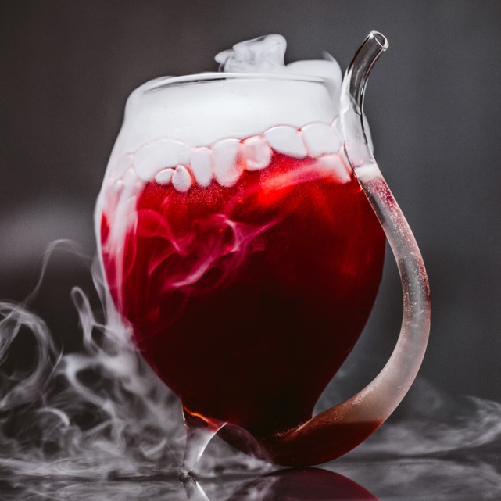
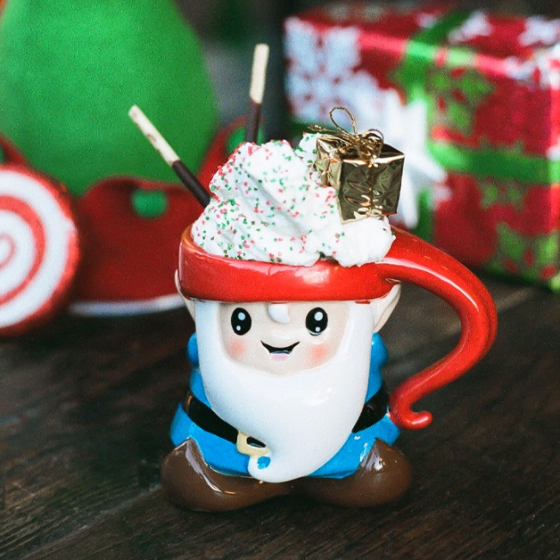
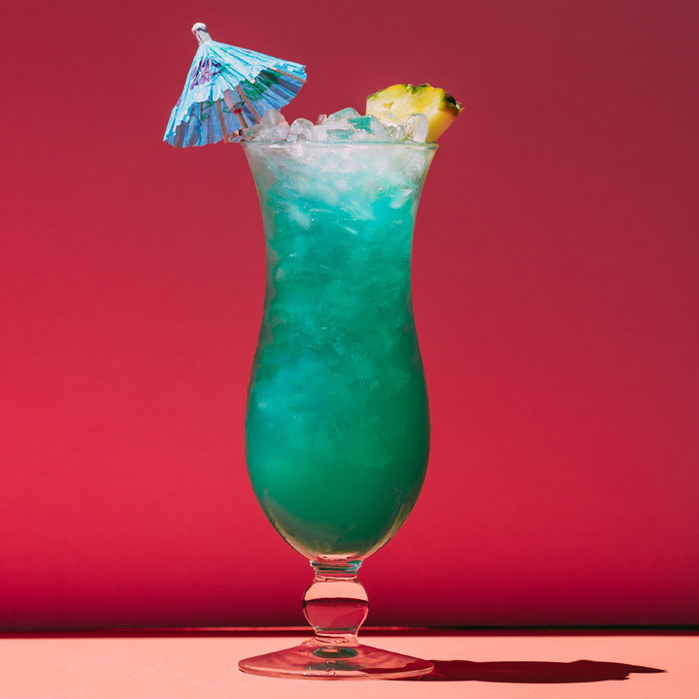
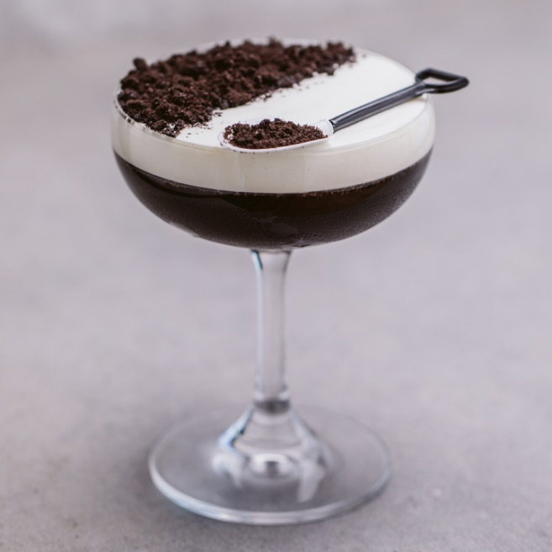
Cocktails
Štepán Beneš
Marek Kučera
Lukáš Matta

Slide 2
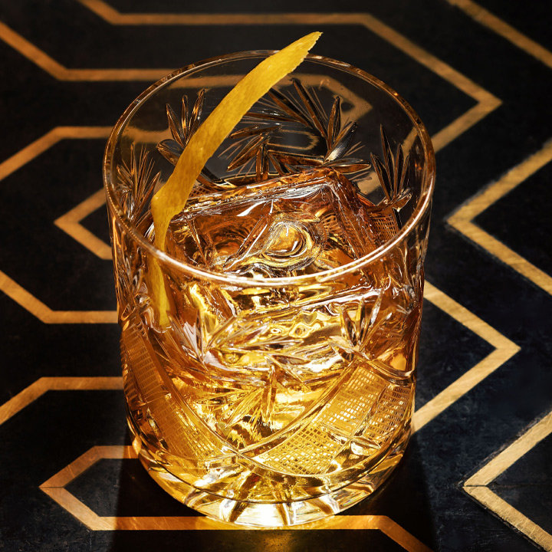
Introduction
Recommending cocktails based on their characteristic
Can be used by:
Bartenders searching for inspiration
Eshop selling alcohol
People trying new stuff

Slide 3
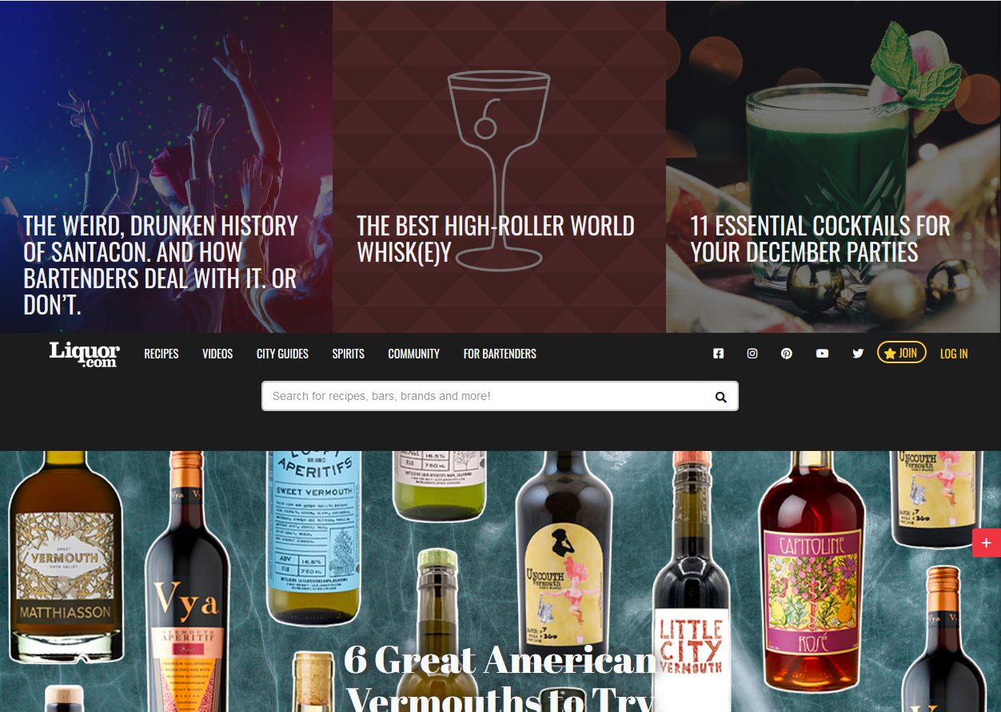
Dataset
https://www.liquor.com 2300 recipes

Slide 4
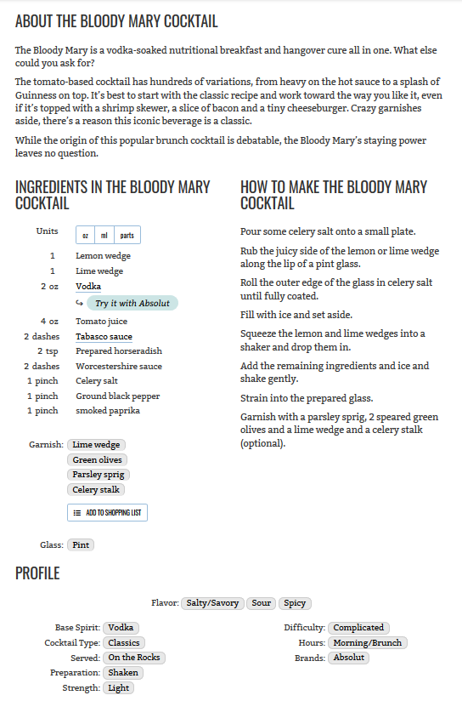
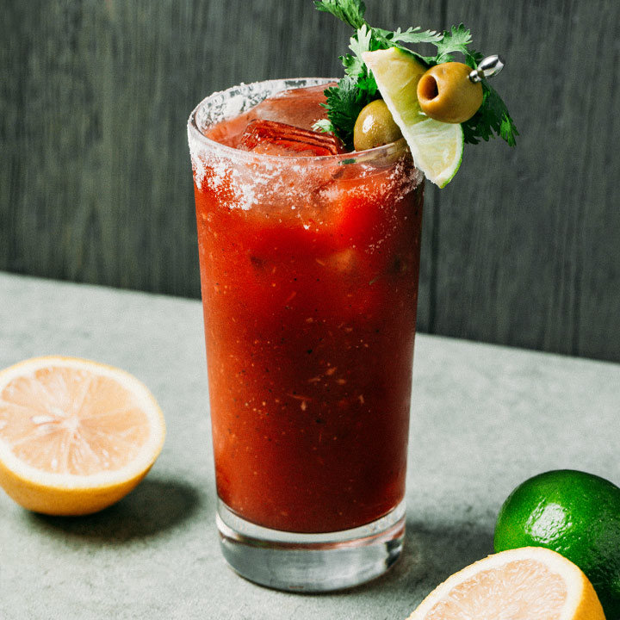
Recipe
Notes:
Describe the distribution of values – fairly equal # of base spirits, …

Slide 5
Scrapping
Implemented in python using beautifulsoup4, requests, re libraries
Ingredients without amount or weight
11 Profile categories plus glass and garnish
About recipe
How to make recipe
Picture for front end
Output: csv for recommender, json for front-end

Slide 6
Recommending
Content-Based (TF-IDF)
User profile – drinks
Top 30 for each drink => a big list
A big list => randomly sampled into final list
Notes:
We’re using basic TF-IDF – 5 more or less similar methods – differ in keywords used .., user profile consists of the drinks he likes, recommendation takes every drink and outputs a list of top30 (passed the eye test the best) similar drinks, then randomly select desired count to display – ensures high % for drinks similar to multiple from profile and also some exploration

Slide 7
Profile-based
Recommends ‘twists’
Understands innate similarity
Maybe a bit too similar
Notes:
Works really good with exploring twists - drinks with slight alternations. Catches onto what makes the drinks similar. But the results might be a bit too similar – poor exploration. Also damned duplicates.

Slide 8
Description-based
Can pick unusual similarities
Some innate similarity
in how cocktails are made
Missing descriptions
Unrelated drinks mentioned
Notes:
Can pick up onto unusual similarities – same book, same series of drinks .. First problem – some drinks were missing descriptions … Another – descriptions mention unrelated drinks

Slide 9
Combined
Best of both worlds .. In theory
Sometimes unrelated results appear
Notes:
Combined keywords from both .. Good mix od very similar items with items similar on some unusual way … sometimes though bad items bubble through

Slide 10
Priorities
“Boosted” Profile-based & Combined
More weight given to: Base Spirit, Cocktail Type, Flavor..
Should deal with recommending drinks based on less important categories
Notes:
Ingredients and how it’s Served. Results should be more similar in the ‘right’ categories

Slide 11
Evaluation
Evaluator screenshot
Short Description

Slide 12
Evaluation
Graph of the evaluation results + commentary about it

Slide 13
Evaluation
Graphs about how different are the sets produce by selected methods ?
Profile vs Description
Boosted Profile vs Profile
Profile vs Combined

Slide 14
The Thing
Screenshot + description of the final app

