Slide 1
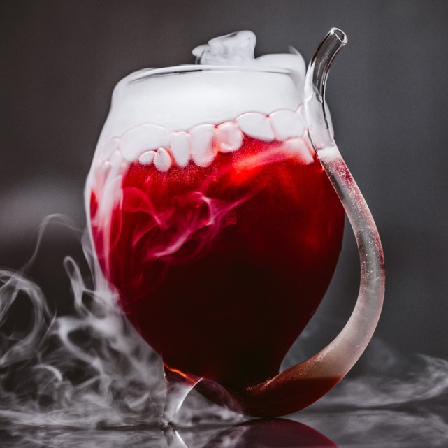
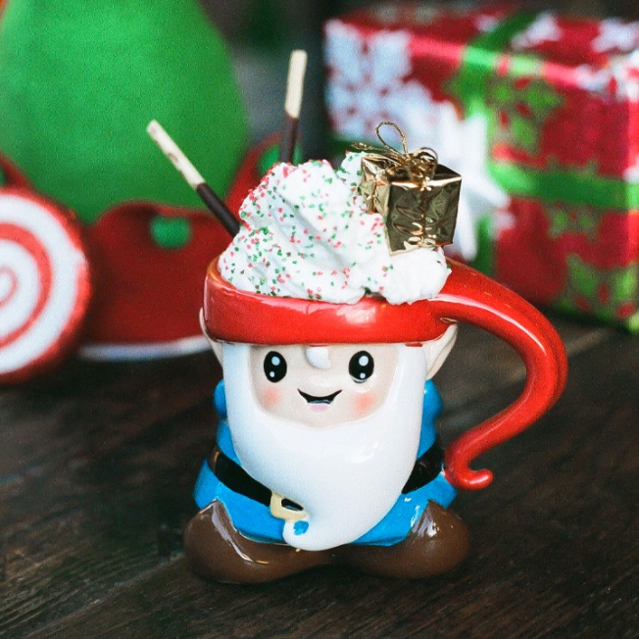
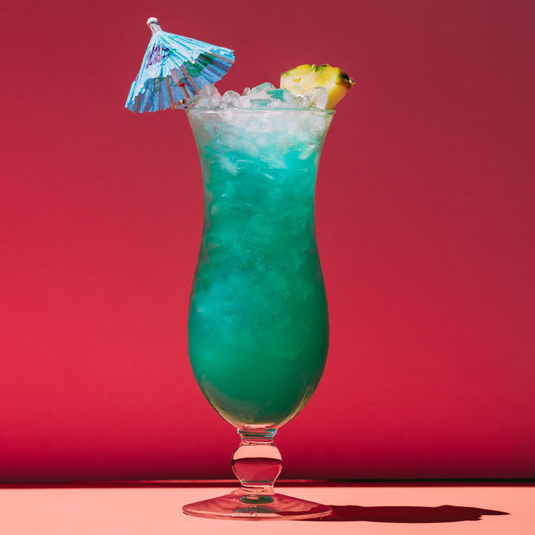
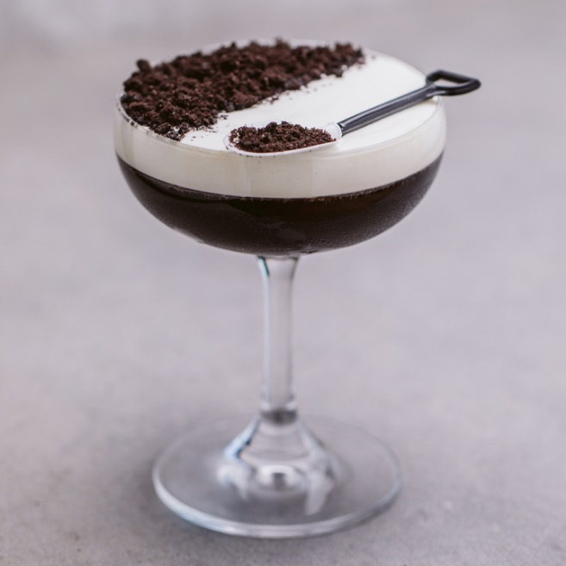
Cocktails
Štepán Beneš
Marek Kučera
Lukáš Matta

Slide 2
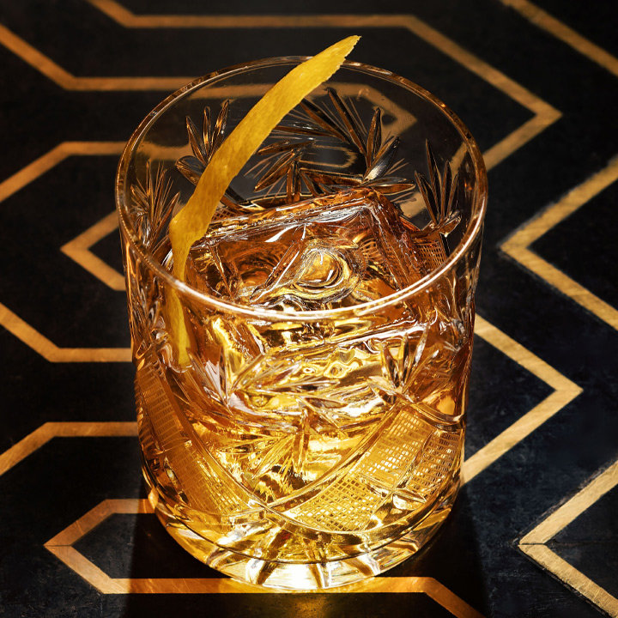
Introduction
Recommending cocktails based on their characteristic
Can be used by:
Bartenders searching for inspiration
Eshop selling alcohol
People trying new stuff

Slide 3
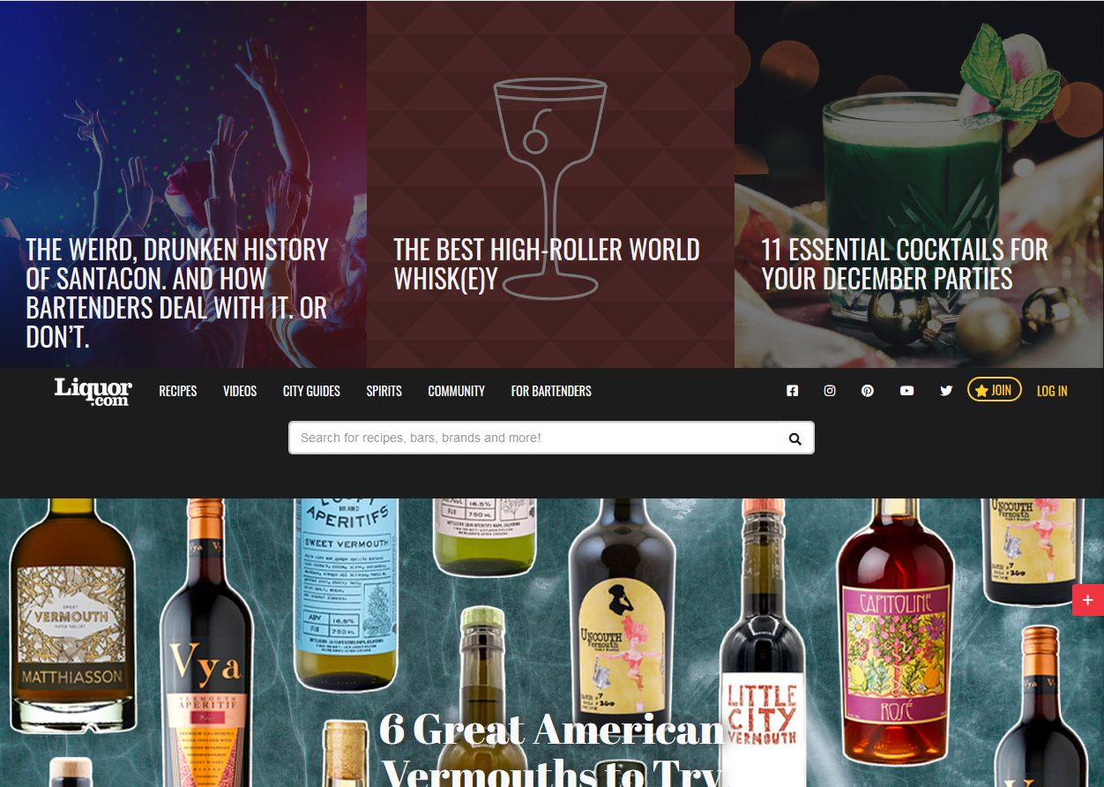
Dataset
https://www.liquor.com 2300 recipes

Slide 4
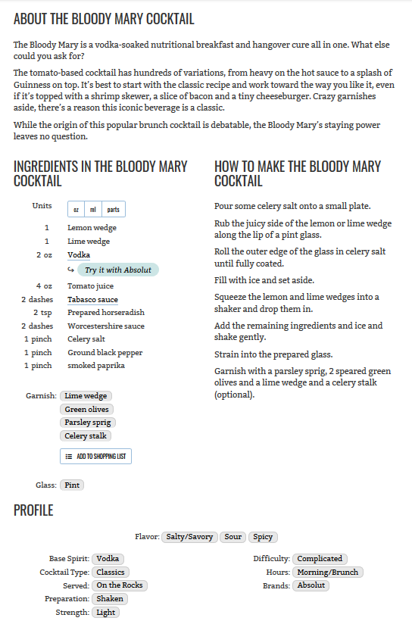
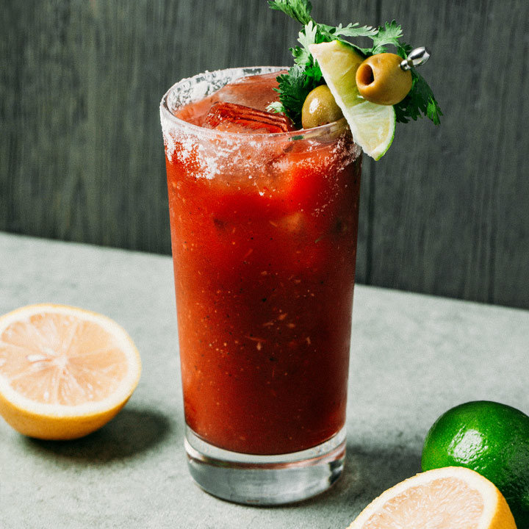
Recipe
Notes:
Describe the distribution of values – fairly equal # of base spirits, …

Slide 5
Scrapping
Implemented in python using beautifulsoup4, requests, re libraries
Ingredients without amount or weight
11 Profile categories plus glass and garnish
About recipe
How to make recipe
Picture for front end
Output: csv for recommender, json for front-end

Slide 6
Recommending
Content-Based (TF-IDF, cosine similarity)
User profile – drinks
Top 30 for each drink => a big list
A big list => randomly sampled into final list
Notes:
We’re using basic TF-IDF – 5 more or less similar methods – differ in keywords used .., user profile consists of the drinks he likes, recommendation takes every drink and outputs a list of top30 (passed the eye test the best) similar drinks, then randomly select desired count to display – ensures high % for drinks similar to multiple from profile and also some exploration

Slide 7
Profile-based
Recommends ‘twists’
Understands innate similarity
Maybe a bit too similar
Notes:
Works really good with exploring twists - drinks with slight alternations. Catches onto what makes the drinks similar. But the results might be a bit too similar – poor exploration. Also damned duplicates.

Slide 8
Description-based
Can pick unusual similarities
Some innate similarity
in how cocktails are made
Missing descriptions
Unrelated drinks mentioned
Notes:
Can pick up onto unusual similarities – same book, same series of drinks, city of origin .. Recipe description mentions ingredients .. First problem – some drinks were missing descriptions … Another – descriptions mention unrelated drinks

Slide 9
Combined
Best of both worlds .. In theory
Poorer results still appear sometimes
Notes:
Combined keywords from both .. Good mix od very similar items with items similar on some unusual way … sometimes though bad items bubble through

Slide 10
Priorities
“Boosted” Profile-based & Combined
More weight given to: Base Spirit, Cocktail Type, Flavor..
Should deal with recommending drinks based on less important categories
Notes:
Ingredients and how it’s Served. Results should be more similar in the ‘right’ categories – similarity on important categories.

Slide 11
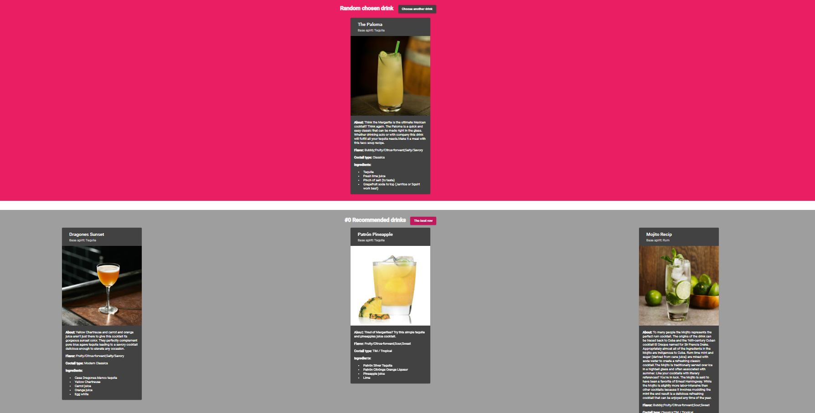
Evaluation
Notes:
Randomly chosen drinks, 5 rows in random order corresponding to the methods, each with 3 drinks – selected best row gains a point
Basic description and ingredients to help with choosing, still takes quite a lot of time

Slide 12
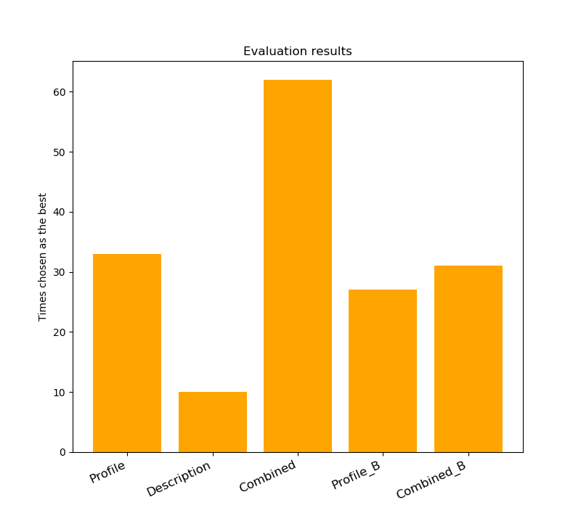
Evaluation
Notes:
Combined proved to be the best, although profile based methods also did well, and they make up a large portion of the Combined list.
Description by itself is pretty poor, but works in Combined approach – key note – drinks provided by Description usually rank pretty high in Combined list, but not completely at the top

Slide 13
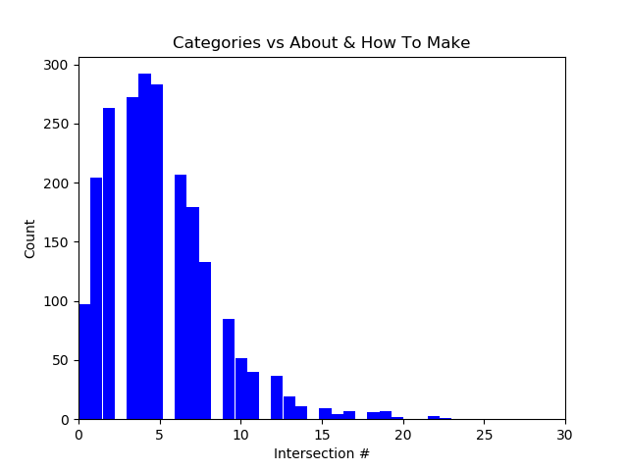
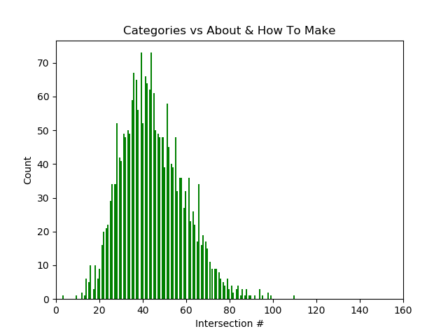
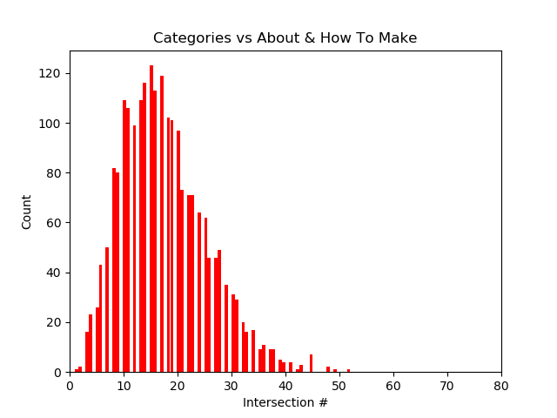
Profile vs Description
Notes:
Little intersection among varying list sizes

Slide 14
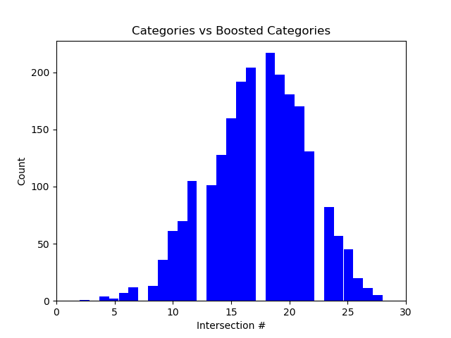
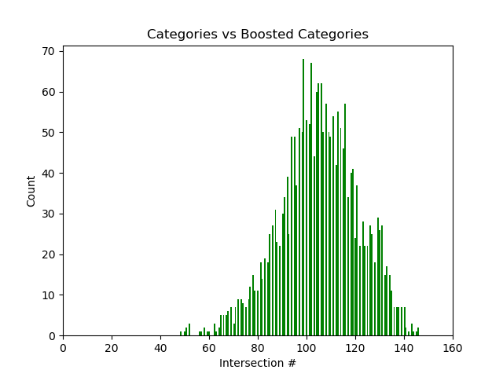
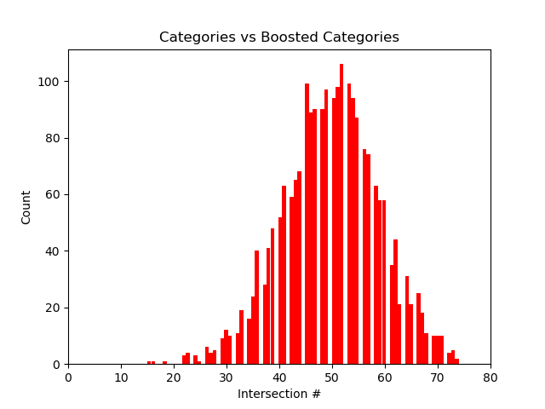
Boosted Profile vs Profile
Notes:
Quite similar but not completely – suppose the boosting does is job

Slide 15
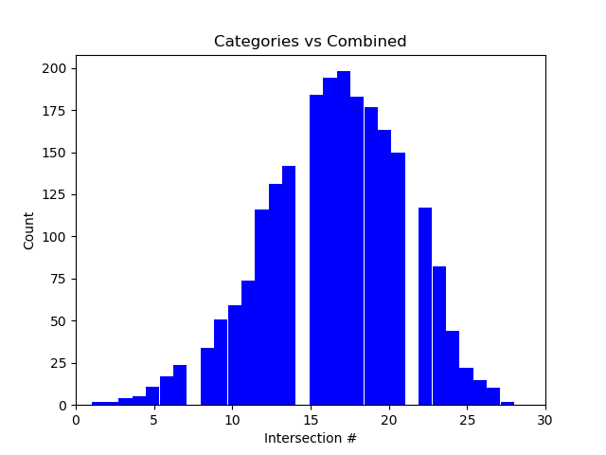
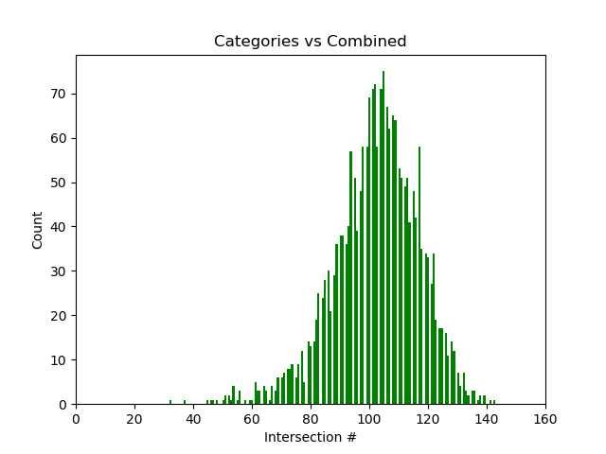
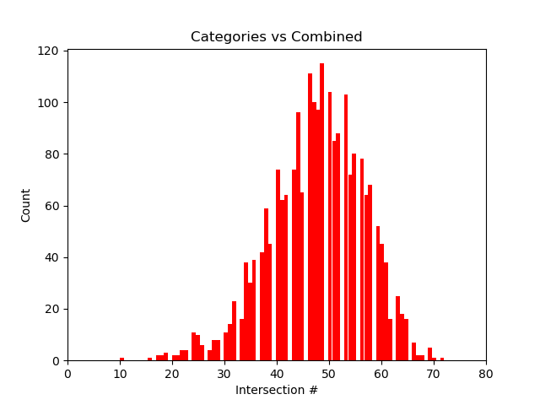
Profile vs Combined
Notes:
Profile makes up a significant chunk of the Combined list, but the added drinks from Description method prove useful – since Combined won

Slide 16
The Thing
Screenshot + description of the final app

