Slide 1
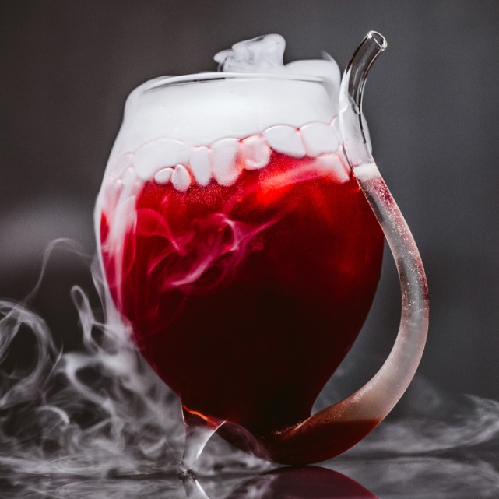
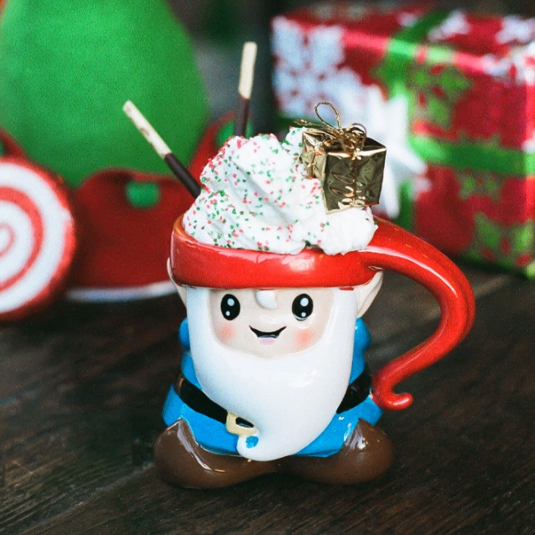
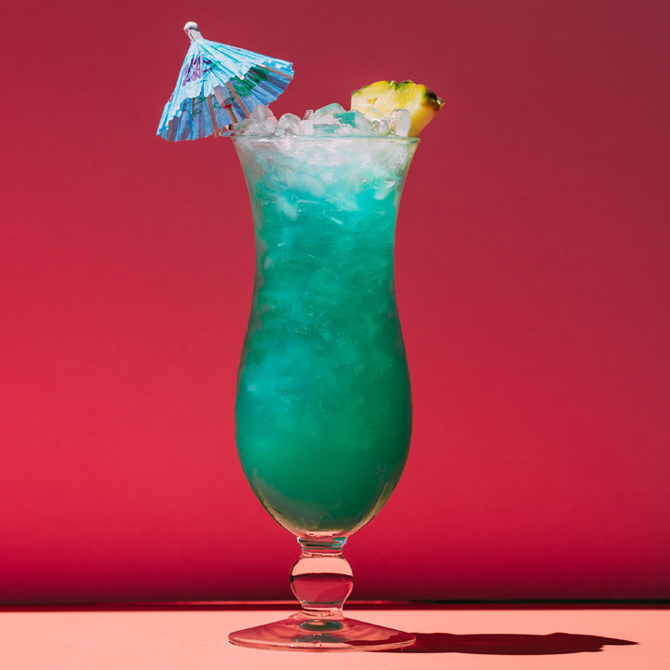
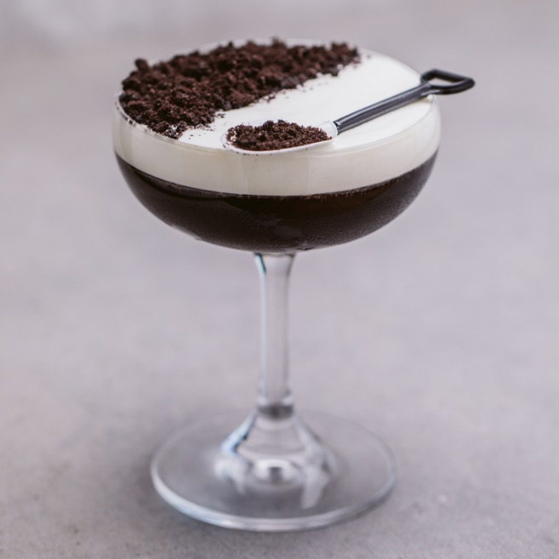
Cocktails
Štepán Beneš
Marek Kučera
Lukáš Matta

Slide 2

Introduction
Recommending cocktails based on their characteristic
Can be used by:
Bartenders searching for inspiration
Eshop selling alcohol
People trying new stuff

Slide 3
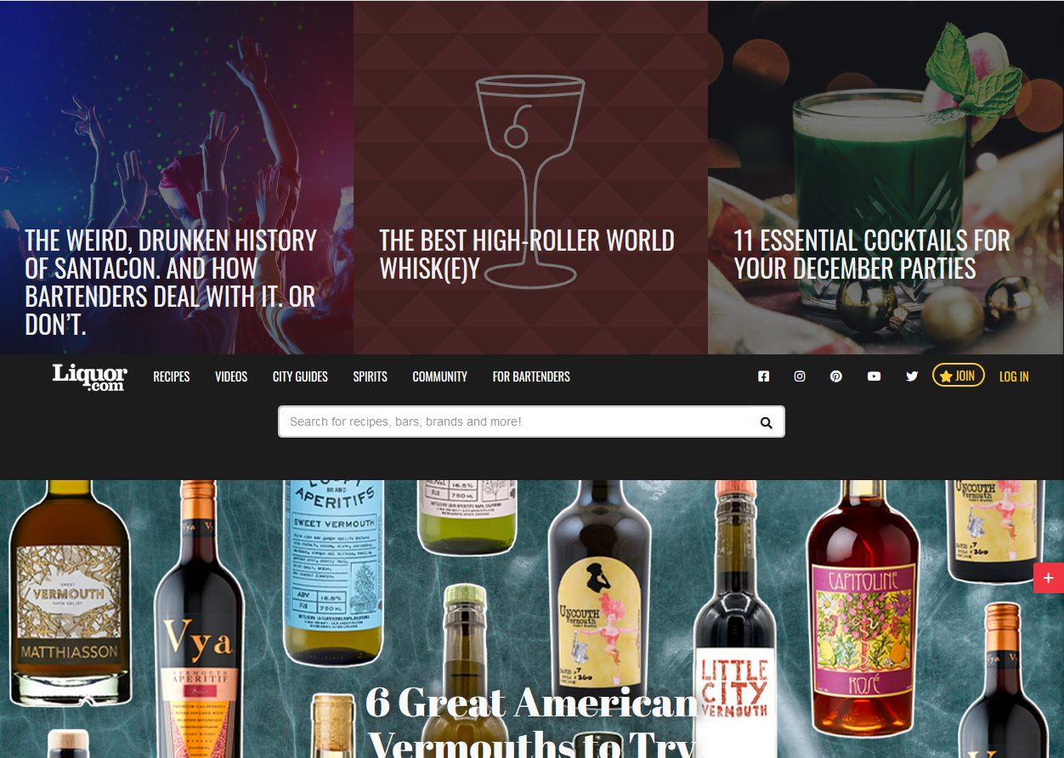
Dataset
https://www.liquor.com 2300 recipes

Slide 4
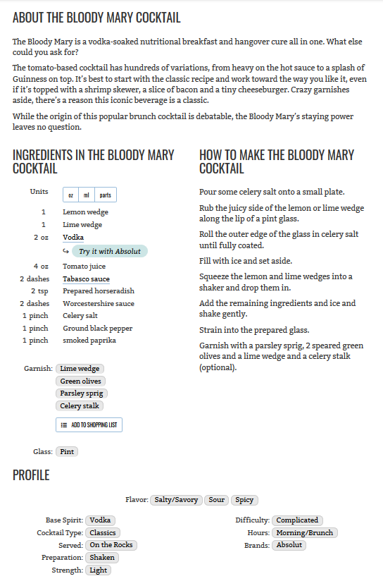
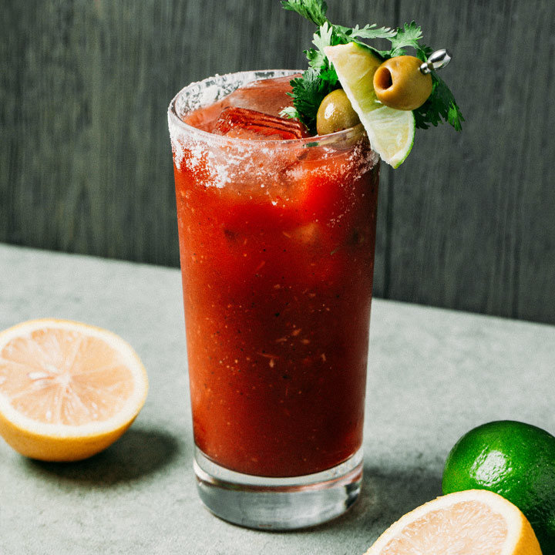
Recipe

Slide 5
Scrapping

Slide 6
Recommending

