Slide 1
Development Project
Lorann
1
1
1
SLAOUI Mehdi, HALTER Alexandre, MONNET Dorian , GANGLOFF Thibaut
SLAOUI Mehdi, HALTER Alexandre, MONNET Dorian , GANGLOFF Thibaut

Slide 2

Summary
2
2
2
Project context
Group presentation
Tools used
Task repartition
Game explication
Game demonstration
SLAOUI Mehdi, HALTER Alexandre, MONNET Dorian , GANGLOFF Thibaut
SLAOUI Mehdi, HALTER Alexandre, MONNET Dorian , GANGLOFF Thibaut

Slide 3
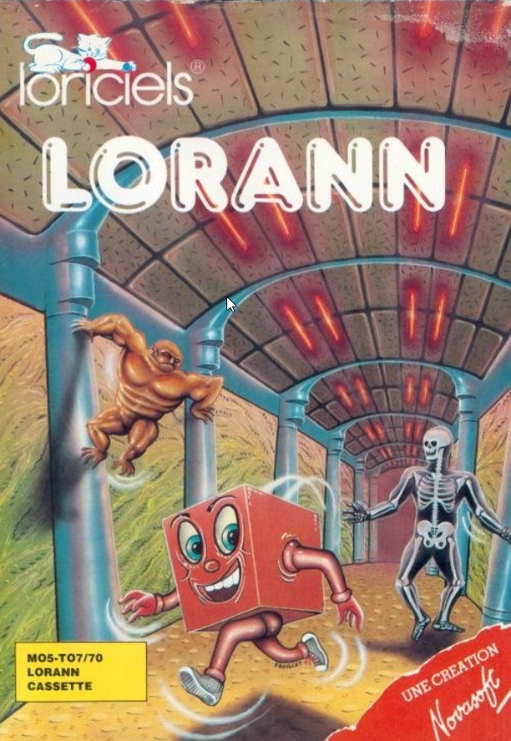
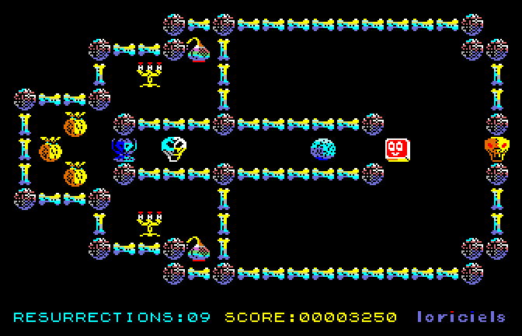
Context of the Project
3
3
SLAOUI Mehdi, HALTER Alexandre, MONNET Dorian , GANGLOFF Thibaut
SLAOUI Mehdi, HALTER Alexandre, MONNET Dorian , GANGLOFF Thibaut
Notes:
We were tasked with recreating the game Lorann develeopped by Loriciels.
Our hero, Lorann, is tasked with liberating the crypts that have fallen under Neckron’s control!
He will have to face 4 demons created by Nekron which will try to prevent him from gathering energy bubles. Fortunatelly he has mastered a spell that will allow him to fend of these monsters!
Those energy bubles will allow to move to the next crypt.
Along the way many treasures await him and are just waiting to be collected!

Slide 4
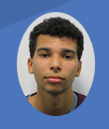
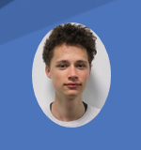
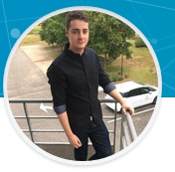
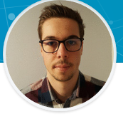
Group presentation
4
4
SLAOUI Mehdi
Project leader
HALTER Alexandre
MONNET Dorian
GANGLOFF Thibaut
SLAOUI Mehdi, HALTER Alexandre, MONNET Dorian , GANGLOFF Thibaut
SLAOUI Mehdi, HALTER Alexandre, MONNET Dorian , GANGLOFF Thibaut

Slide 5
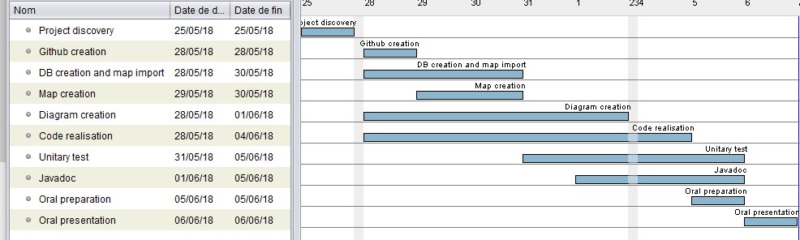
Task repartition
5
SLAOUI Mehdi, HALTER Alexandre, MONNET Dorian , GANGLOFF Thibaut
Notes:
Here we can see the various tasked we worked on during the project’s duration.

Slide 6





Tools used
6
SLAOUI Mehdi, HALTER Alexandre, MONNET Dorian , GANGLOFF Thibaut
Notes:
In order to complete this project we have used a variety of tools like database management, IDEs, and code sharing softwares.

Slide 7
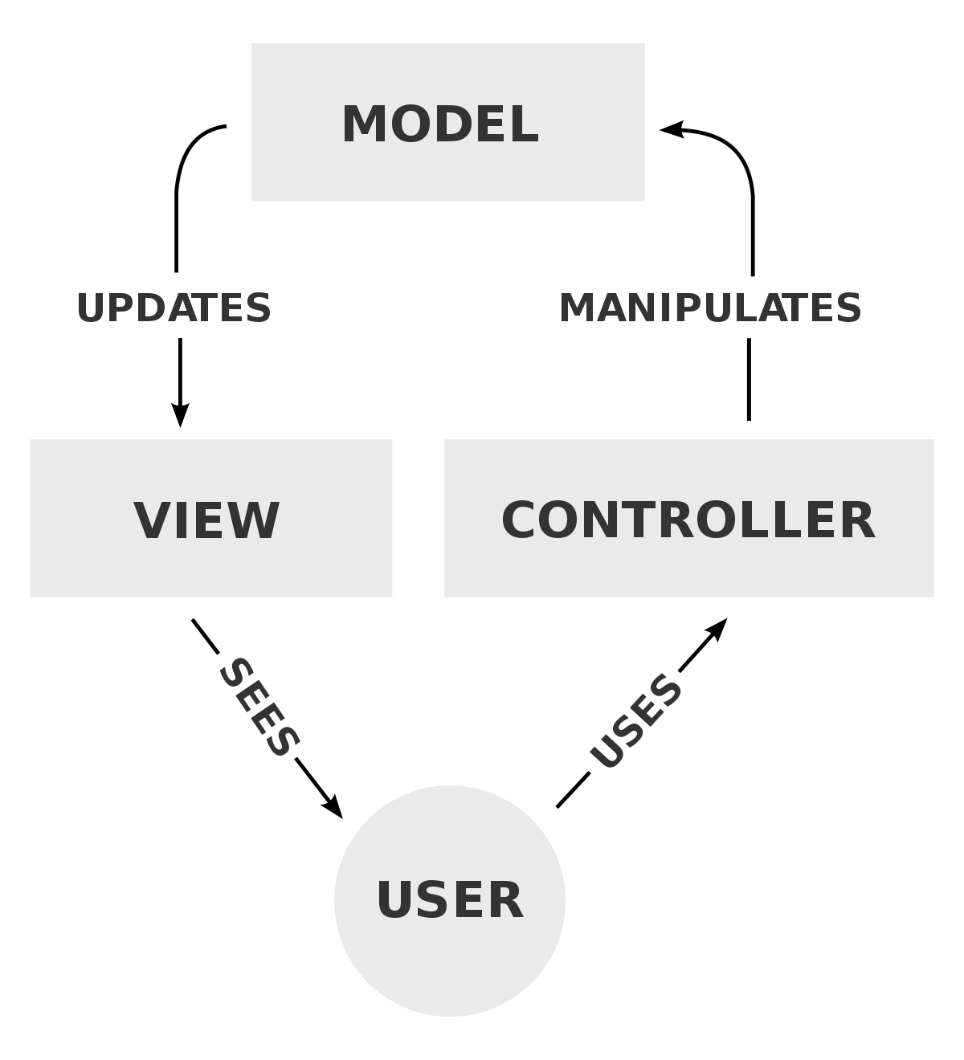
Programming – MVC
Notes:
Here we can see that we have a main actor here : The user.
As you can see the user uses the controller, this controller manipulates the model, the model updates the view and the user sees the view.
We can use a computer using windows as a simple example… As a user you interact with the mouse and keyboard, those can be seen as the controller.
These allow you to manipulate, change and interact with data stored on your computer which can be seen as the model
And finally to view which changes you have made the computer shows you on a screen how you interacted with him, which can be seen as the view

Slide 8
Our game
8
SLAOUI Mehdi, HALTER Alexandre, MONNET Dorian , GANGLOFF Thibaut
Notes:
Since we had to recreate the game we don’t have every of the game that is like the original version:
We still have 4 demons and still have to collect the energy balls to allow us to pass on to the next level.
But in our version of the game instead of having 101 levels we have 5, the only treasure we can find is a purse which contains gold coins and jewels.

Slide 9
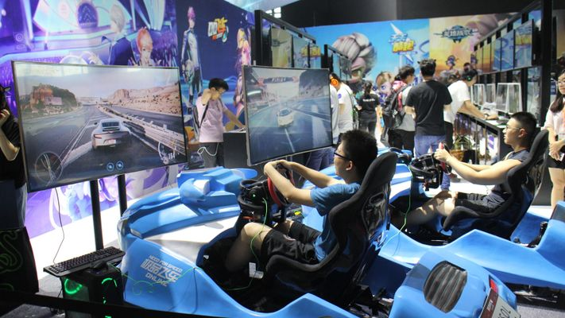
Game demonstration
9
SLAOUI Mehdi, HALTER Alexandre, MONNET Dorian , GANGLOFF Thibaut

