Slide 1



D-CROWLERS
ELEC CLUB & GDG BATNA

Slide 2


plan
01 | Contexte et problématique | 05 | techstack
02 | promesse | 06 | architecture
03 | solution | 07 | ending
04 | demo | 08 | Q&A

Slide 3
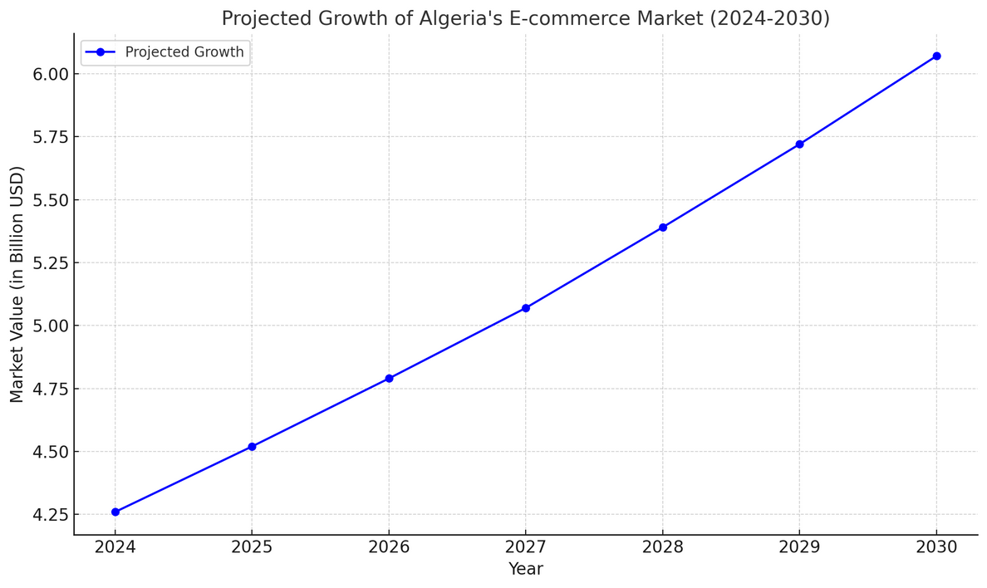
Contexte
2024
why E-COM
$4.26 billion
aftter a case study for the small buisness industry in Algeria we found that the E-com is the largest small buisness factory and the amount of money drope in this factory justify why and also it the most scalable field for the next years

Slide 4

problimatique
Limited technical expertise: Many businesses lack the
skills needed to adopt and utilize advanced technology
effectively
B High costs: Implementing digital and AI solutions often
requires substantial upfront investment, which is
prohibitive for many small enterprises#
c TDaditional Deliance: A cultural preference for manual
processes and in-person transactions creates inertia
against adopting innovative solutions.

Slide 5

HOW CAN wE SOLVE THIS MODERN PROBLEM

Slide 6
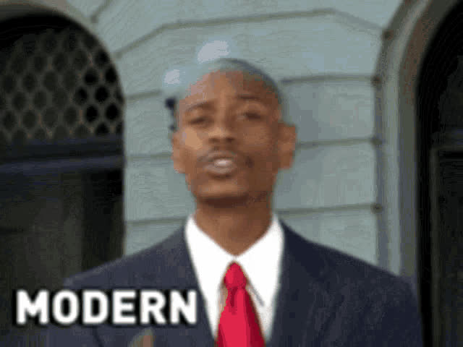
HOW CAN wE SOLVE THIS MODERN PROBLEM

Slide 7
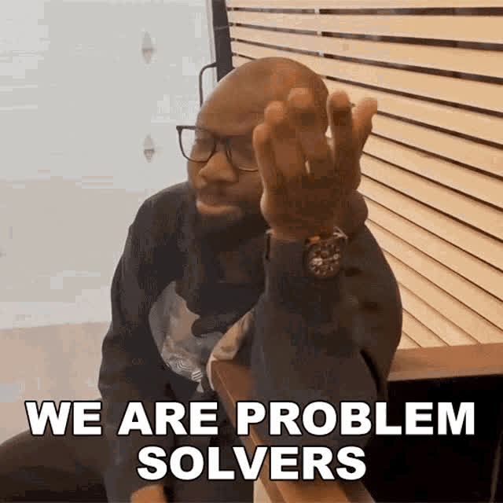

Slide 8
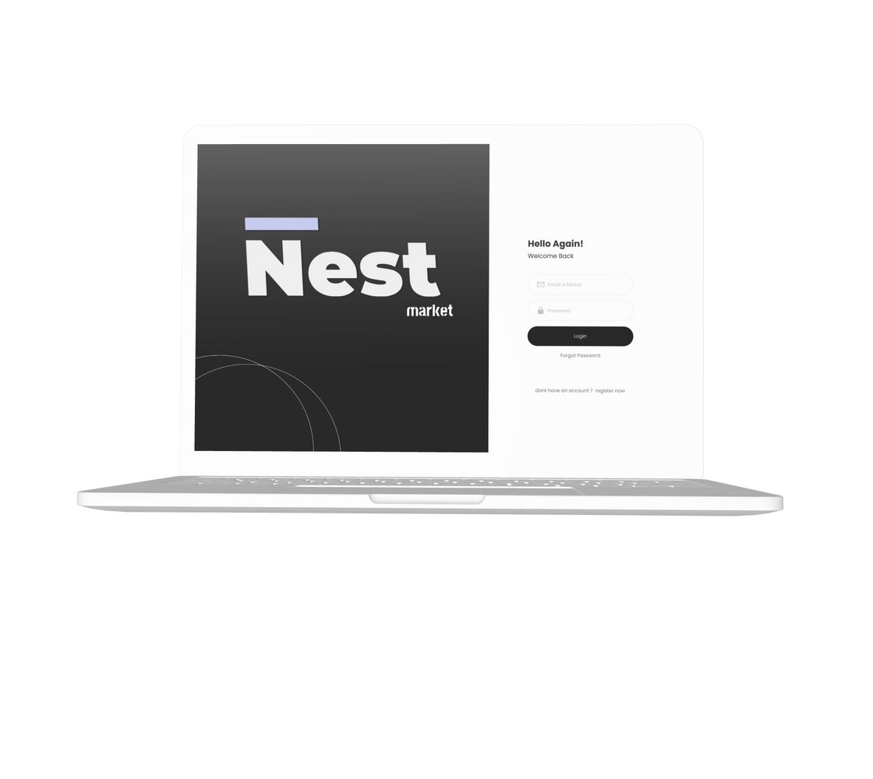
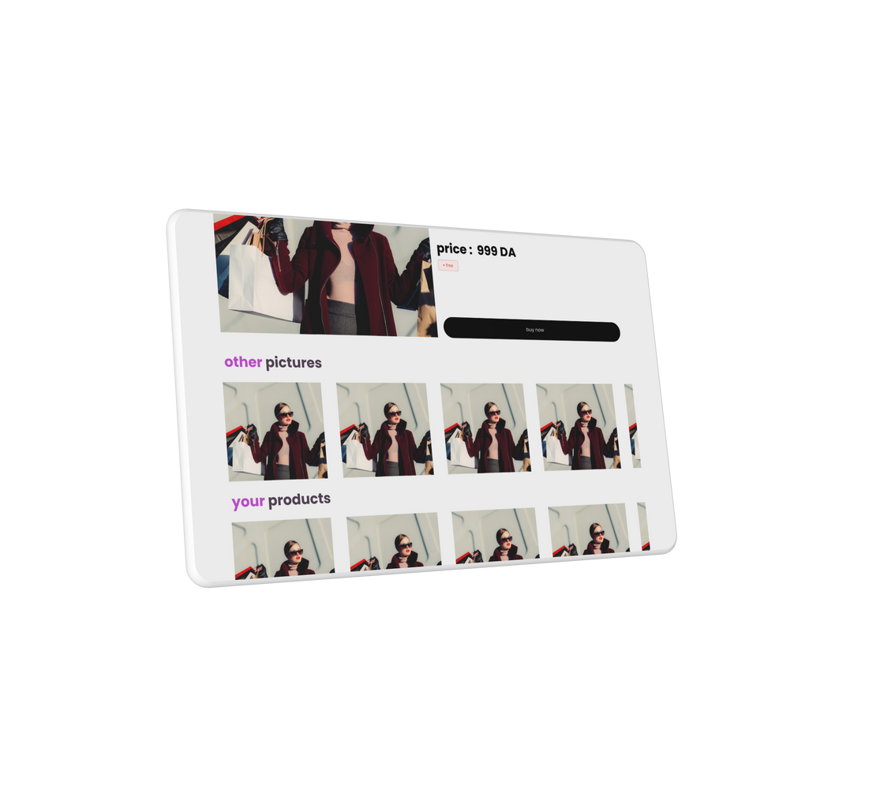
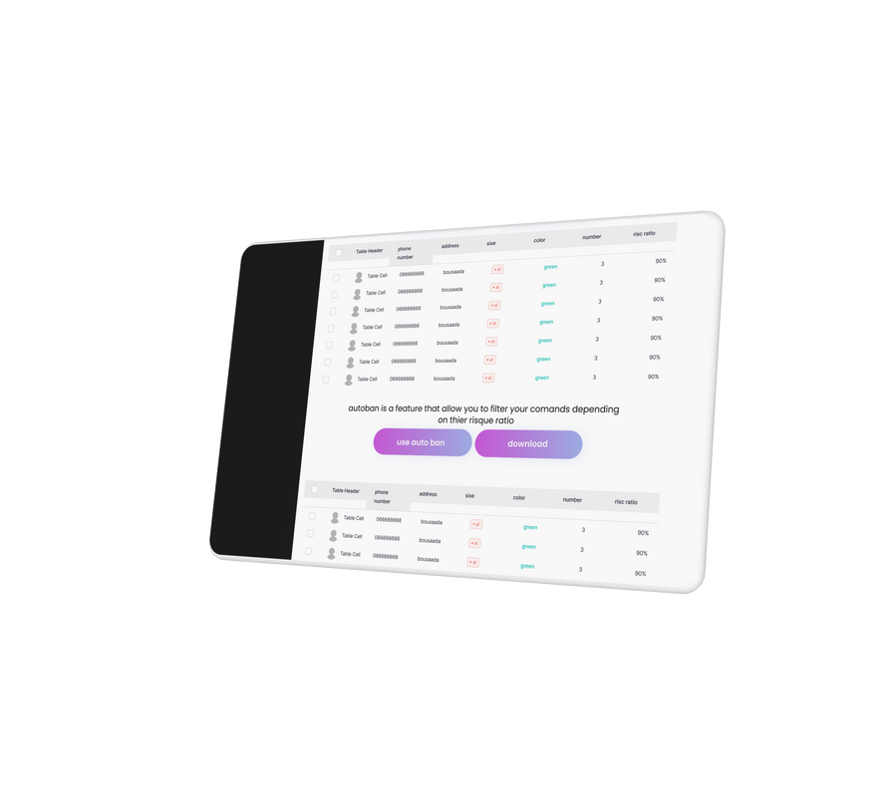



our solution
a webapp for that allows Ecommercers to create a product and landing pages by just adding the medias and discription of the product including price and colors ext
the web app allows the user also to manage his orders in clean and effective layout to eliminate the traditional ways of confirmation and the tracking of the order
and with our BFL filter he can now see the risc and safety ratio of every order and with the autoban filter he can also create a list of oders with the desired safety ratio

Slide 9

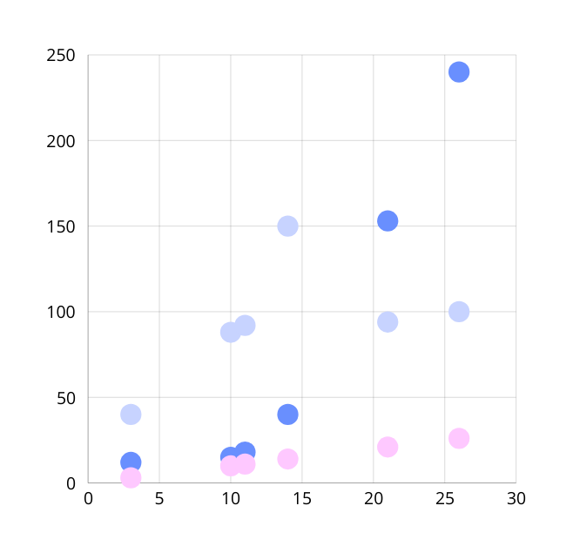

Slide 10

lets get into the demo

Slide 11
















techstack
backend
frontend
ui ux
API’s
visuals
resaerch

Slide 12
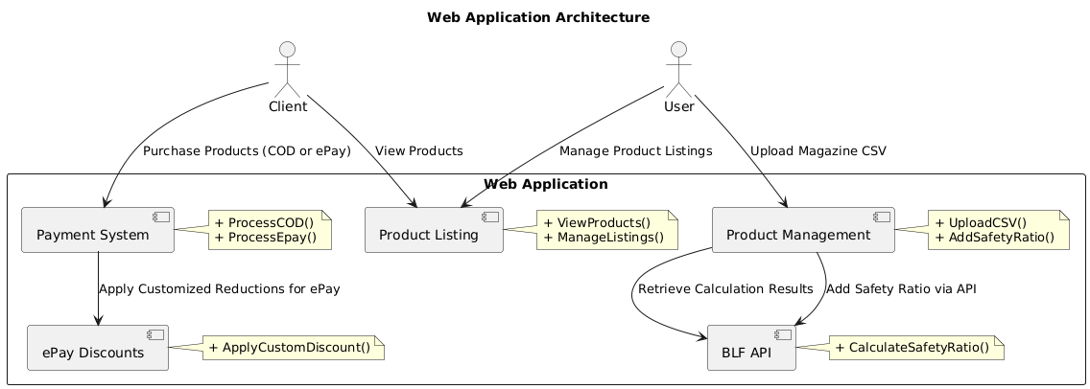
architecture

Slide 13

Conclusion
Limited technical expertise:
COD
TDaditional Deliance
hight cost

Slide 14
D-CROWLERS
thank you !
ELEC CLUB - GDG BATNA

