Slide 1
ORACLE ERP ACCOUNTS PAYABLE MODULE SETUP

Slide 2

ORACLE ERP ACCOUNTS PAYABLE MODULE SETUP

Slide 3


ORACLE ERP ACCOUNTS PAYABLE MODULE SETUP
SPONSORERS

Slide 4

GOLDEN ARCH CONSTRUCTION

Slide 5
Team Members
Mohamed Wafik Mohamed
Abdelrahman Ashraf
Ramy Gamal Abdelkareem
Mahmoud Mohamed Owais

Slide 6
Overview This project focuses on implementing and training on the Oracle ERP Accounts Payable (AP) module within a real business environment. The goal is to give team members practical, hands-on experience in handling payables, processing invoices, managing vendor data, and generating financial reports

Slide 7
About the Company (GAC): Golden Arch Company (GAC) is a growing firm in the construction industry. As the company scales up, it is experiencing difficulties in managing its vendor payments, invoice tracking, and reporting through traditional/manual methods.
Business Need: The company requires a digital transformation in its financial operations to enhance efficiency, accuracy, and transparency. Implementing the Oracle AP module helps streamline processes and train staff to handle transactions digitally and in compliance with accounting standards

Slide 8
Project Objectives
Main Goals
To implement the Accounts Payable module of Oracle EBS for GAC.
To simulate business processes that include invoice entry, payment processing, and reporting.
To ensure participants gain real-world skills in handling ERP systems.
To create a working AP system model that can be adopted by small to mid-sized enterprises like GAC.
Learning Outcomes:
How to enter and validate supplier invoices.
How to process different types of payments (manual, electronic).
How to manage supplier records and terms.
How to generate payable reports and perform reconciliations

Slide 9
Project Timeline & Budget
Duration: The project was executed over a 1 mounth period including planning, setup, testing, training, and documentation.
Estimated Budget:
Oracle EBS training instance: Free (Sponsor license).
Zoom/Teams for training sessions: Free tools.
No hardware or external consultancy cost.
Thus, the project was implemented with zero financial cost, relying on internal effort and free resources

Slide 10
Member | Responsibilities
Abdelrahman Ashraf | Led system configuration and vendor data setup
Ramy Gamal | Entered sample invoices and processed payments
Mahmoud Owais | Created reports and performed data analysis in Excel
Mohamed Wafik | Documented the whole project and prepared the final presentation

Slide 11
Lack of prior hands-on experience with Oracle ERP.
Difficulty setting up a realistic business environment.
Understanding the full workflow of vendor transactions.
How We Overcame Them
Used online tutorials and Oracle documentation for system navigation.
Designed simple but realistic data for practice.
Worked as a team to simulate approvals, payments, and vendor interactions.
Constant testing and learning from errors

Slide 12
Oracle AP Module – Implementation Process at GAC
This section describes the step-by-step approach our team followed to implement the Oracle Accounts Payable module in the training environment for Golden Arch Company (GAC). The steps were designed to mirror a real-world ERP implementation life cycle

Slide 13
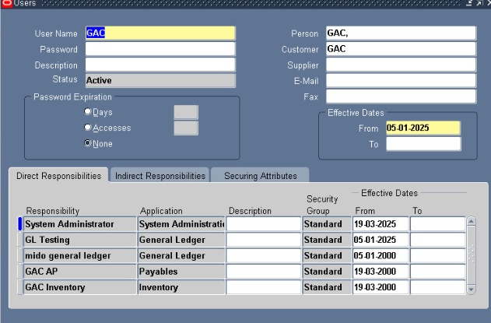
Creating Users in Oracle EBS Training Environment
The first technical step in our implementation was creating system users who would interact with the Accounts Payable module. This process is essential for assigning responsibilities, controlling access, and enabling secure data entry within the Oracle EBS system
Navigated to: System Administrator → Security → User → Define
Created a new user for each team member.
Assigned unique usernames and temporary passwords.
Set effective dates for account activation.
Attached relevant responsibilities:
System administrator
General Ledger
Account Payable
Inventory

Slide 14
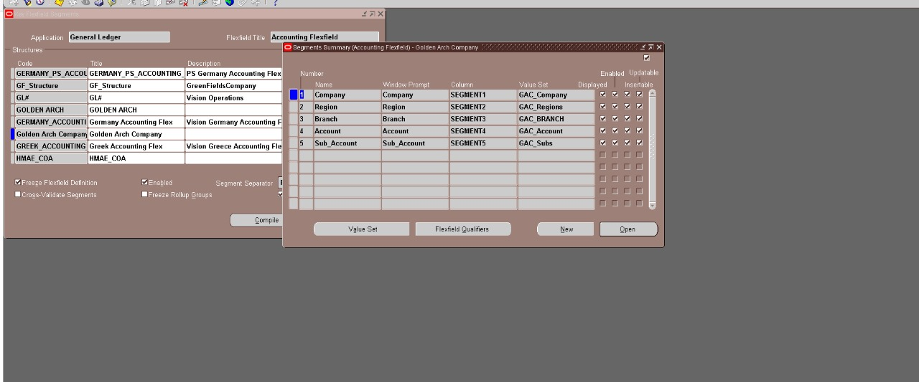
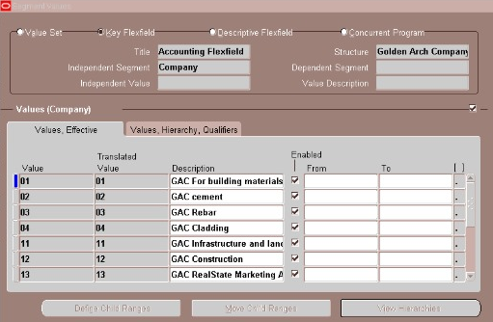
Defining the 5 Cs Required for Oracle Accounts Payable Module
Chart of Accounts – The structure that defines how financial data is categorized.
Calendar – The fiscal calendar used for recording accounting entries.
Currency – The base and transaction currencies used in financial operations.
Convention (Accounting Convention) – Determines how periods and depreciation are handled (mainly in fixed assets but still tied to GL).
COA Structure/Set of Books / Ledger – Defines the accounting structure including the Chart of Accounts, Calendar, and Currency setup for financial reporting

Slide 15
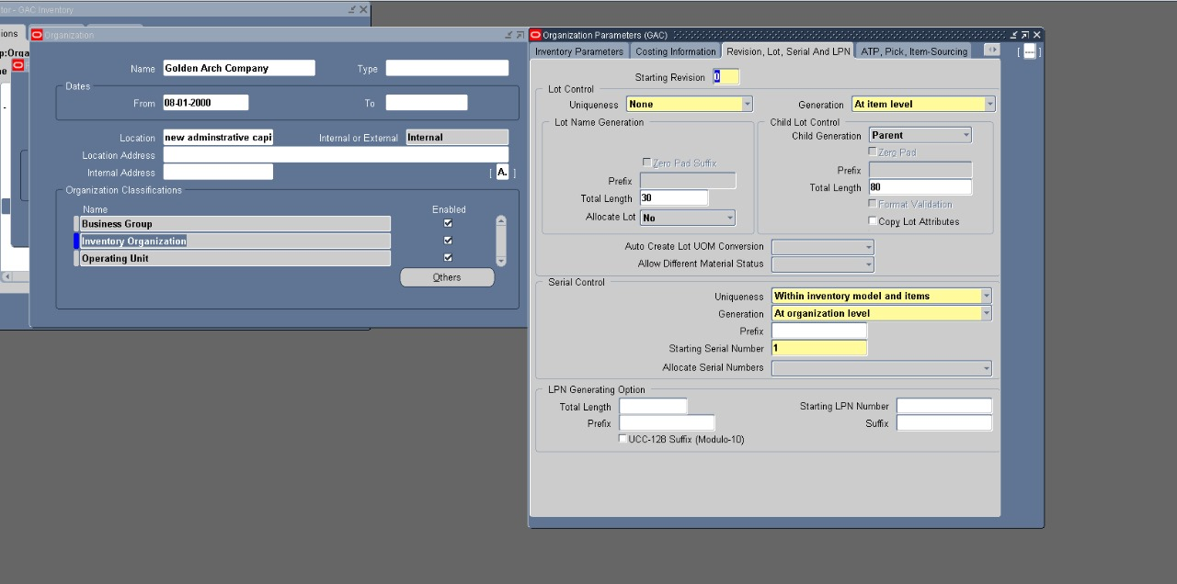
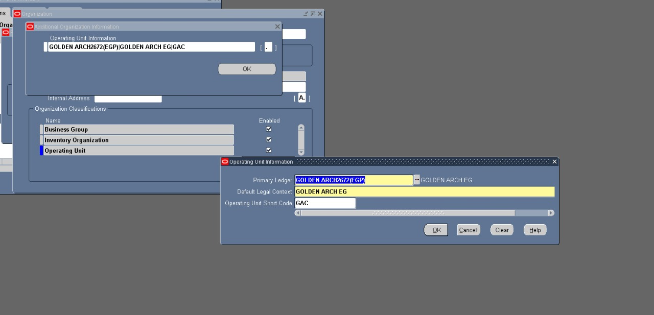
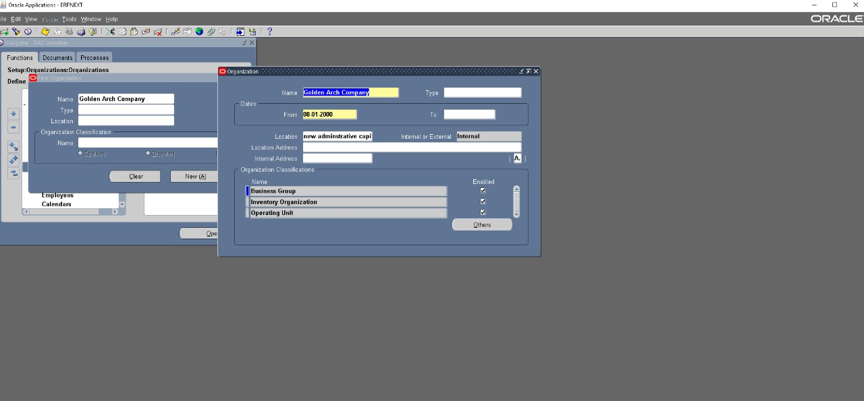
Configuring Payables Organization Parameters in Oracle ERP
After defining the 5 Cs, the next step was to configure the AP Organization Parameters. These parameters are specific to the operating unit (OU) and determine how the Payables module functions in relation to other financial modules

Slide 16
Configuring Payables Organization Parameters in Oracle ERP
After defining the 5 Cs, the next step was to configure the AP Organization Parameters. These parameters are specific to the operating unit (OU) and determine how the Payables module functions in relation to other financial modules

Slide 17
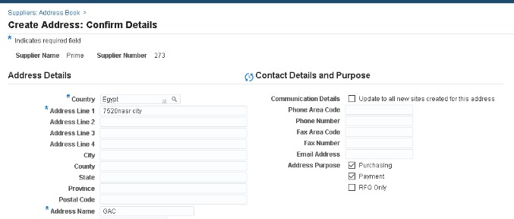
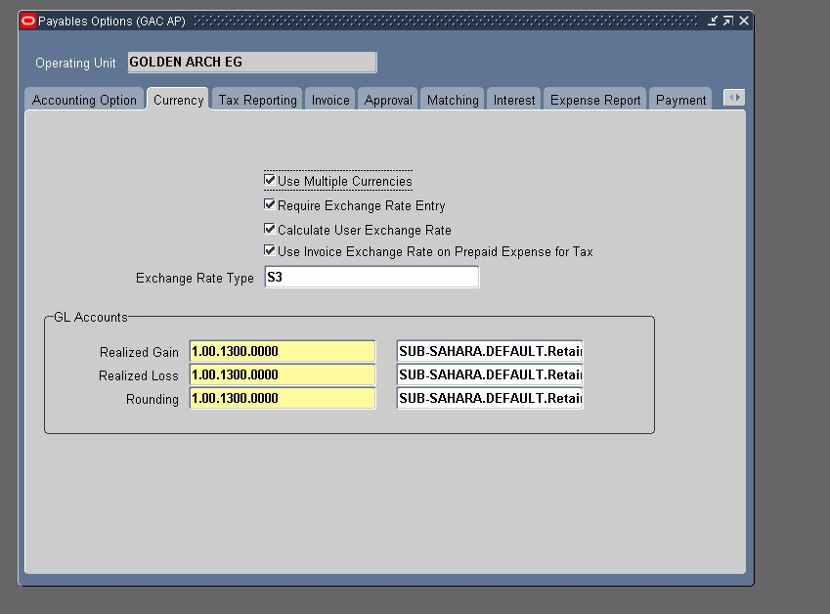
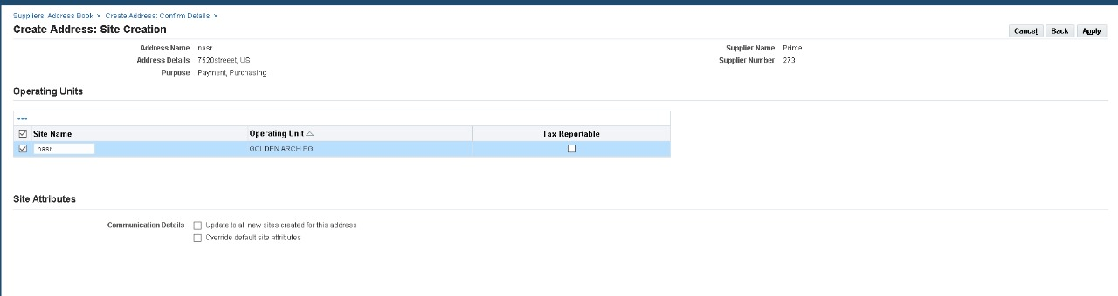
Invoice Setup and Supplier Master Data Configuration
This step covers two essential configurations before starting transactional work in Oracle Payables: setting invoice behavior and creating supplier master records. These setups are required to ensure that invoices are entered correctly and matched to valid supplier data
Purpose: To define how Oracle handles invoice validation, numbering, approvals, and tax handling.
Navigation Path: Payables Manager → Setup → Options → Payables Options Payables Manager → Suppliers → Entry → Suppliers

Slide 18
Invoice Setup and Supplier Master Data Configuration
This step covers two essential configurations before starting transactional work in Oracle Payables: setting invoice behavior and creating supplier master records. These setups are required to ensure that invoices are entered correctly and matched to valid supplier data
Purpose: To define how Oracle handles invoice validation, numbering, approvals, and tax handling.
Navigation Path: Payables Manager → Setup → Options → Payables Options Payables Manager → Suppliers → Entry → Suppliers

Slide 19
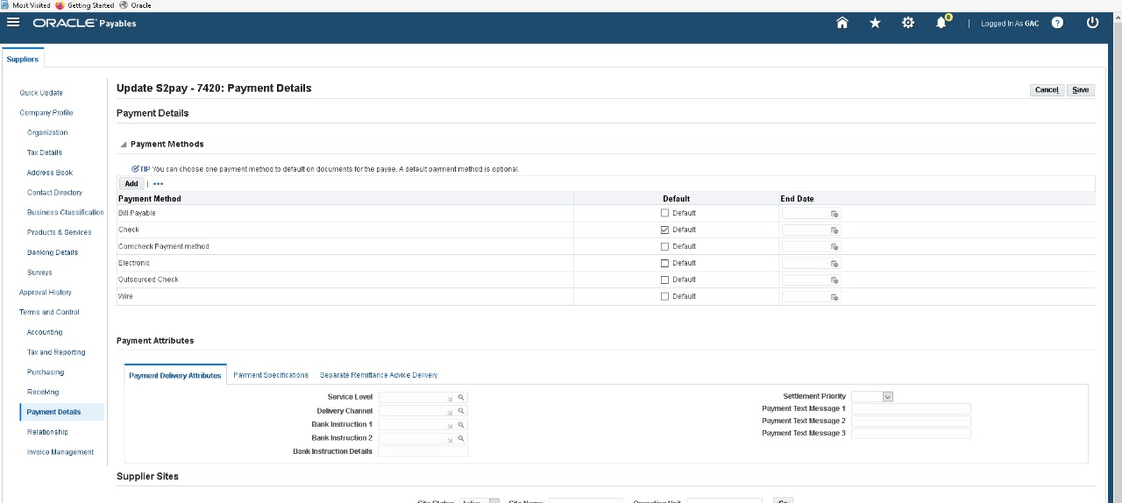
Invoice Setup and Supplier Master Data Configuration
This step covers two essential configurations before starting transactional work in Oracle Payables: setting invoice behavior and creating supplier master records. These setups are required to ensure that invoices are entered correctly and matched to valid supplier data

Slide 20
Invoice Setup and Supplier Master Data Configuration
This step covers two essential configurations before starting transactional work in Oracle Payables: setting invoice behavior and creating supplier master records. These setups are required to ensure that invoices are entered correctly and matched to valid supplier data
Purpose: To define how Oracle handles invoice validation, numbering, approvals, and tax handling.
Navigation Path: Payables Manager → Setup → Options → Payables Options Payables Manager → Suppliers → Entry → Suppliers

Slide 21
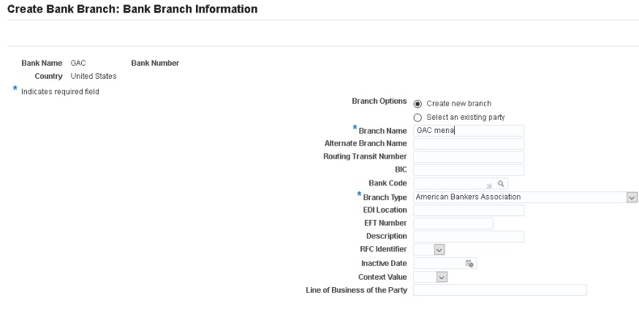
Bank and Payment Method Setup for AP Transactions
Before recording supplier invoices and payments, we configured the banking infrastructure within Oracle EBS. This step ensures smooth and secure processing of supplier payments through different methods
STEP 1
Create Banks & Branches
Navigation Cash Management → Setup → Banks → Banks
Purpose of this Step
To define bank accounts used by the company for paying suppliers.
To configure valid payment methods (e.g., Check, Wire).
To prepare for assigning bank info to suppliers during site creation.

Slide 22
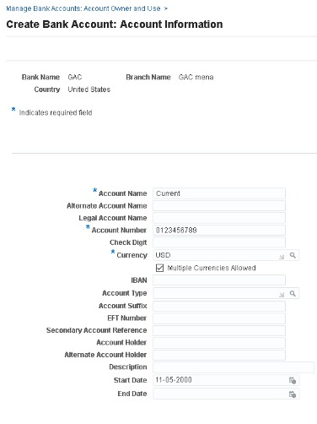
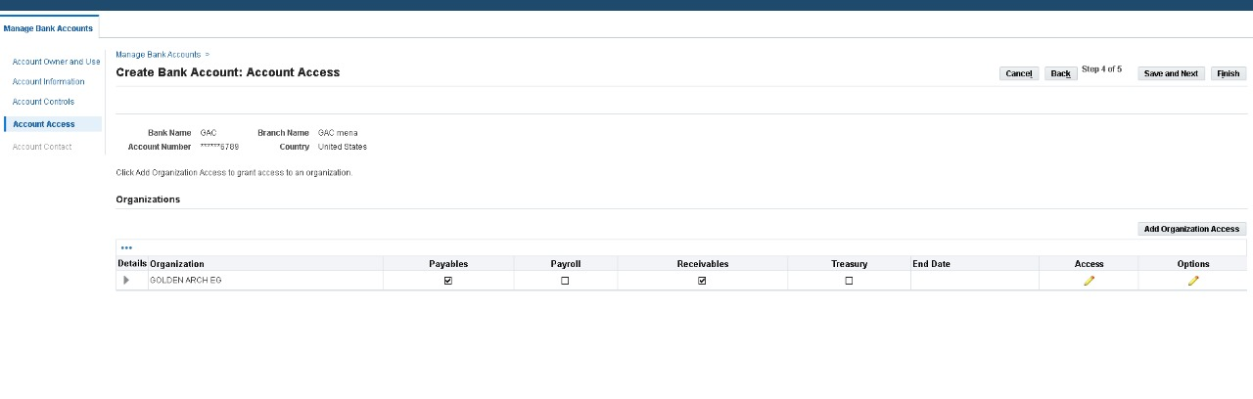
Bank and Payment Method Setup for AP Transactions
Before recording supplier invoices and payments, we configured the banking infrastructure within Oracle EBS. This step ensures smooth and secure processing of supplier payments through different methods
STEP 2
Define Bank Accounts
Navigation Payables Manager → Setup → Payment → Bank Accounts
Purpose of this Step
To define bank accounts used by the company for paying suppliers.
To configure valid payment methods (e.g., Check, Wire).
To prepare for assigning bank info to suppliers during site creation.

Slide 23
Bank and Payment Method Setup for AP Transactions
Before recording supplier invoices and payments, we configured the banking infrastructure within Oracle EBS. This step ensures smooth and secure processing of supplier payments through different methods
STEP 2
Define Bank Accounts
Navigation Payables Manager → Setup → Payment → Bank Accounts

Slide 24
Creating and Processing Invoices in Oracle AP Module
After completing all setup steps (users, banks, suppliers, payment terms, and organization parameters), we proceeded to the final and most critical operational task in the Payables module: entering supplier invoices.
This process represents the core transactional activity in AP and links all the previous configurations together

Slide 25
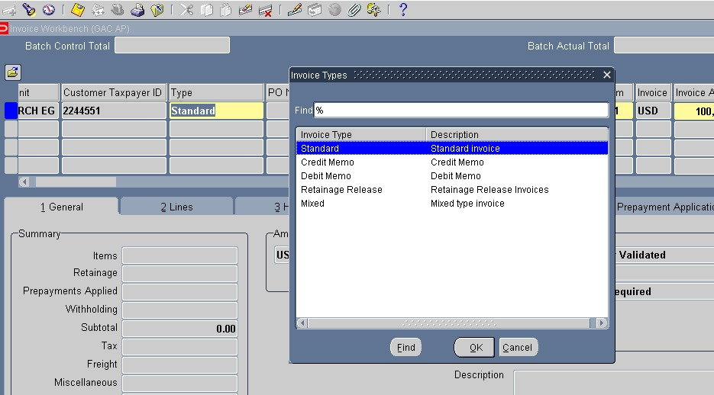
Creating and Processing Invoices in Oracle AP Module
After completing all setup steps (users, banks, suppliers, payment terms, and organization parameters), we proceeded to the final and most critical operational task in the Payables module: entering supplier invoices.
This process represents the core transactional activity in AP and links all the previous configurations together

Slide 26
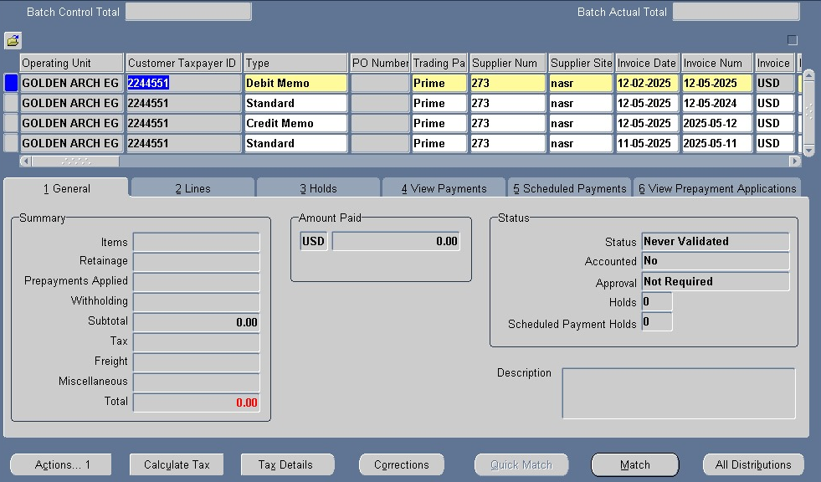
Creating and Processing DEBIT , CREDIT MEMO AND STANDARD Invoices in Oracle AP Module

Slide 27
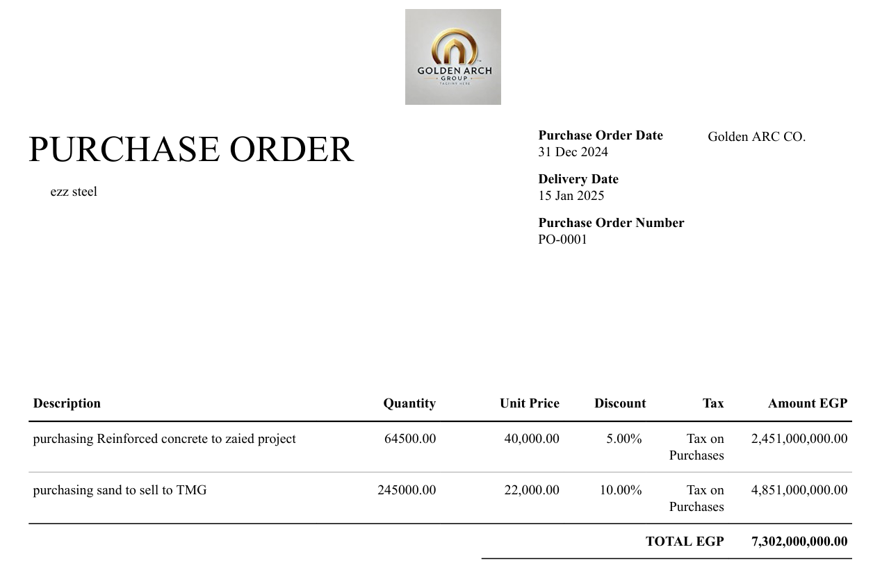
Purchase Order

Slide 28
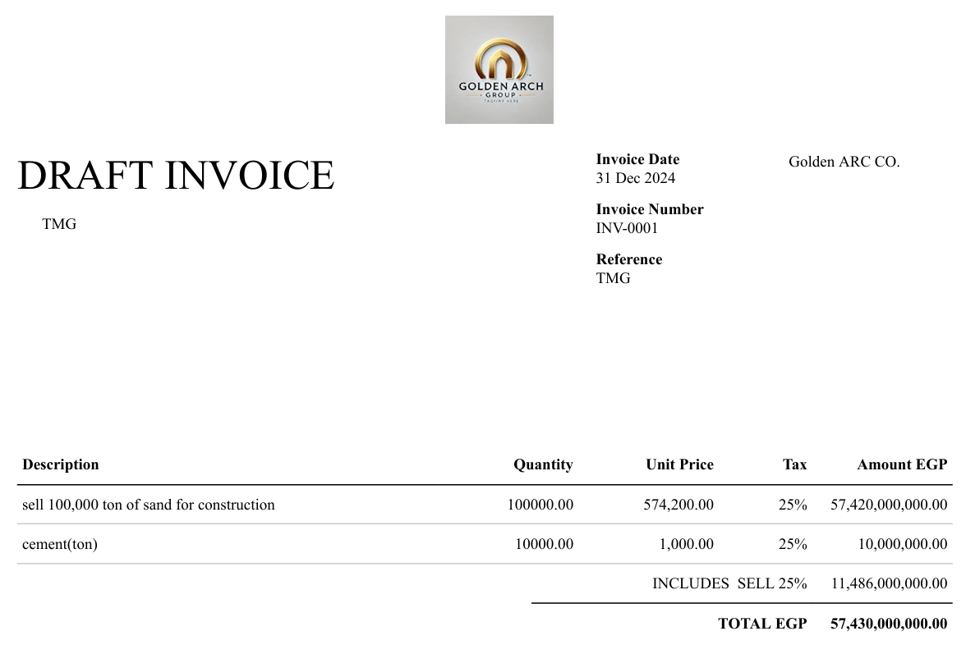
FINALY THE INVOICE

Slide 29
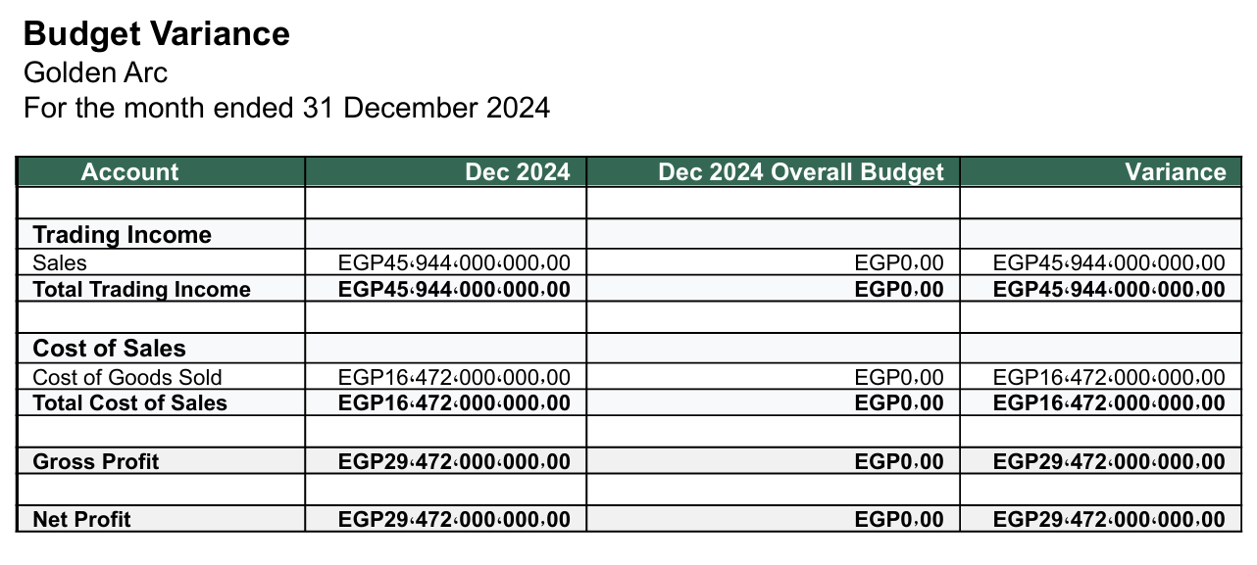
Our budget variance

Slide 30
Final Reflections and Key Takeaways
After completing this end-to-end implementation of the Oracle ERP Accounts Payable Module for Golden Arch Company (GAC), our team successfully demonstrated the full cycle of automating and managing supplier payments in a structured ERP environment.
This project provided us with practical, hands-on experience that mirrors real-world financial operations, from system setup to transaction execution

Slide 31
Final Reflections and Key Takeaways
What We Achieved
Built a fully functional AP process inside Oracle EBS
Configured financial structure (5 Cs, banks, calendar, terms)
Created and managed supplier records with payment details
Entered and validated real invoice transactions
Simulated a complete business flow used in modern organizations
What We Learned
How ERP systems integrate accounting, suppliers, and banks
The importance of each configuration step in the transaction lifecycle
How to troubleshoot validation issues and system behavior
Collaboration and task delegation in ERP projects

Slide 32
THANKS

