Slide 1
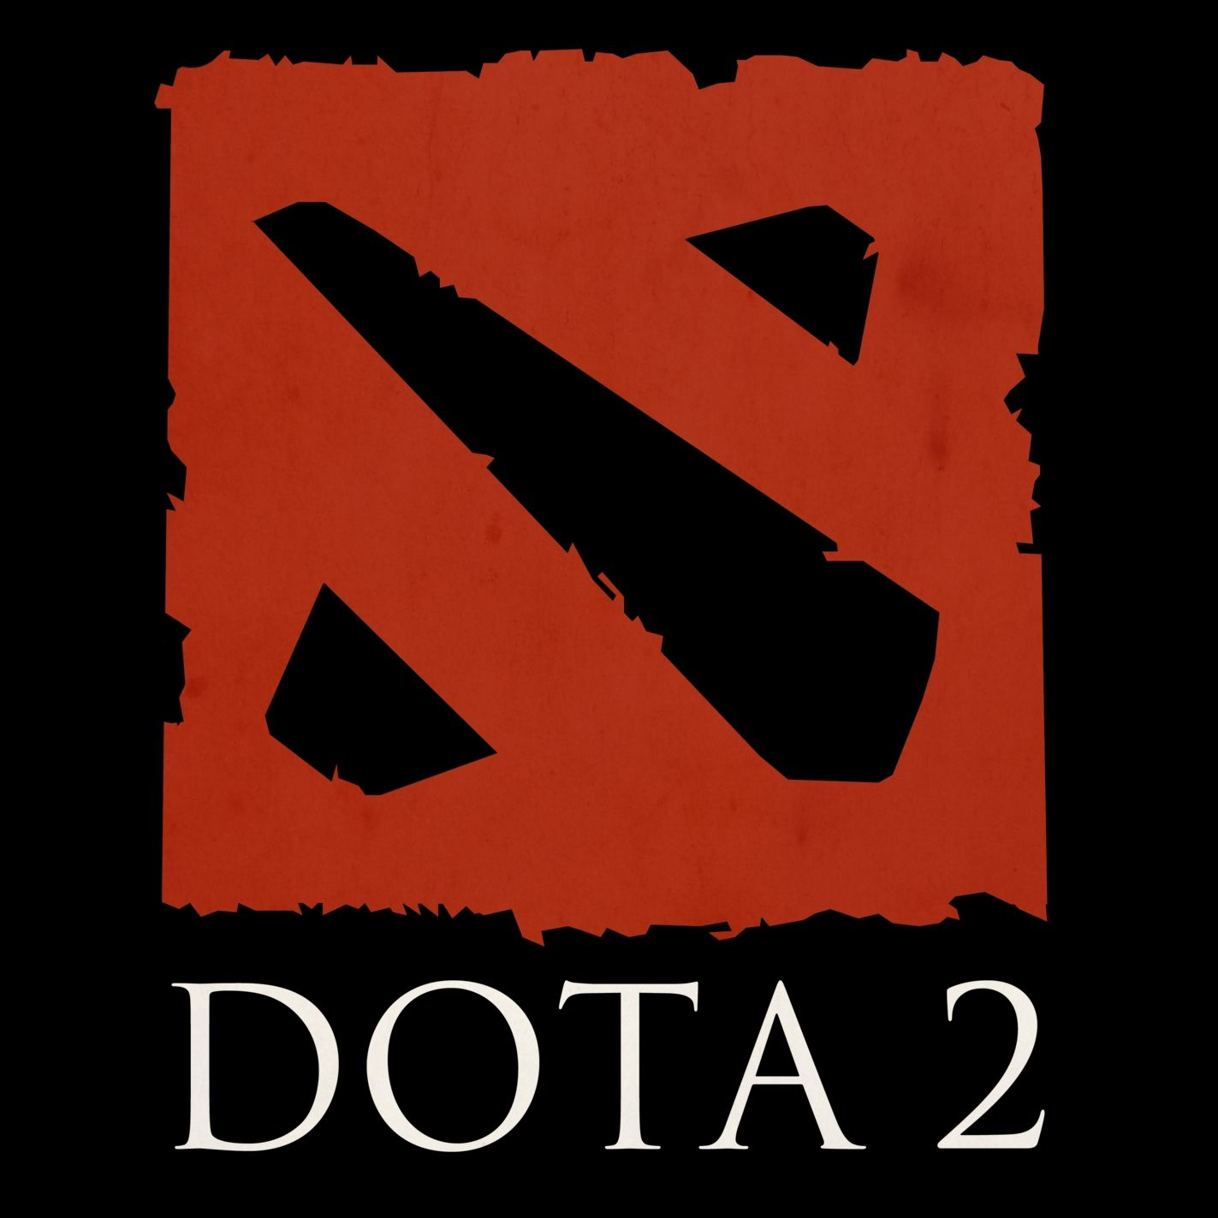
Deep leaning applied to drafting heroes in Dota 2

Slide 2
What is Dota 2?
MOBA (Multiplayer Online Battle Arena)
Similar to: League of Legends, Smite, Heroes of the Storm

Slide 3
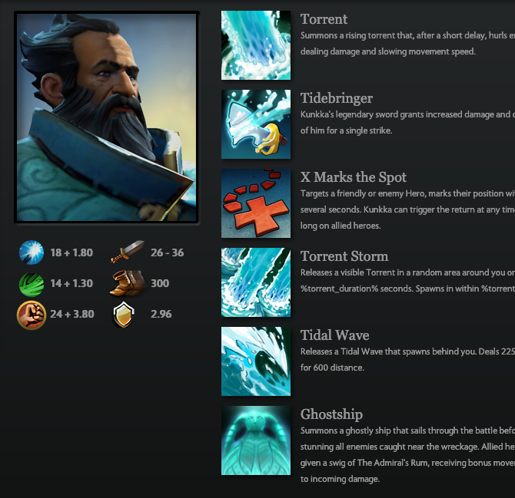
Gameplay
2 teams of 5
Pick a unique hero each
Hero has abilities
Heroes can counter each other
Gather resources
Attack and destroy enemy buildings
Defend your own buildings from the enemy

Slide 7
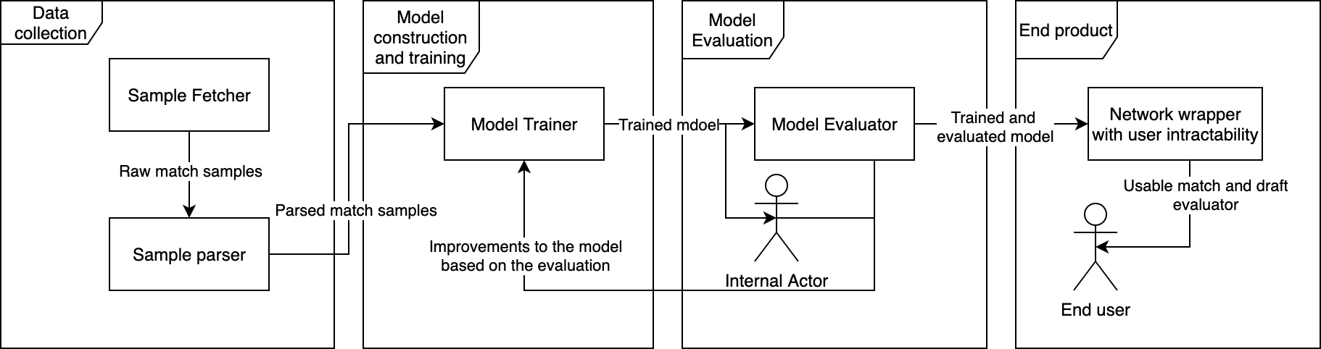

Slide 8
{
"avg_mmr": 4093,
"avg_rank_tier": 47,
"cluster": 185,
"dire_team": "44,81,11,1,31",
"duration": 610,
"game_mode": 22,
"lobby_type": 0,
"match_id": 5743319617,
"match_seq_num": 4833249638,
"num_mmr": 1,
"num_rank_tier": 2,
"radiant_team": "37,56,106,50,34",
"radiant_win": false,
"start_time": 1608036708
}

Slide 9
{
"avg_mmr": 4093,
"avg_rank_tier": 47,
"cluster": 185,
"dire_team": "44,81,11,1,31",
"duration": 610,
"game_mode": 22,
"lobby_type": 0,
"match_id": 5743319617,
"match_seq_num": 4833249638,
"num_mmr": 1,
"num_rank_tier": 2,
"radiant_team": "37,56,106,50,34",
"radiant_win": false,
"start_time": 1608036708
}

Slide 10
{
"avg_rank_tier": 47,
"dire_team": "44,81,11,1,31",
"duration": 610,
"radiant_team": "37,56,106,50,34",
"radiant_win": false,
}

Slide 11
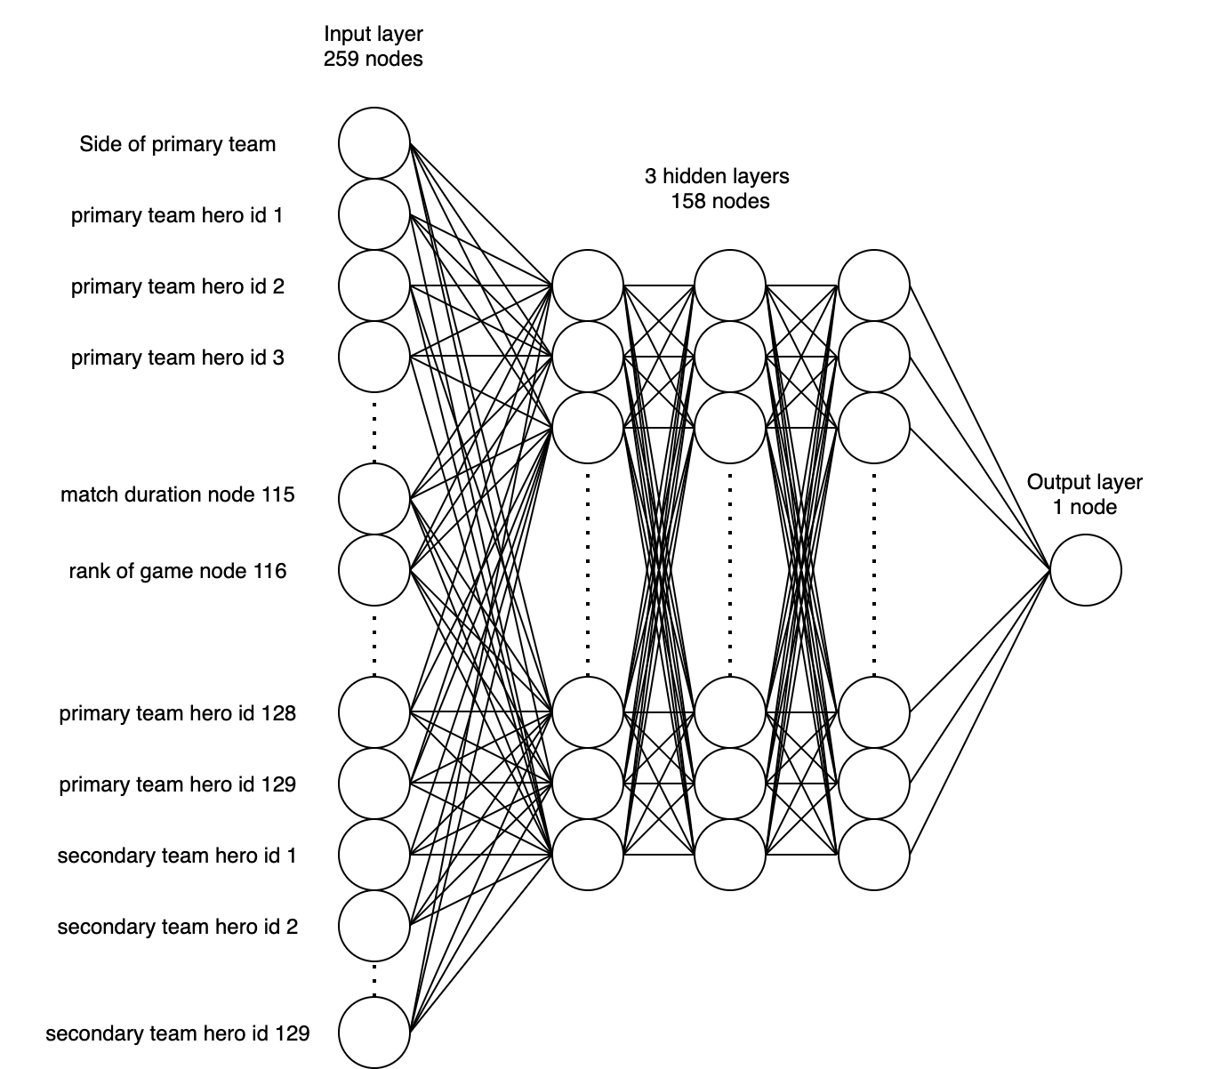

Slide 12
The output node
Values close to 1 are wins
Values close to 0 are losses
Accuracy: percentage of matches that are labelled correct after rounding to nearest number.

Slide 13
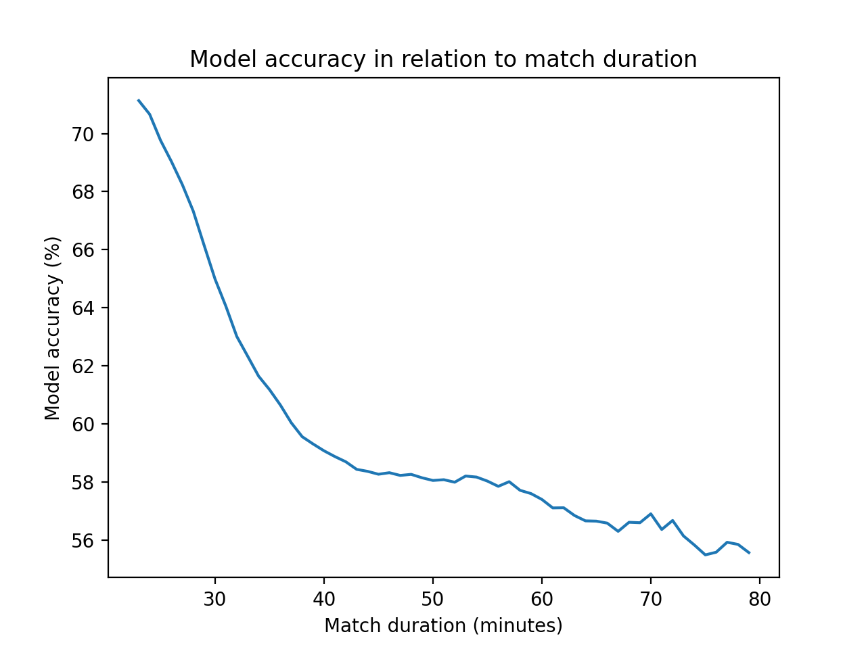
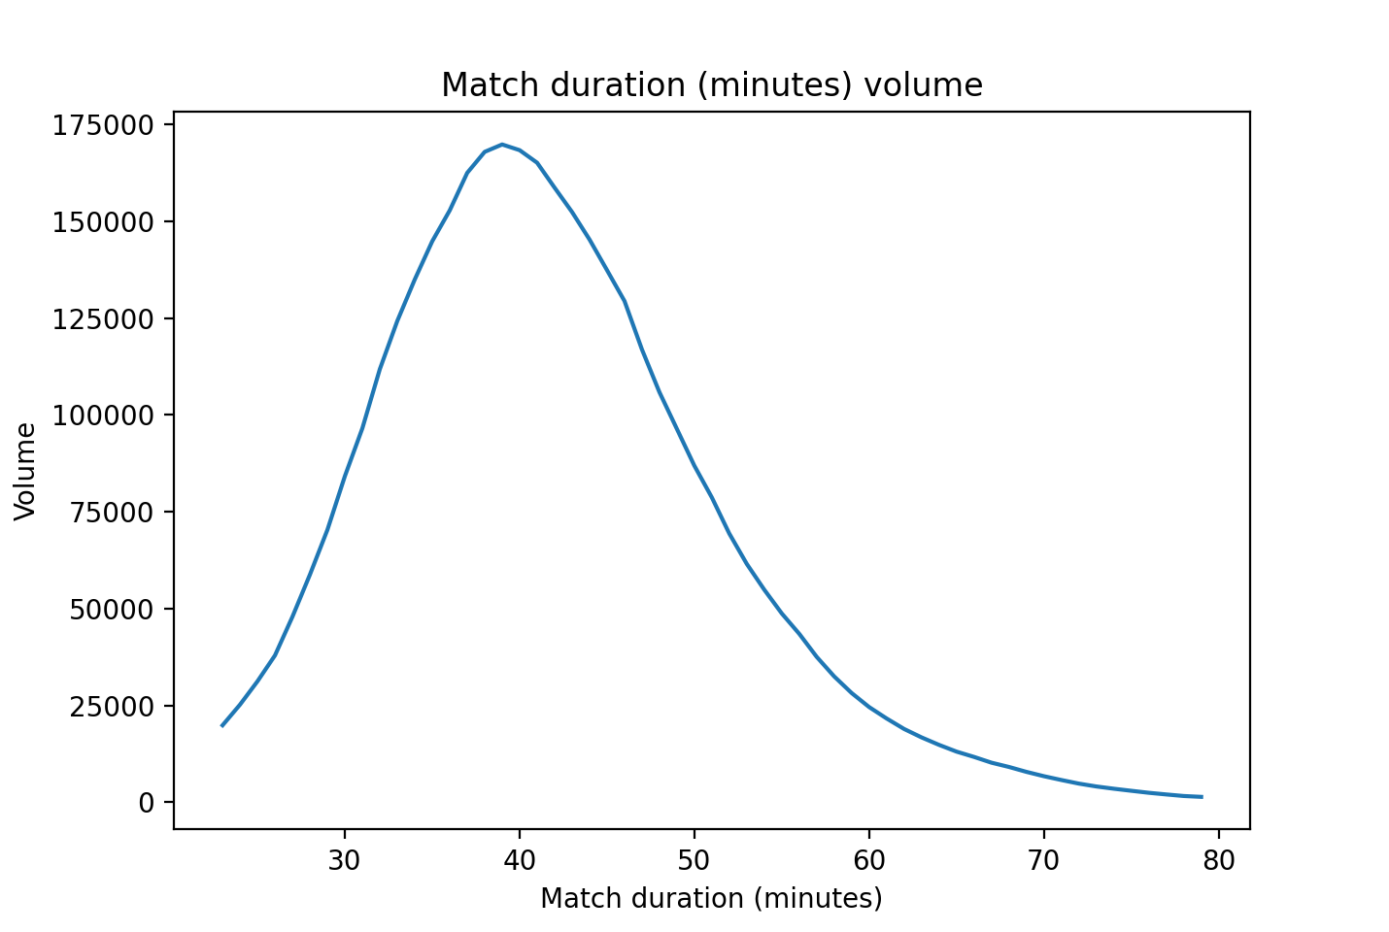

Slide 14
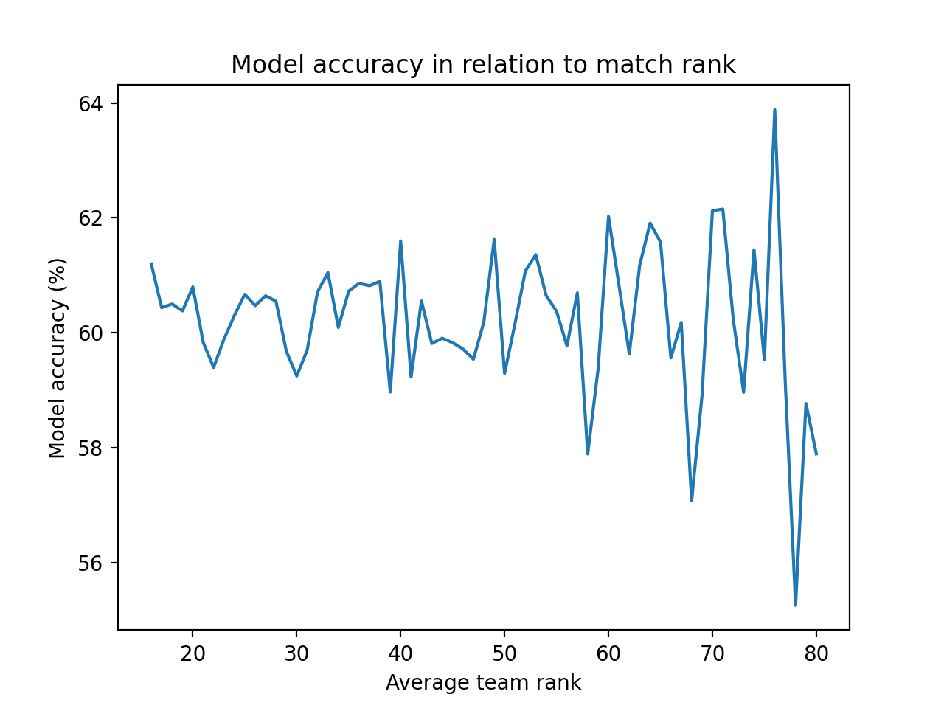

Slide 15
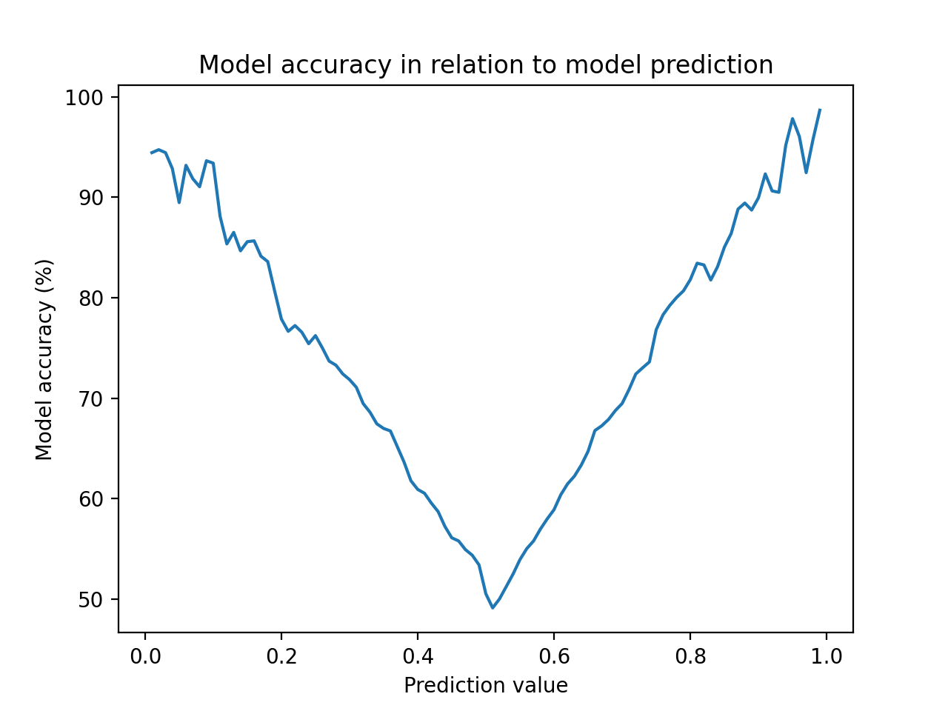
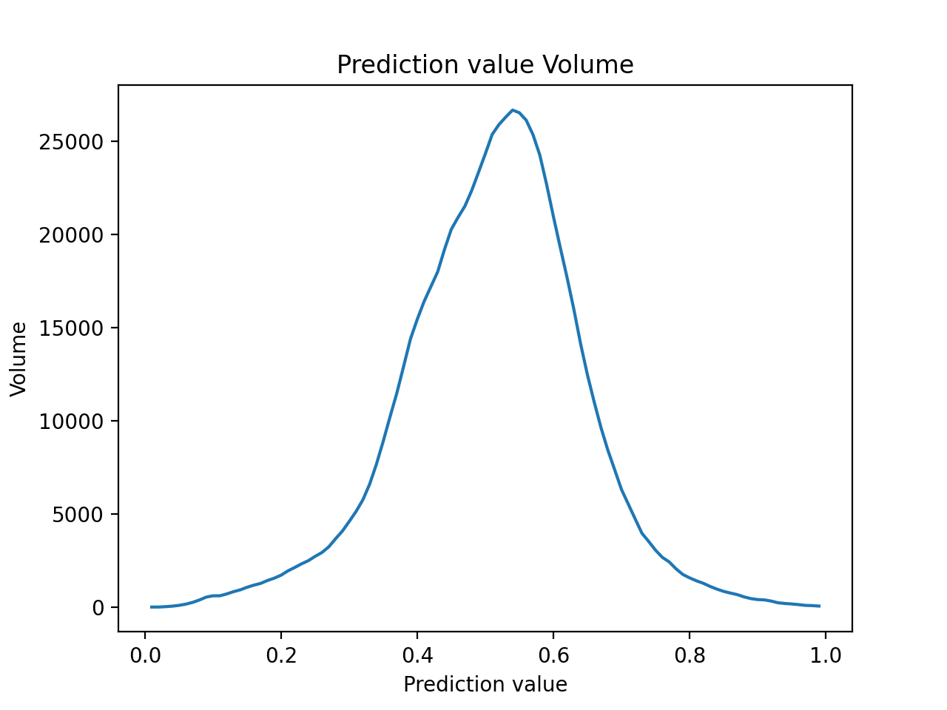

Slide 16
Results
62% of games were labelled correctly
Game was designed to be fair
Gameplay is also an deciding factor

