Slide 1
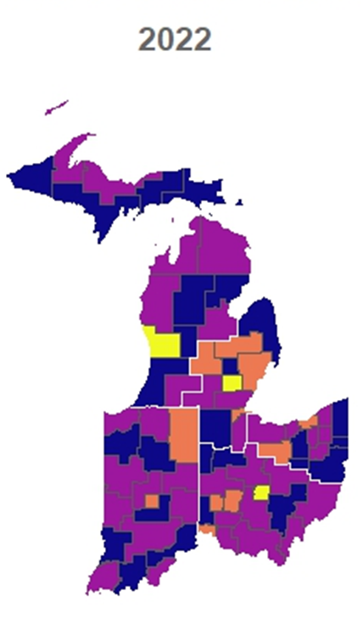
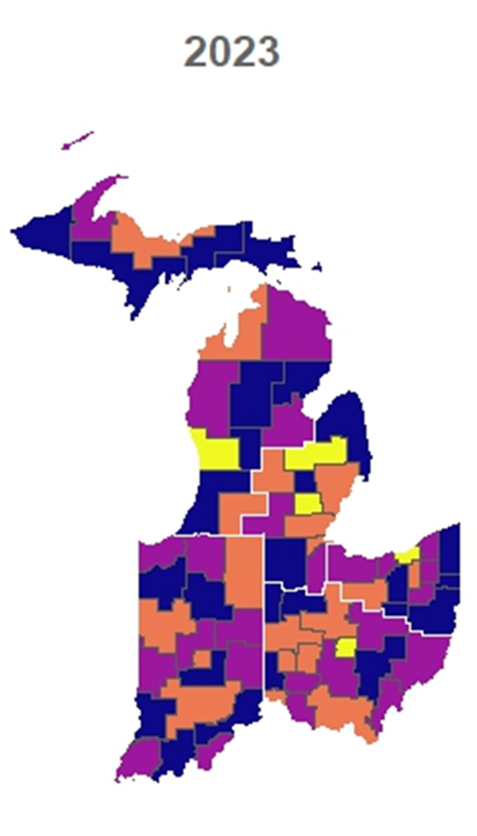
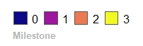
RIDVAN 2023 GOAL CLUSTERS
Sub-Region | Cluster | Cluster Name | 2023
Indiana | IN-04 | W Lafayette | M1 to M2
Indiana | IN-05 | Hollow Reed (Bloomington) | M1 to M2
Michigan E | MI-08 | Davison-Flint | M2 to M3
Michigan E | MI-15 | Adrian/Monroe | M1 to M2
Michigan N/W | MI-13 | Kalamazoo Area | M1 to M2
Michigan N/W | MIUP-04 | Marquette | M1 to M2
Ohio N | OH-01 | Emerald (Cuyahoga-Cleveland) | M2 to M3
Ohio N | OH-07 | Summit Co (Akron) | M1 to M2
Ohio S | OH-27 | Wyandot | M1 to M2
Ohio S | OH-29 | Darke | M1 to M2
Ohio S | OH-35 | Appalachia III | M1 to M2

