Slide 1
Injury Prevention in Restaurants and Kitchens
Updated: November, 2019

Slide 2
This overview will
Identify the most common injuries in restaurants and kitchens
Identify the hazards most likely to cause injuries
Provide ideas for reducing the hazards and preventing injuries
Discuss a special population of worker – Teens
Provide additional resources so that you can obtain more information

Slide 3
Restaurants in Washington
11,000 Restaurants are listed with L&I
1000 more with the Department of Revenue
36% are considered Quick-service restaurants
The major occupations in restaurants are:
Cooks, kitchen workers, other food prep workers
Waiters, waitresses, and their assistants
Managers, supervisors, owners
Other occupations are
Food counter and fountain workers
Janitors and cleaners
Drivers, cashiers, and bartenders

Slide 4
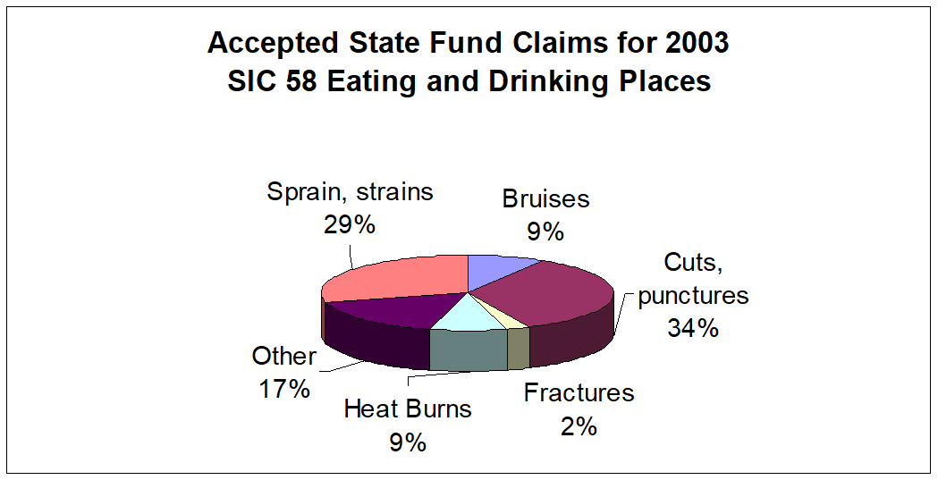
Injuries in Eating and Drinking Places (2003)
This overview will focus on prevention of:
Strains, Sprains, Bruises, and Fractures
Cuts, Lacerations, and Punctures
Burns and Scalds

Slide 5
Strains, Sprains, Bruises, and Fractures
Result primarily from:
Slips, trips, and loss of balance
Falls to floors, walkways, and other surfaces
Overexertion in lifting
Bending
Climbing
Crawling
Reaching
Twisting

Slide 6

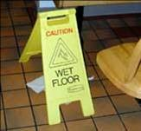
Preventing Slips, Trips, and Falls
Slippery surfaces are a major cause of accidents in restaurants and kitchens. To reduce the risk of this type of accident:
Use non-slip footwear
Keep floors free from water or grease
Clean floors regularly
Clean up spills immediately
Put up warning signs around spills or wet floors
Consider installing non-slip tiling or other non-slip floor products
Use rubber mats in areas where the floors are constantly wet
Use slip-resistant waxes on floors

Slide 7
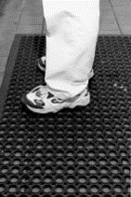
Preventing Slips, Trips, and Falls (Cont’d)
Keep floors and stairs free of debris and obstructions
Make sure mats and carpet are free of holes and bumps
Report poor lighting and replace burned out bulbs as soon as possible
Do not leave oven, dishwasher, or cupboard doors open
Report or fix hazards immediately

Slide 8
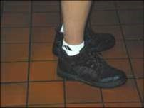
Sample Shoe Policy
To prevent slips and falls use shoes with:
Slip-resistant soles and a good tread
Tightly tied laces
No leather or smooth soles
No open-toes
No platform or high heels
No porous fabric such as canvas

Slide 9
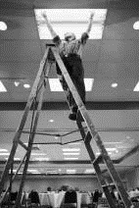
Preventing Falls
To reduce the risk of falls from ladders:
Use ladders with slip-resistant feet
Do not use defective ladders
Do not use chairs, boxes, or tables as a substitute for a ladder
Set ladder on a flat, firm surface
Face the ladder when standing on it and when climbing up or down
Keep the center of your body between the side rails of the ladder
Don’t work from the top two steps of a ladder

Slide 10

Preventing Sprains, Strains, and Overexertion in Kitchen Staff
Manual handling, especially in storage areas, can lead to injuries. Design and organize the workplace to make manual handling easier:
Keep loads off the floor
Heavier objects should be stored between chest and knuckle height
Lighter objects can be stored above chest height
Medium weight objects can be stored below knuckle height

Slide 11
Preventing Sprains, Strains, and Overexertion in Kitchen Staff
Provide dollies and other lifting and handling equipment
Provide training in manual handling skills
Reduce the weight of the load
Share the load between two or more persons
Split the load into two or more smaller boxes,
Make more than one trip
Keep the work area free of clutter. Cluttered workspaces can cause awkward postures that make handling tasks more difficult
Remove trip hazards from the area, and
Eliminate obstacles that workers must reach over

Slide 12
Preventing Sprains, Strains, and Overexertion in Kitchen Staff
Choose utensils designed to reduce force and awkward posture:
tools with large rounded grips so you can use your whole hand rather than just fingers
knives that are sharp and designed for the task
Store frequently used utensils, dishes, and food between shoulder and hip height, close to where they are needed
Tilt bins toward you
Use a work surface near waist height for forceful tasks such as chopping
Use work surface near elbow height for finely detailed work such as pastries and candies

Slide 13
Preventing Sprains, Strains, and Overexertion in Kitchen Staff
Stand as near the work surface as possible
Reduce your reach by using the near part of the work surface, grill, or stove
Place one foot on a step or rail to reduce stress on back and legs. Alternate which foot is on the rail from time to time
Use anti-fatigue matting
Wear shoes with cushioning

Slide 14

Preventing Sprains, Strains, and Overexertion in Servers and Bus People

Slide 15
Preventing Sprains, Strains, and Overexertion in Servers and Bus People
Use additional wait staff to serve parties of three or more
Move around the table when serving guests
Wait staff can assist one another in delivery and clearing of tables – “Full hands into the kitchen, full hands out of the kitchen”
When pouring, move the glass or cup close to you so that you don’t have to reach as far
When lifting and carrying, keep the load close to your body

Slide 16
Preventing Sprains, Strains, and Overexertion in Servers and Bus People
Make sure trays are clean and dry
Control tray weights
Keep plates flat on the tray surface, balance the load and place heavy items in the middle
When carrying large trays
Carry most of load over your shoulder to support it
Use both hands to support and balance the tray
Keep wrists in a neutral position by grasping the outside edge of the tray
When carry small trays
Carry the tray with your shoulder, arm, and hand in neutral positions
Carry the tray as close to your body as possible, balanced on both your arm and hand

Slide 17
Preventing Sprains, Strains, and Overexertion in Bar Staff
Use a step stool to reach high shelves or cupboards
Store frequently used glasses and liquors between shoulder and hip height, close to where they are needed
When lifting, keep the load close to the body
Turn your feet to point at your work to prevent twisting your back
Keep your elbows close to your body when dispensing drinks
Place one foot on a step or rail to reduce stress on back and legs. Alternate which foot is on the rail from time to time
Use anti-fatigue matting
Wear shoes with cushioning

Slide 18
Preventing Sprains, Strains, and Overexertion in Dishwashers
Stand as close to the work surface as possible
When placing glasses into racks, fill the near rows first, then rotate the rack to bring the back rows to the front
Turn your feet to point at your work to prevent twisting your back
Lower your rinse nozzle to rest at mid-body height to reduce your reach
Don’t overload dish racks so that weight is lower
Rack heavier items, such as plates, closest to you
Choose cleaning tools with good grips when heavy duty cleaning is needed
Place one foot on a step or rail to reduce stress on back and legs. Alternate which foot is on the rail from time to time
Use anti-fatigue matting
Wear shoes with cushioning

Slide 19
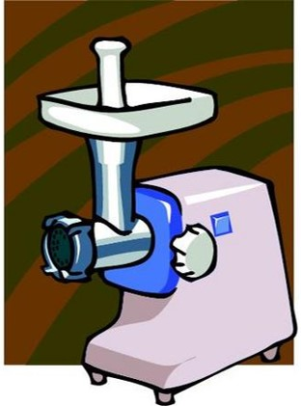
Cuts, Lacerations, and Punctures
Result primarily from:
Peeling, Dicing, Mincing, or Slicing with:
Nonpowered cutting tools – mostly knives
Food slicers
Meat grinders
Mixers, blender, and whippers
A smaller number resulted from broken dishes, cups, and glasses.

Slide 20
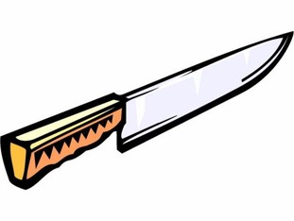
Preventing Cuts, Lacerations & Punctures
Blade safety tips:
Cut AWAY from, not toward, your body
Use a stabilizing tool and not your fingers to steady the food
Use a cutting board. Never hold items in your hands while cutting or slicing
Use the correct knife for the job. For example:
Carving knives for large jobs
Boning knifes to remove meat from the bone
Paring knives for slicing small jobs

Slide 21
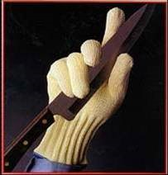
Preventing Cuts, Lacerations & Punctures
Blade safety tips:
Wear appropriate gloves for your job
Use cut resistant gloves for high production jobs. However, remember they are cut resistant, not cut proof- injuries can still occur.
Make sure gloves fit properly
Keep knives and blades sharp
Dull blades slip
Sharp blades improve accuracy and performance
Sharp blades decrease strain and fatigue
Tighten or replace loose handles

Slide 22
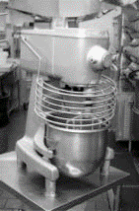
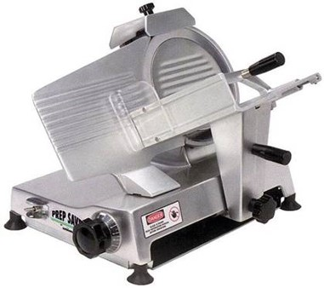
Preventing Cuts, Lacerations & Punctures
Make sure all guards and safety devices are in place on slicers and other machinery such as mixers, blenders, electrical tools and maintenance equipment
Use food pushers to advance food in machines
Never put your fingers near moving parts or blades
Don’t try to cut anything too thin in a slicer. Use a knife.
Don’t try to catch falling items, especially knives.
Discard broken or chipped dishes
and glassware

Slide 23
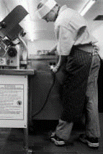
Preventing Cuts, Lacerations & Punctures
Lockout
Equipment that starts up unexpectedly, especially during cleanup or maintenance, can cause many serious injuries
To reduce the risk of injury, unplug equipment before doing clean-up, maintenance, or repairs. If the equipment is hardwired, follow the specific lockout procedure for that equipment

Slide 24
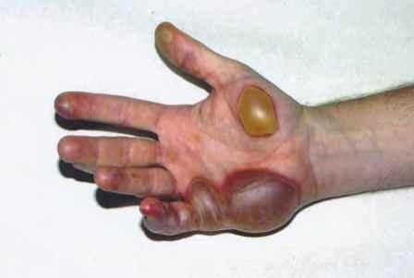
Burns and Scalds
Result primarily from:
Spilling and splashing of hot fats, oils, and food products
Hot beverages
Contact with hot surfaces such as stove tops, ovens, grills, pots, pans, and trays
Steam

Slide 25
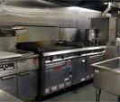
To Reduce the Risk of Burns and Scalds
Turn off stoves when not in use
Assume all pots and metal handles are hot. Touch only when you are sure they are not hot or when wearing proper gloves/mitts
Organize your work area to prevent contact with hot objects and flames
Keep pot handles away from hot burners
Make sure handles of pots and pans do not stick out from counter or stove
Use oven mitts that are provided and long gloves for deep ovens
Use only recommended temperature settings for each type of cooking
Follow manufacturer’s operating instructions. Manuals are available through your supervisor

Slide 26
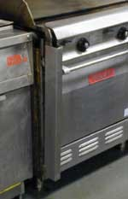
To Reduce the Risk of Burns and Scalds
Open hot water and hot liquid faucet slowly to avoid splashes
Open lids away from you to allow steam to escape
Wear long-sleeved cotton shirts and cotton pants
Report any faulty equipment to your supervisor
Do not overfill pots, pans, or fryers
Do not leave metal spoons in pots while cooking
Do not overstretch to reach an uncomfortable distance
Do not open cookers and steamers while they are under pressure
Do not lean over pots of boiling liquids
Remember that foods removed from the microwave continue to cook

Slide 27
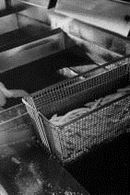
To Reduce the Risk of Burns and Scalds
Dry items thoroughly before using with hot oil
Food items for frying should be placed in the basket first, then lowered into hot oil, rather than dropping food directly into the oil. Lower basket slowly into oil
Use rollers for moving large vats
Allow grease to cool before transporting, filtering, or disposing
Two people are to be used for changing and disposing of grease, due to heavy lifting
Do not stand on hot fryer to clean ventilation components or filters. Use a ladder or stepstool.

Slide 28
Examples of Commonly Used Hand, Foot, & Eye Protection in the Restaurants and Kitchens
Gloves:
Chemical-resistant gloves when cleaning with or handling chemicals (check MSDS for specific type of glove required)
Work gloves when handling garbage or working in storage areas
Cut-resistant gloves for some cutting and equipment cleaning operations
Footwear:
Non-slip footwear
Safety glasses, goggles, and face shields:
Safety glasses when general eye protection is required
Safety goggles and face shields when there is a great danger of chemical splashes

Slide 29



Important Consideration in Restaurants: Teen Workers
67% of restaurants in Washington are likely to employ minors (where no alcohol is served)
Teen workers bring many positive attributes to the workplace:
High energy, enthusiastic, willing to learn, eager to please

Slide 30
Important Consideration in Restaurants: Teen Workers
There are additional issues to consider for minors:
Are not just small adults
Different patterns of work
Minimal work experience
Differences in size, development, maturity, and judgment
Exploring, experimenting, learning
Lack a sense of vulnerability
Laws protecting them are sometimes more stringent

Slide 31
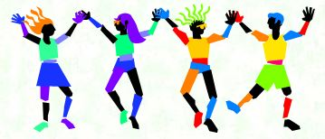
Resources for Employing Teen Workers
Laws for employing teens
Keeping teen workers safe in restaurants

Slide 32
Other References Used
Sample Restaurant Accident Prevention Program (APP)

Slide 33

Additional Resources
WISHA Core Safety Rules (WAC 296-800)
(Basic safety and health rules needed by most employers in Washington State)
Workplace Safety and Health
WorkSafe BC Health and Safety Centre
OSHA Dietary eTool

Slide 34
DOSH Consultation Services
Safety & Health program review and worksite evaluation
By employer invitation only
Free
Confidential
No citations or penalties
Letter explains findings
Follow-up all serious hazards
For additional assistance, you can request a consultation by one of our consultants.
Find a local L & I office location

Slide 35

Thank you for taking the time to learn about safety and health and how to prevent injuries and illnesses.

