Slide 1
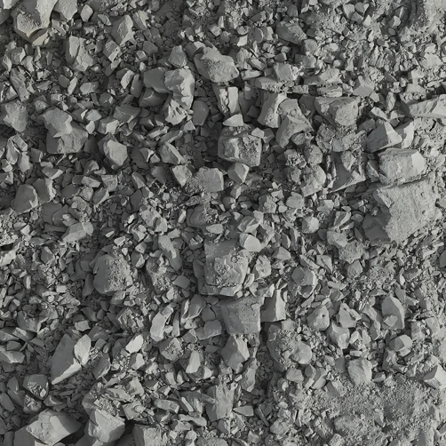
Input
Module1:Tiling
Module2:Detection
DOM(GeoTIFF)

