Slide 1

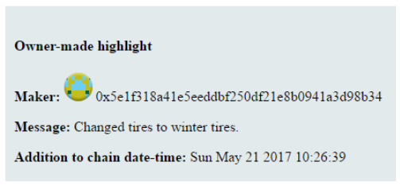
Developing a smart contract for tracking the life cycle of a classic car
Lauri Miettinen
Degree programme in information technology, software development
Introduction​
The BitCoin currency was invented in 2009. BitCoin-transactions are saved into a decentralized data base called the block chain. Years later, a man named Vitalik Buterin invented Ethereum, a decentralized computing platform whose smart contracts and information transactions are saved into a block chain.
This thesis was made for the Hilla-program – a Finnish research project for studying future technologies. ​The goal of the project was to create an application that would show in a concrete way how the block chain technology could be used in the future
Objectives​
The idea for the application was to create a smart contract that could be used to track the life cycle of a classic car. Classic cars are valuable, and the subject is also closely related to trafficking. Both of these properties together make this subject a good demonstration case for the block chain technology.
Image 1. The block chain’s structure. Each block contains multiple transactions. Each block is linked to the previous one. ”Tx” means ”transaction”
Methods​
The smart contract was written with the Solidity-language and the interface was created with the Meteor-framework.
During development, a software called TestRPC was used to test and develop the smart contract. TestRPC is a NodeJS application that mimics the functionality of the Ethereum platform closely. (TestRPC’s name was changed to GanacheCLI in Oct. 2017.)
The Meteor framework normally uses a MongoDB -data base, but it can be easily applied to interact with the Ethereum-platform with a library called Web3.
Results​
​Most of the planned use-cases were successfully implemented. The greatest obstacle in the project were the lacking features of the Solidity-language. Solidity-language is, however, easy to learn. Meteor is a very useful framework.
Conclusions​
The subject for the thesis was chosen well. The task was challenging and educating. This project was an interesting peek at technologies we all might end up seeing in the future.
Block chain researchers claim that the block chain technology will have the same impact on the world as the invention of the internet did. Is this a case of over-enthusiastic researchers, or will this technology end up changing the world? We will have to wait and see.
​
References​
https://github.com/Miettine/ClassicCarChain. The thesis’ GitHub-repository.
https://bitcoin.org/bitcoin.pdf
Image 2. The idea in the application was for the car owner to collect highlights that happen in the car’s life cycle. These highlights will convince the future buyer of the car’s value.
Thesis
ECTS credits: 6
Date of publication: December 1. 2017​
Supervisor: Veijo Väisänen

