Slide 1
Stealthy Wi-Fi MitM Attack
Miftahul Huq, Jacob Fricano, Songyuan Bo

Slide 2
Motivation:
Wi-Fi Technology widely implemented globally
Prior techniques require deployment of rogue AP
WPA3 has mandatory Protected Management Frames
Notes:
The motivation for studying this attack stems primarily from the global adoption of Wi-Fi technology, and thus the severe consequences that could be faced with successful MitM attacks. More specifically to the attack covered in the reference paper, it introduces a technique to establish a MitM position without needing to deploy a rogue AP, unlike previous known techniques. This leads to a stealthier technique that only utilizes a single to maybe 20 ICMP redirect messages being sent to a victim in order to establish the MitM position. Lastly, with WPA3 being supported by more and more devices, an attack infrastructure that requires a rogue AP becomes even more difficult with mandatory protected management frames protecting against deauthentication attacks. This attack technique, however, leverages the cross-layer interactions of ICMP and WPA meaning that this will not prevent our attack from being successful.

Slide 3
Technical Details
Notes:
Ubuntu 18.10 (Cosmic Cuttlefish) w/ Linux Kernel 4.18

Slide 4
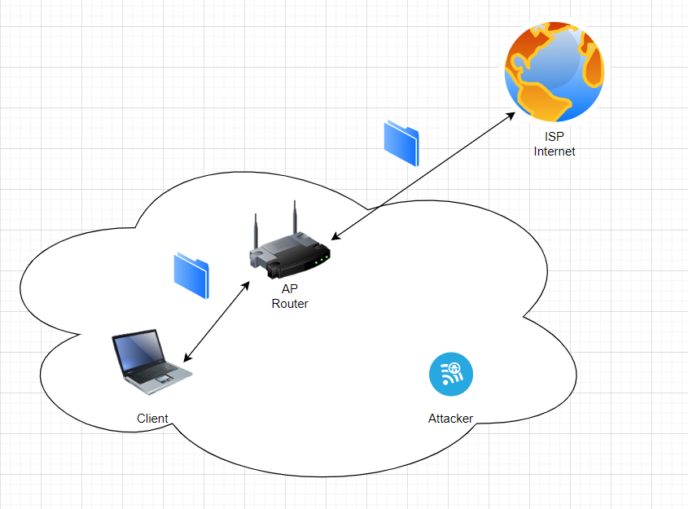

Slide 5
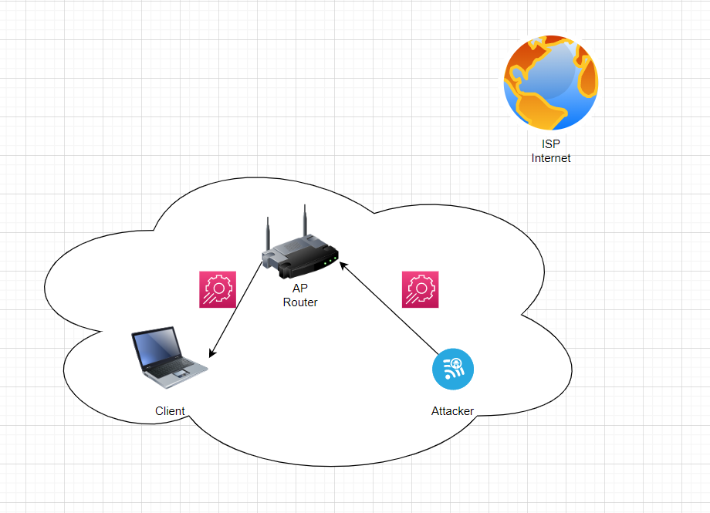

Slide 6
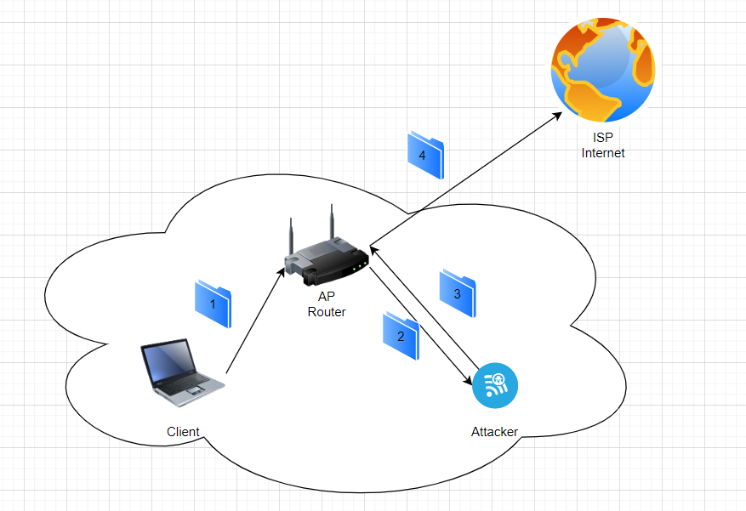

Slide 7
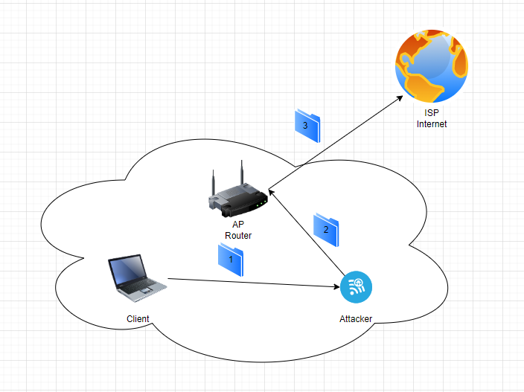

Slide 8
Demo Time!

Slide 9
Potential Impacts
Traffics without higher layer encryption is vulnerable!
DNS Packets are usually in plaintext!
Poison the DNS Server address
8.8.8.8 -> Attacker
Modify DNS reply
www.chase.com - > Attacker’ IP

Slide 10
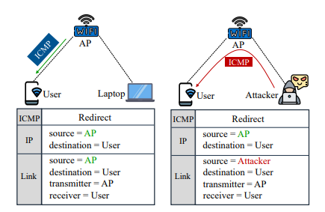
Mitigation:
The attacker spoofs the valid AP in all ways but one…
Valid ICMP Redirect -> Source = AP MAC address
Forged ICMP Redirect -> Source = Attacker MAC address
[1]

Slide 11
Implementation of Countermeasure
Check source MAC address in Frame.
Take IP in actual ICMP redirect, and lookup MAC address.
If these don’t match -> reject the redirect

Slide 12
Continuing Work
Replicate attack with WPA3 enabled router
Implement and demonstrate countermeasure
*Time permitting: Actually modify DNS query to demonstrate DNS poisoning the victim

Slide 13
References:
[1] Xuewei Feng, Qi Li, Kun Sun, Yuxiang Yang, and Ke Xu, “Man-in-the-Middle Attacks without Rogue AP: When WPAs Meet ICMP Redirects” In Proc. 2023 IEEE Symposium on Security and Privacy (S&P), San Francisco, CA, USA, May 2023.

Slide 14
Any Questions?

