Slide 1


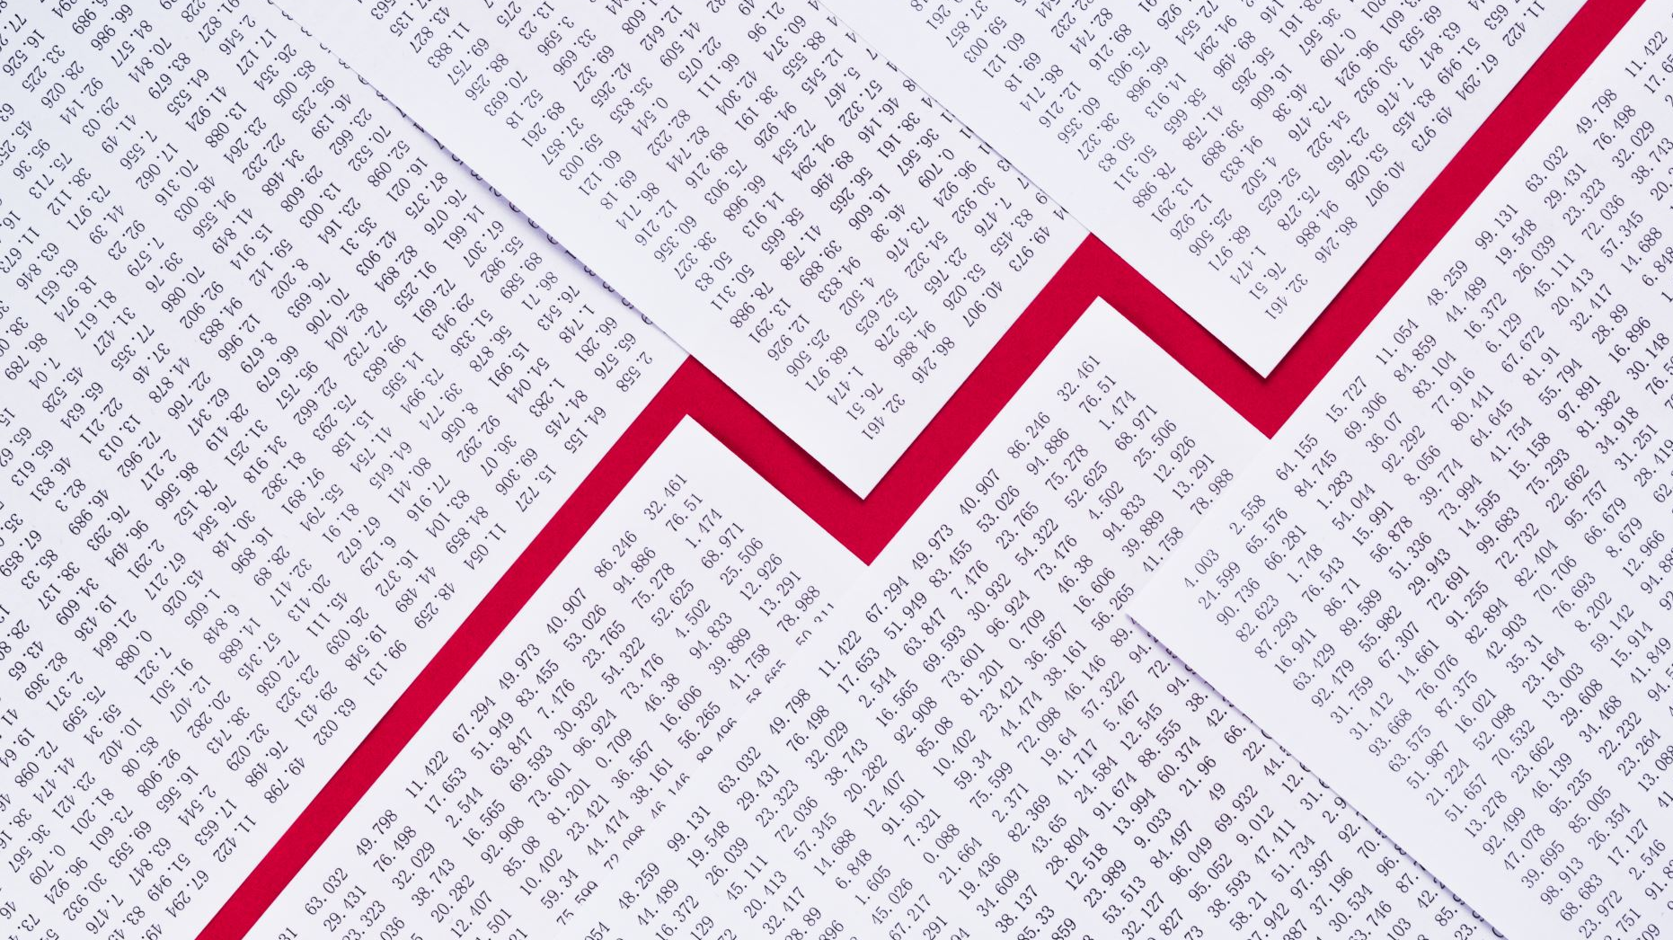

Understanding Charts
Victoire Migashane

Slide 2
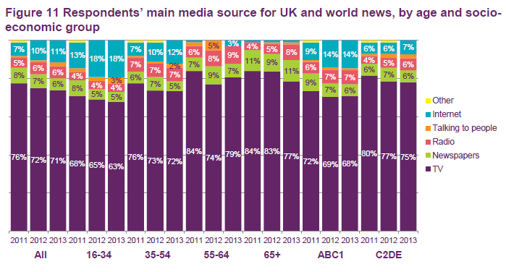
Bad Chart
Bad chart because:
To much information
Axis not clearly labeled
Don’t add up to 100%
Doesn’t clearly describe objective

Slide 3
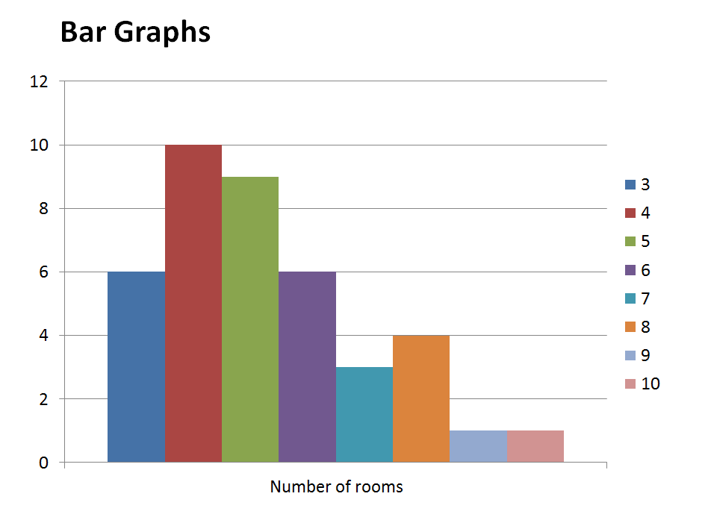
Good Chart
Good chart because
No miss leading
Axis clearly labeled
Simple to understand

Slide 4
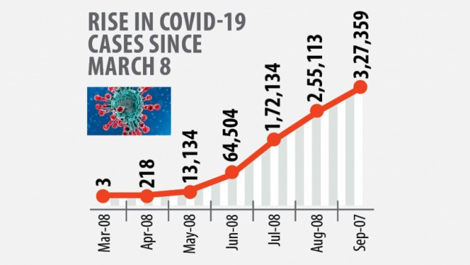
Muddled Chart
Simple to understand but miss labeled
Expecting March 8 results but I get monthly results
Additional visual that is not necessary.

Slide 5
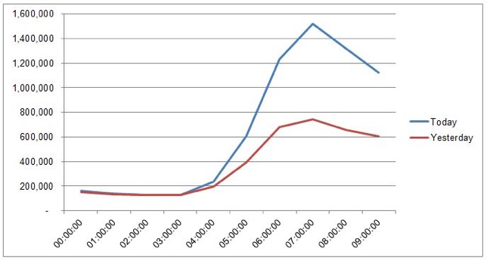
Clear Chart
No title but it’s the simplicity of the chart that attracts me to it
Super simple to understand

Slide 6
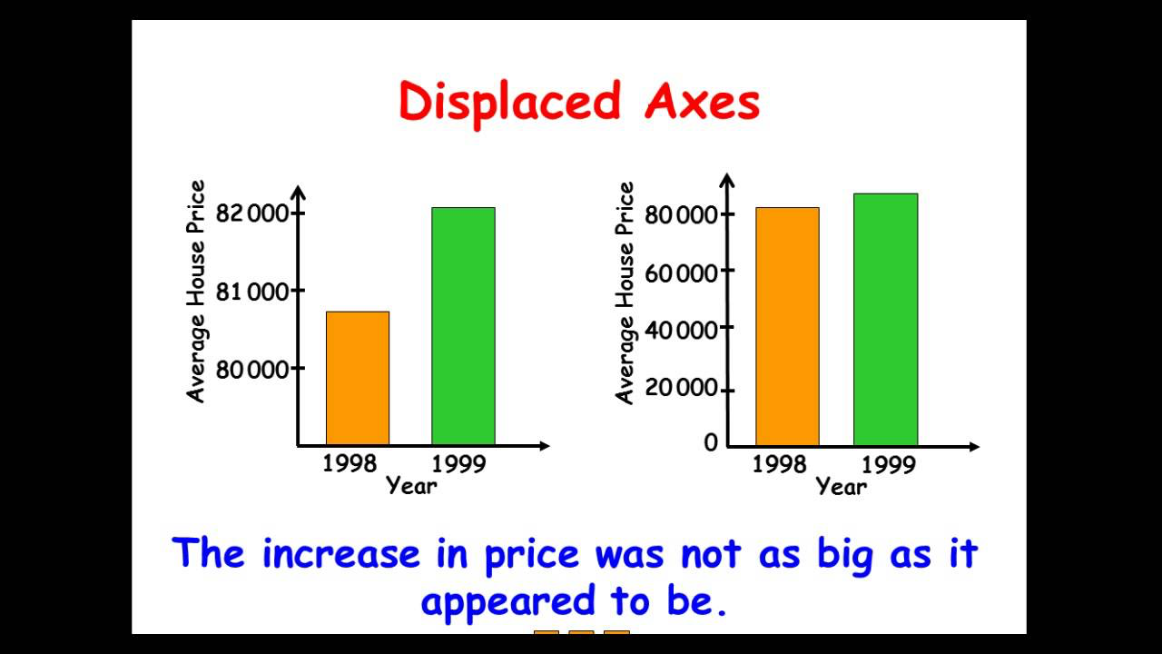
Deceiving Chart

Slide 7
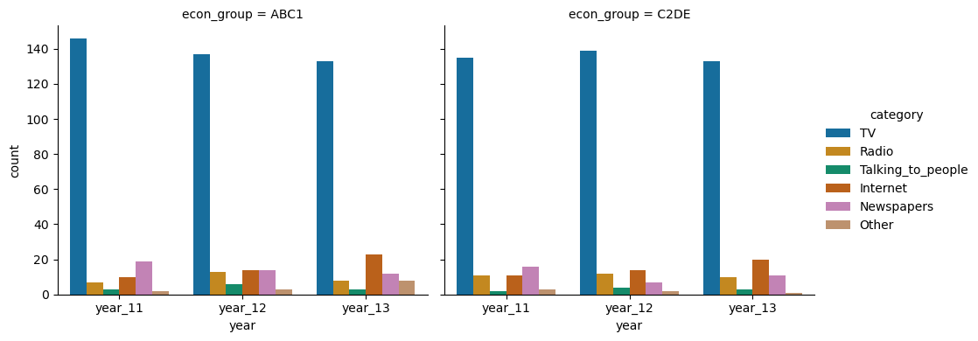
Chart Solution

Slide 8
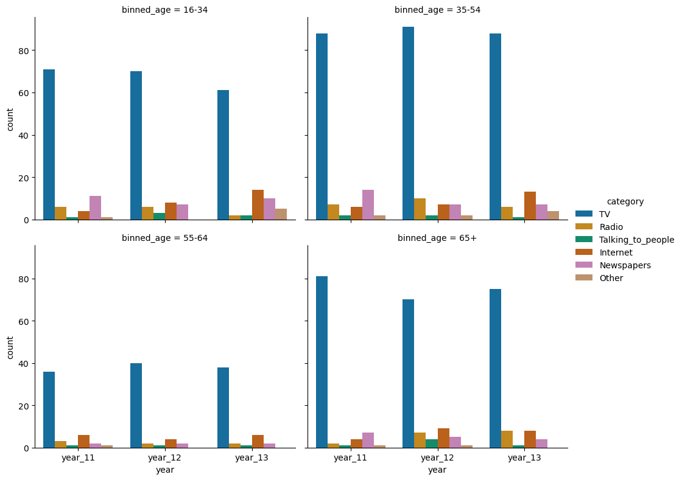
Chart Solution

Slide 9

Thank you for being valuable Listeners

