Slide 1

New York City Dog Bite
Victoire Migashane
August 4, 2023

Slide 2
Today’s Agenda
Executive Summary
Key Findings
Recommendations
Conclusion

Slide 3
Executive Summary
Goal
Forecast weekly dog bites in New York City to help with resource allocation to mitigate bite risk and receive early treatment.
Findings
Summer and weekends have the highest average bite overall.
Queens, Manhattan and Brooklyn have the highest bite counts.
Recommendations
I recommend the local authorities to remain diligent and on high alert during the weekend and especially more flexible in the summer due to high bite rates show in the data.

Slide 4
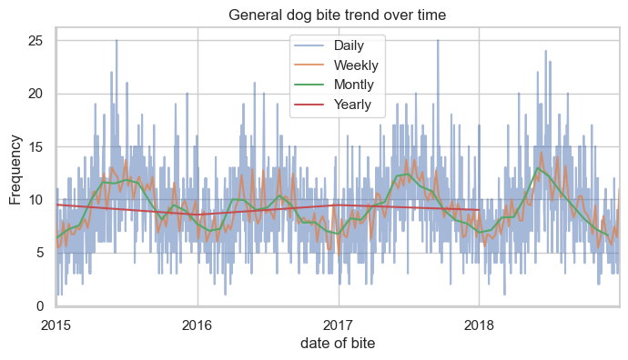
Key Findings
Are there any noticeable trends in the number of dog bites over time?

Slide 5
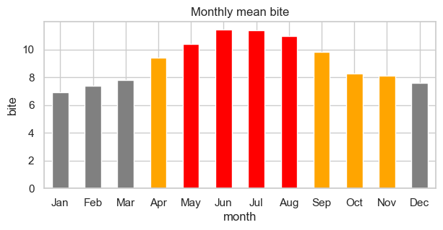
Key Findings
Are certain months or seasons associated with a higher number of incidents?

Slide 6
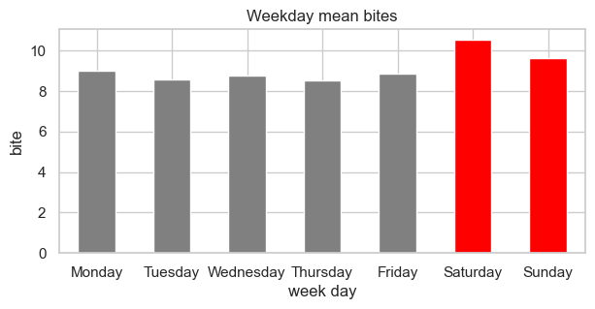
Key Findings
Are there specific days of the week when dog bites are more frequent than others?

Slide 7
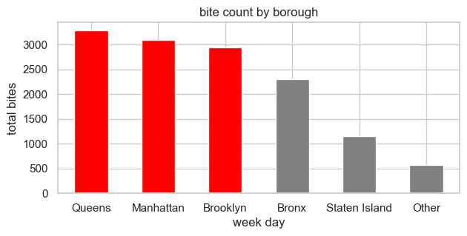
Key Findings
What impact does dog bite have in different boroughs?

Slide 8
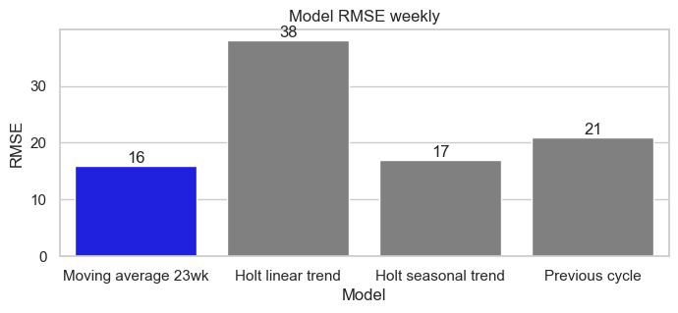
Modeling
Moving average
Holt’s linear trend
Holt’s seasonal trend
Previous cycle

Slide 9
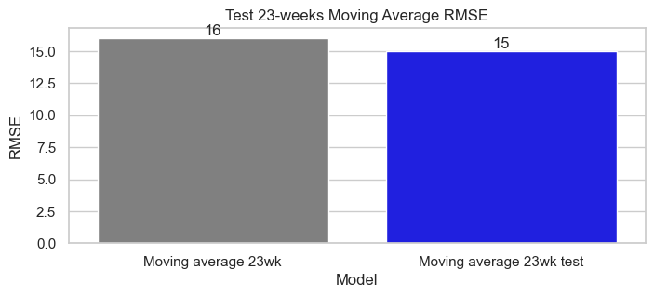
Test Model

Slide 10
Conclusion
The goal for this project was to forecast weekly dog bites in the City of New York. I accomplished this by running four time series models, however, I failed to beat my baseline model showing lack in weekly data.

Slide 11
Recommendations
I recommend the local authorities to remain diligent and on high alert during the weekend and especially more flexible in the summer due to high bite rates shown in the data.
I also recommend for necessary resources to distributed mainly in Queens, Manhattan, and Brooklyn to help with urgent cases.

Slide 12
Next Steps
Collect more data then achieve a working model on the weekly or monthly resamples.
What effect does the dog's age have on bites?
How long after getting bitten did they wait before seeking medical attention?

Slide 13


Contact and Resources
Resources
View project: Github.com
Data source: Data.gov
Contact
LinkedIn: /Migashane-victoire
Github: /MigashaneVictoire
Notes:
MigashaneVictoireMigashaneVictoire

Slide 14
Contact and Resources
Resources
View project: Github.com
Data source: Data.gov
Contact
LinkedIn: /Migashane-victoire
Github: /MigashaneVictoire

