Slide 1

Technical support for new and high-cost customers is needed
Victoire Migashane

Slide 2
Executive summary
Goal
Find what is driving churn and how to reduce churn.
Findings
Fiber optic month-to-month customers who make high monthly payments and don’t receive technical support churn.
Recommendation
Provide technical support to month-to-month fiber optic customers who are making high monthly payments and are in their first 2 years with Telco.

Slide 3
Findings

Slide 4
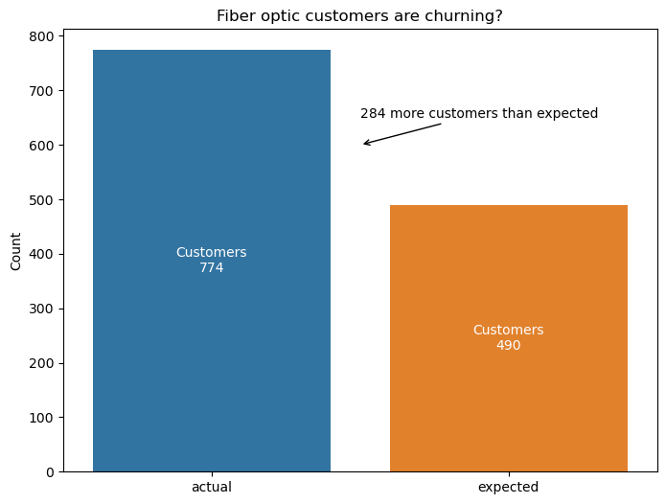
Fiber optic customers churn more than any other customers.

Slide 5
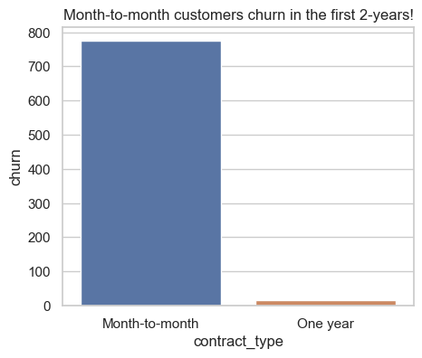
Month-to-month customers who make high monthly payments tend to churn within their first 24 months.

Slide 6
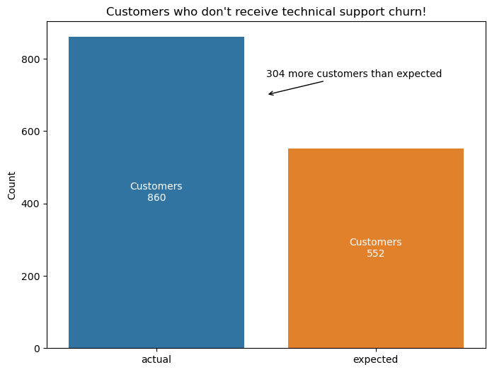
Customers who receive technical support stay with Telco much longer.

Slide 7
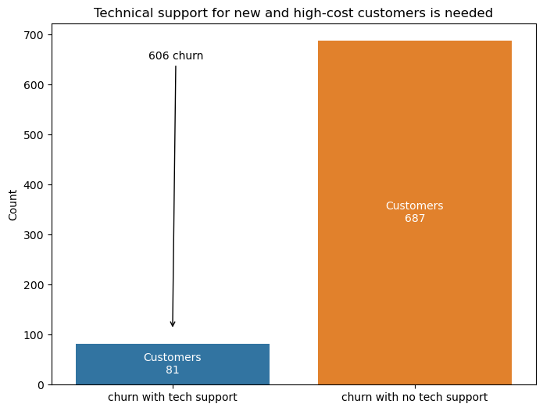
Fiber optic monthly contract customers who churn while they do not receive tech support with monthly charges more than the median monthly cost and have been with Telco for 24 months or less.

Slide 8
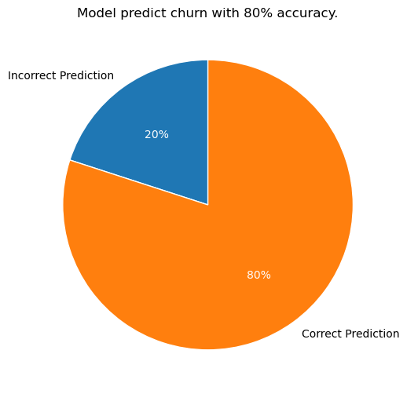
Model Findings
Month-to-month contracts, fiber optic internet service type, technical support, and monthly charges are strong drivers for churn.
Logistic regression model using these features predicted customer churn with 80% beating the baseline by 7%.

Slide 9


Recommendations
Provide technical support to month-to-month fiber optic customers who are making high monthly payments and are in their first 2 years with Telco.
Offer them a different longer contract or internet service to increase their chance of staying with Telco.
Give discounts or set milestones for the high-paying customers to make them think twice before leaving.

Slide 10
Conclusion
The goal was to find drivers of churn and determine what could be done to reduce churn. I did this using statistical testing and found the main drivers to be contract type, internet service type, monthly charges, and technical support. I used a logistic regression model to predict churn with 80% accuracy. I recommend reliable technical support to customers making high monthly payments and have been on a month-to-month contract for less than 2 years.

Slide 11

Next steps
Customer transaction dates
Customer standing debt
Customer geographic data
Customer age

Slide 12
Thank you
Victoire Megaphone
migashanevictoire@gmail.com
linkedin.com/in/migashane-victoire

