Slide 1
Course Project : COVID-19 Named Entity Recognition
COMP 4901K / MATH 4824B Fall 2020

Slide 2
Named Entity Recognition (NER)
NER seeks to find and classify named entities mentioned in unstructured text into pre-defined categories such as person names, organizations, and locations.
https://en.wikipedia.org/wiki/Named-entity_recognition

Slide 3
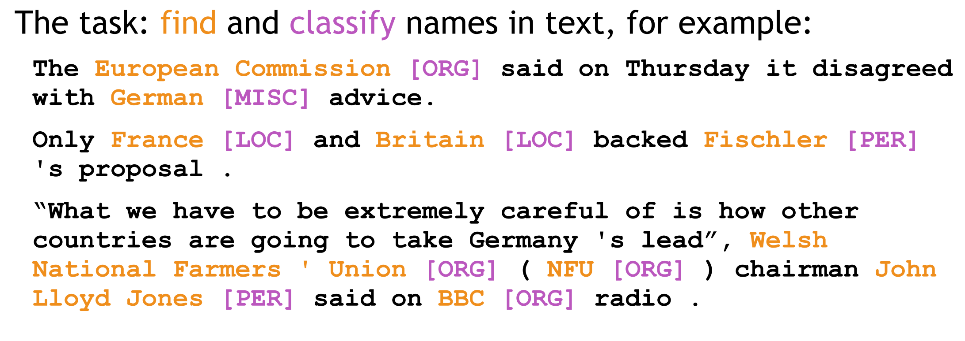
Named Entity Recognition (NER)
https://web.stanford.edu/class/cs224n/slides/cs224n-2020-lecture03-neuralnets.pdf

Slide 4
Dataset in this project
A corpus containing the scholarly literature about COVID-19, together with the annotation for NER task.
The dataset contains 64 fine-grained entity types:
General types (e.g., person, organization)
common biomedical entity types (e.g, genes, chemicals and diseases)
COVID-19 related types (e.g., coronaviruse, viral protein, substrates and immune responses)
The label ‘O’ means no type

Slide 5
Dataset
We pre-processed and split the dataset into train, validation and test sets, which are stored in train.pkl, val.pkl and test.pkl respectively.
Ground labels are provided for training and validation, while omitted for testing set.
Please refer to playground.ipynb file for more details about the dataset (e.g., dataset format, how to load the dataset).

Slide 6
Goal of this project
You are asked to predict the tag of every token in a given sentence.
``Protection of calves against fatal enteric colibacillosis by orally administered Escherichia coli K99 - specific monoclonal antibody.’’
Token | Protection | of | calves | against | fatal | enteric | colibacillosis | by
tag | O | O | LIVESTOCK | O | O | DISEASE_OR_SYNDROME | DISEASE_OR_SYNDROME | O
Token | orally | administered | Escherichia | coli | K99 | specific | monoclonal | antibody
tag | GENE_OR_GENOME | GENE_OR_GENOME | GENE_OR_GENOME | GENE_OR_GENOME | GENE_OR_GENOME | CARDINAL | CARDINAL | CARDINAL

Slide 7
Hints
Simple ways: use one-hot vector to represent each token, and apply a dense layer to predict the tag labels.
Advanced methods: use lower dimensional embedding, and CNN/RNN to get contextualized representation of tokens, plus a dense layer to predict the labels.
More fancy ways: use pretrained word embeddings (word2vec, Glove, etc, which you can find online), multiple layers of neural networks, bidirectional RNN/LSTM, etc.

Slide 8
Hints
Hyper-parameters that you could tune:
learning rate
Optimizer (e.g., ADAM, SGD)
size of hidden layers
activation function
parameter initializer
…

Slide 9
Computational requirement
For light-weight models, it is OK to only use CPU for this project. For instance, by using only CPU, a simple CNN model takes 10s/epoch, and for onehot+dense model, it takes 30s/epoch.
If you want to use GPU but your own computer is insufficient for that, you might try the Kaggle Notebook (see the kaggle notebook.pdf file in the zip folder for details).

Slide 10
Evaluation metric
Accuracy on test set => we provide the code for calculating accuracy in playground.ipynb and evaluate.py.
You should check your output format on validation set using the provided codes in playground.ipynb and evaluate.py before submission.
By calling evaluate(“val_preds.csv”, “data/val.pkl”), it should return the accuracy of the validation set.
The .csv file that you submit should be exactly the same as defined in the playground.ipynb.

Slide 11
You need to submit the following
The predictions on test data
Make sure your output format is the same as that described in playground.ipynb.
Make sure you can successfully evaluate your validation predictions on the validation data with the help of evaluate.py.
Report (1~2 pages)
Code (Frameworks and even programming languages are not restricted.)
Due: 23:59, Nov 28, 2020
Each team leader is required to submit the groupNo.zip file that contains preds.csv, the report, and the code of your team on canvas.
we will check your report with your code and the accuracy on test set.

Slide 12
Grading Rule
Grade | Model (80%) | Report (20%) | Baseline models’ accuracy on validation set
60% |  | submission
80% | an easy model that most students can outperform | detailed explanation | 83.1%
90% | a competitive model that about half students can surpass | detailed explanation and analysis | 87.9%
100% | a very competitive model | excellent visualization and analysis | 89.7%
Note: we will grade the performance of your model based on its accuracy score on the test set. Since you don’t
have access to the labels on the test set, you should compare your model’s accuracy score on the validation set with the values in the rightmost column in the above table to have a rough reference of how your model performs.

Slide 13
Thank You

