Slide 1

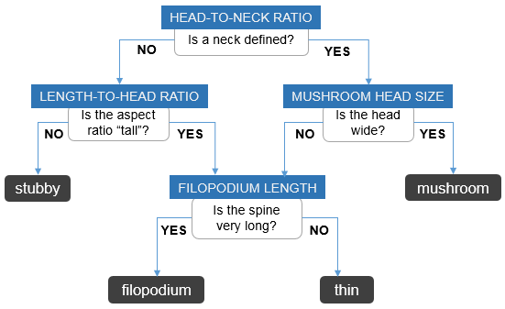


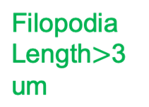
https://www.mbfbioscience.com/help/neurolucida360/Content/3Dcsh/csh_classifySpines.htm

