Slide 1
REMOTE CELLULAR SMS NETWORK COMMANDER
Presented by,
Mily Wilson
Anjali Hareendran
Manju M.S
Neethu Ninan

Slide 2
Introduction
Provides remote access control and security to a computer using mobiles
Consist of mobile phone and computer
Achieved through SMS service

Slide 3
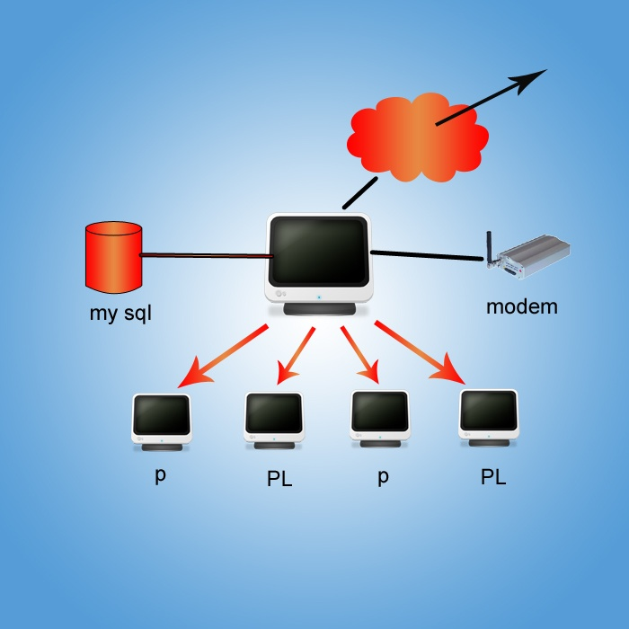

GSM NETWORK
SERVER SYSTEM
Database

Slide 4
Existing system
No device to control a PC in a network
Various factors responsible for proposed system :
- security
- resource utilisation maximum
- availability

Slide 5
Proposed system
For monitoring networks
Server computer and client computers
Remote PC controlled using mobile phone through SMS
For poviding security to remote systems

Slide 6
Scope
Ability to monitor the computer and notifies the user through sms
Ability to shutdown and restart a computer
Send notifications to any PC in the LAN
Ability to provide security.

Slide 7
Modules
Server module consist of :
Connection management module
Client session management module
Database connectivity
User managemnet
SMS module

Slide 8
Client modules are :
Server request process unit
Client authentication module
Client application module
Application management module

Slide 9
Hardware Interface
Processor | Pentium III or above
Speed | 1.4 GHz
Base Memory | 128MB RAM
Hard Disk Drive | 40 GB
Key Board | ISO/IEC9995 QWERTY Keyboard
Display Type | VGA/EGA
Mobile Device | Any mobile device with inbuilt SMS functionality

Slide 10
Software Interface
Platform | Windows
Database | mySQL
Languages | Java SE,NetBeans IDE

Slide 11
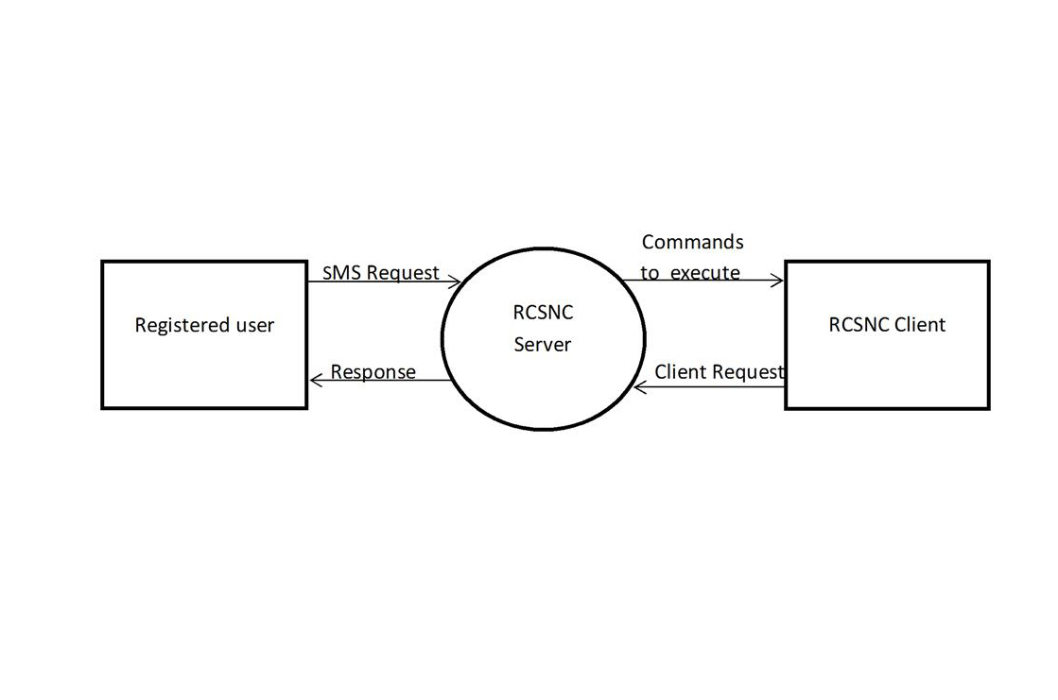
Detailed Design
Dataflow Diagram
Level 0 DFD

Slide 12
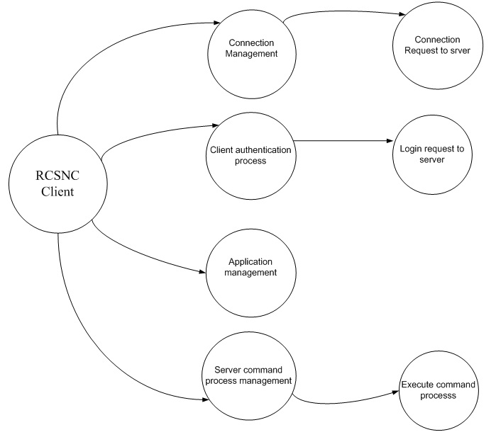
Level 1 - Client

Slide 13
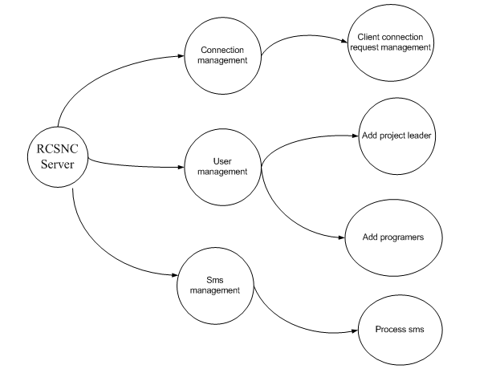
Level 1 - Server

Slide 14
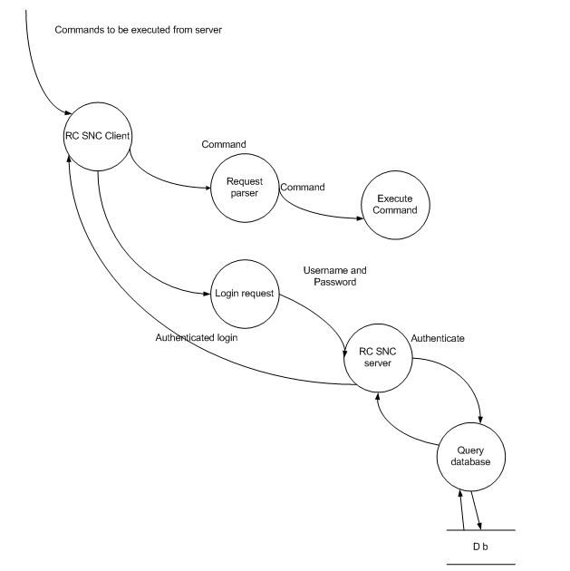
Level 2 - Client

Slide 15
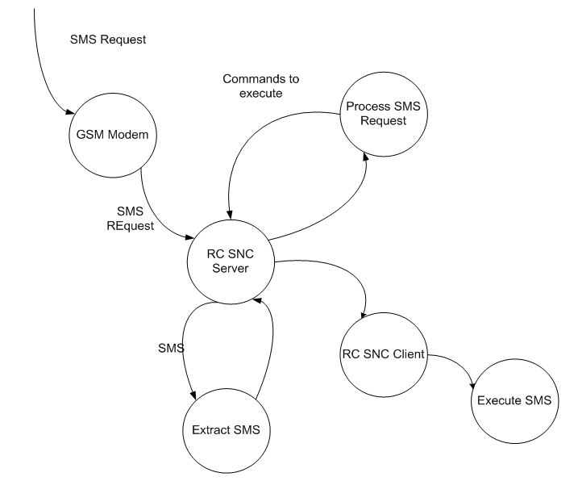
Level 2 - Server

Slide 16
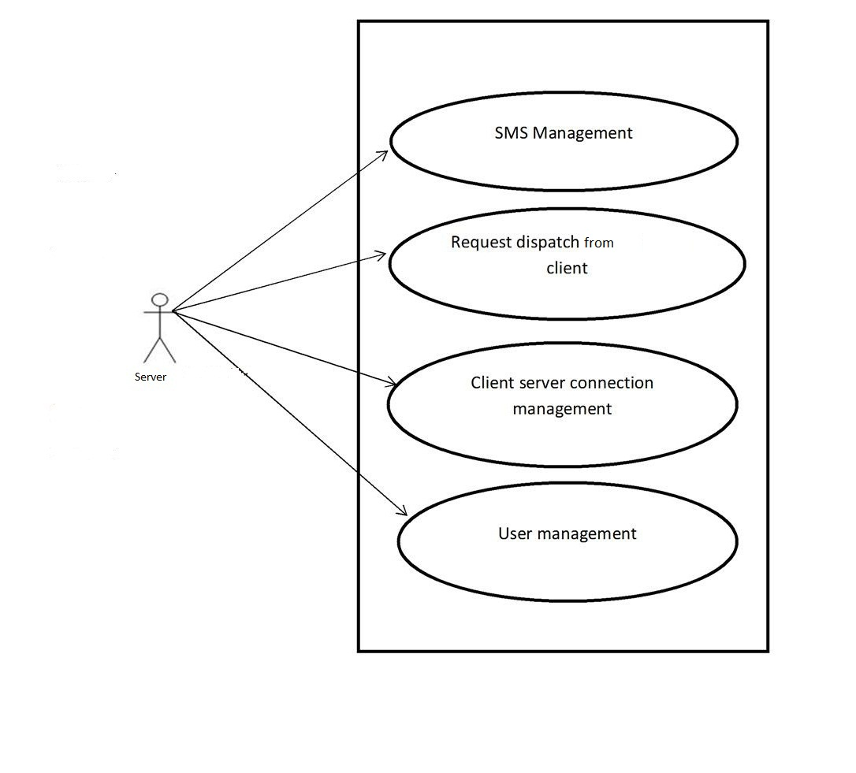
Usecase Diagrams
Server

Slide 17
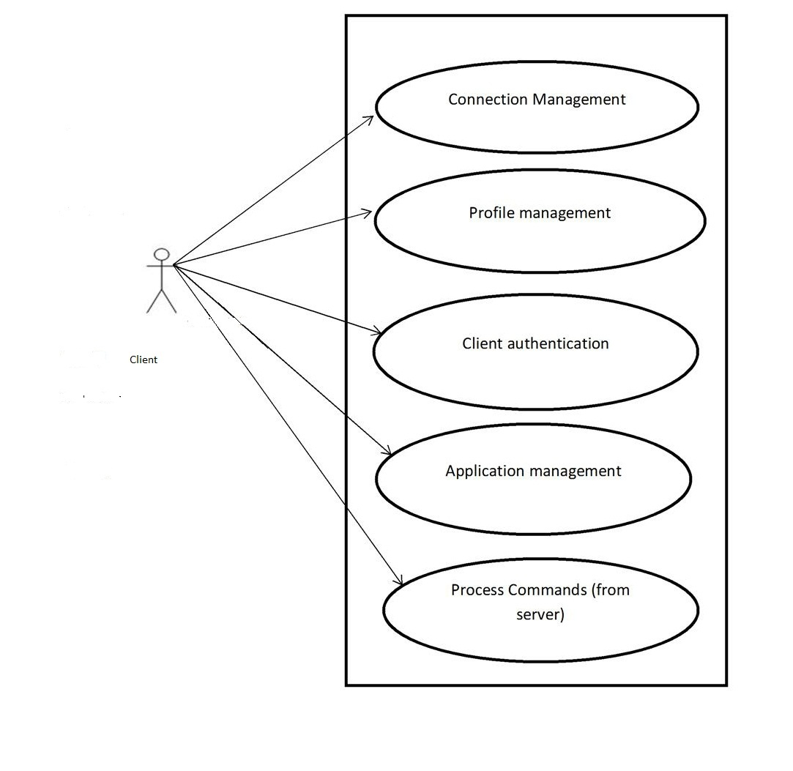
Client

Slide 18
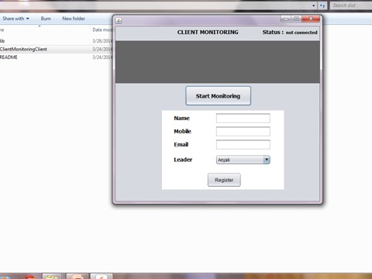
Screen Shots
Registration

Slide 19
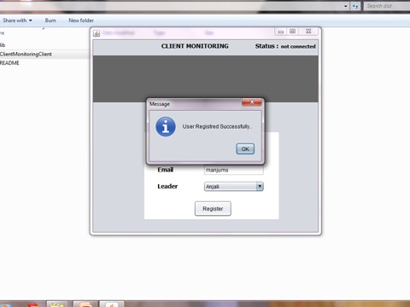
After registration

Slide 20
Future Scope
mobile phone to provide interactive control of any process.

Slide 21
Conclusion
Control working of a computer in a network
Two users :
-Administrator
-Client
Increased security and accessibility can be gained

Slide 22
Reference
[1] Ming Xu, Jiayou Du. “Design of SMS-based remote control system using TC35 and MCU”. International Conference on Internet Computing and Information Services 2011

Slide 23


