Slide 1
Optimizing Maze Exit Strategies using Search Algorithms
Rochester Institute of Technology CSCI 630: Foundation of Artificial Intelligence
Group 3- Cazal Tirkey, Shakshi Mukeshbhai Patel, Nhlonipho Marwala Date: 24 April 2026

Slide 2
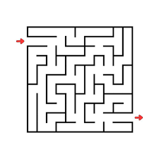
Introduction
Maze game where an agent must navigate from a start cell to a goal cell while avoiding walls/obstacles. The objective is to compute and visualize a path, and compare multiple algorithms by path quality, runtime, and nodes expanded.
We represent the maze as a graph: Node/state, edges, cost/weight
Algorithms:
DFS (Depth-First Search)
BFS (Breadth-First Search)
Uniform Cost Search (Dijkstra’s Algorithm)
Greedy Algorithm
A* Search
Genetic Algorithm
__

Slide 3
Types of maps used to evaluate
Spiral Maps: designed with one possible solution to test the running limits of each algorithm.
Labyrinth Maps: made to accommodate multiple solution path of different length and dead ends to test whether algorithms could run over simple mazes
Empty Maps: made to test the memory limits of the application, have the source and destination in open space
Map Sizes: constructed the maps to the upper limit of 20x20 map

Slide 4
Depth First Search
__
Encoding: each maze cell is a state represented as (row, col).
Frontier: DFS uses a stack, so the most recently discovered state is expanded first.
Search behaviour: explores one branch deeply before backtracking.
Cycle handling: uses a visited set so the same state is not expanded again.
Tracked results: path, cost, path length, expanded nodes, expanded count, and runtime.
Test Map Types: Empty, Spiral, Simple Labyrinth
Test Sizes: 5x5, 10x10,20x20
Strength: Usually needs less memory and can find a solution quickly by going deep along one branch.
Limitation: Not optimal, because it may return a longer path even when a shorter one exists.

Slide 5
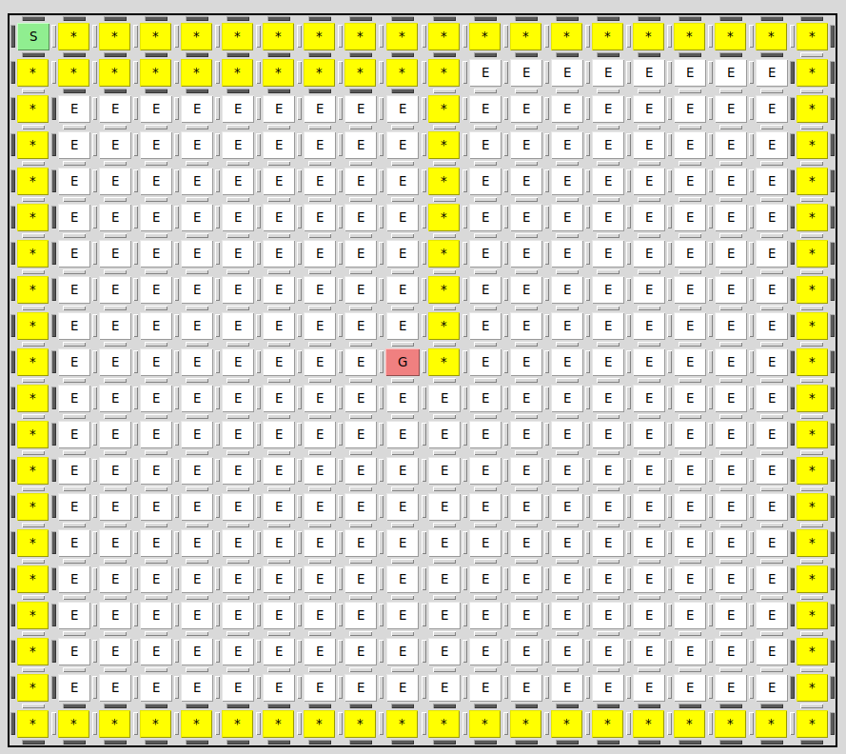
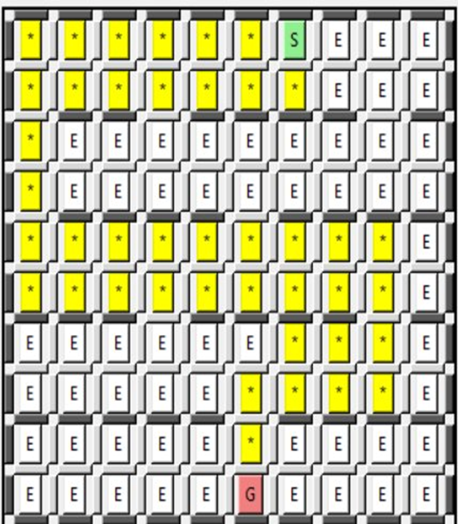
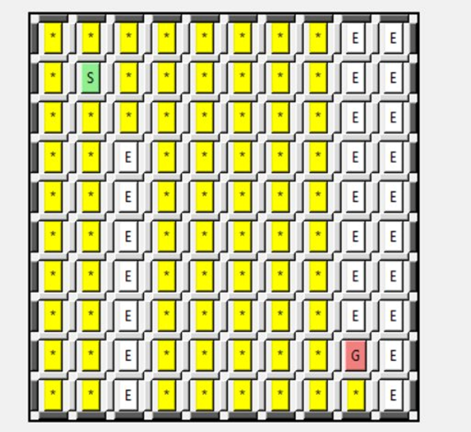
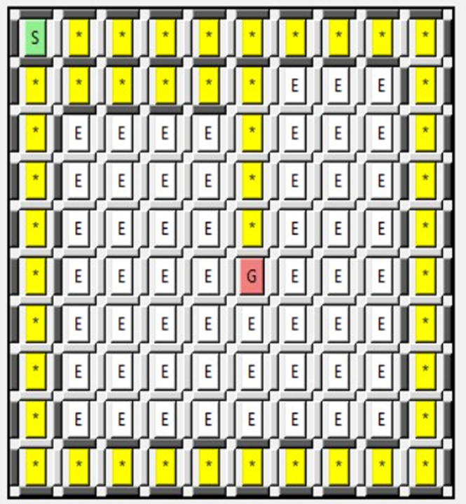
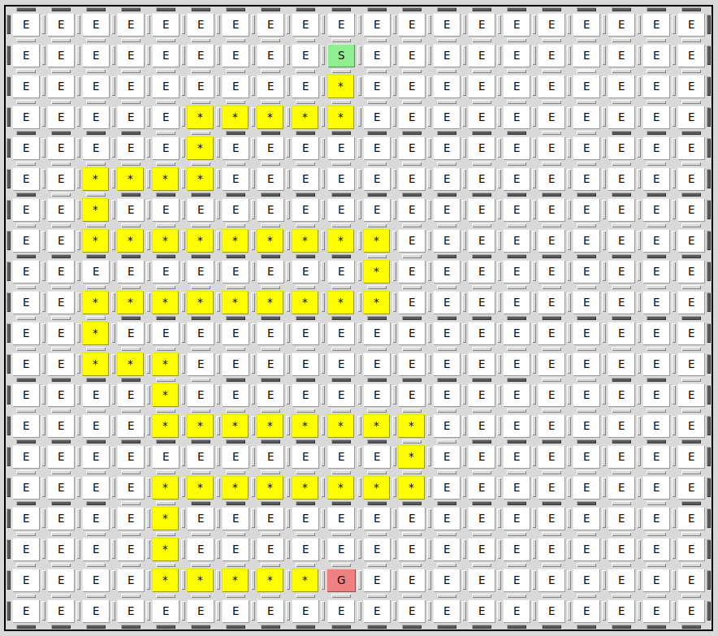
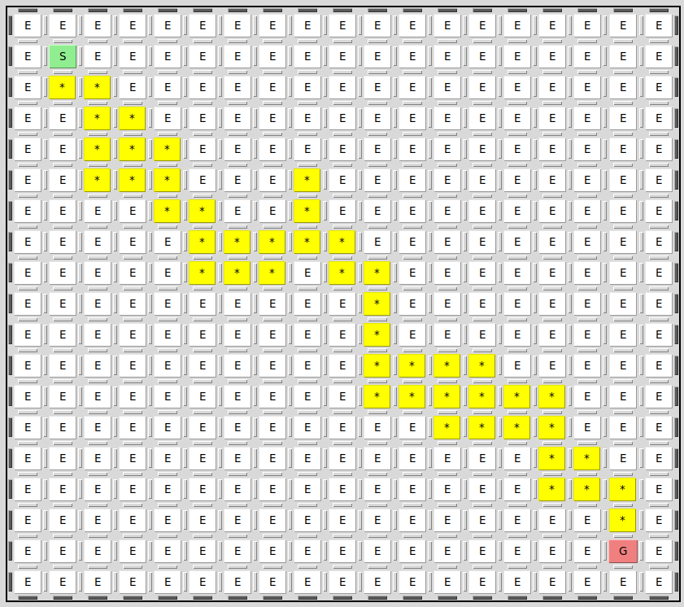
Depth First Search Solution Paths
Spiral
Labyrinth
Empty

Slide 6
Depth First Search Performance Metrics
 | Map size | Path length | Cost | Time(s) | Expanded Nodes count
Empty | 5x5 | 25 | 24 | 0..000110 | 25
 | 10x10 | 75 | 74 | 0.000395 | 82
Labyrinth | 5x5 | 9 | 8 | 0.000108 | 18
 | 10x10 | 43 | 42 | 0.000173 | 78
Spiral | 5x5 | 16 | 15 | 0.000129 | 19
 | 10x10 | 45 | 44 | 0.000087 | 45

Slide 7
Breadth First Search
__
Encoding: Each maze cell is a state represented as (row, col).
Frontier: BFS uses a queue (FIFO), so the earliest discovered state is expanded first.
Search behaviour: Explores level by level. It checks all neighbours at the current depth before going deeper.
Cycle handling: Uses a visited set so the same state is not expanded again.
Tracked results: path, cost, path length, expanded nodes, expanded count, and runtime.
Test Map Types: Empty, Spiral, Simple Labyrinth
Test Sizes: 5x5, 10x10,20x20
Strength: Always finds the shortest path (fewest steps). Complete - guaranteed to find a solution if one exists.
Limitation: Uses a lot of memory because it stores all nodes at each level.

Slide 8
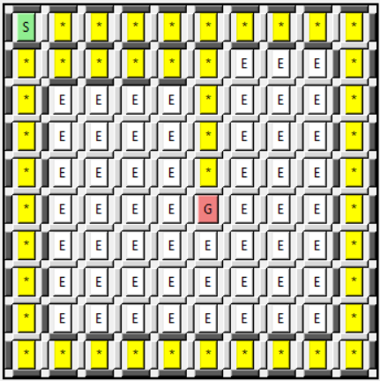
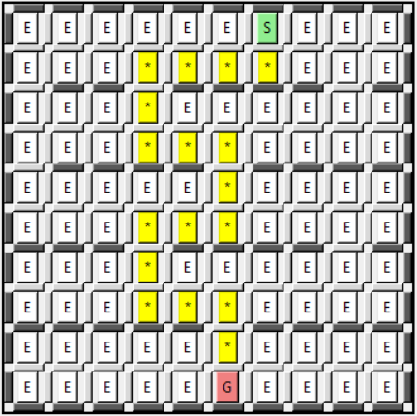
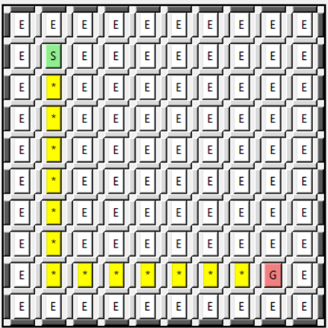
Breadth First Search Solution Paths
Spiral
Labyrinth
Empty

Slide 9
Breadth First Search Performance Metrics
Map Type | Map size | Path length | Cost | Time(s) | Expanded Nodes count
Empty | 5x5 | 9 | 8 | 0..000093 | 25
 | 10x10 | 15 | 14 | 0.000247 | 96
Labyrinth | 5x5 | 9 | 8 | 0.000103 | 24
 | 10x10 | 19 | 18 | 0.000212 | 82
Spiral | 5x5 | 16 | 15 | 0.000066 | 19
 | 10x10 | 45 | 44 | 0.000246 | 54

Slide 10
Uniform Cost Search
__
Encoding: Each maze cell is a state represented as (row, col)
Frontier: Uses a priority queue. States are ordered by their path cost g(n), meaning the state with the lowest cumulative cost is expanded first.
Search Behavior: Explores the maze in concentric "cost" waves. It doesn't care about depth; it cares about value. It expands all paths that are cheaper than the optimal solution before it finally reaches the goal.
Cycle Handling: Uses a visited set (or "closed list") to keep track of the minimum cost to reach each state. If a state is reached again via a more expensive path, it is ignored.
Tracked Results: Path, cost (crucial here), path length, expanded nodes, expanded count, and runtime.

Slide 11
Uniform Cost Search Performance Metrics
Map Type | Map size | Path length | Cost | Time(s) | Expanded Node Count
Empty | 5x5 | 9 | 8 | 0.000058 | 25
 | 10x10 | 15 | 14 | 0.000159 | 96
Labyrinth | 5x5 | 9 | 8 | 0.000057 | 24
 | 10x10 | 19 | 18 | 0.000140 | 84
Spiral | 5x5 | 16 | 15 | 0.000051 | 20
 | 10x10 | 45 | 45 | 0.000093 | 60

Slide 12
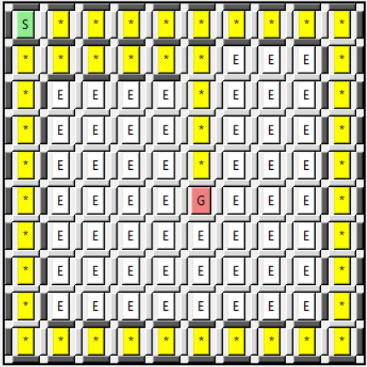
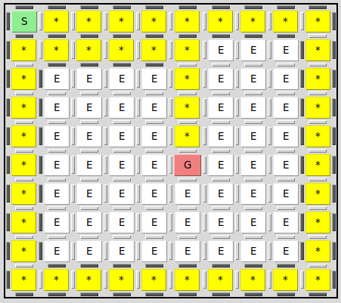
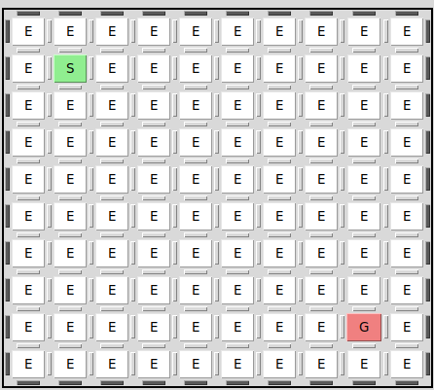
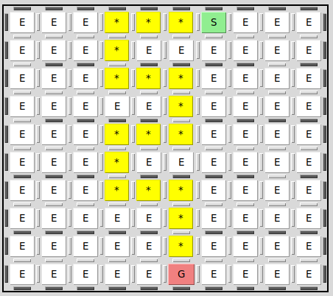
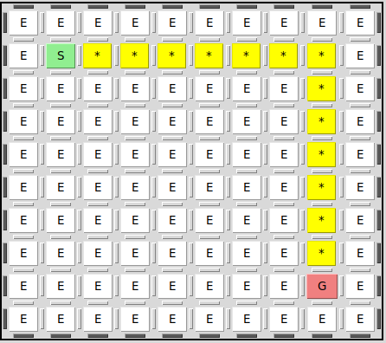
Uniform Cost Search Solution Paths
Spiral
Labyrinth
Empty

Slide 13
Greedy Best First Search
__
Encoding: each maze cell is a state represented as (row, col).
Frontier: Greedy BFS always chooses the state with the lowest heuristic value.
Evaluation Function: f(n) = h(n).
Heuristic Used: We use Manhattan distance to estimate how close the current cell is to the goal.
Search style: It tries to move toward the goal as quickly as possible based on the heuristic.
Cycle handling: Our implementation uses a visited set, so the same state is not expanded again.
Test Map Types: Empty, Spiral, Simple Labyrinth
Test Sizes: 5x5, 10x10,20x20
Output recorded: path, cost, path length, expanded nodes, and expanded count
Strength: Usually expands fewer nodes and can reach the goal quickly.
Limitation: Not optimal, because it only considers h(n) and ignores the path cost already travelled.

Slide 14

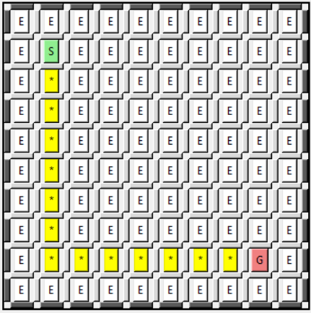
Greedy Best First Search Solution Paths
Spiral
Labyrinth
Empty

Slide 15
Greedy Best First Search Performance Metrics
Map Type | Map size | Path length | Cost | Time(s) | Expanded Nodes count
Empty | 5x5 | 9 | 8 | 0..000096 | 9
 | 10x10 | 15 | 14 | 0.000214 | 15
Labyrinth | 5x5 | 9 | 8 | 0.000140 | 12
 | 10x10 | 19 | 18 | 0.000151 | 25
Spiral | 5x5 | 16 | 15 | 0.000132 | 19
 | 10x10 | 45 | 44 | 0.000165 | 45

Slide 16
A* search
__
Encoding: Each maze cell is a state represented as (row, col).
Frontier: A* uses a priority queue. States are ordered by f(n) = g(n) + h(n). g(n) = actual cost from start to current node h(n) = estimated cost to goal (Manhattan distance)
Search behavior: Expands the node with the lowest f-value first. Combines what it knows (g) with what it estimates (h) to find the goal efficiently.
Cycle handling: Tracks the best cost to reach each state. Only keeps the path if it found a cheaper way to get there.
Tracked results: path, cost, path length, expanded nodes, expanded count, and runtime.
Test Map Types: Empty, Spiral, Simple Labyrinth
Test Sizes: 5x5, 10x10,20x20
Strength: Optimal and usually expands fewer nodes than BFS by using the heuristic to focus the search toward the goal.
Limitation: Still uses a lot of memory like BFS. Depends on having a good heuristic.

Slide 17
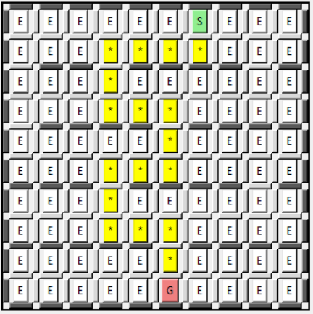
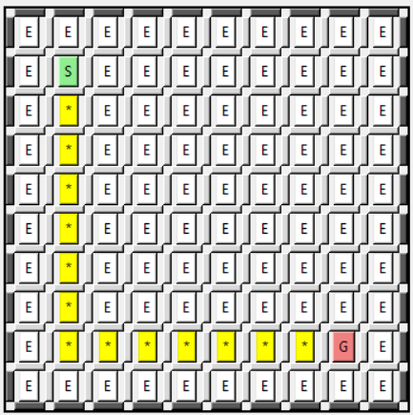
A* Search Solution Paths
Spiral
Labyrinth
Empty

Slide 18
A* Performance Metrics
Map Type | Map size | Path length | Cost | Time(s) | Expanded Nodes count
Empty | 5x5 | 9 | 8 | 0..000128 | 25
 | 10x10 | 15 | 14 | 0.000298 | 64
Labyrinth | 5x5 | 9 | 8 | 0.000114 | 19
 | 10x10 | 19 | 18 | 0.000235 | 54
Spiral | 5x5 | 16 | 15 | 0.000090 | 19
 | 10x10 | 45 | 44 | 0.000171 | 45

Slide 19
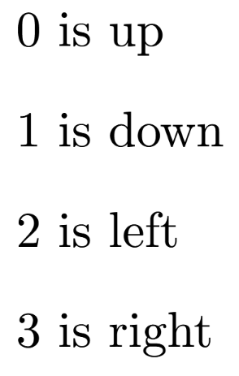

Genetic Algorithm
__
Encoding:
Test Map Types: Empty, Spiral, Simple Labyrinth
Test Sizes: 5x5, 10x10
Test Sample: 15 runs
Test Iteration Range Range:
Selection: Truncation Selection
Crossover: Two Point
Mutation rate: 30%

Slide 20
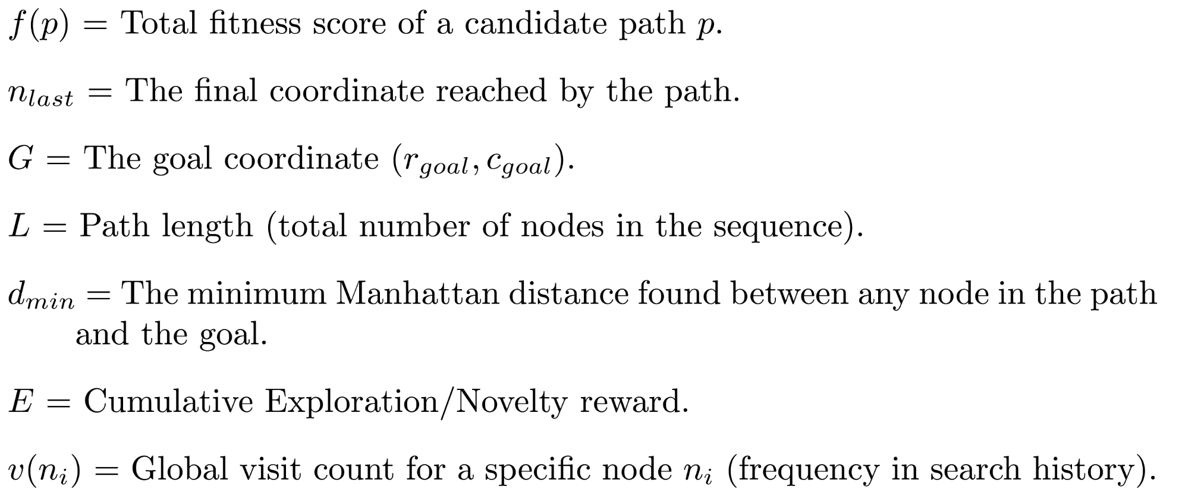
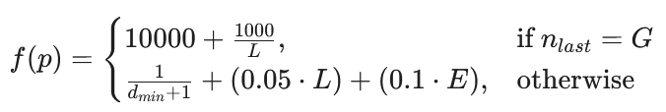
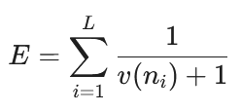
Fitness Function
Version | Effectiveness
V1 (Dist + Success) | 36.67%
V2 (Dist + Success + Survival) | 46.67%
V3 (Dist + Success + Survival + Curiosity) | 60.00%

Slide 21
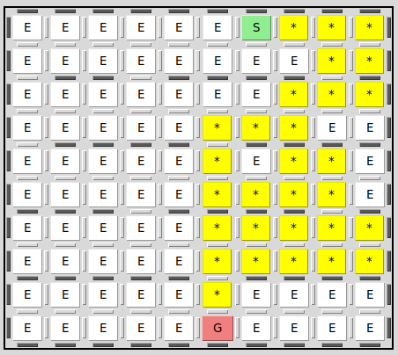
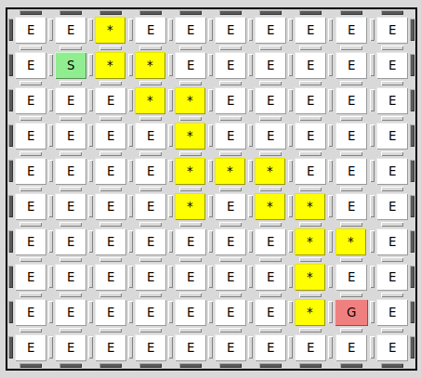
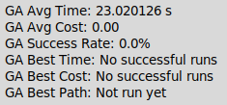
Genetic Algorithm Solution Paths
Spiral
Labyrinth
Empty

Slide 22
Genetic Algorithm Performance Metrics
Map Type | Map size | Iteration Cap | Success | Avg Cost | Avg Time | Best Length | Best Time
Empty | 5x5 | 500 | 100.00% | 9.6 | 0.002519 | 8 | 0.00258
 | 10x10 | 500 | 100.00% | 29.4 | 0.007756 | 24 | 0.007312
Labyrinth | 5x5 | 500 | 100.00% | 13.2 | 0.011402 | 11 | 0.006632
 | 10x10 | 500 | 60.00% | 40 | 0.515621 | 40 | 0.073164
Spiral | 5x5 | 100000 | 0.00% | nul | 120.224116 | nul | nul
 | 10x10 | 100000 | 0.00% | nul | 227.224116 | nul | nul

Slide 23
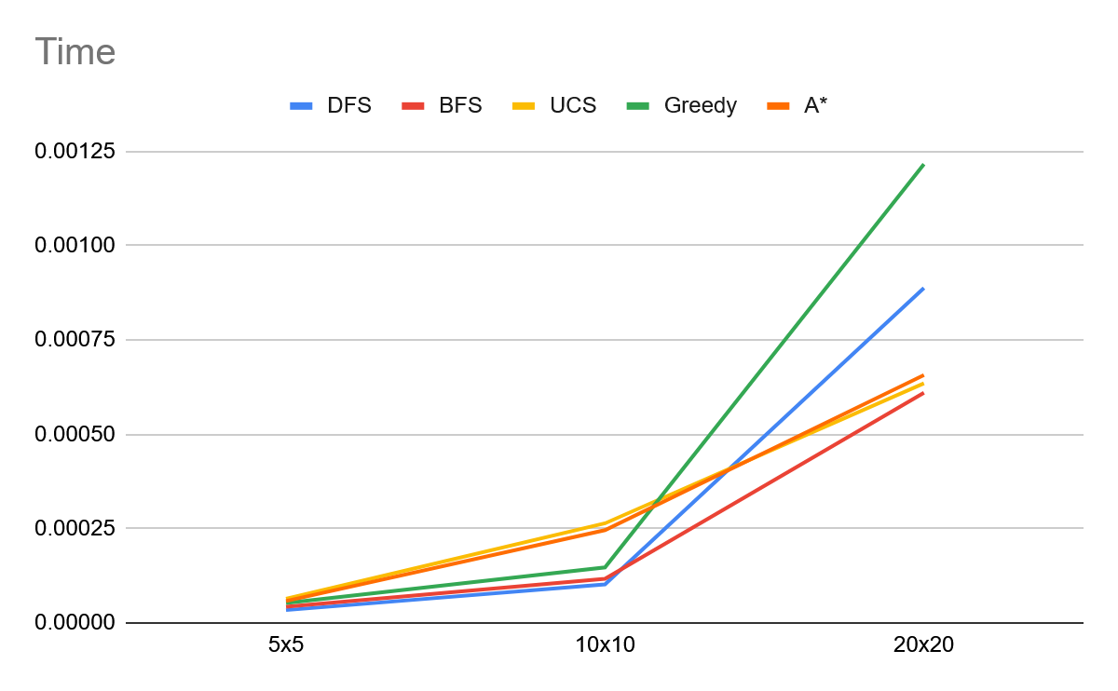
Time Comparison
Genetic Algorithm was an outlier in test of time so they are not included
For the Labyrinth Map

Slide 24
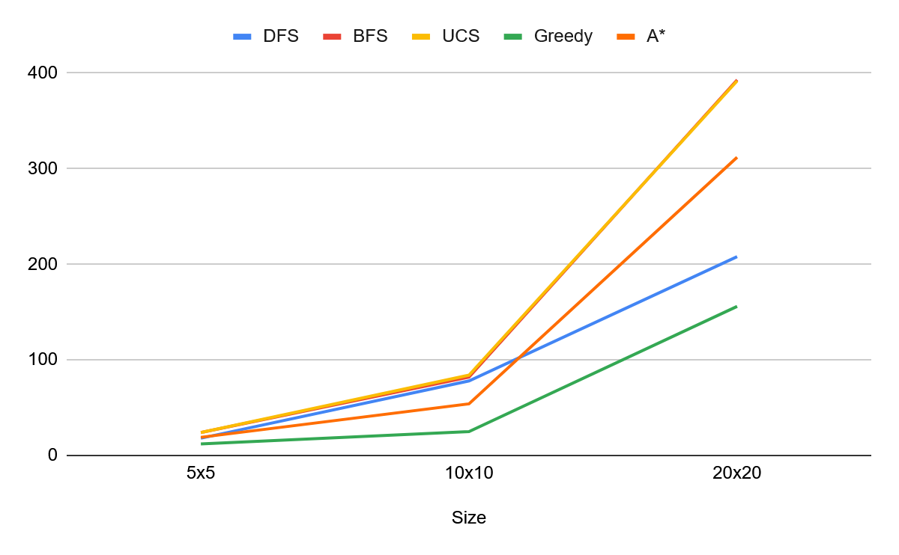
Expanded Node Count Comparison
For the Labyrinth Map
For the same reason its expanded node count is not measured

Slide 25
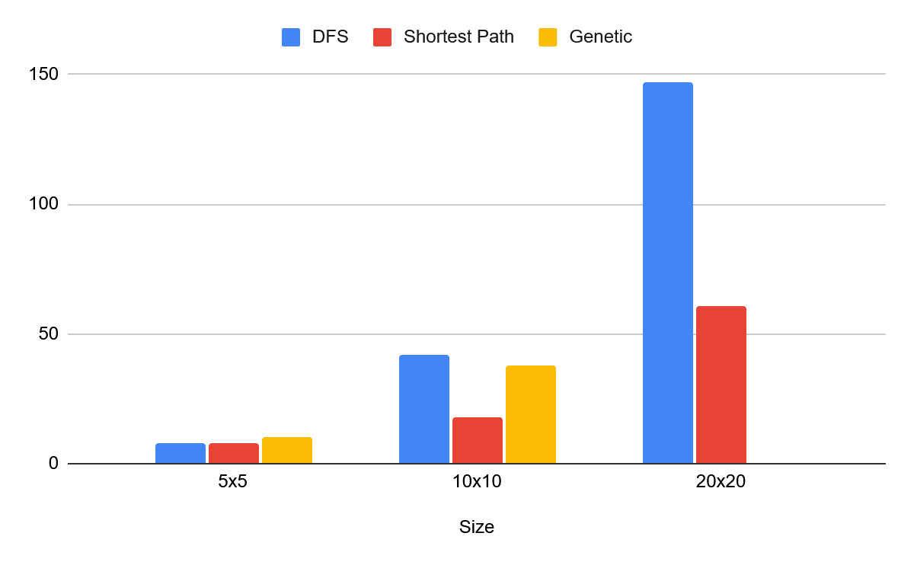
Path Length Comparison
Genetic algorithm failed in more complex maps but performed similarly to a DFS in terms of cost
Shortest path algorithms consistent performed the best of all map sizes

Slide 26
Limitations & Future Work
LIMITATIONS:
Scale: Maximum 20x20 mazes tested; larger grids (100x100+) not evaluated
Static Environment: No dynamic obstacles or real-time maze changes
Simple Costs: Uniform edge weights (cost=1); no varied terrain difficulty
GA Instability: Genetic algorithm failed on spiral mazes (0% success), required 500+ iterations
Single Heuristic: Only Manhattan distance tested; no comparison with Euclidean or custom heuristics
FUTURE WORK:
Test scalability on larger mazes (50x50, 100x100) and measure memory consumption
Explore hybrid algorithms combining Greedy's efficiency with A*'s optimality
Improve Genetic Algorithm fitness function for complex maze success
Apply to real-world scenarios: warehouse robots, game AI, emergency evacuation planning
Test bidirectional search (simultaneous search from start and goal)

Slide 27
Acknowledgments
We would like to thank:
Professor Suresh Pokharel for guidance throughout this project and valuable feedback on our algorithm implementations.
Team Contributions:
Cazal Tirkey: BFS & A* implementation
Nhlonipho Marwala: UCS & Genetic Algorithm
Shakshi Mukeshbhai Patel: DFS & Greedy Best-First Search
References:
Russell & Norvig's "Artificial Intelligence: A Modern Approach" - our primary textbook for understanding search algorithms
Hart, Nilsson & Raphael's foundational paper on A* search (1968)
Various online resources and research papers on genetic algorithms for pathfinding

