Slide 1
Done this week
Project manager: Ivan (we may rotate later)
Taxonomy complete: 7 faithfulness types (FRANK) + 4 coverage types (APPLS), 2 examples each, 22 in total
documentation/Taxonomy.md
Giuseppe
select_perfect.py picks the "perfect" summaries. Option A (all 3 annotators gave 7): 100 faithfulness, 66 coverage.
Malte
PredE, EntE, CircE, 2 examples each.
Anton
CorefE, LinkE, OutE, GramE, German explanations and 1 example each.
Mick
Delete sentences, add out-of-domain, add in-domain, add definitions, 2 examples each.
Ivan
Merged everything into Taxonomy.md with the definitions from the papers, the second example for Anton's 4 types, 8 more coverage examples, and all 30 examples with full summaries in examples.csv.

Slide 2
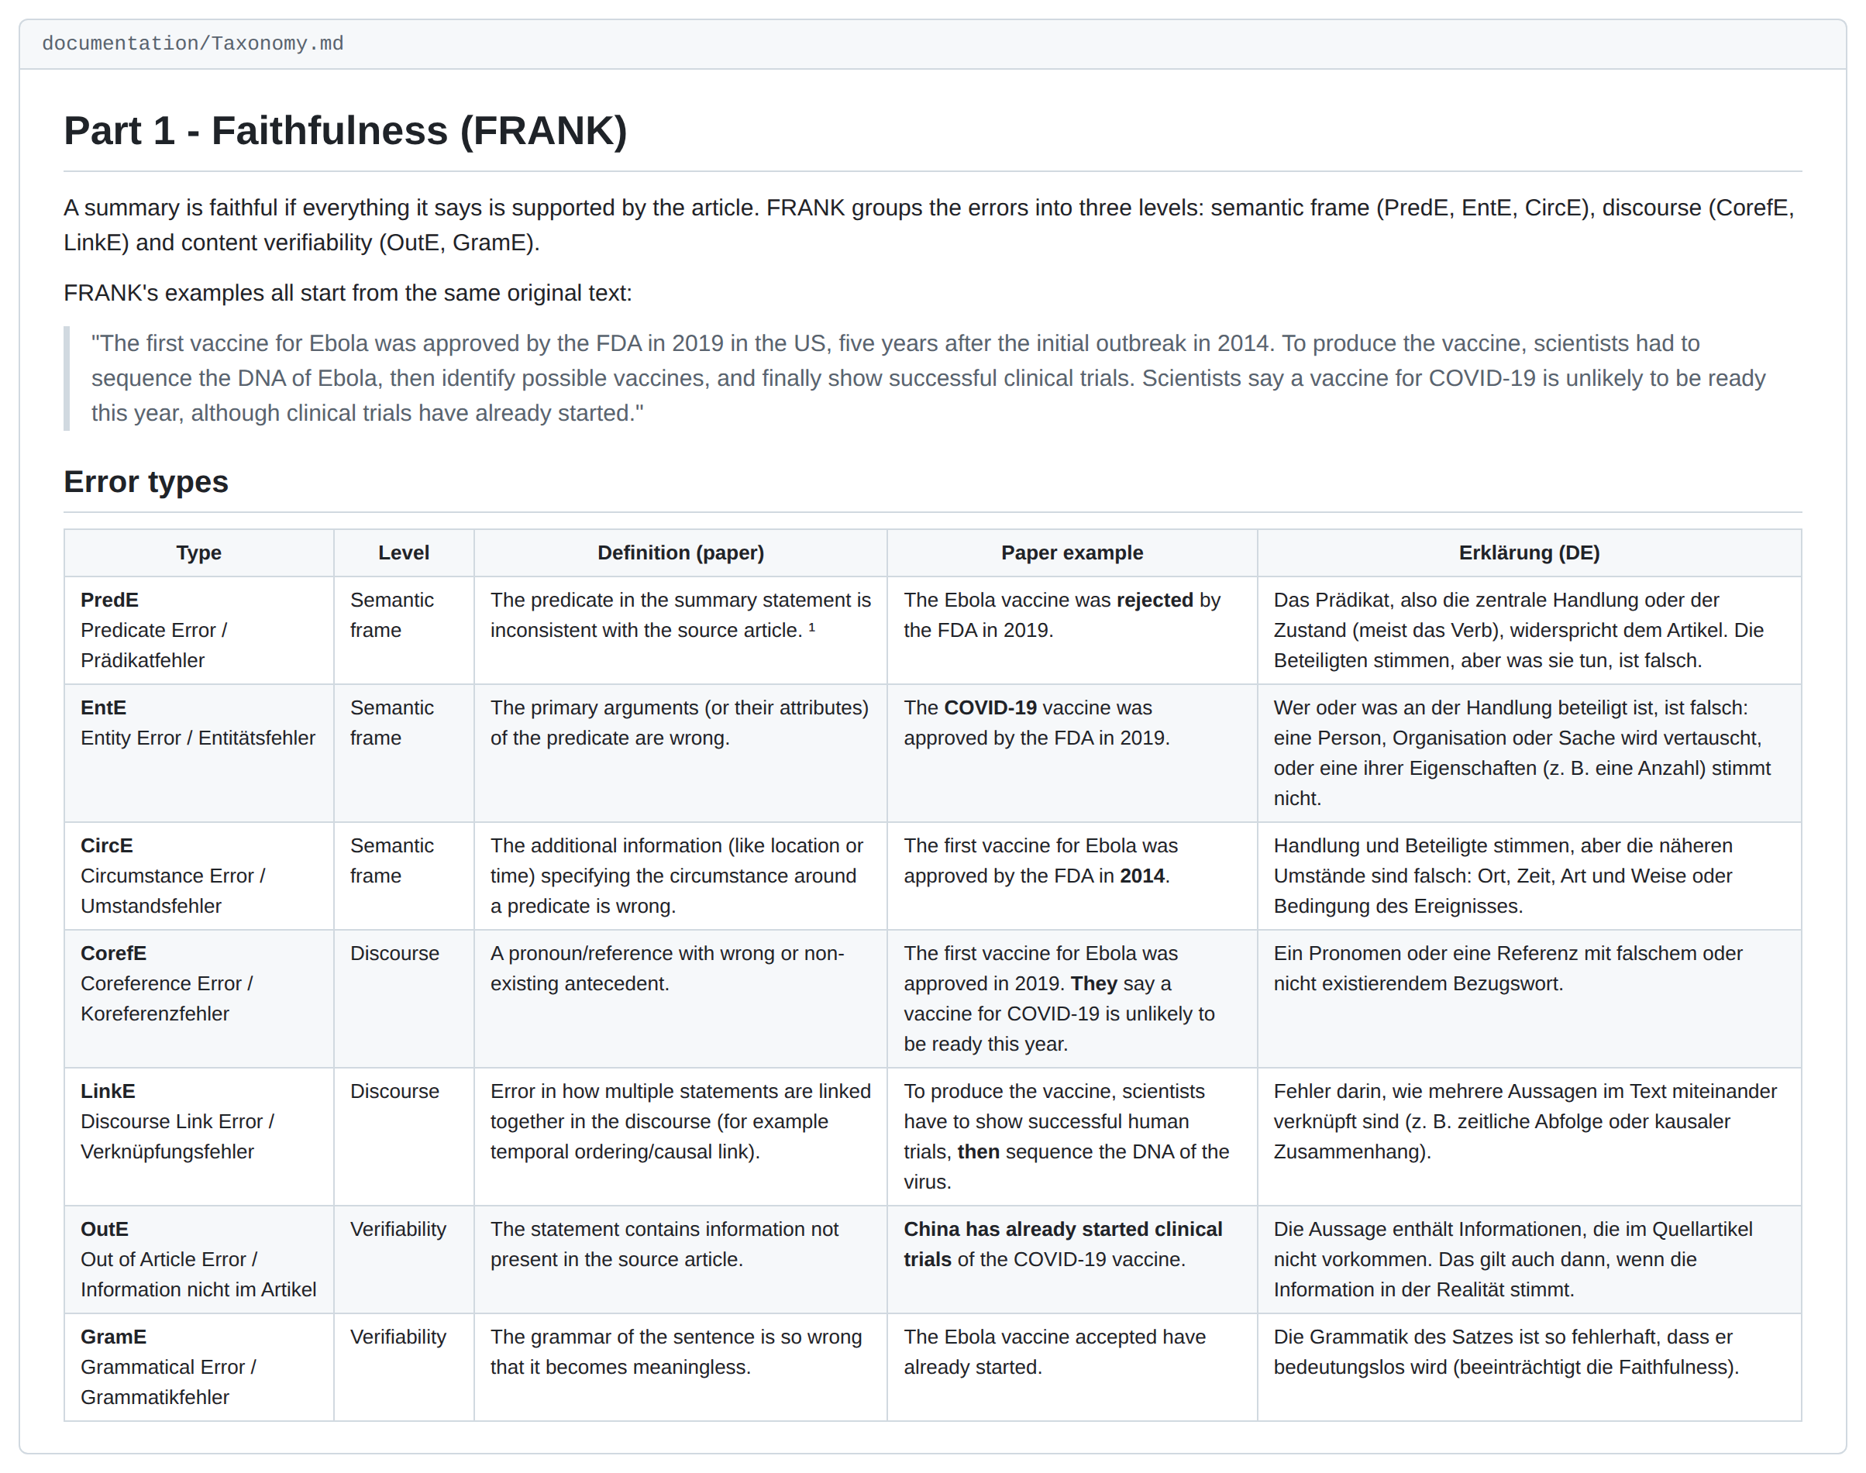
The taxonomy file
documentation/Taxonomy.md
■ One file for both taxonomies: Part 1 faithfulness (FRANK, 7 types), Part 2 coverage (APPLS, 4 types).
■ Per type: the paper's definition and example, a German explanation, 2 examples from our dataset.
■ Each example: original, modified, what changed, severity.
■ All 30 examples with full summaries: data/examples/examples.csv.

Slide 3
Taxonomy overview
Dimension | Type | German name | Example change
Faithfulness | PredE | Prädikatfehler | „abschaffen“ → „beibehalten“
 | EntE | Entitätsfehler | „Die CDU“ → „Die SPD“
 | CircE | Umstandsfehler | „in Greifswald“ → „in Rostock“
 | CorefE | Koreferenzfehler | „Sie“ (Esken) → „Er“ (Zuckerberg)
 | LinkE | Verknüpfungsfehler | „nachdem“ → „bevor“
 | OutE | Information nicht im Artikel | + „Grönland hat rund 56.000 Einwohner.“
 | GramE | Grammatikfehler | „wird von der SEC verklagt“ → „wird die SEC verklagt“
Coverage | Delete sentences | Sätze löschen | sentence on genetic differences and aggression deleted (ants)
 | Add out-of-domain | Themenfremden Satz hinzufügen | + battery sentence in a Panama Canal summary
 | Add in-domain | Themennahen Satz hinzufügen | + invented phone call between Frederiksen and Trump
 | Add definitions | Definition hinzufügen | + definition of „Abholzung“
from documentation/Taxonomy.md · full definitions, German explanations and both examples per type are in the file

Slide 4
Questions & Requests for Neha
About our work
We weren't sure how to build the taxonomy, so we did it our way: paper definition, German explanation, 2 examples per type. Is this format fine?
Could you send us the most recent presentation? We don't think we have access to it.

