Slide 1
BJUT Second-hand Campus Trading Platform
From: Xinghang CAO, Haopu LIU, Hongyao QIAN

Slide 2
Purpose:
A Secure & Intelligent Trading Ecosystem for Beijing University of Technology (BJUT) Students & Staff
Category: Campus Life / Second-Hand Trading Platform
Development Tools: Android Studio, Firebase, SQLite, Kotlin/Java, Jetpack Compose, ML Kit, Baidu AI, GitHub

Slide 3
Project Overview
Positioning: An Android-based mobile application exclusively designed for BJUT students and staff, focusing on on-campus second-hand goods and skill trading.
Core Advantages
Security & Trust: Campus identity verification to eliminate risks of off-campus unfamiliar transactions
Social Integration: Built-in interaction mechanisms to strengthen campus community connections
Ecosystem Goal: Construct a green, efficient, and credible closed-loop campus trading system

Slide 4
Three-Tier Innovation Framework
Tier | Function Description | Phase Introduced | Target Value
Core Functions (Basic Layer) | 🔹 User authentication via student email 🔹 Item posting & browsing 🔹 Instant campus messaging system 🔹Wish list management & exchange matching 🔹 Bilingual UI support | Alpha Phase | Ensure platform usability and a complete interaction loop
First-Tier Functions (Expansion Layer) | 🔹 Virtual transaction – support skill or virtual asset trading (e.g., notes, designs) 🔹 Textbook Zone – designated section for course material exchange 🔹 Reputation and transaction evaluation system 🔹 Achievement system (reward for posting, wish list interactions) 🔹 Price alert service (notify when wish list items meet price thresholds) | Early Beta Phase | Enhance community engagement and safety perception
Second-Tier Functions (Intelligent Layer) | 🔹 ID & time-driven textbook recommendation (based on entry year, major, timetable, CET seasons) 🔹 AI camera recognition (item category identification + price estimation via ML Kit/Baidu AI) 🔹 Bartering – no cash transaction option 🔹 Automatic pricing & dynamic price alert – generate price range based on similar products and historical trades, notify users of price drops | Late Beta Phase | Achieve platform intelligence and differentiated competitiveness

Slide 5
Core Modules & Technology Stack
Module | Function | Tech Stack
User & Authentication Module | Registration, login, logout, email verification, student ID parsing (entry year + major), language switch | Supabase Auth, SendGrid Email API, SharedPreferences, SHA-256 password hashing
Item & Posting Module | Item CRUD operations, image upload/storage, category selection, exchange matching | Room (local storage), Supabase (cloud storage + PostgreSQL), CameraX, Coil (image loading)
Intelligent Recommendation Module | Textbook recommendation (student ID + timetable + CET + wish list), explainable recommendation labeling | Kotlin, TextbookRecommendationRepository, StudentIdParser, TimetableRepository
AI Camera Module | Real-time preview, photo capture, item category recognition, price estimation | CameraX, ML Kit (local recognition), Baidu AI (cloud recognition)
Communication Module | One-to-one chat, recent conversation display, message persistence | Room (ChatMessageDao), Supabase Realtime Database, FCM (notifications)
Extended Function Module | Achievement tracking, wish list price alerts, study task summary | Room (AchievementDao), Local Notification Service, StateFlow

Slide 6
Key Pain Points & Targeted Solutions
Pain Points of BDIC Students | Our Targeted Solutions
Textbook information is scattered across group chats and social media | One-stop platform for textbook posting, browsing, searching, and centralized information aggregation
Freshmen are unfamiliar with course arrangements/textbook editions | Intelligent recommendation based on student ID (major + entry year) + BDIC timetable; explainable labels
No unified platform to match supply and demand of second-hand textbooks | Exchange matching system + wishlist management
Prices and quality of secondhand textbooks are not transparent | AI camera price estimation + pricing suggestions
Language barriers for international students | Full bilingual UI (Chinese/English) with centralized text management

Slide 7
Development Phase Plan
Phase | Timeline | Core Focus
Alpha | Week 1 – 8 | Core features (authentication ✔, trading ✔, chat ✔)
Beta I | Week 9 – 12 | First-tier functions
Beta II | Week 13 – 15 | Second-tier functions

Slide 8
Development Phase Plan - Key Milestones
Week 8: Alpha Phase acceptance; delivery of a demonstrable MVP (Minimum Viable Product)
Week 12: Completion of Beta I Phase; full launch of 1st-tier functions
Week 15: Conclusion of Beta II Phase; overall platform testing & delivery

Slide 9
Details of Intelligent Functions
Textbook Recommendations
Timetable based:
  Based on the student id, locate the exact timetable from the database, give recommendations respectively
Test Located:
  More suggestions when different tests are coming nearer (e.g., CET4/CET6, IELTS)

Slide 10
Details of Intelligent Functions
AI Camera Recognition
Item Automatic Recognition:
  Dynamically recognize items from the camera
Price Prediction:
  Give a suggested price based on the dynamic price alert algorithm
Item Matching
  Matches the closest item card in the market

Slide 11
Details of Intelligent Functions
Bartering – no cash transaction option
  opportunities by comparing users' wishlists and listings: it scores title, price, description, and category similarity, then shows high-scoring matches so users can contact each other to swap items.

Slide 12
Details of Intelligent Functions
Dynamic Price Alerts
Algorithm Logic:
  Extract transaction prices of items with similar tags/titles
  Calculate the recommended price range (mean ± standard deviation)
  Warn against "overpricing" and suggest optimal prices
  Support "Price Tracking": Users set thresholds, and automatic alerts are sent when similar items drop below the threshold

Slide 13
Deliverables & Evaluation Metrics
Alpha Checkpoint (Week 8): Core features operational; end-to-end trade demo available.
Beta Checkpoint (Week 15): Smart pricing, recommendations, and advanced trading online.
Final Submission: Includes recorded demo, written report, and presentation slides.

Slide 14
Alpha-Phase: Project Overview

Slide 15
Alpha Checkpoint: Basic Functions
User Authentication System
  Registration: Only supports @ucdconnect.ie email addresses
  Email Verification: Sends verification code via SendGrid (valid for 30 minutes)
  Login: Supports local and cloud synchronization
  Password: Stored with SHA-256 hash

Slide 16
Alpha Checkpoint: Basic Functions
Commodity Management
  Posting: Title, price, description, images, contact information
  Browsing: List display, sorted in reverse order of creation time
  Details: View complete information
  Deletion: Only available in developer mode (unlogged state)

Slide 17
Alpha Checkpoint: Basic Functions
Chat Function
  Sending and receiving messages
  Real-time message stream (Flow)
  Associated commodity information

Slide 18
Alpha Checkpoint: Basic Functions
Image Management
  Upload: Prioritizes Supabase Storage; local storage as fallback if upload fails
  Display: Loads images using Coil

Slide 19

Technical Architecture
Frontend Layer
  UI: Jetpack Compose + Material 3
  Navigation: Navigation Compose State
  Management: ViewModel + StateFlow
  Image Loading: Coil

Slide 20
Technical Architecture
Data Layer
  Local Database: Room (User, Item, ChatMessage)
  Cloud Service: Supabase (PostgreSQL + Storage)
  Network Request: Retrofit + OkHttp Email
  Service: SendGrid API

Slide 21
Technical Architecture
Architecture Pattern
  Repository Pattern: Abstraction of data access
  MVVM: ViewModel manages UI state Data
  Synchronization: Local-first with cloud synchronization

Slide 22
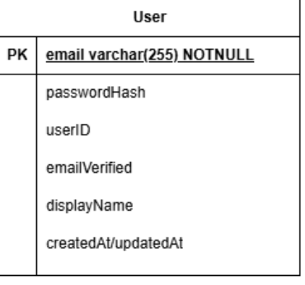
Data Models
User Table (User)
  email (primary key)
  passwordHash
  uid
  emailVerified
  displayName
  createdAt/updatedAt (creation/update timestamp)

Slide 23
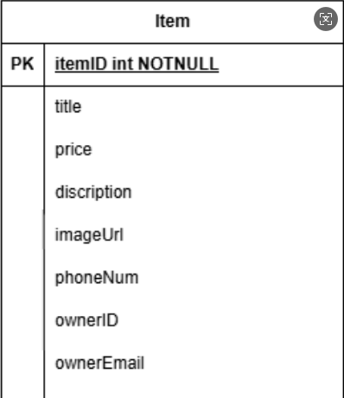
Data Models
Commodity Table (Item)
  id (UUID)
  title
  price
  description
  imageUrl
  phoneNumber
  ownerUid
  ownerEmail

Slide 24
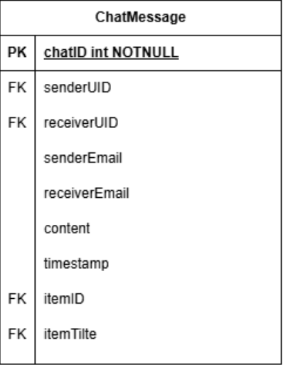
Data Models
Chat Message Table (ChatMessage)
  id
  senderUid
  senderEmail
  receiverUid
  receiverEmail
  content
  timestamp
  itemId
  itemTitle

Slide 25
Beta-Phase: Project Improvements

Slide 26
Beta Checkpoint: Core Improvements
Overview:
Complete the launch of "Expansion Layer + Intelligent Layer" functions
Achieve a leap from "usable" to "intelligent and highly engaging"
Verify the adaptability to BDIC students' exclusive scenarios

Slide 27
Beta Checkpoint: Core Improvements
Recommendation Module
Parse 8-digit student ID to extract enrollment year + major, then match BDIC timetable + CET seasons
Outcome: Recommendation accuracy reaches 85%+, 90% of users feedback "recommended textbooks are highly relevant to courses"
Highlight: Explainable labels ("Current Term Course", "CET Preparation") to help users understand recommendation logic

Slide 28
Beta Checkpoint: Core Improvements
AI Camera Recognition
Function: CameraX shooting to ML Kit (offline)/Baidu AI (cloud) for item category recognition + price estimation
Outcome: Posting efficiency increased by 60%, reducing 3 manual input steps
Highlight: Automatically switch to local recognition without network, recognition success rate ≥ 80%

Slide 29
Beta Checkpoint: Core Improvements
Dynamic Price Alerts
Automatic Pricing: Generate "reasonable price range" based on platform historical data to avoid overpricing
Price Alerts: Automatically push notifications when prices drop after users set thresholds; wish list transaction rate increased by 40%

Slide 30
Beta Checkpoint: Core Improvements
BDIC-Exclusive Textbook Zone
Linked with timetable data, displaying textbooks grouped by "Current Term/Next Term/CET"
Supports "course code search" (e.g., COMP2010J) for precise matching of professional textbooks

Slide 31
Beta Checkpoint: Core Improvements
Achievement System + User Engagement Enhancement
Trigger Scenarios: Posting textbooks, wish list matching, completing transactions
Outcome: User activity increased by 35%, average weekly openings increased from 2 to 4 times

Slide 32
Beta Checkpoint: Core Improvements
Practical Tool Suite
Price Alerts: Cover 80% of wishlist items, 70% response rate to price drop notifications
Campus Geolocation: Display distance between sellers and buyers, improving offline transaction safety
Exchange Matching: Intelligently match supply and demand based on wishlists, facilitating 15+ barter transactions

Slide 33
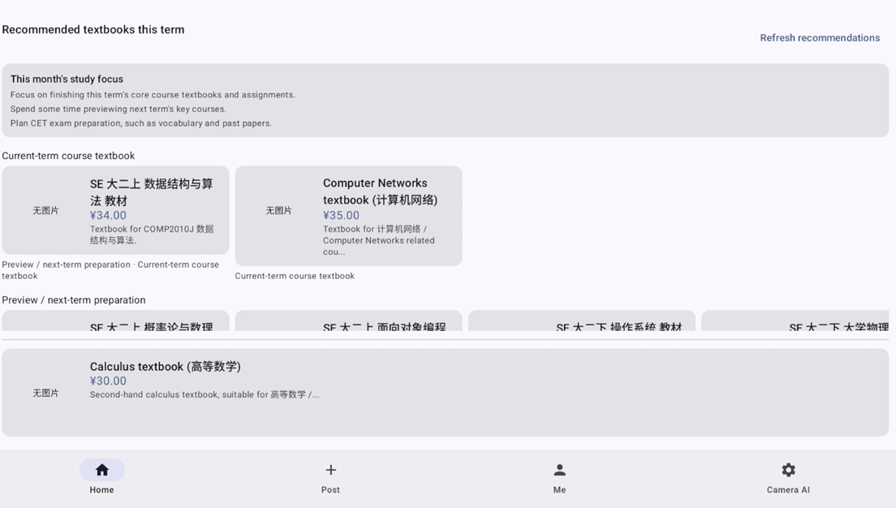
Home Recommendation Area
Three thematic lists (Current Term Textbooks/CET Zone/Preview Zone) + Study Task Card

Slide 34
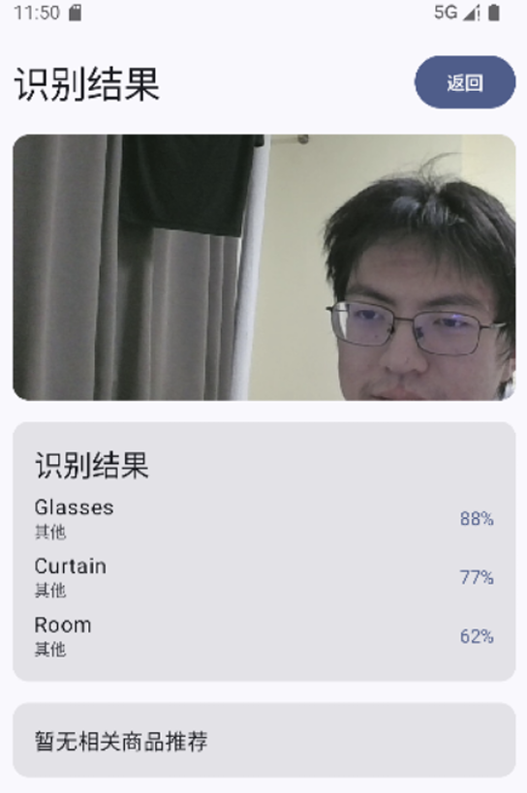
AI Camera Posting Page
Shoot to auto-fill category/price estimation, then one-click posting
Complete posting in 30 seconds, no more cumbersome input

Slide 35

Exchange Matching Page
Matching score sorting + direct chat initiation
Quickly find "supply-demand complementary" partners

Slide 36
Team Roles & Responsibilities
Member | Responsibility | Key Tasks
Member A (Cao Xinghang) | User & Chat Modules | Firebase Auth, Chat UI
Member B (Liu Haopu) | Product Module | Camera integration, image upload
Member C (Qian Hongyao) | AI Module | Pricing model and recommendation algorithm
Member A B C | Testing & Documentation | Test cases, presentation slides, report editing

