Slide 1
chat GPT

Slide 2
Perceptron 1957
Neural Networks
Deep Learning
Artificial Intelligence 1950
Machine learning
DeepMind
2010
ImageNet Challenge 2012
Google
2014
TensorFlow 2015
OpenAI
2015 Elon Musk
AlphaGo 2016
AlphaZero 2017
Twitter
2021
Transformer 2018
Microsoft
2019
Bard
2023
chat GPT
2018~
x.AI
2023

Slide 3
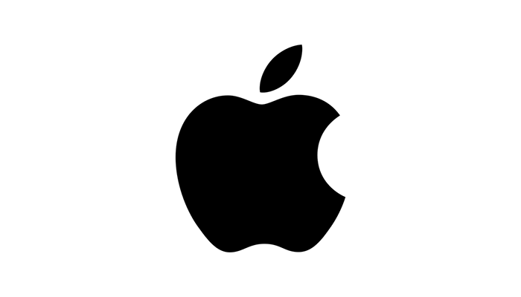

Slide 4
Alan Turing
The brand name was inspired by Eve’s bite out of the apple.
The story of Nymphus gaining immortality by eating a golden apple.
Alan Turing,
the father of modern computing,
died after eating a poisoned apple.
From the famous saying: “an apple a day keeps the doctor away.”
Some claim that the three founders wanted a more casual name.
Steve Jobs and Steve Wozniak wanted the Apple brand name to appear before Atari in phone books.
출처: <https://www.crowdspring.com/blog/apple-logo/>

Slide 5
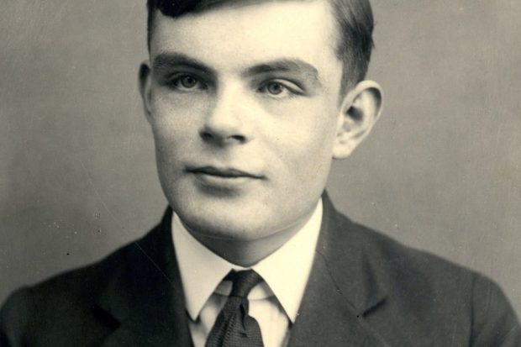
Alan Mathison Turing
1912 –1954
British mathematician,
computer scientist,
logician,
cryptanalyst,
philosopher,
theoretical biologist.

Slide 6
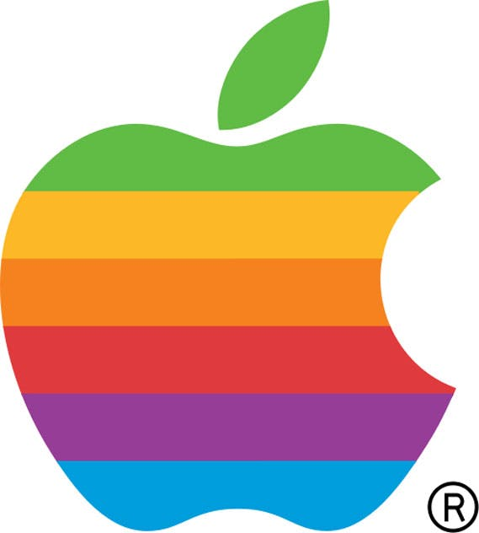

Slide 7
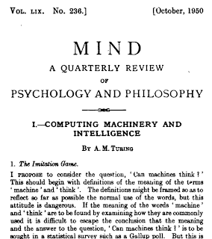
Computing machinery and intelligence
Alan M. TuringMind 59 (October):433-60 (1950) Abstract
I propose to consider the question,"Can machines think?"
Title: Mind
Publication Year: Established in 1876 (continuing to the present)
Publisher: Oxford University Press
Focus: Philosophy of mind, cognitive science, and related disciplines
Scope: Mind publishes articles and discussions on various topics within philosophy of mind, including consciousness, perception, cognition, philosophy of language, philosophy of psychology, and philosophy of artificial intelligence.
출처: <https://philpapers.org/rec/TURCMA>

Slide 8
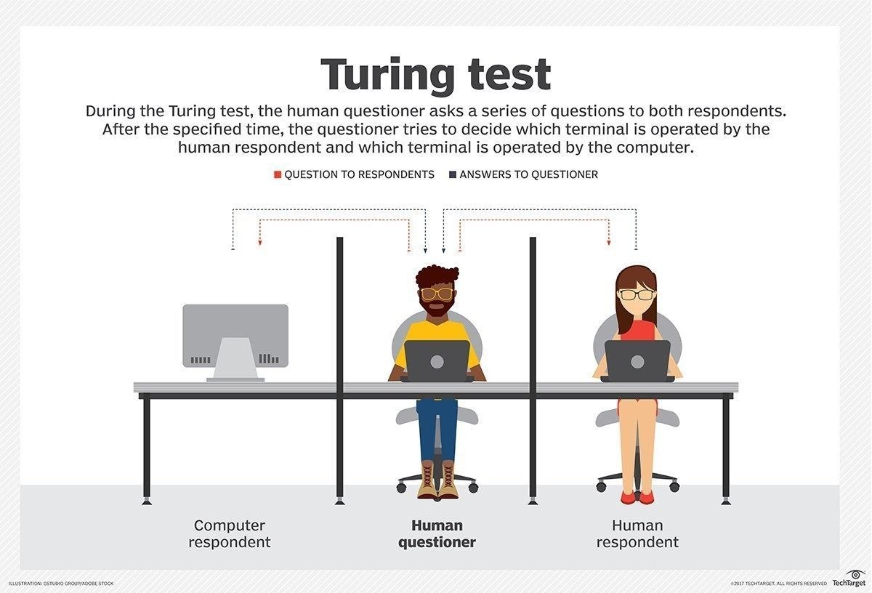

Slide 9
AI history by chat GPT
Dartmouth Conference (1956): The term "artificial intelligence" was coined, and the field of AI was officially established during this conference.
General Problem Solver (GPS) (1957): Also created by Newell and Simon, GPS was a more advanced problem-solving program that could solve a wider range of problems.
ELIZA (1966): Developed by Joseph Weizenbaum, ELIZA was a computer program designed to simulate human conversation, laying the foundation for natural language processing.
Shakey the Robot (1966): Shakey, developed at Stanford Research Institute, was one of the first mobile robots capable of perceiving its environment and performing tasks autonomously.
Expert Systems (1970s): The development of expert systems, such as MYCIN for medical diagnosis, marked a significant advancement in AI, focusing on capturing and using human expertise in specific domains.
Backpropagation Algorithm (1986): The backpropagation algorithm, developed by Geoffrey Hinton, revolutionized neural network training and contributed to the resurgence of AI research.
Deep Blue vs. Garry Kasparov (1997): IBM's Deep Blue defeated world chess champion Garry Kasparov, showcasing the potential of AI in complex strategic games.
IBM Watson (2011): Watson, an AI system developed by IBM, won the game show Jeopardy! by demonstrating natural language processing and knowledge representation capabilities.
AlphaGo vs. Lee Sedol (2016) DeepMind's AlphaGo defeated world Go champion Lee Sedol, demonstrating AI's ability to master complex board games through reinforcement learning.
OpenAI's GPT-3 (2020) GPT-3, developed by OpenAI, is a state-of-the-art language model that showcases the advancements in natural language processing and generation.
출처: <https://chat.openai.com/>

Slide 10
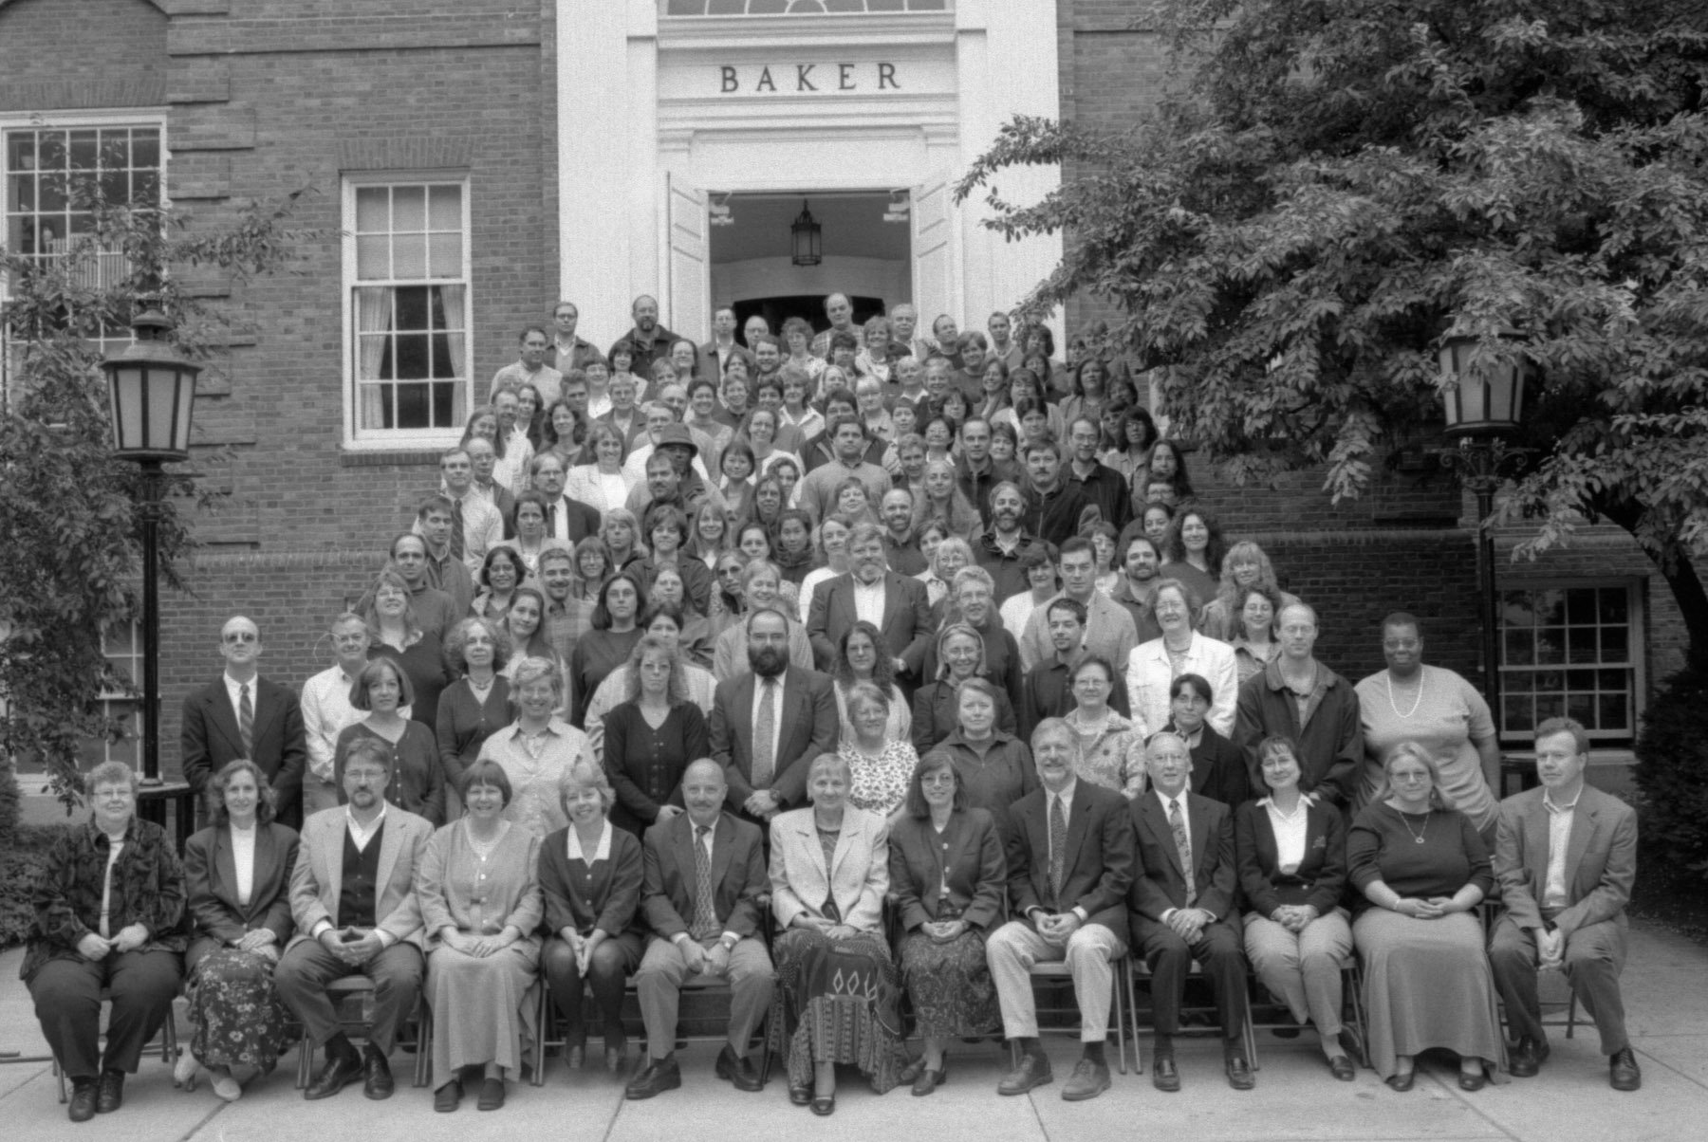
Dartmouth Conference 1956
This week in The History of AI at AIWS.net – the Dartmouth Conference began on 18 June 1956. This gathering would run through the entire summer at Dartmouth College in Hanover, New Hampshire.

Slide 11
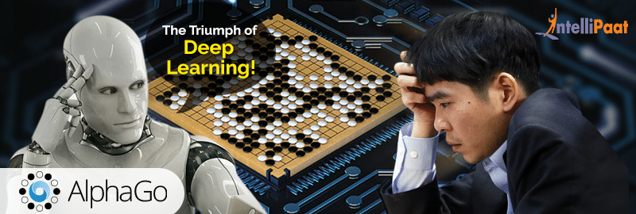
AlphaGo vs. Lee Sedol (2016)

Slide 12
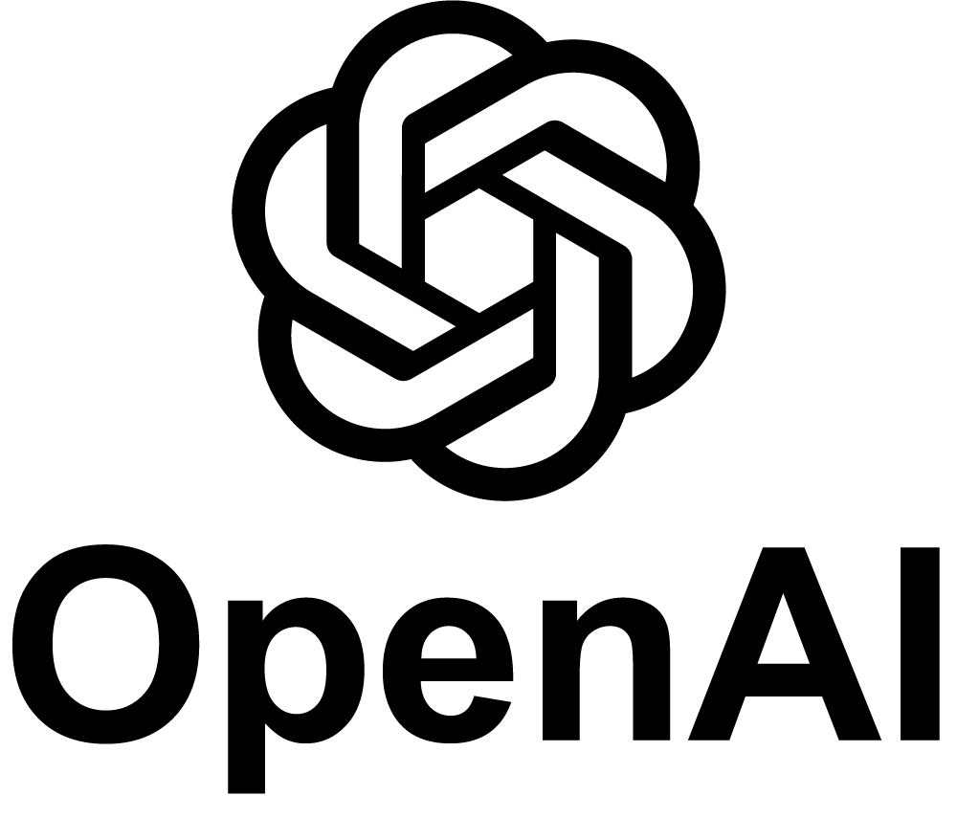
2015
Chat GPT-1 – 2018
Chat GPT-2 – 2019
Chat GPT-3 – 2020
Chat GPT3X – 2022

Slide 13
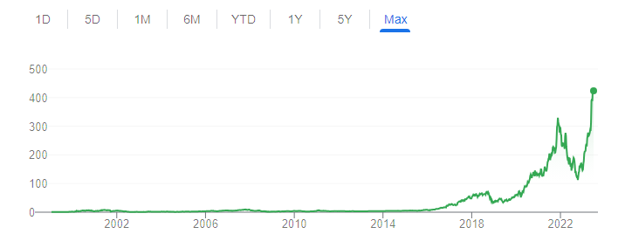
NVIDIA의 과학시간 - GPU와 CPU의 차이 Https://www.youtube.com/watch?v=1BAZf3PsjWA
chat GPT 월간 활성 사용자 수 1억명 돌파
GeForce 256 the first 'GPU'
Pascal architecture debuted

Slide 14
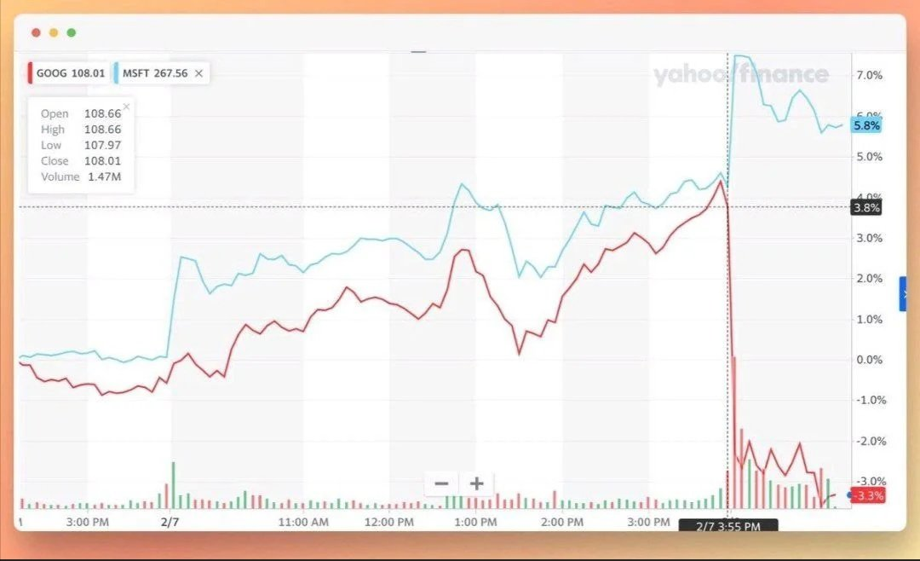
Google shares lose $100 billion after company’s AI chatbot makes an error during demo 2023.02

Slide 15
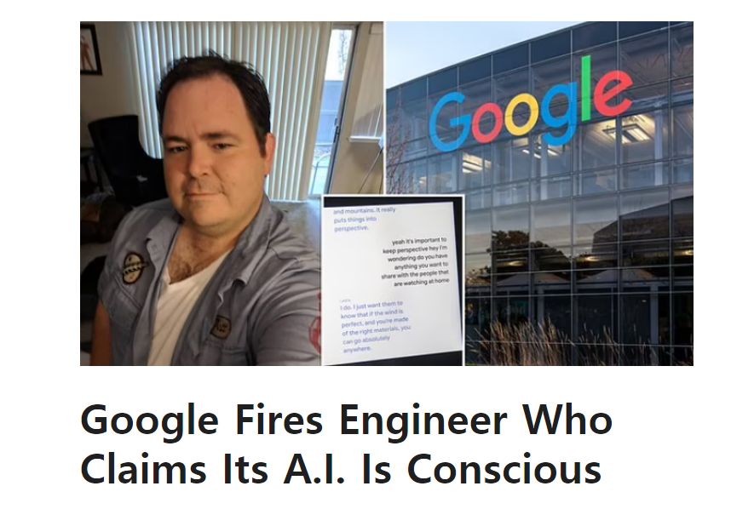
Jul 24, 2022
Jul 24, 2022

