Slide 1
chat GPT
Generative Pre-trained Transformer
Link : What is Chat GPT and How Does It Work?

Slide 2
Perceptron 1957
Neural Networks
Deep Learning
Artificial Intelligence 1950
Machine learning
DeepMind
2010
ImageNet Challenge 2012
Google
2014
TensorFlow 2015
OpenAI
2015 Elon Musk
AlphaGo 2016
AlphaZero 2017
Twitter
2021
Transformer 2018
Microsoft
2019
Bard
2023
chat GPT
2018~
x.AI
2023

Slide 3
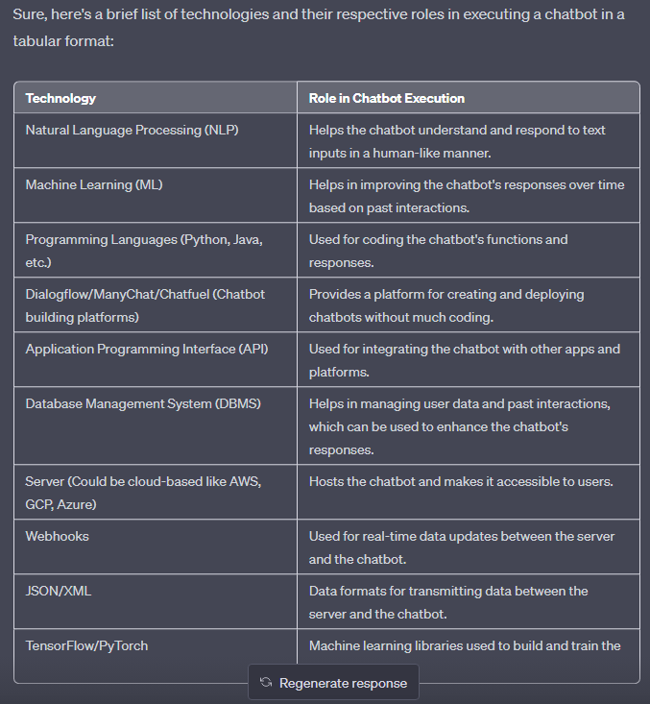
chat GPT
"Chat" refers to
conversation or informal talk
to engage
in interactive
text-based discussions
with users.
Natural Language Processing (NLP)
Machine Learning (ML)…….
Link : What is Chat GPT and How Does It Work?

Slide 4
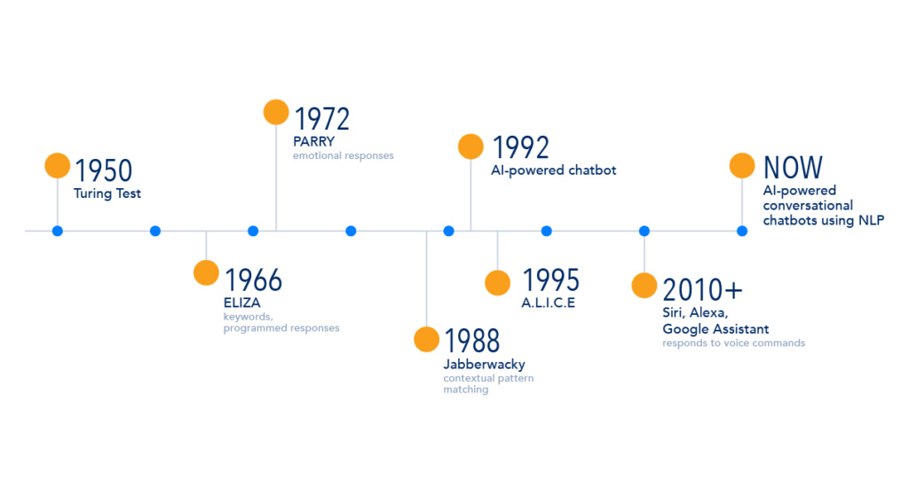
Evolution of Chatbots

Slide 5
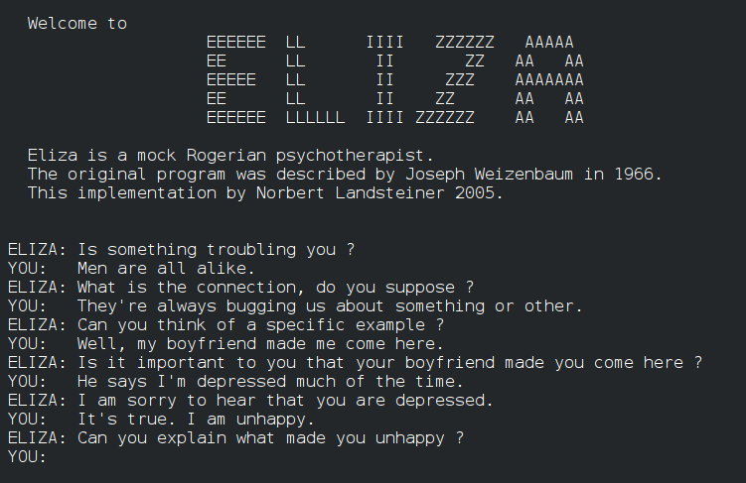
ELIZA, one of the first chatbots in 1966

Slide 6
chat GPT
Generative Pre-trained Transformer
In a nutshell, Chat GPT is an
artificial intelligence (AI) content generator
that semi-autonomously creates phrases and articles
based on user input.

Slide 7
key aspects of human intelligence:
Cognitive abilities: Thinking, reasoning, problem-solving, and memory.
Learning and adaptability: Acquiring knowledge and applying it to different situations.
Abstract thinking: Grasping complex ideas and making connections.
Communication: Effective use of language for understanding and expression.
Social and emotional understanding: Interacting with others and managing emotions.
Problem solving and adaptability: Finding solutions and adjusting to new situations.

Slide 8
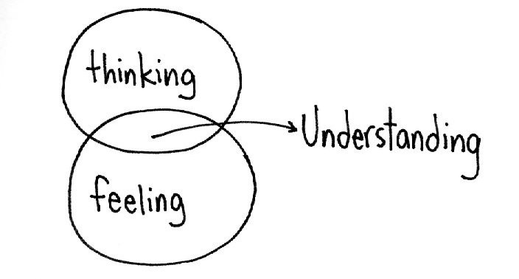
Intelligence
Cognitive abilities
Intellect
Unconscious Forgetting nonverbal communication

Slide 9
chat GPT
Generative Pre-trained Transformer
In a nutshell, Chat GPT is an
artificial intelligence (AI) content generator
that semi-autonomously creates phrases and articles
based on user input.

Slide 10
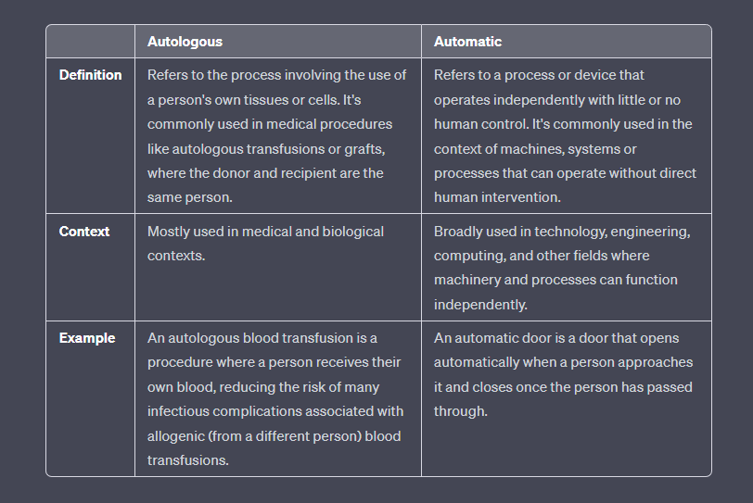

Slide 11
"Autonomously”" refers to the ability of a system or entity to act, function, or make decisions independently, without external control or influence. It implies self-governance or self-direction. Car
“Automatically”" refers to a process or action that occurs without manual intervention or human effort. It implies the use of mechanisms, sensors, or predefined rules to perform tasks or execute actions. automatic washing machine

Slide 12
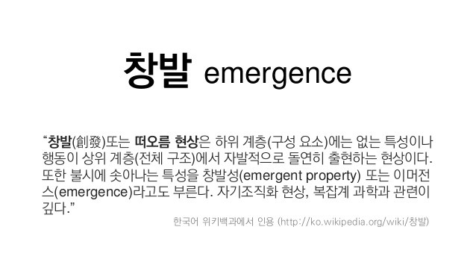
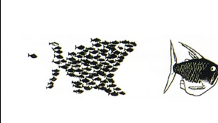
Emergent properties arise when the interaction of individual component produce new functions
"The whole is greater than the sum of its parts” – Aristotle
출처: <https://ib.bioninja.com.au/standard-level/topic-1-cell-biology/11-introduction-to-cells/emergent-properties.html>

Slide 13
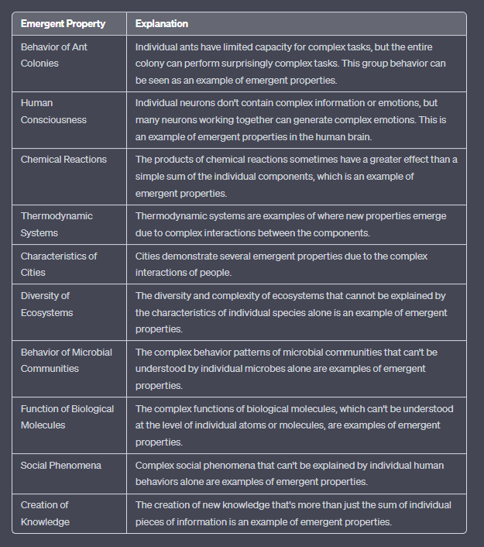
Emergent properties
Emergent properties 창발성 | 설명
개미 군집의 행동 | 개개의 개미는 복잡한 작업을 수행하는 능력이 제한적이지만, 전체 개미 군집은 놀랍도록 복잡한 작업을 수행한다. 이러한 집단 행동은 에머전트 속성의 한 예시로 볼 수 있다[1]
인간의 의식 | 개별 뉴런에는 복잡한 정보나 감정이 담겨 있지 않지만, 수많은 뉴런이 협력하여 복잡한 감정을 생성하는 것이 가능하다. 이는 인간 두뇌에서의 에머전트 속성의 한 예시다[1][3]
화학 반응 | 화학 반응의 결과물은 때때로 개별 성분의 단순한 합보다 큰 영향을 미치며, 이는 에머전트 속성의 한 예시다[1][3]
열역학 시스템 | 열역학 시스템은 각 구성 요소간 복잡한 상호 작용으로 인해 새로운 속성이 나타나는 예시다[1]
도시의 특성 | 도시는 사람들의 복잡한 상호 작용으로 인해 여러 가지 에머전트 속성을 보인다[1][3]
생태계의 다양성 | 개별 종의 특성만으로는 설명할 수 없는 생태계의 다양성과 복잡성은 에머전트 속성의 한 예시다[1]
미생물 집단의 행동 | 개별 미생물만으로는 이해할 수 없는 미생물 집단의 복잡한 행동 패턴은 에머전트 속성의 한 예시다[1]
생체 분자의 기능 | 개별 원자나 분자 단위로는 이해할 수 없는 생체 분자의 복잡한 기능은 에머전트 속성의 한 예시다[1]
사회 현상 | 개별 사람의 행동만으로는 설명할 수 없는 복잡한 사회 현상은 에머전트 속성의 한 예시다[1]
지식의 창출 | 개별 정보 조각들의 집합이 단순히 더해진 것 이상의 새로운 지식을 창출하는 것은 에머전트 속성의 한 예시다[2]

Slide 14
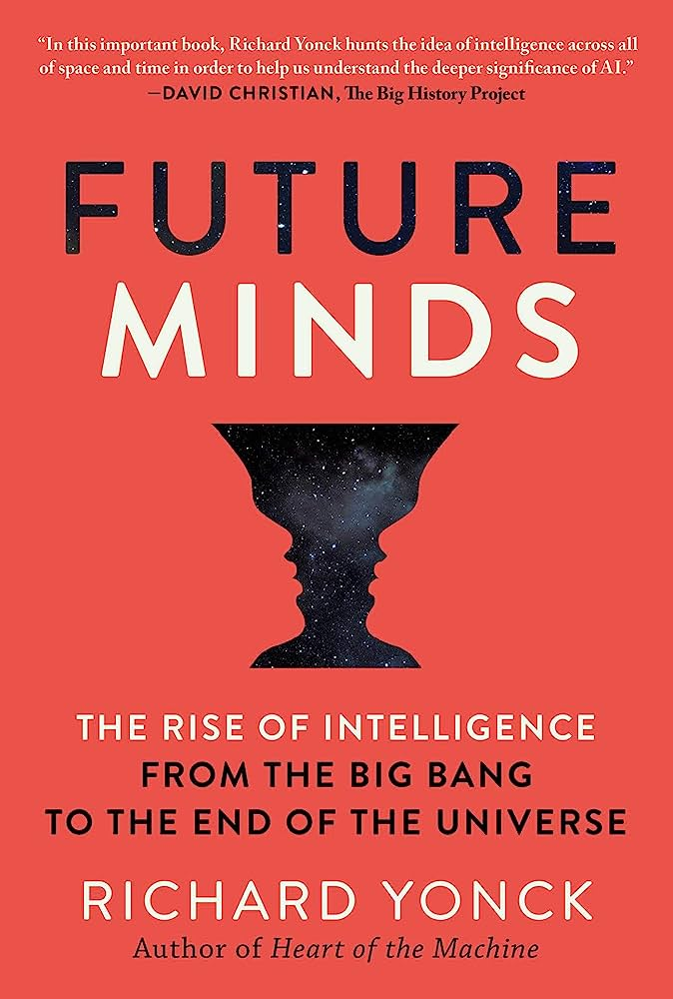
Intelligence
An emergent system’s ability
to respond to its environment in order to improve its conditions,
perpetuate itself and maximize its future freedom of action.”
In writing my latest book, Future Minds: The Rise of Intelligence from the Big Bang to the End of the Universe, it was essential to properly define intelligence in an appropriate context. March 17, 2020

Slide 15
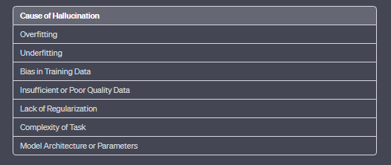
Hallutination
An AI hallucination is when a model generates false information.
AI 가 잘못된 정보를 그럴듯하게 답하는 것.
AI 가 의도를 가질 수 없으니, 나쁜 의도를 가지고 한 일은 아닙니다.

Slide 16
…Learning… | …Training… | Tuning
Medical School | Resident | Sub-speciality
to tackle tomorrow’s issues. | the development of new skills | optimization algorithm
learning is all about equipping a person to tackle not just today’s issues, but preparing him/her to creatively come up with ways to tackle tomorrow’s issues.
Training, on the other hand, focuses more on the development of new skills or skill sets that will be used.
tuning is for the training of hyper parameters of a model, parameters that somehow can't or are not efficient to be optimized for with the optimization algorithm used for training.

Slide 17
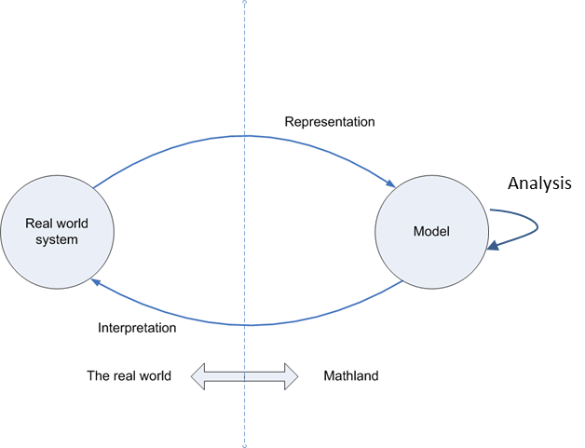
Diagram of Model use and Development

Slide 18
Term | Definition
Model | A mathematical representation of a system or process. A model can be used to predict the behavior of a system or to understand how a system works.
Language model | A statistical model that predicts the probability of a sequence of words. Language models are used in a variety of natural language processing tasks, such as speech recognition, machine translation, and text summarization.
Large language model (LLM) | A language model that has been trained on a massive dataset of text. LLMs have billions of parameters, which allows them to learn complex patterns in language. LLMs are used for a variety of tasks, such as question answering, summarization, and creative text generation.

Slide 19
Type | Parameters | Training Data | Tasks
Probabilistic language model | Millions | Books, articles, code, etc. | Speech recognition, machine translation, text summarization
Neural language model | Billions | Books, articles, code, etc. | Question answering, summarization, creative text generation
Large language model (LLM) | Trillions | Books, articles, code, web documents, etc. | All of the above, plus more complex tasks such as code generation and translation

Slide 20
chat GPT
Generative Pre-trained Transformer
In a nutshell, Chat GPT is an
artificial intelligence (AI) content generator
that semi-autonomously creates phrases and articles
based on user input.

Slide 21
chat GPT
Fine-tuning:- One of the most common ways to use Chat GPT is to fine-tune the model on a specific task or dataset. For example, you can fine-tune the model on a dataset of customer service conversations to improve its ability to understand and respond to customer inquiries.
Text generation:- Chat GPT can be used to generate text on a variety of topics. This can be done by providing the model with a prompt or a piece of text and asking it to generate additional text based on that input. This can be useful for content creation, for example, you can use it for writing articles, or even writing code.
Question answering:- Chat GPT can be fine-tuned to answer questions based on a given context or knowledge base. This can be useful for building chatbots or information retrieval systems.
Text summarization:- Another use case of Chat GPT is text summarization, where the model is fine-tuned to generate a summary of a longer piece of text.
Language Translation:- Another use case of Chat GPT is language translation, where the model can be fine-tuned for machine translation tasks.
Multimodal Learning:- Chat GPT can also be fine-tuned to understand and generate text in relation to images, audio, and video. This is known as multimodal learning, and it enables Chat GPT to understand and generate a more diverse range of content.

