Slide 1
chat GPT
Generative Pre-trained Transformer
In a nutshell, Chat GPT is an
artificial intelligence (AI) content generator
that semi-autonomously creates phrases and articles
based on user input.

Slide 2
Perceptron 1957
Neural Networks
Deep Learning
Artificial Intelligence 1950
Machine learning
DeepMind
2010
ImageNet Challenge 2012
Google
2014
TensorFlow 2015
OpenAI
2015 Elon Musk
AlphaGo 2016
AlphaZero 2017
Twitter
2021
Transformer 2018
Microsoft
2019
Bard
2023
chat GPT
2018~
x.AI
2023

Slide 3
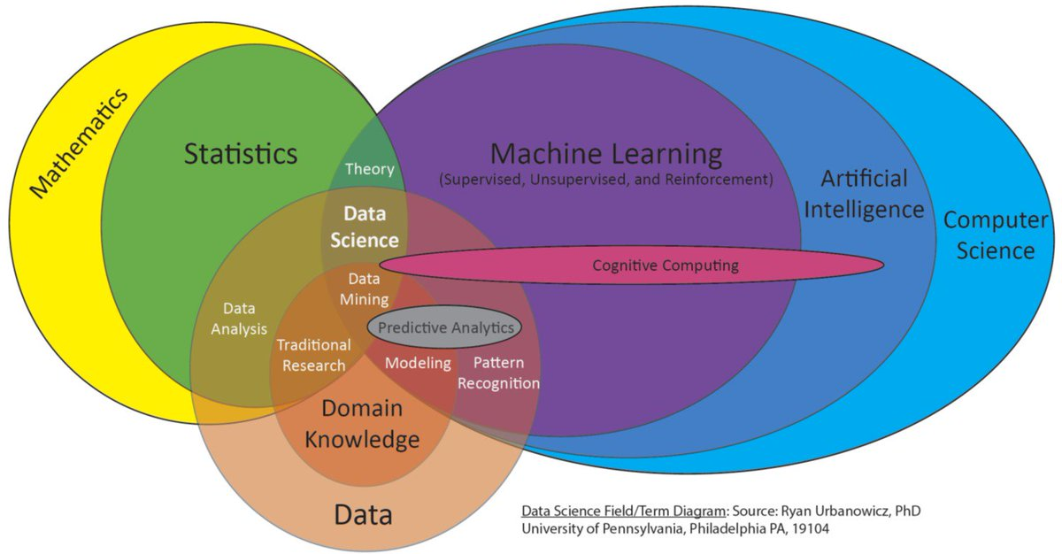

Slide 4
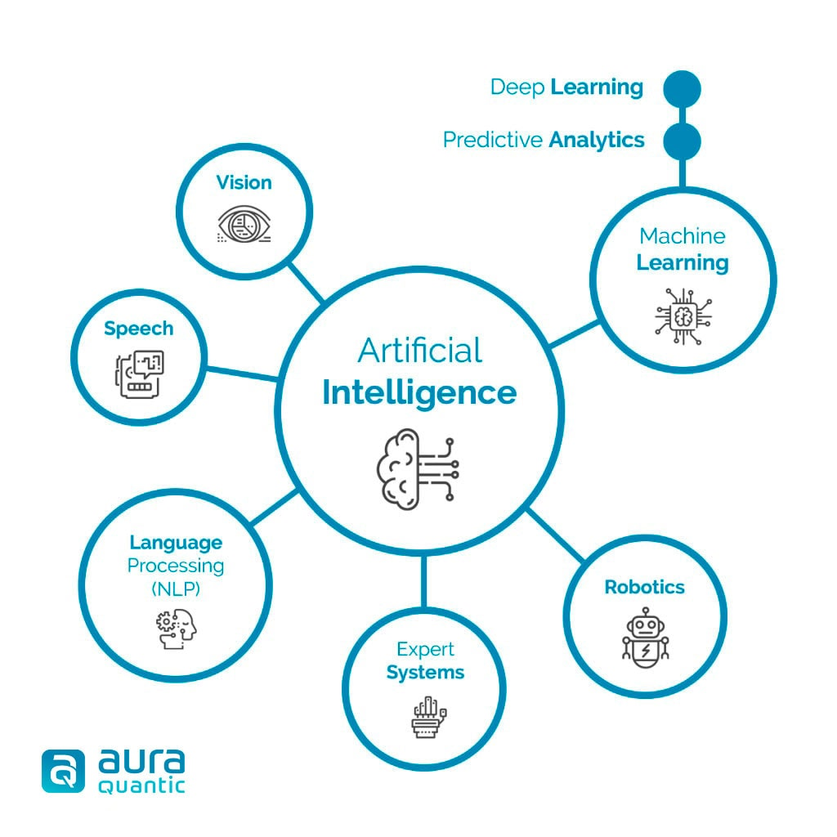

Slide 5
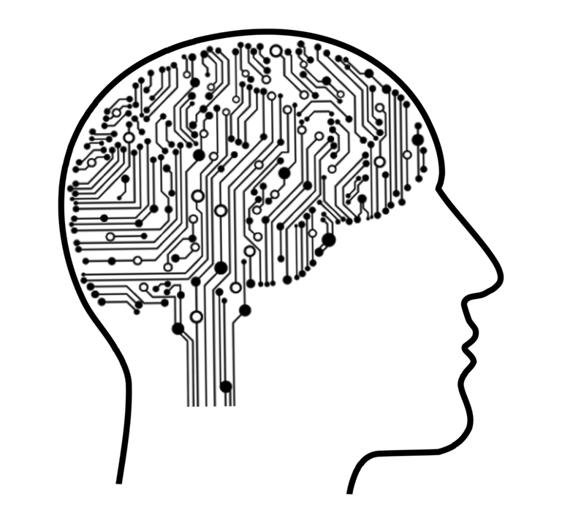
Machine learning
Machine Learning is a subfield of artificial intelligence (AI) that focuses
on the development of algorithms and statistical models that enable computers to perform tasks
without being explicitly programmed to do so.
Machine learning algorithms are designed to identify and learn from patterns in large datasets, enabling them to generalize and make accurate predictions
or take appropriate actions when presented with new, unseen data.

Slide 6
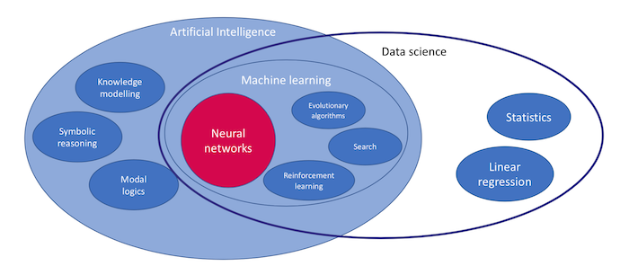
Deep Learning == Neural networks

Slide 7
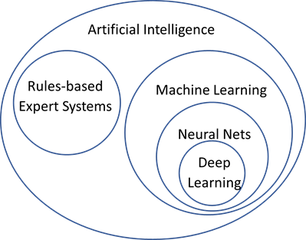

Slide 8
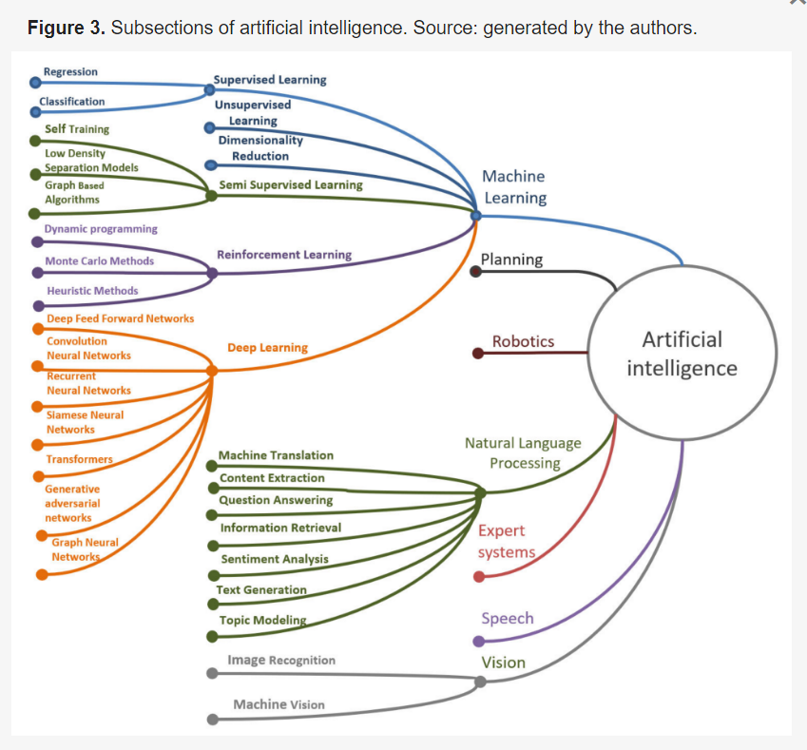
Transformer

Slide 9
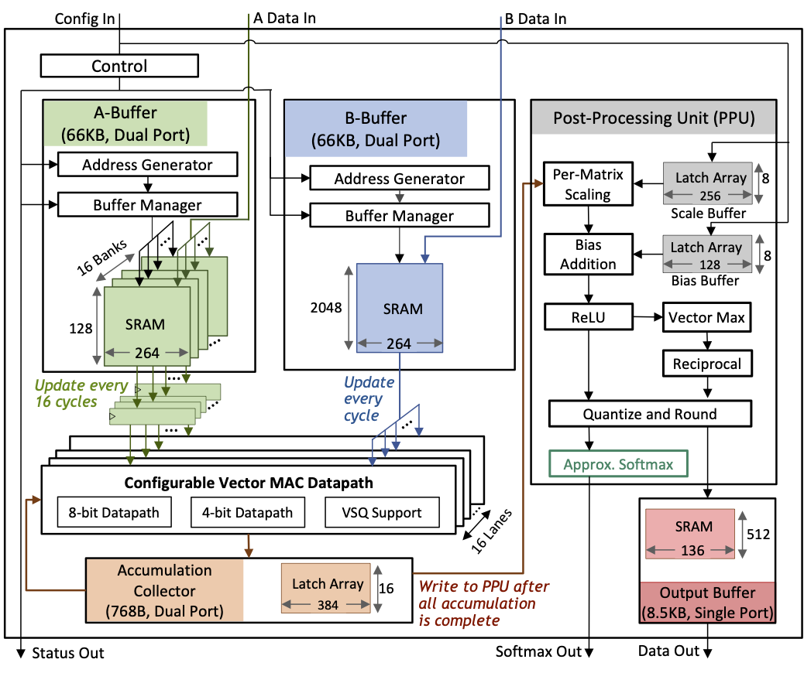
Transformer
a specific type of
deep learning model architecture
called the Transformer model.

Slide 10
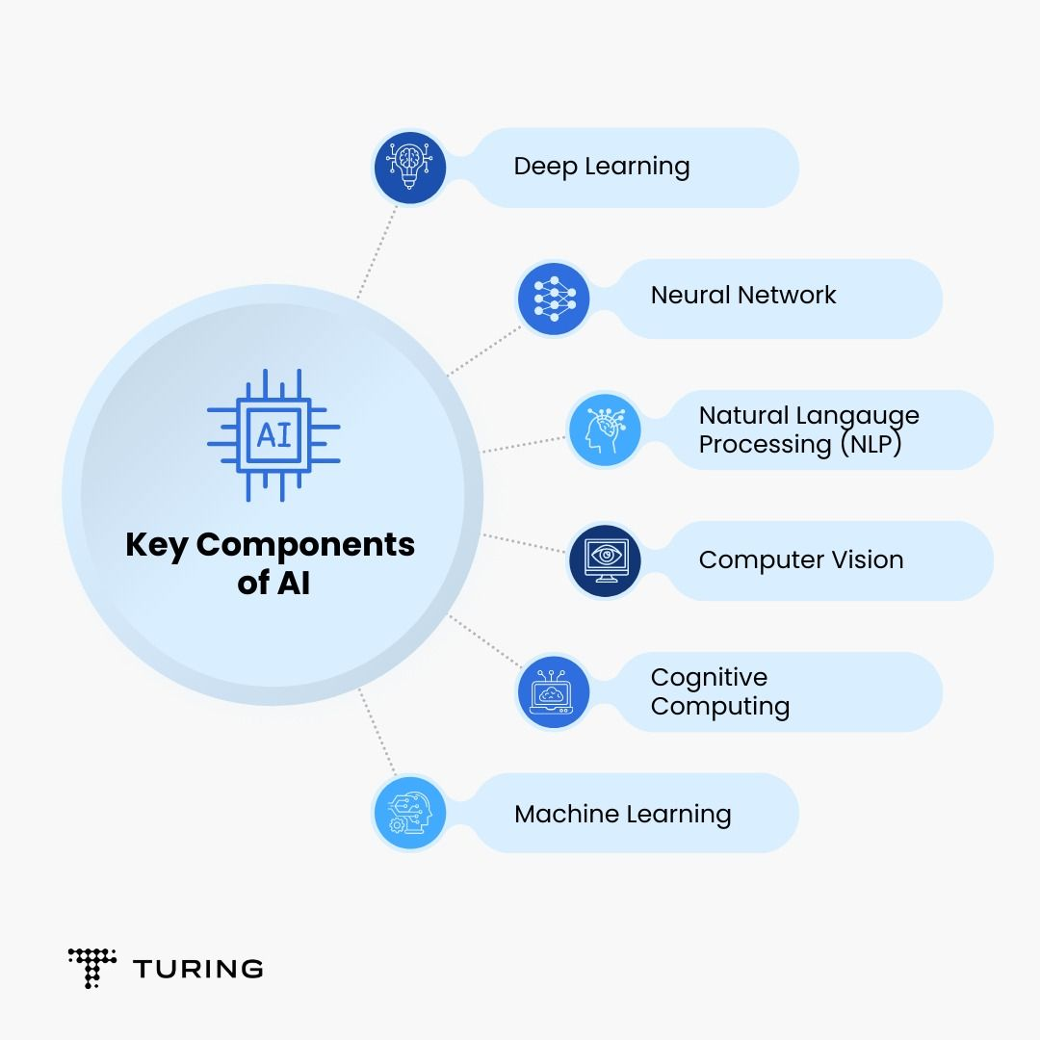

Slide 11
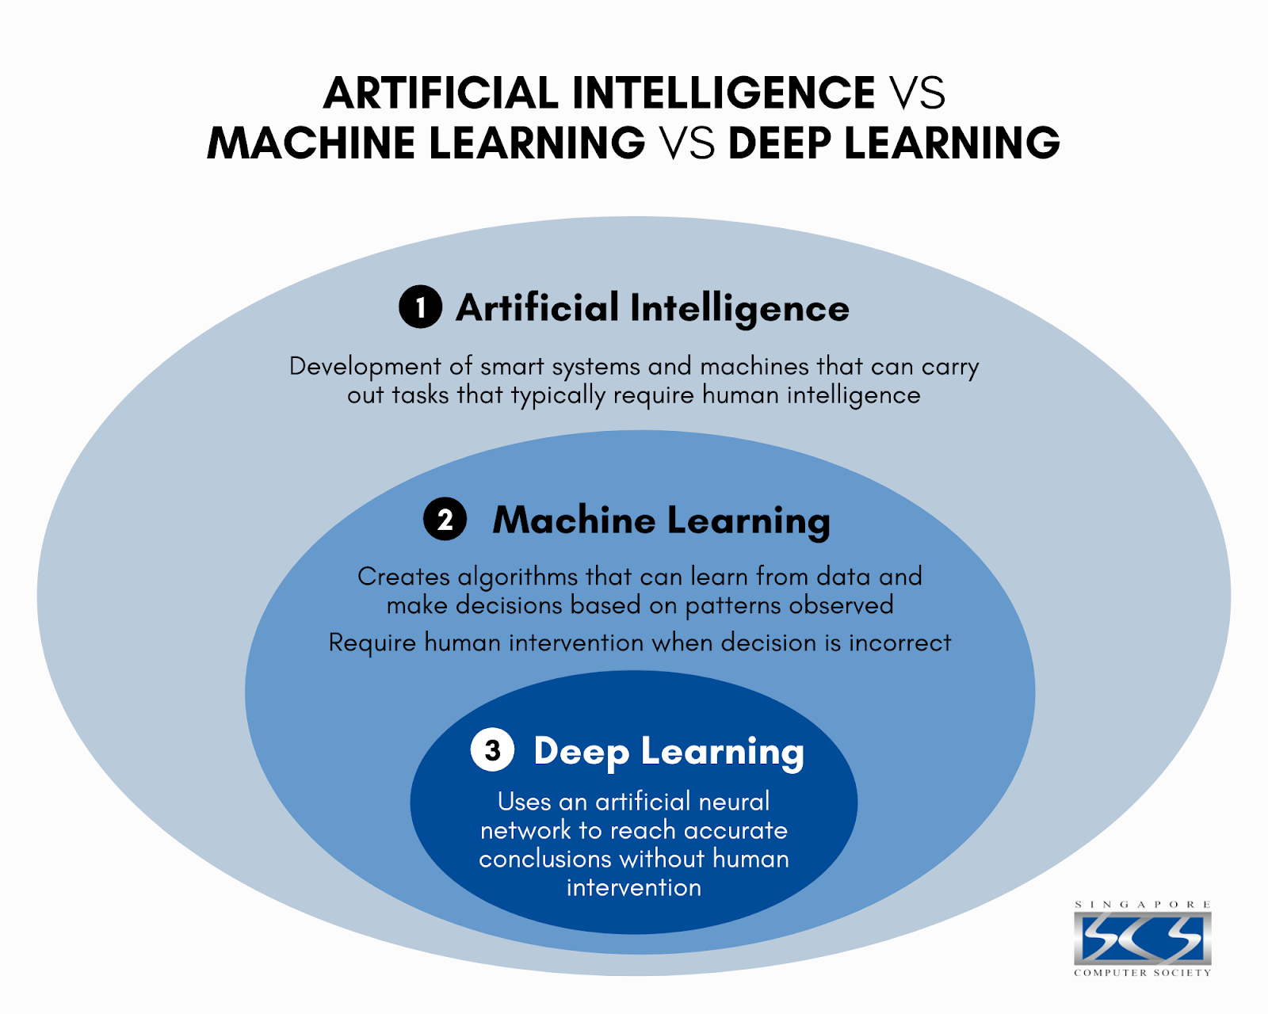

Slide 12
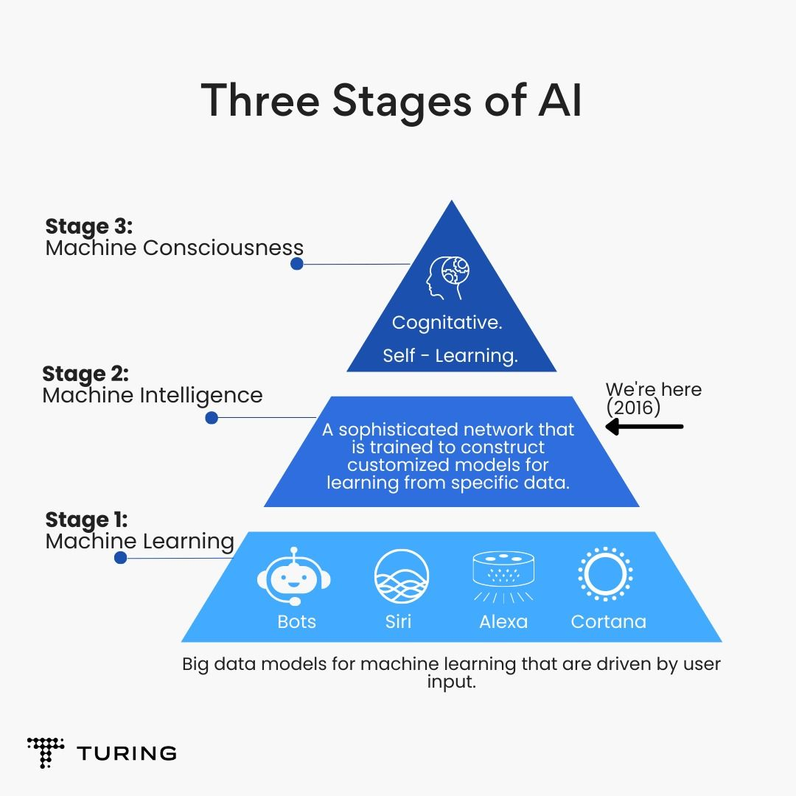

Slide 13
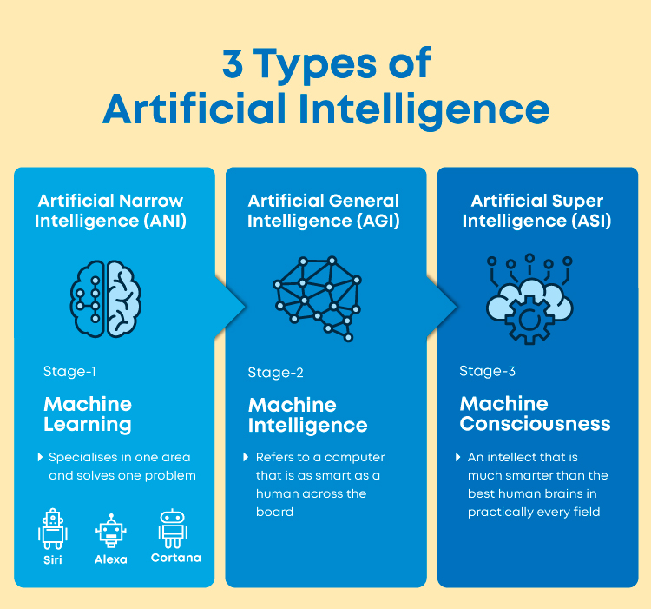

Slide 14
chat GPT
Generative Pre-trained Transformer
In a nutshell, Chat GPT is an
artificial intelligence (AI) content generator
that semi-autonomously creates phrases and articles
based on user input.

Slide 15
