Slide 1
Perceptron 1957
Neural Networks
Deep Learning
Artificial Intelligence 1950
Machine learning
DeepMind
2010
ImageNet Challenge 2012
Google
2014
TensorFlow 2015
OpenAI
2015 Elon Musk
AlphaGo 2016
AlphaZero 2017
Twitter
2021
Transformer 2018
Microsoft
2019
Bard
2023
chat GPT
2018~
x.AI
2023

Slide 2
Limitations of ChatGPT
Lack of context awareness
One limitation of ChatGPT is that it is not always able to fully understand the context of a given text.
This can lead to the generation of text that is not appropriate or does not make sense in the given context.
This is particularly a limitation when the model is used in a conversational setting, where understanding the context of a conversation is crucial.
Limited ability to handle tasks that require common sense knowledge
ChatGPT has been trained on a large dataset of text data, but it does not have access to common sense knowledge that humans possess.
This can limit its ability to perform certain tasks that require knowledge of the world, such as understanding idioms or sarcasm.
This limitation can be overcome by fine-tuning the model with task-specific data, but it still may not perform as well as a human in certain tasks.
Potential ethical concerns surrounding the use of AI-generated text
The use of AI-generated text raises ethical concerns such as potential manipulation of public opinion or spreading misinformation.
As the generated text can be difficult to distinguish from text written by a human, it may be used for malicious purposes such as impersonation or propaganda.
It is important to consider these ethical concerns when developing and deploying ChatGPT models, and to have proper measures in place to detect and prevent any potential misuse of the technology.

Slide 3
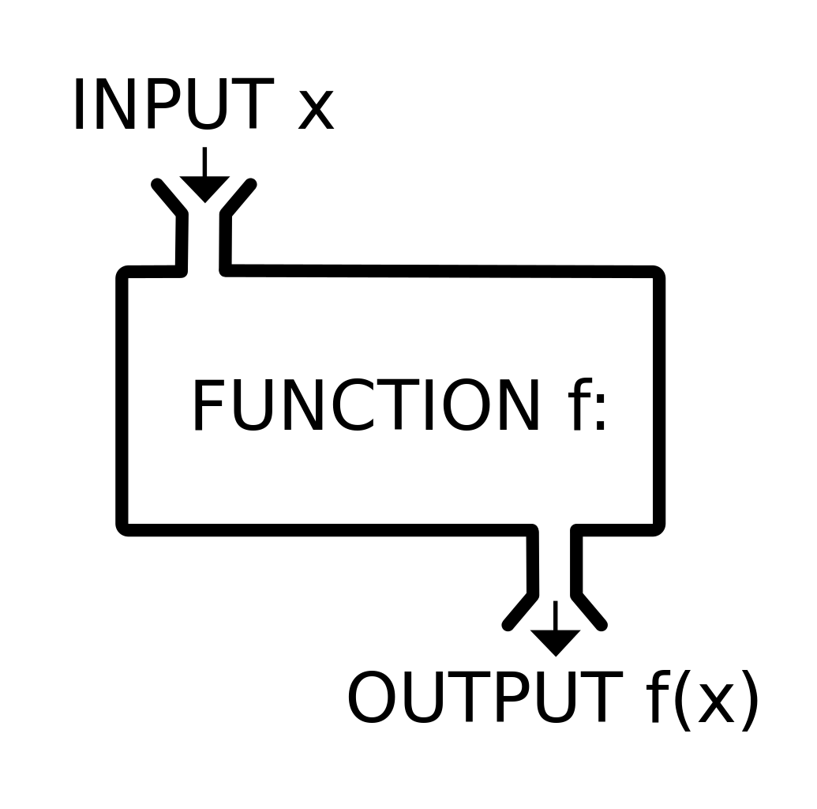
Function

Slide 4
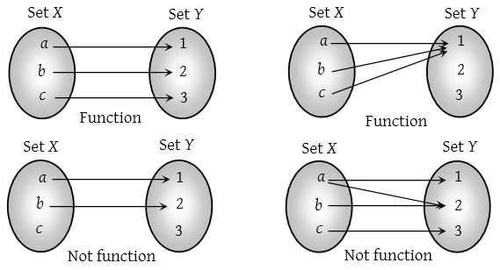

Slide 5
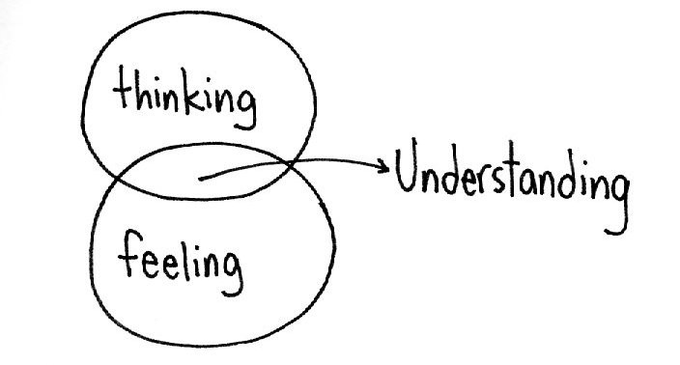
Intelligence
Cognitive abilities
Intellect
Unconscious Forgetting nonverbal communication

Slide 6
Unconsciousness
Human forgetting
Nonverbal communication

Slide 7

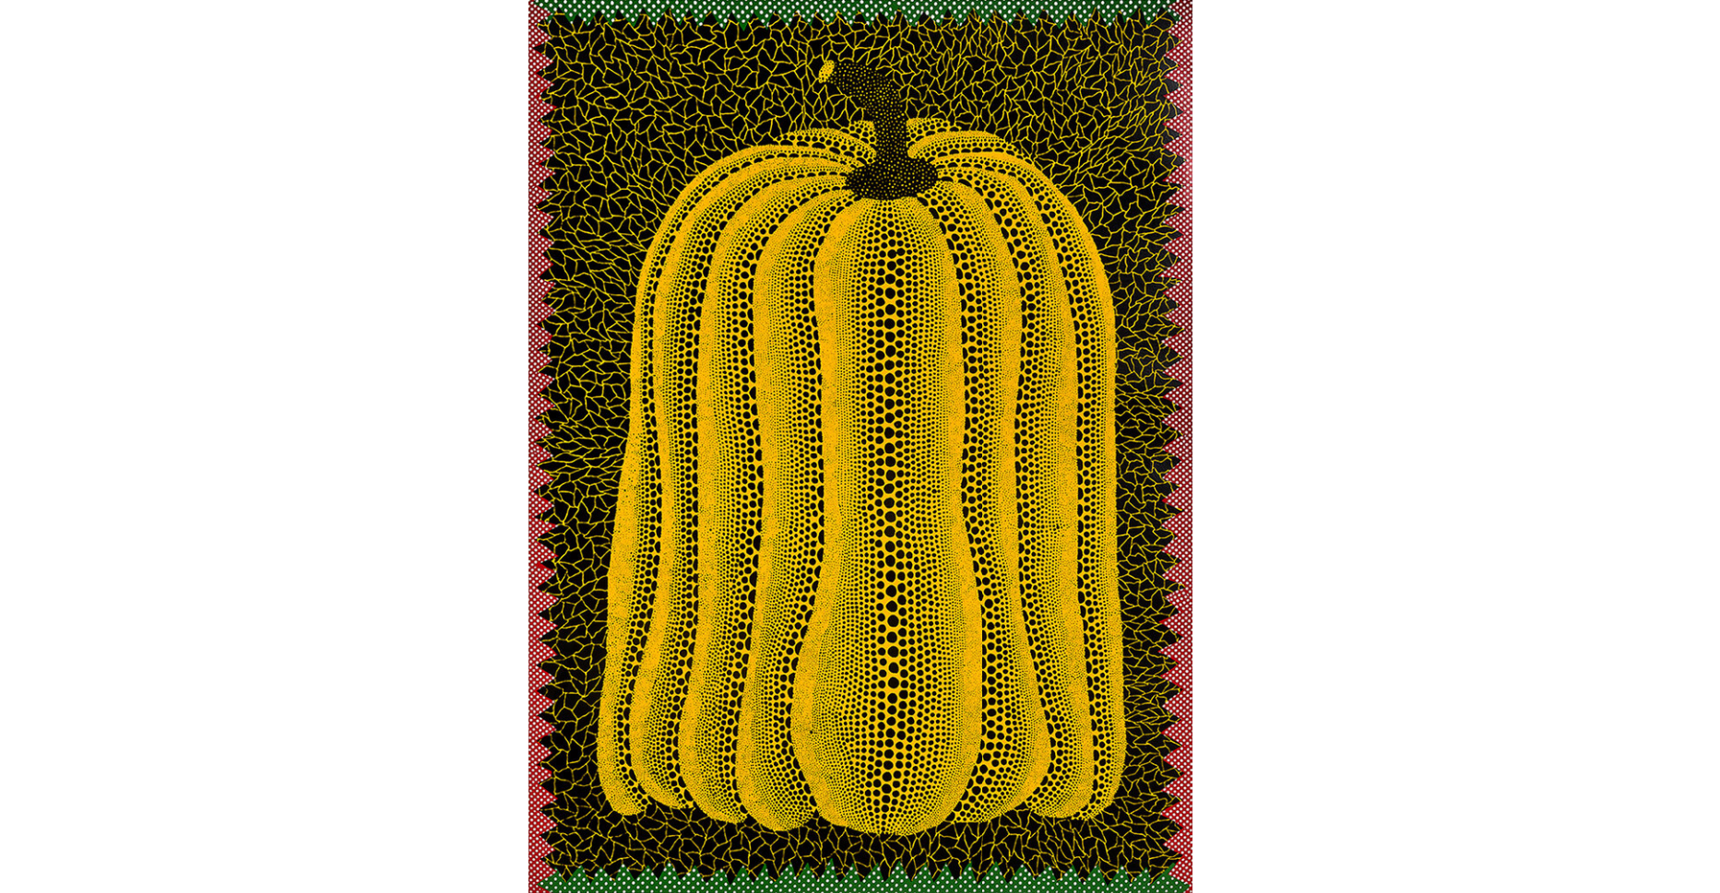
Whanki Kim
Yayoi Kusama

Slide 8
chat GPT
Generative Pre-trained Transformer
In a nutshell, Chat GPT is an
artificial intelligence (AI) content generator
that semi-autonomously creates phrases and articles
based on user input.

Slide 9
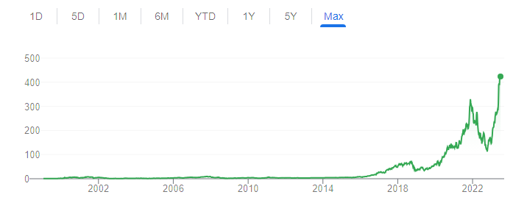
NVIDIA의 과학시간 - GPU와 CPU의 차이 Https://www.youtube.com/watch?v=1BAZf3PsjWA
chat GPT 월간 활성
사용자 수 1억명 돌파

Slide 10
