Slide 1
chat GPT
Generative Pre-trained Transformer
In a nutshell, Chat GPT is an
artificial intelligence (AI) content generator
that semi-autonomously creates phrases and articles
based on user input.

Slide 2
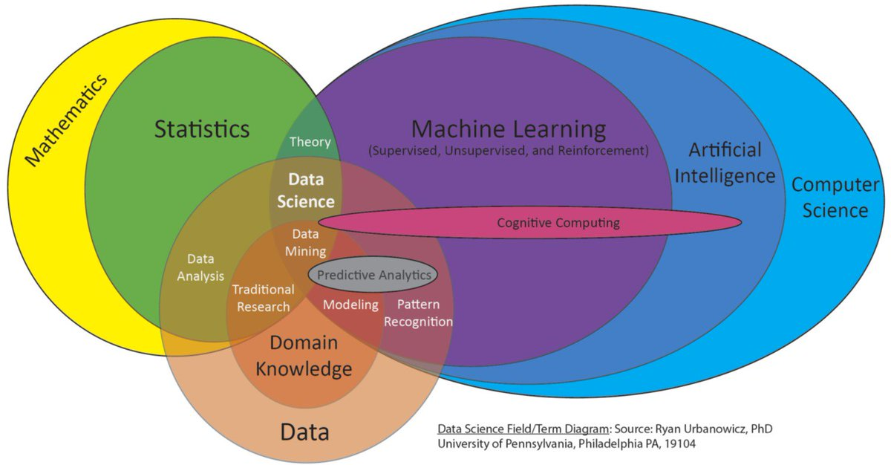

Slide 3
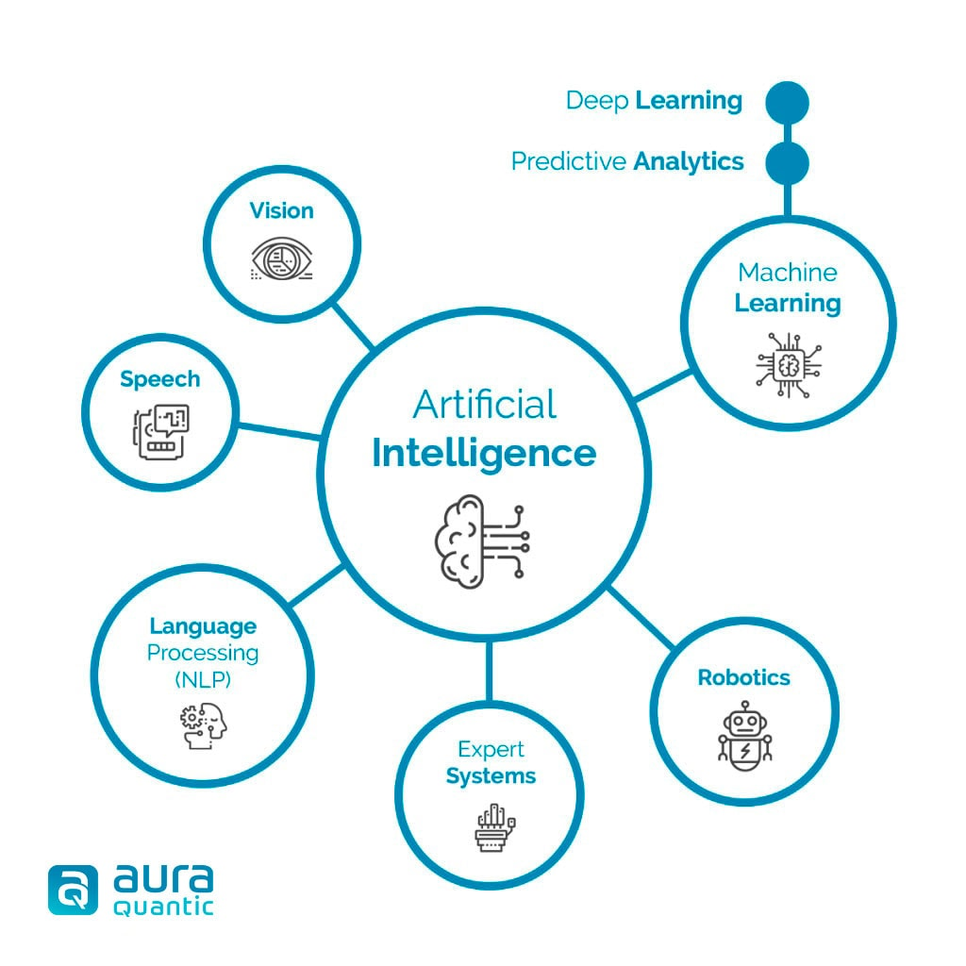

Slide 4
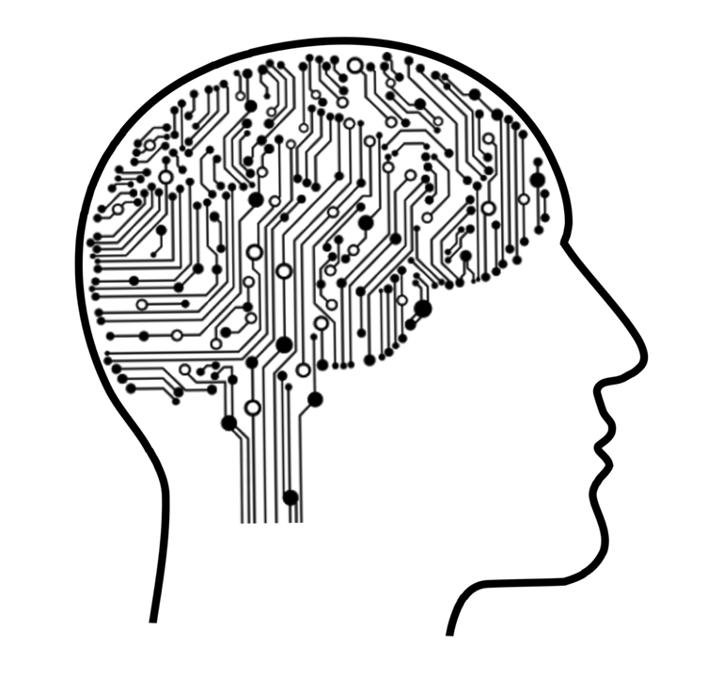
Machine learning
Machine Learning is a subfield of artificial intelligence (AI) that focuses
on the development of algorithms and statistical models that enable computers to perform tasks
without being explicitly programmed to do so.
Machine learning algorithms are designed to identify and learn from patterns in large datasets, enabling them to generalize and make accurate predictions
or take appropriate actions when presented with new, unseen data.

Slide 5
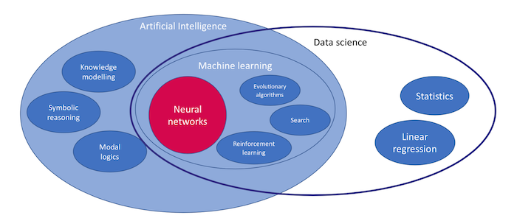
Deep Learning == Neural networks

Slide 6
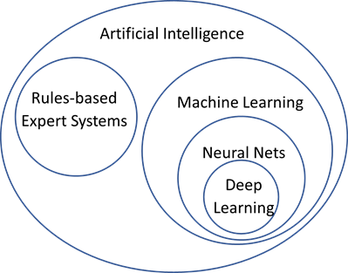

Slide 7
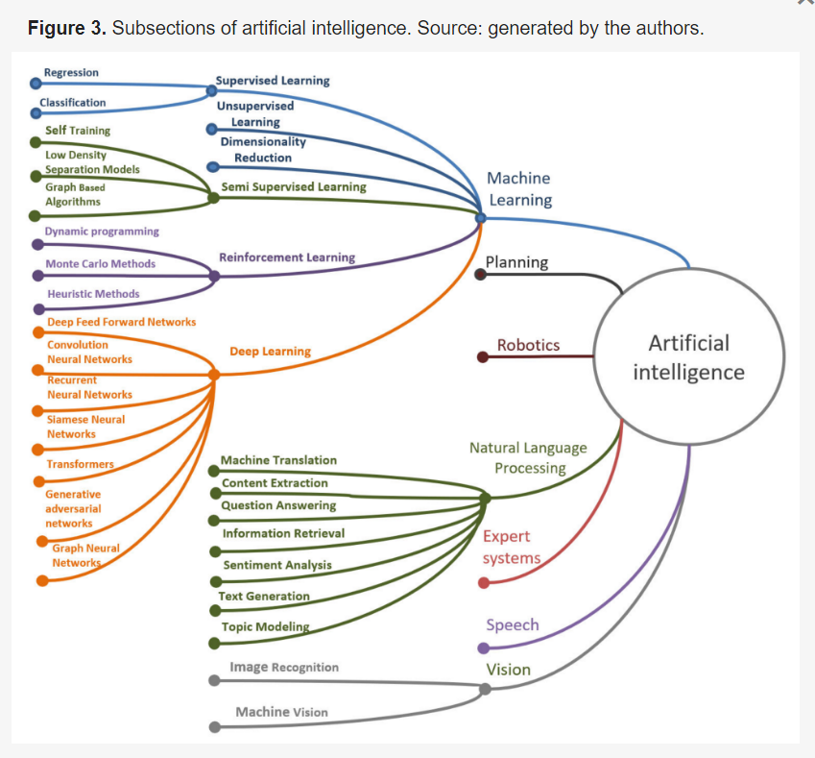
Transformer

Slide 8
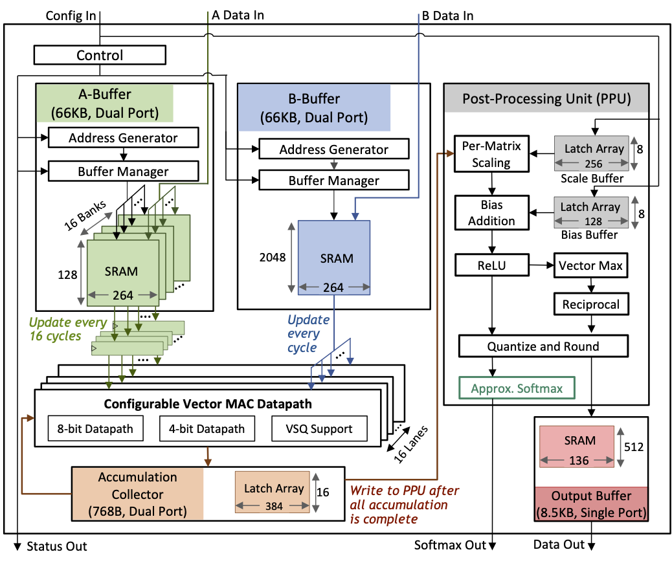
Transformer
a specific type of
deep learning model architecture
called the Transformer model.

Slide 9
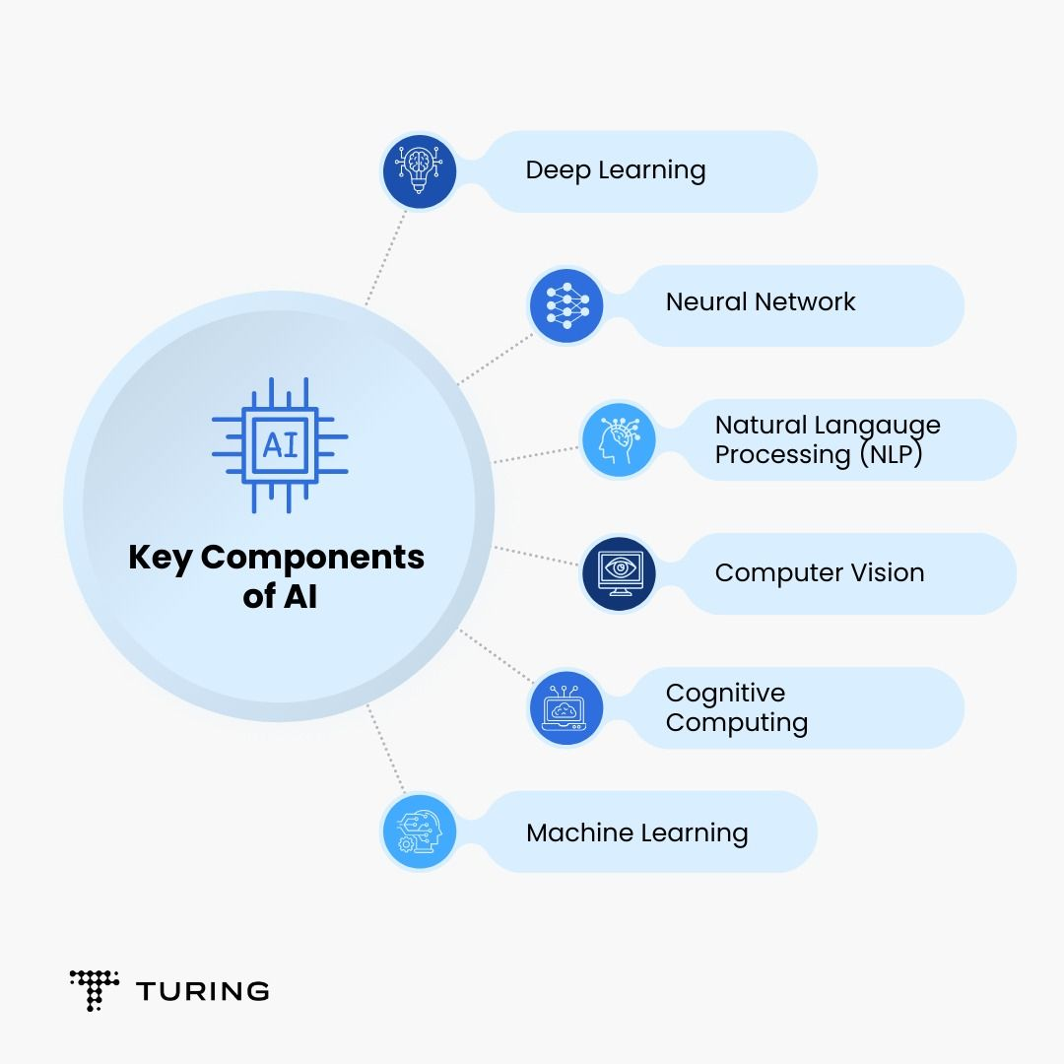

Slide 10
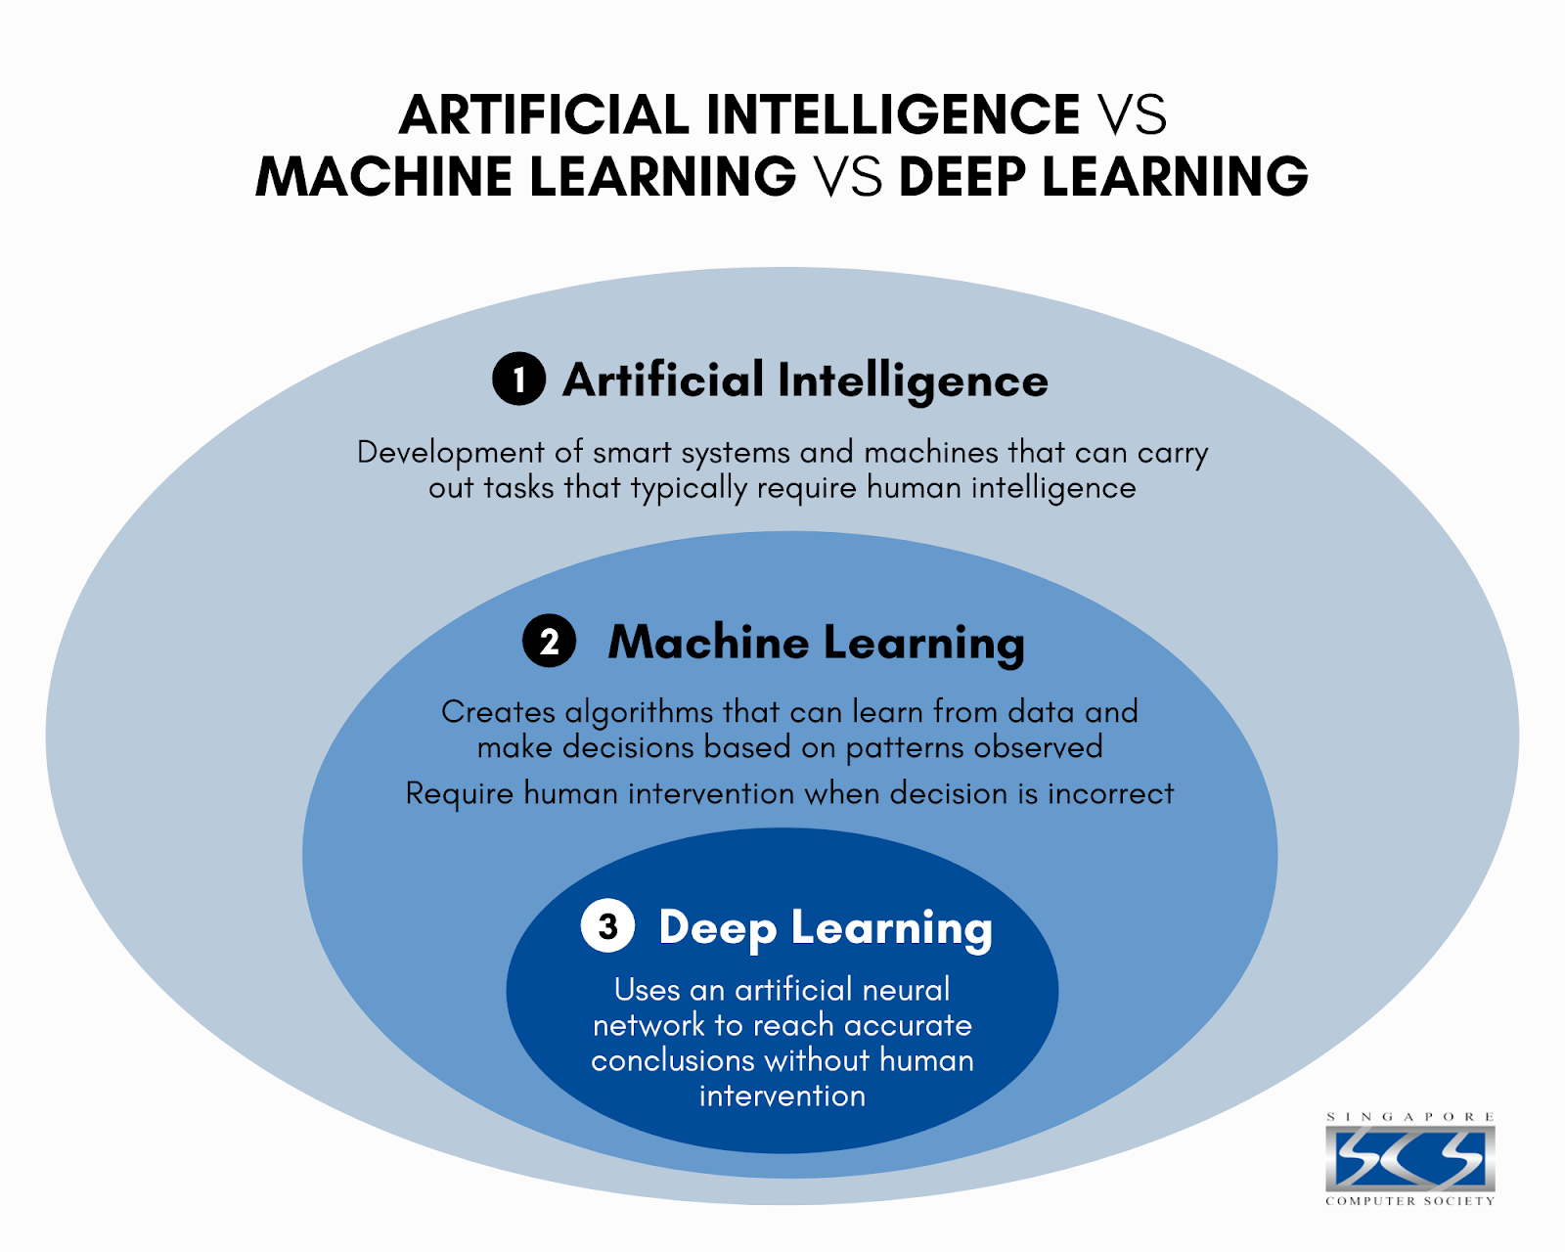

Slide 11
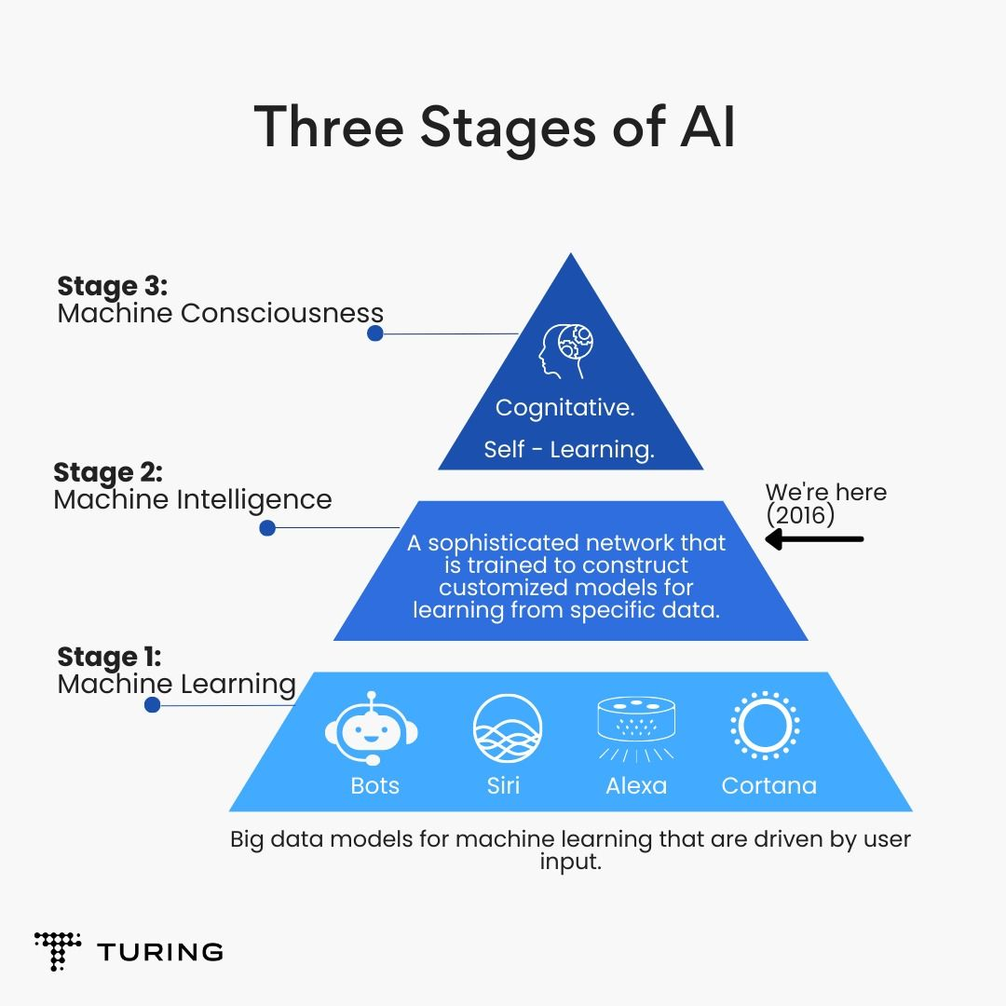

Slide 12
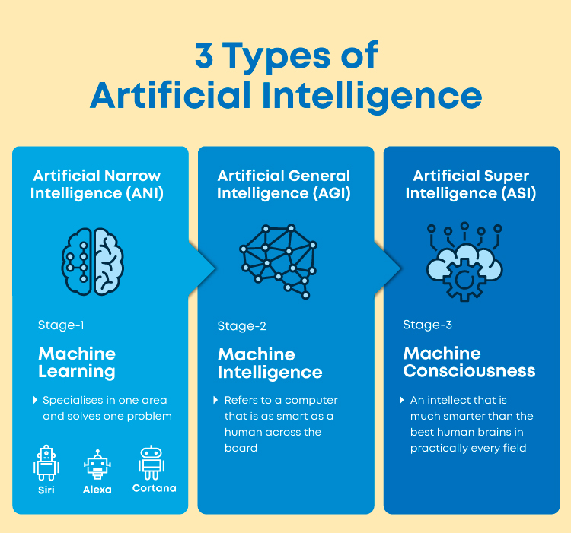

Slide 13
chat GPT
Generative Pre-trained Transformer
In a nutshell, Chat GPT is an
artificial intelligence (AI) content generator
that semi-autonomously creates phrases and articles
based on user input.

Slide 14
