Slide 1
Perceptron 1957
Neural Networks
Deep Learning
Artificial Intelligence 1950
Machine learning
DeepMind
2010
ImageNet Challenge 2012
Google
2014
OpenAI
2015 Elon Musk
AlphaGo 2016
AlphaZero 2017
Twitter
Microsoft
Transformer 2018
Bard
2023
chat GPT
2020
x.AI
2023

Slide 2
Limitations of ChatGPT
Lack of context awareness
One limitation of ChatGPT is that it is not always able to fully understand the context of a given text.
This can lead to the generation of text that is not appropriate or does not make sense in the given context.
This is particularly a limitation when the model is used in a conversational setting, where understanding the context of a conversation is crucial.
Limited ability to handle tasks that require common sense knowledge
ChatGPT has been trained on a large dataset of text data, but it does not have access to common sense knowledge that humans possess.
This can limit its ability to perform certain tasks that require knowledge of the world, such as understanding idioms or sarcasm.
This limitation can be overcome by fine-tuning the model with task-specific data, but it still may not perform as well as a human in certain tasks.
Potential ethical concerns surrounding the use of AI-generated text
The use of AI-generated text raises ethical concerns such as potential manipulation of public opinion or spreading misinformation.
As the generated text can be difficult to distinguish from text written by a human, it may be used for malicious purposes such as impersonation or propaganda.
It is important to consider these ethical concerns when developing and deploying ChatGPT models, and to have proper measures in place to detect and prevent any potential misuse of the technology.

Slide 3
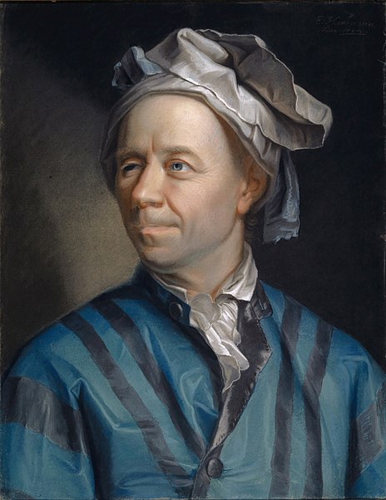
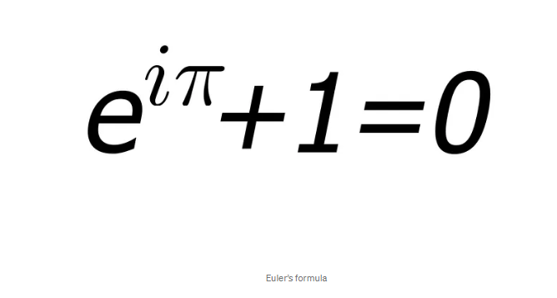
Leonhard Euler Introductio in Analysin Infinitorum. 1748

Slide 4
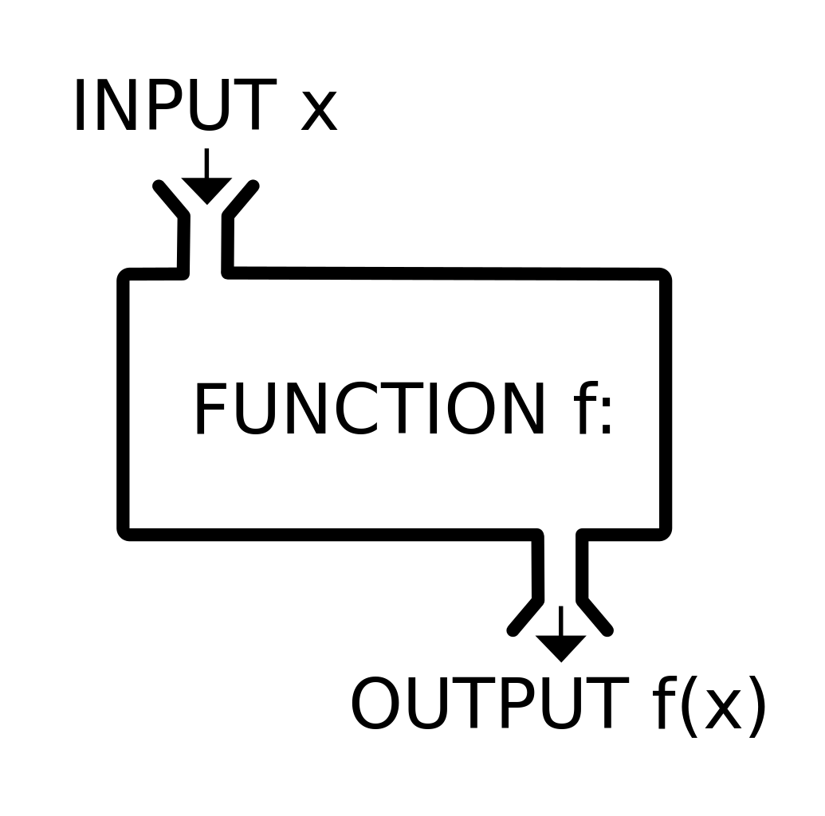
Function

Slide 5
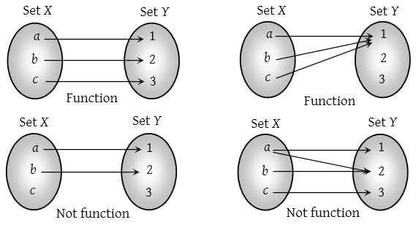

Slide 6
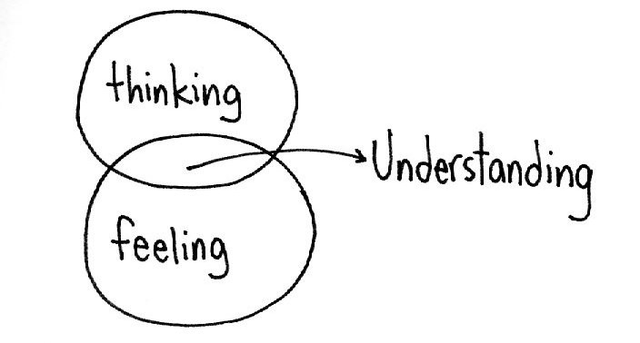
Intelligence
Cognitive abilities
Intellect
Unconscious Forgetting nonverbal communication

Slide 7
Unconsciousness
Human forgetting
Nonverbal communication

Slide 8


Whanki Kim
Yayoi Kusama

Slide 9
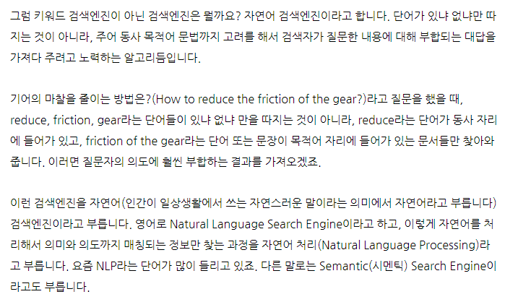
https://contents.premium.naver.com/chatgpt/buff/contents/230622235641423mo

Slide 10
Conventional Search Engine:
Relies on keyword matching and indexing.
Results are based on factors like keyword density and page rankings.
Provides a list of relevant web pages.
Emphasizes popularity and authority of web pages.
Does not focus on understanding the meaning or context of the search query.
Semantic Search Engine:
Analyzes the meaning and context of the search query.
Considers user's location, search history, and other factors.
Provides more personalized and context-aware results.
Understands relationships between words and concepts.
Uses natural language processing (NLP) techniques.
Presents rich snippets and leverages knowledge graphs for additional context.
Aims to deliver more accurate and meaningful search results.
In summary, conventional search engines primarily rely on keyword matching, while semantic search engines aim to understand the meaning and intent behind search queries, providing more contextually relevant results.

Slide 11
chat GPT
Generative Pre-trained Transformer
In a nutshell, Chat GPT is an
artificial intelligence (AI) content generator
that semi-autonomously creates phrases and articles
based on user input.

Slide 12
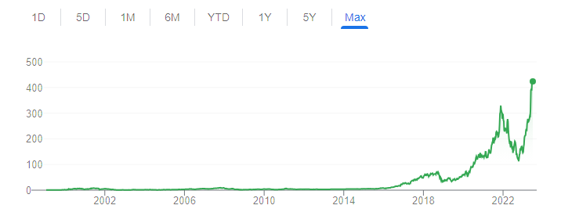
NVIDIA의 과학시간 - GPU와 CPU의 차이 Https://www.youtube.com/watch?v=1BAZf3PsjWA
chat GPT 월간 활성
사용자 수 1억명 돌파

Slide 13
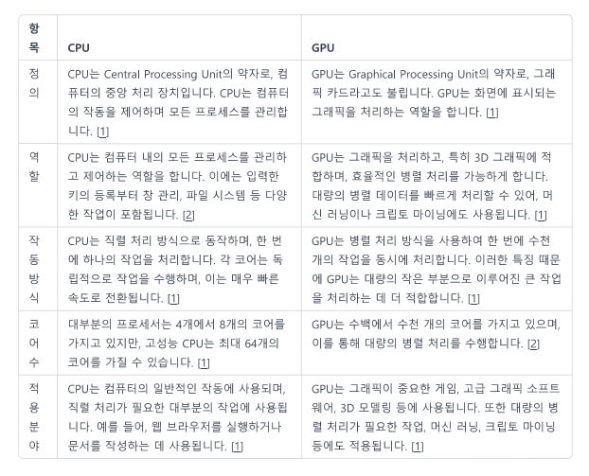
CPU vs GPU

Slide 14
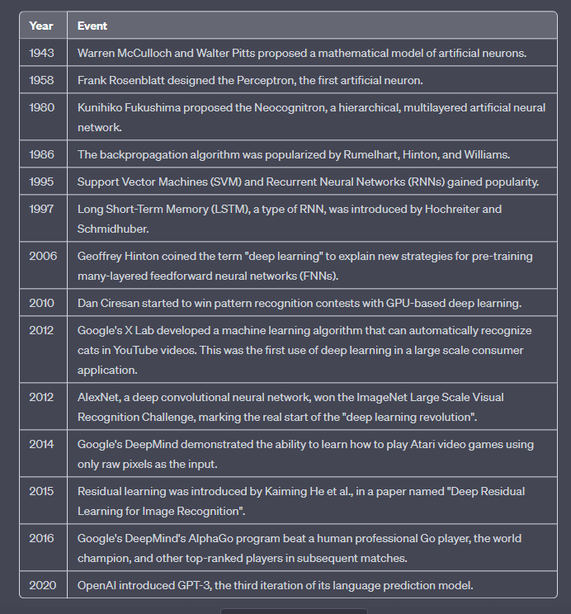

Slide 15
