Slide 1
Washington houses dataset
Miguel Angel Acuña Silva
Adebowale Oluwasanmi

Slide 2
The dataset
The variables inside the dataset are:
ID: A house’s ID in the dataset
Date: Date the house was sold
Price: Price at which it was sold
Bedrooms: Number of bedrooms in the house
Bathrooms: Number of bathrooms in the house
sqft_living: Square footage of the home

Slide 3
The dataset
sqft_lot: Square footage of the lot
Floors: Number of levels of the house
Waterfront: House has a view to a waterfront (Yes/No)
View: House has been viewed
Condition: How good the condition is overall (1-5)
Grade: overall grade given to the housing unit, based on King County grading system
sqft_above: Square footage of the house excluding the basement

Slide 4
The dataset
sqft_basement: square footage of the basement.
yr_built: Year in which the house was built.
yr_renovated: Year in which the house was renovated
Zipcode
Lat: Latitude of the house
Long: Longitude of the house
sqft_living15: Living room area in 2015 (implies renovations).
sqft_lot15: Area of lot in 2015 (implies renovations).

Slide 5
Objective
By looking at the zip code and knowing that the grade is given by tehe King county grading system for the United States, we were able to determine that all houses are in Washington state of the USA.
The driving question of all further analysis will be, What are the characteristics of a house that have more impact on its price?

Slide 6
Literature review
Amirhosen and Reza (2019) mention that, for houses in the US, variables worthy of selection are:
Variables related to area
Number of bedrooms and bathrooms
Variables related to the age of the house
Variables related to the location of the house

Slide 7
Descriptive analysis
Our sample contained 21597 observations.
The bedroom distribution across the data set is
Frequency distribution for Bedroom
Bedroom |  | Frequency | Percent
 | 1 | 196 | .9
 | 2 | 2760 | 12.8
 | 3 | 9825 | 45.5
 | 4 | 6882 | 31.9
 | 5 | 1601 | 7.4
 | 6 | 272 | 1.3

Slide 8
Descriptive analysis
That is, over 70% of the houses are 3 or 4 bedroom houses, consistent with the sizes of modern urban families.

Slide 9
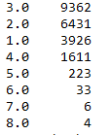
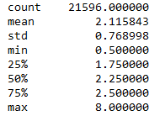
Descriptive analysis
The bathroom distribution is

Slide 10
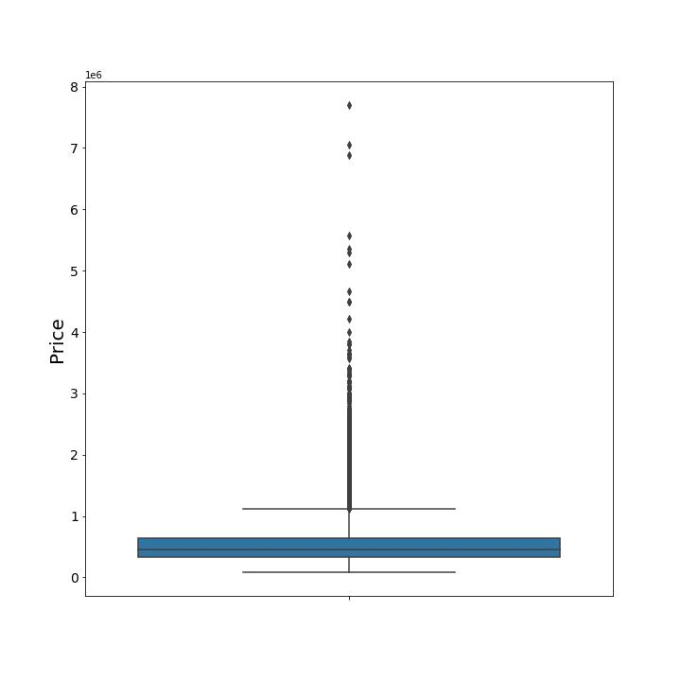
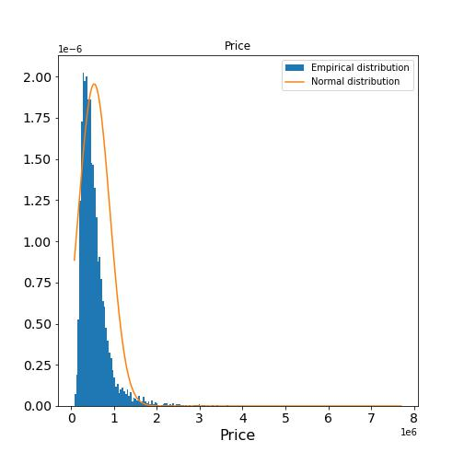
Descriptive analysis
The price variable, being continuous and the most crucial one for our analysis, is summarized as follows.

Slide 11
Descriptive analysis
And the statistics are
mean 5.403451e+05
std 3.673332e+05
min 7.800000e+04
25% 3.220000e+05
50% 4.500000e+05
75% 6.450000e+05
max 7.700000e+06

Slide 12
Descriptive analysis
Both visual summaries show that the price data are very skewed to the right, and it is easy to see that don’t conform to normality (more on this later).
The data also span a wide range, of two orders of magnitude. Thus, there is a lot of variability in this variable.
Most of the data are concentrated in the lower end, but the astronomical prices of the ones on the higher end are enough to skew the whole distribution.

Slide 13
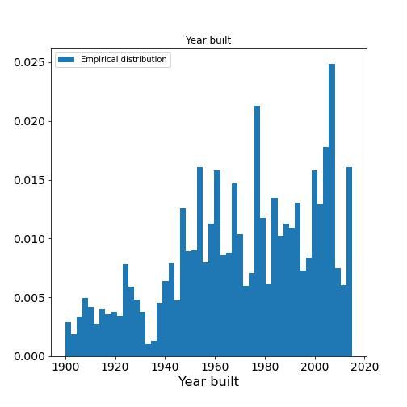
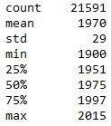
Descriptive analysis
The year built distribution is

Slide 14
Descriptive analysis
Basically, it shows that house building took a big leap at around 1940, and since then it has been more or less steady, with some notable years.
Oldest house in the data set is of 1900, newest of 2015.

Slide 15
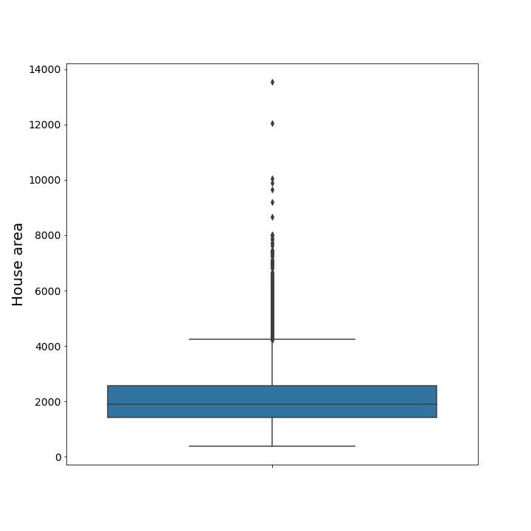
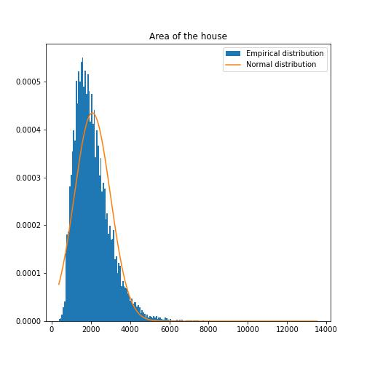
Descriptive analysis
The summary of the area of the house is also graphical

Slide 16
Descriptive analysis
The area variable seems to be much more normal, but still not conforming to normality completely. This will be put to the test in a later stage.
Still, the number of outliers is fairly big.
The mean of the area variable is 2080 squared feet (not shown), above the average of an apartment in Seattle.

Slide 17
Missing value analysis
All missing values of the relevant variables were well under 1% of the total data, so they were replace by the median since we believe data significantly departs from normality.

Slide 18
References
Amirhosein Jafari, Reza Akhavian, (2019) "Driving forces for the US residential housing price: a predictive analysis", Built Environment Project and Asset Management, https://doi.org/10.1108/BEPAM-07-2018-0100

