Slide 1

Parametric tests
Adebowale Oluwasanmi
Miguel Angel Acuna Silva
GROUP B

Slide 2
OBJECTIVES
To carry out :
Observed power & Effect size analysis.
One-Sample T-test
Paired sample T-test
Unpaired sample T-test
One-factorial ANOVA
Two-factorial ANOVA
(All tests were carried out on the assumption that relevant variables followed normal distribution)

Slide 3
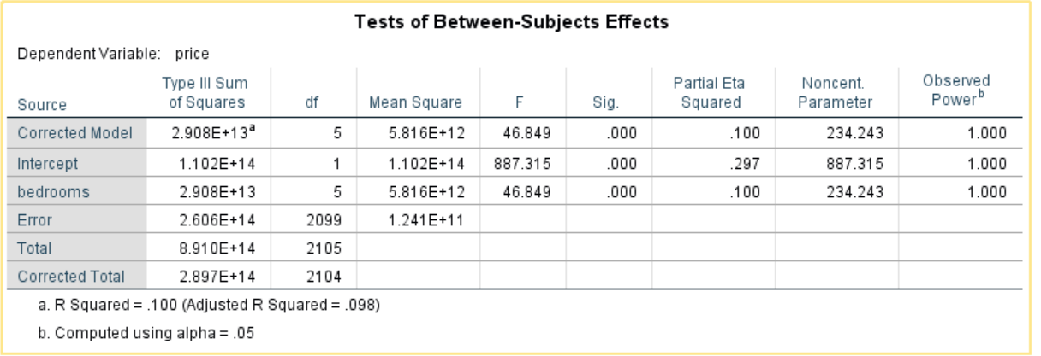
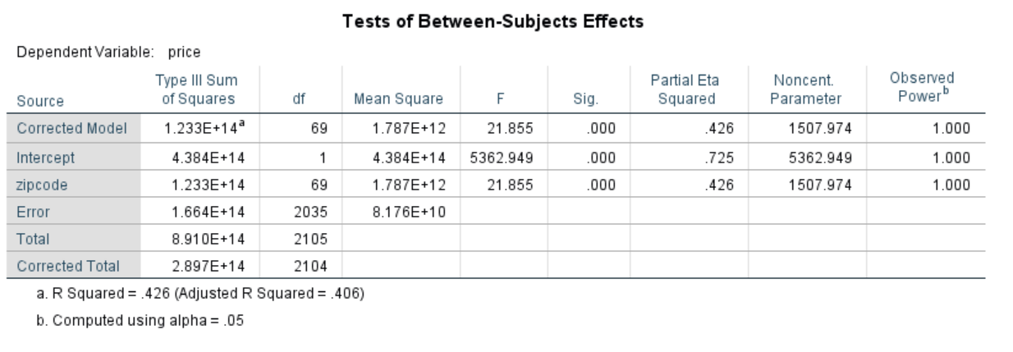
Observed power & Effect size
Observed Power & Effect size between price and bedrooms
Observed power shows a result of 1. This means that we have a 100% chance of detecting significant effects and a 0% chance of committing a type II error which is good.
Effect size result is 0.100
Even though P<0.05, the effect size is relatively small, therefore the findings has limited to no practical significance.
Observed Power & Effect size between price and zip code
Observed power also shows a result of 1.
Effect size is 0.426
Here also, P<0.05 and effect size is average , meaning that the finding may have practical significance in the real world.

Slide 4
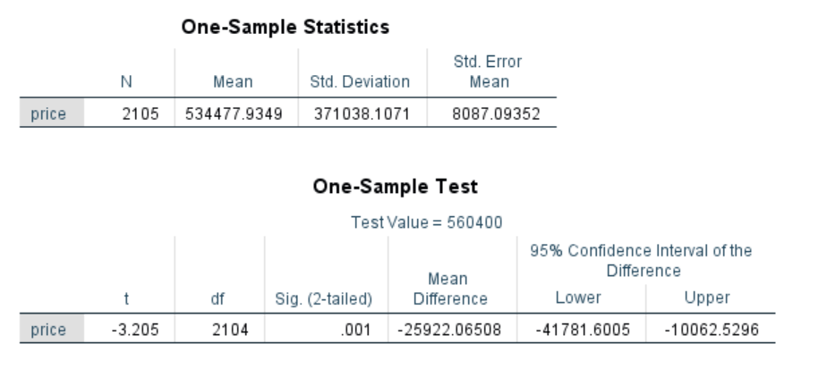
T-tests
One Sample T-test
According to the office of financial management (https://ofm.wa.gov/), the median price of a house in 2021 in Washington state was $560,400 us dollars.
Q: We want to find out if the average price of homes has changed due to economic conditions?.
H(o) : The average price of homes is equal to or greater than 560,400.
As shown in the statistics result, the sample mean is lower than the specified mean, with P<0.05
But critical t value(-1.65) > t statistic, however the findings were still statistically significant.
Therefore, we reject the null hypothesis.
This means that the economic conditions has caused the average home price to decrease in Washington.

Slide 5
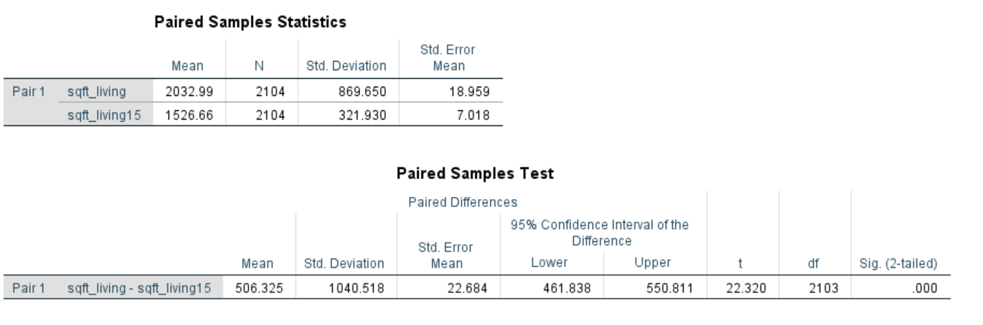
T-tests
Paired Sample T-test
Q 1: We wanted to find out if the average sq. ft for homes was different after renovation?.
H(o) : The average sq. ft before and after renovation is equal.
H(A) : The average sq. ft before and after renovation is different.
As shown, the average sq. ft before renovation is higher than after renovation.
T statistic > critical t value(1.96), P<0.05
The mean sq. ft before and after renovation is different.
Therefore, we accept the alternative hypothesis.

Slide 6
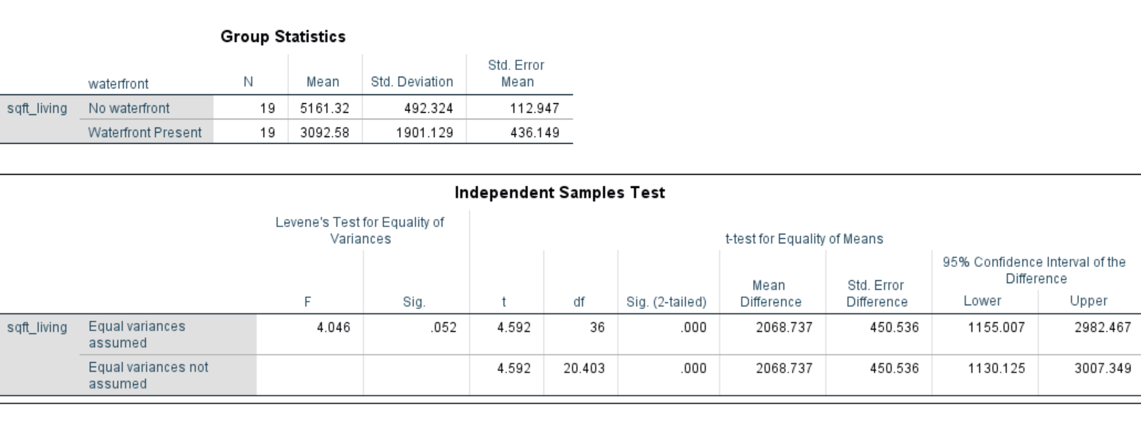
T-tests
Unpaired Sample T-test
Q 2.1: We wanted to find out if the average sq. ft vary for homes with and without a waterfront?.
H(o) : The average sq. ft is the same for homes with and without a waterfront.
We ensured equal number of sample size in both groups for robust results.
As shown in the statistics result, the sample mean for houses with no waterfront is higher than those with waterfronts.
T statistic > critical t value(1.72), P<0.05
Therefore, we reject the null hypothesis.
This means there is a significant difference in the average sq. ft of homes with and without a waterfront.

Slide 7
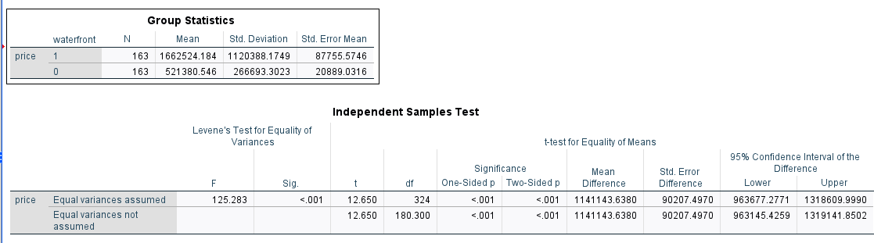
T-tests
Unpaired Sample T-test
Q 2.2: We wanted to find out if the average price for homes with and without a waterfront is different?.
H(o) : The average price is the same for homes with and without a waterfront.
N.B : We ensured equal number of sample size in both groups for robust results.
As shown in the statistics result, the mean price of the houses with waterfront is almost 3 times of that without.
T statistic > critical t value(1.72), P<0.05
Therefore, we reject the null hypothesis.
This means there is a significant difference in the means of the price of houses with and without a waterfront.

Slide 8
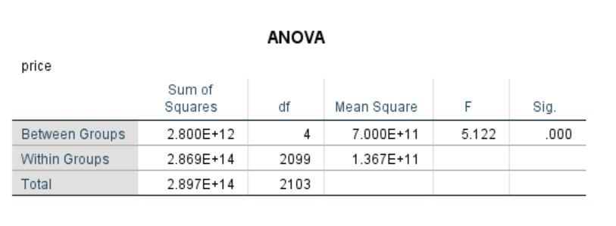
One-Factor ANOVA
ANALYSIS OF VARIANCE (ANOVA)
Results of a research done by (Shishir Mathur 2019, p. 1),showed that a medium-quality house sells for approximately 25% more than a low-quality house, and a well-maintained house sells for approximately 5% more than a house that is not well-maintained.
Q : We wanted to find check if there is a difference in price between different housing conditions.
Categories: (Very Poor, Poor, Average, Good, Excellent).
H(o) : There are no significant differences between the mean price of each housing condition.
F statistic > critical f value(2.38), P<0.05
Therefore, we reject the null hypothesis.
This means the avg. price of at least two groups are significantly different from each other.

Slide 9
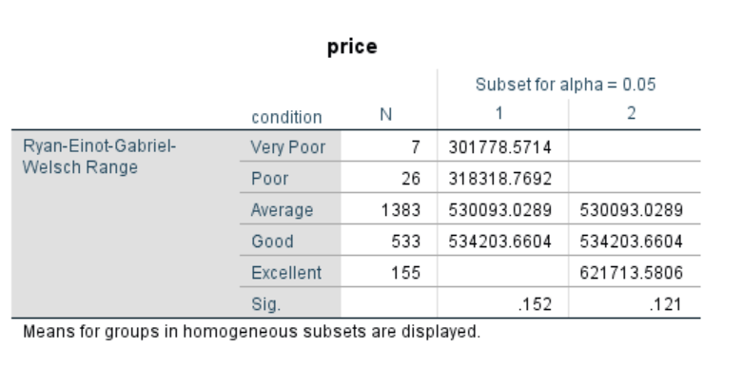
Post-Hoc Test
While ANOVA tests for significant differences between the means of individual groups,
Post Hoc tests are used to dive in and uncover where the differences lie within the groups by
testing each possible pair of groups.
We used the R-E-G-W-Q post hoc test.
Groups that share the same column are not significantly different while groups that DO NOT share the same column are significantly different.
There is a significant difference between the mean price of the groups {Very Poor, Poor} and {Excellent}.
This confirms the ANOVA test that the mean price of at least two groups were significantly different.

Slide 10
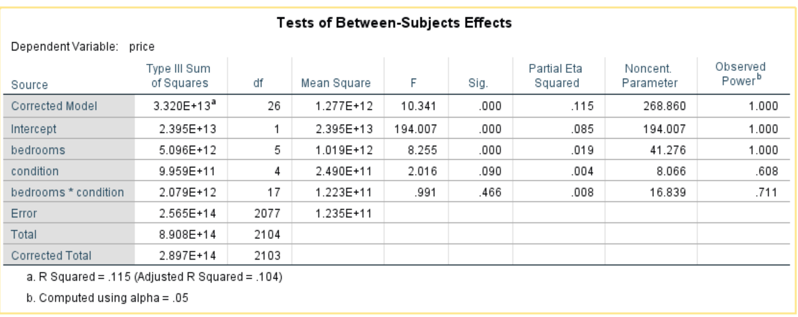
Two-Factor ANOVA
ANALYSIS OF VARIANCE (ANOVA)
Q : Asides the number of bedroom, does housing condition also have an influence on price?.
H(o) : There are no significant differences in the mean price between the groups of each independent variable.
Sample size (N=2104)
We noticed that Observed power (0.608) for the condition variable was low, at sample size (N= 2104)
This means there is a high risk of Type II error, so we increased the sample size to over 6k.

Slide 11
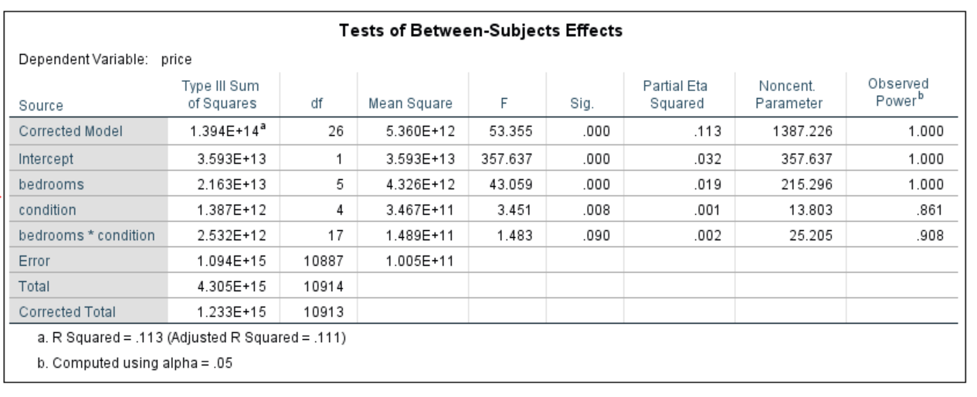
Two-Factor ANOVA (Cont’d)
ANALYSIS OF VARIANCE (ANOVA)
At a sample size of over 6k, the Observed power for the condition variable increased to about 0.67
We further increased the sample size to (N=10,914). Statistics result is as shown below :
Sample size (N=10,914)
At a sample size of (N=10,914), Observed power for condition variable increased to 0.861
It is clear there are no interactions between the bedrooms and condition variables, as P>0.05
Both variables have extremely small effect sizes, which means the effects on price may have little to no practical significance.
Also, with P<0.05 for both variables, we can deduce that number of bedrooms and housing conditions have a statistically significant influence on price.
Therefore, we reject the null hypothesis.

Slide 12
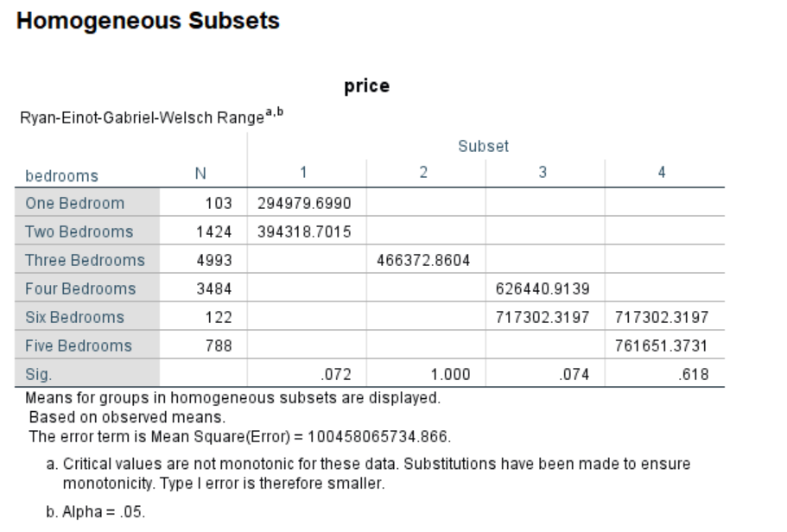
Post-Hoc Test
We also used the R-E-G-W-Q post hoc test, because the number of groups within the variables (bedrooms and housing condition) were more than three.
Between groups for bedrooms variable
N.B: Groups that share the same column are not significantly different while groups that DO NOT share the same column are significantly different.
Post hoc result show a significant difference
between the mean price of groups {One, Two},
{Three}, {Four, Six},{Four, Five} bedrooms.
This confirms our conclusion that there is a significant difference in the mean prices between the groups of bedrooms variable (first factor).

Slide 13
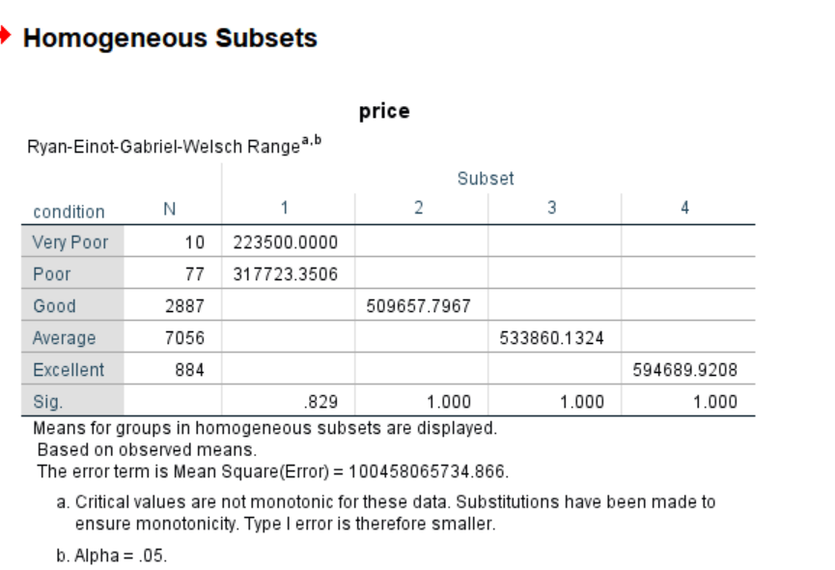
Post-Hoc Test (cont’d)
Between groups for condition variable
Here, the post hoc result also reveal a significant difference between the mean price of groups
{Very Poor, Poor},{Good}, {Average}and
{Excellent} housing conditions.
This confirms the conclusion that there is a significant difference in the mean prices between the groups of condition variable (second factor).
Therefore, we reject the null hypothesis.

Slide 14
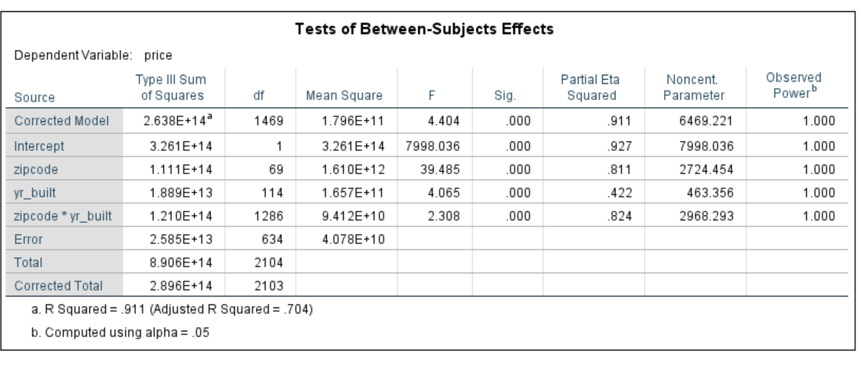
Two-Factor ANOVA
ANALYSIS OF VARIANCE (ANOVA)
Q 2 : Does the zip code and year built influence the price of homes?
H(o) : There are no significant differences in the mean, between the groups of each independent variable.
We have an excellent result for observed power
i.e., there are no risks of type II error.
The effect size for zip code is large (0.811), and that of year built is relatively medium (0.422), which means these findings likely have practical significance.
For both variables, P<0.05 . This means that the
effects on prices are statistically significant.
Results also show a high level of interaction between both variables, accompanied with a large effect size.
In conclusion, we reject the null hypothesis as there is a significant difference in the mean between the groups of each independent variable.

Slide 15
References
Office of financial management 2022, Median home price in Washington. Washington Data and Research, accessed 24 January 2023, https://ofm.wa.gov/washington-data-research/statewide-data/washington-trends/economic-trends/median-home-price.
Shishir, M 2019,’ House price impacts of construction quality and level of maintenance on a regional housing market’,
Evidence from King County, Washington, accessed 24 January 2023, https://www.researchgate.net/publication/332487322_House_price_impacts_of_construction_quality_and_level_of_maintenance_on_a_regional_housing_market_Evidence_from_King_County_Washington.

Slide 16


Thank You
Adebowale Oluwasanmi
Miguel Acuna Angel Silva

