Slide 1
Non parametric tests
Miguel Angel Acuña Silva
Adebowale Oluwasanmi

Slide 2
Objectives
To find out which characteristics of a house have the greater impact on its price.
To perform non parametric tests and correlation analysis in the variables of our data set.

Slide 3
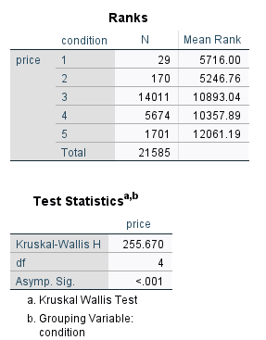
Kruskall-Wallis test
Does the condition of the house influence its price?
H0: There is no difference in the rank sums of the
Houses in different conditions.
Since p < 1%, we reject the null hypothesis.
It is also clear by looking at the mean ranks.

Slide 4
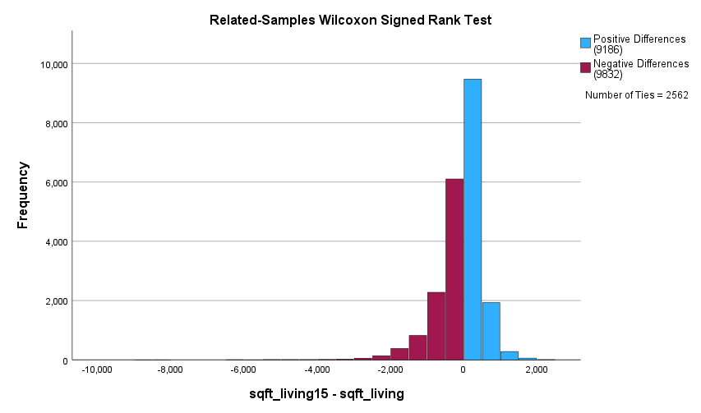
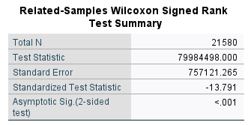
Wilcoxon test
Do the houses change their area after renovation?
H0: There is no difference in the central tendencies of area of houses before and after renovation.
Since p < 1%, we reject the null hypothesis.

Slide 5
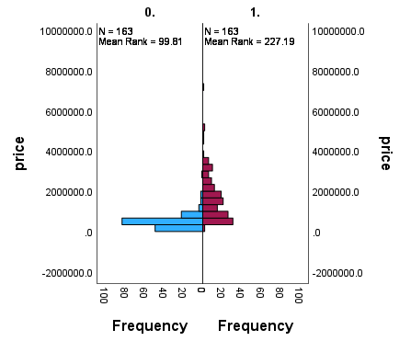
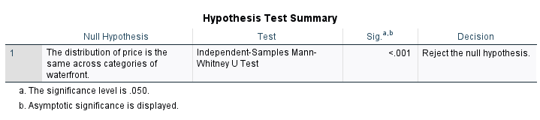
Mann Whitney test
Is the price affected if the house has a water front?
H0: There is no difference in the sum of the ranks for houses with and without a waterfront.

Slide 6
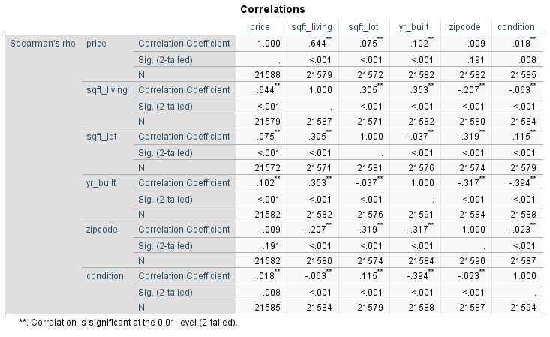
Correlations

Slide 7
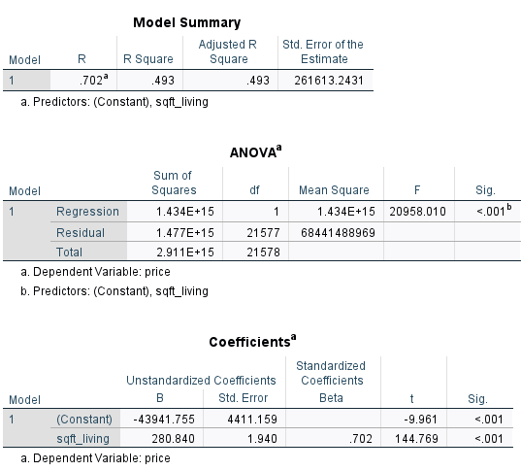
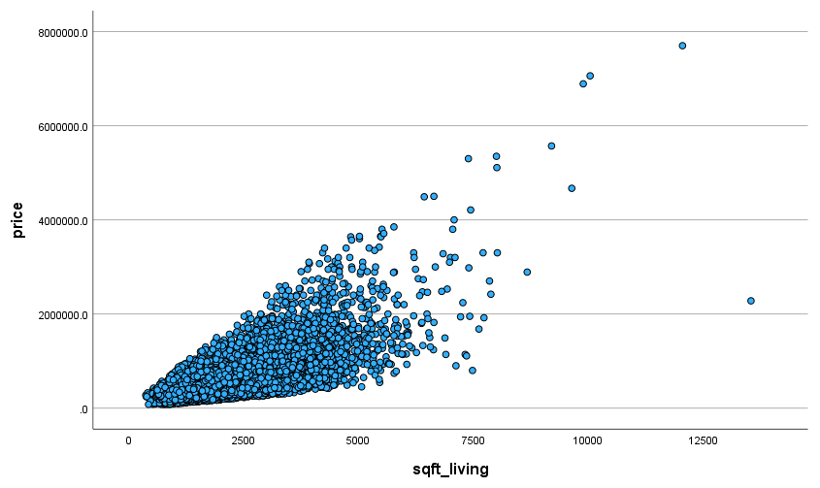
Regression
Price vs area of living

Slide 8
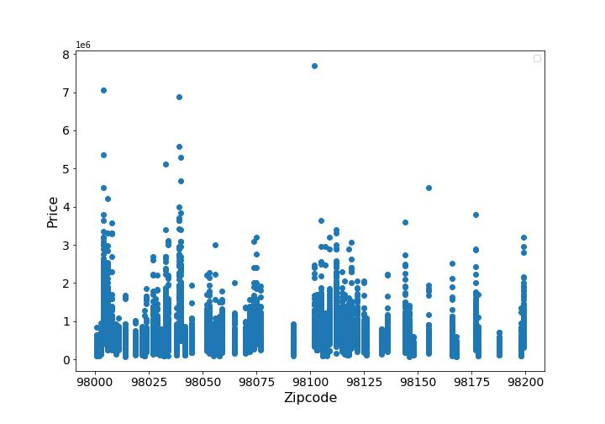
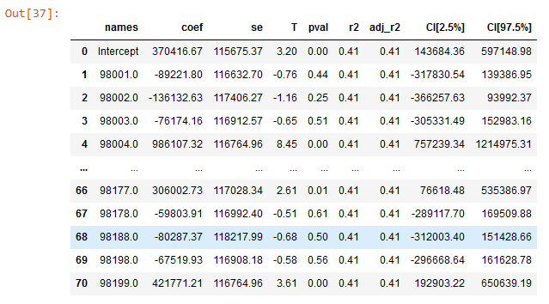
Regression
Price vs zipcode
We have to create dummy variables for the zipcode variable

