Slide 1
15. The original Turing machine
Lecture slides for What Can Be Computed?

Slide 2
Turing’s 1936 paper, On computable numbers, contains many striking ideas
Full title: On computable numbers, with an application to the Entscheidungsproblem
we study only these
definition of computing machines (which we now call Turing machines)
a convincing argument that any computation performed by a human can also be performed by a computer
a complete example of a universal computer
proofs that various problems are undecidable, including a variant of the halting problem
a resolution of a famous mathematical problem (the Entscheidungsproblem)
many other computational ideas, including nondeterminism, subroutines, recursion, binary numbers, Turing reductions, and proofs that an immense variety of mathematical calculations can be mechanized

Slide 3
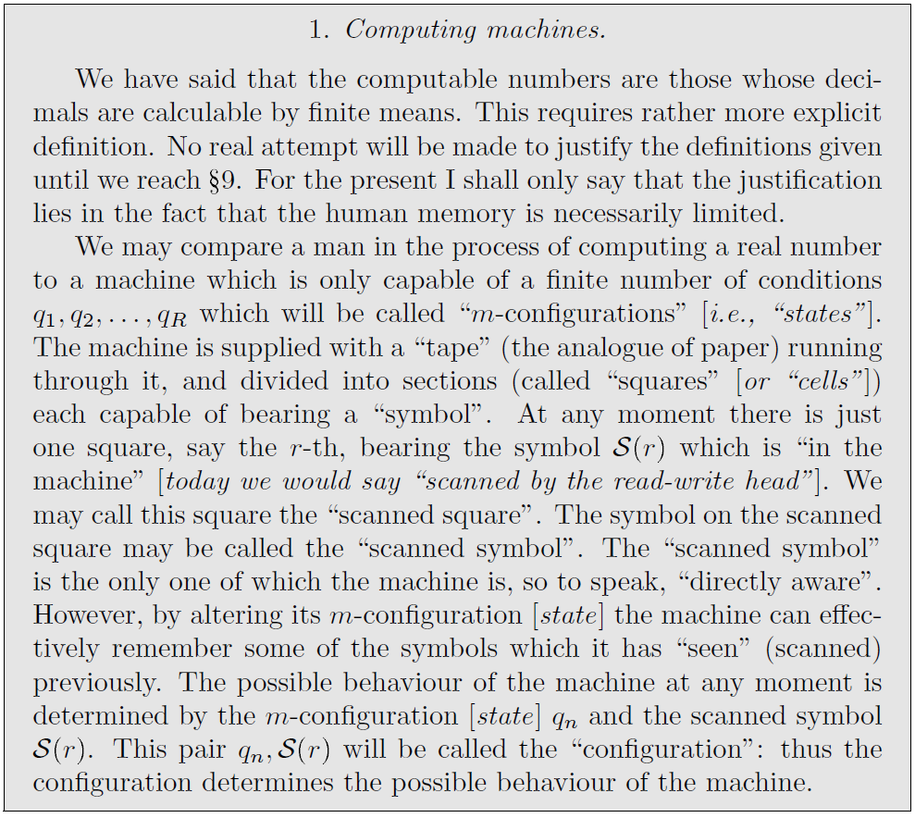

Description of Turing machine
Turing reduced computation to its essentials,
reading and writing symbols as a function of state of mind and the symbols read; a prodcess used for addition as well as caclulating probabilities.

Slide 4
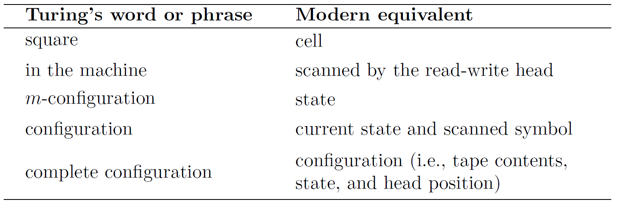
Differences in terminology

Slide 5
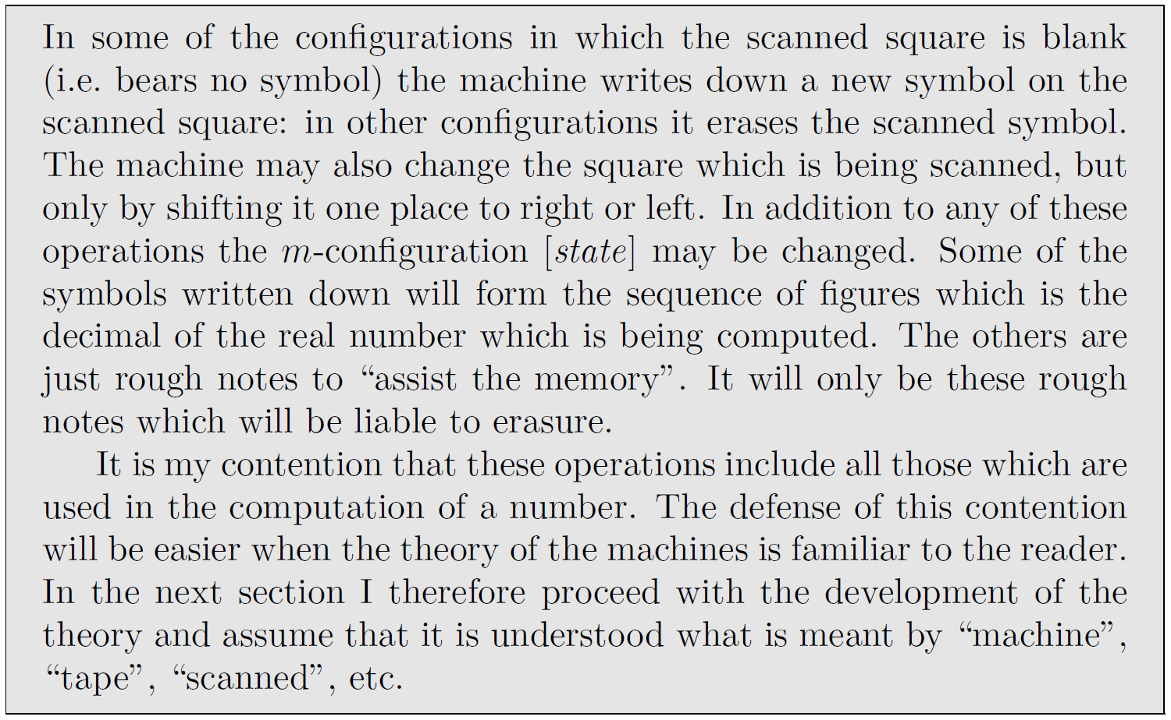



A Turing machine can do any (numerical) computation

Slide 6
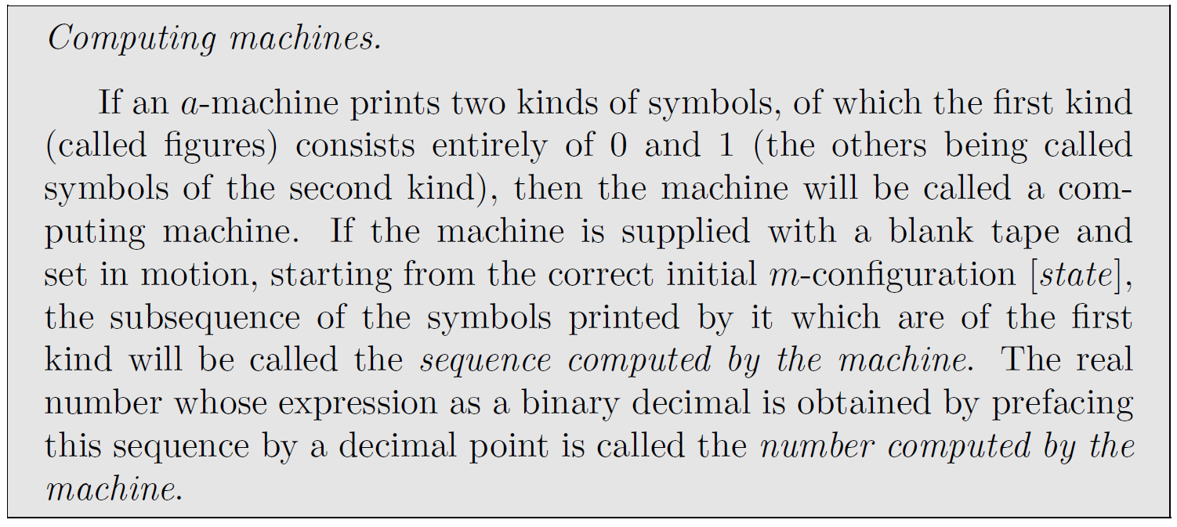






Example:
machine’s tape contains “dfh0110fjsdj100euipr0dj0f0v0d0d0d0d0d0…”
This represents the binary number $0.01101000000$…, or decimal $0.40625$
Turing was only concerned with computing the real numbers, so the lower case letters on the output tape are simply ignored.

Slide 7
We use a slightly different model: two-tape decimal computing machine (2TDCM)
Use two tapes instead of two kinds of symbols: an output tape and a regular tape (for input and intermediate results)
Output tape contains only digits 0-9, regular tape contains any ASCII symbols
Output tape represents a decimal between 0 and 1, e.g.
“4746305729454545…” represents $0.4746305729454545$…
An infinite representation of such a decimal.
In the WCBC library, twoDTM.py and simulate2TDCM.py both simuate a two-tape decimal computing machines. MacCormick says that twoDTCM.py is the more robust, but uses object-oriented Python requiring more sophisticated than he expects from his readers.

Slide 8
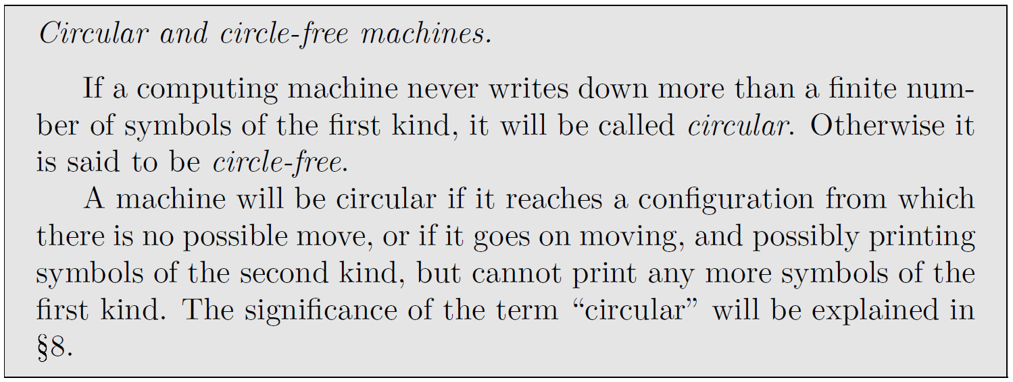
Turing doesn’t explicitly consider “halting” and instead considers circular versus circle-free
Turing considers this desirable: he wants the machine to output an infinite decimal expansion!
For 2TDCM:
circle-free means “writes infinitely many symbols on the output tape”
circular means “either halts or loops without writing on the output tape”

Slide 9
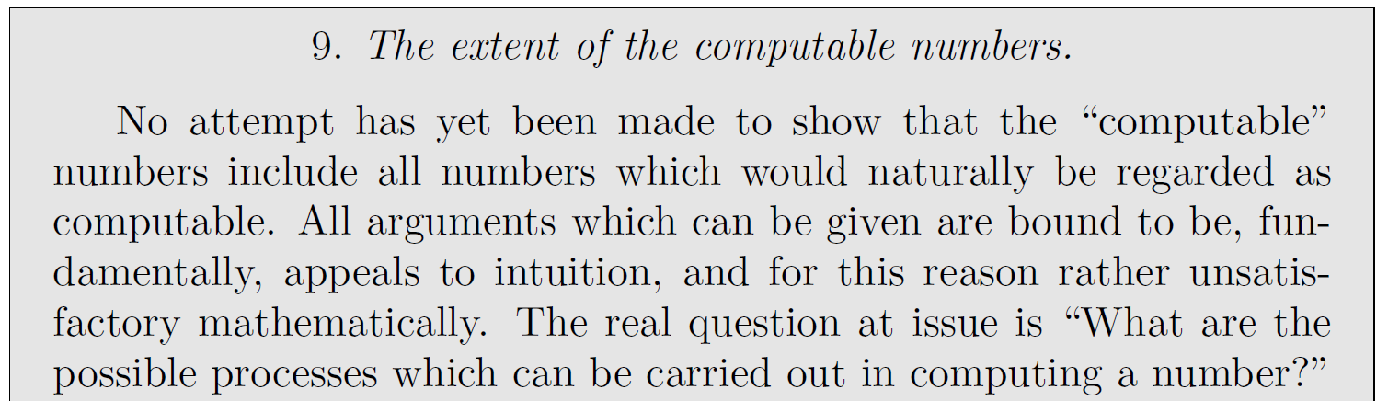
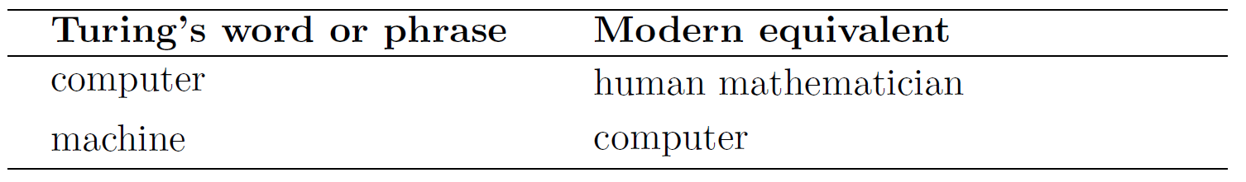
In section 9, Turing makes his first foray into artificial intelligence
Exercise 1: Do you believe the claim that a Turing machine can compute any number that a human mathematician can compute?
If not, do you have a counter-example?
Exercise 2: Do you believe the claim that Turing machines and human brains are computationally equivalent? Carefully justify your answer.
No additional justification needed if your answer for both exercises is "No."

Slide 10
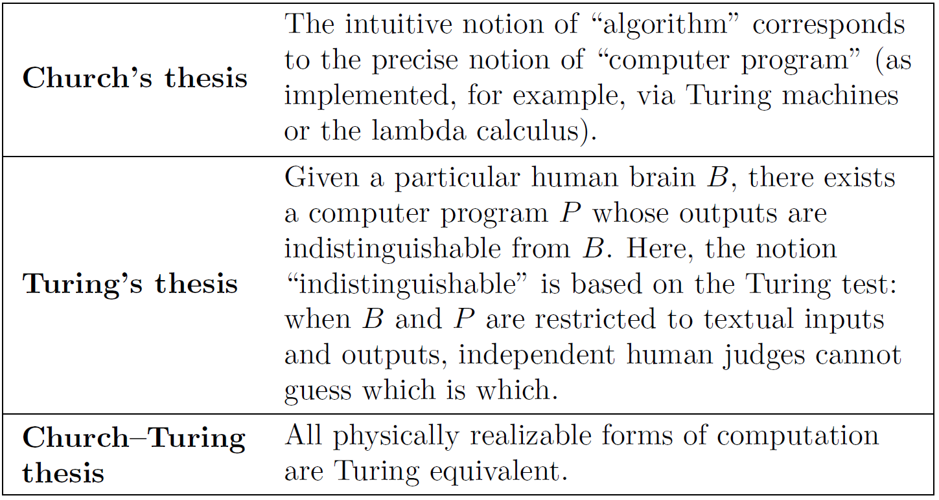
Turing’s work provides evidence for
various hypotheses about AI
Or by Python.
Turing actually proposed the "Turing test" for AI in a paper published in 1950 entitled Computing Machinery and Intelligence. This was 14 years after he introduced his machine model of computation with On Computable Numbers, with an Application to the Entscheidungsproblem. MaCormick argues that any any Turing machine could be considered to have AI, if the criteron was getting correct answers to questions the machines were programmed to compute.

Slide 11
Notes on the Church, Turing, and Church-Turing Theses
Per MacCormick, the lambda calculus and the TMs may solve the same set of problems, but spring from different motivations. Church was trying to define the notion of algroritm, the numbers that are "effectively caclulable." Turing assumed that the effectively calculable numbers were the ones that humans can compute, and designed his machines to capture the essence of this human activity.
Thus for MacCormick, "computer programs and human brains are equivalent in terms of what they can compute…in my experience, this formulation of Turing's thesis is believed by a reasonable number of AI experts and philosophers, but rejected by most other people."
There are many variants of the Church-Turing thesis, but all entail the notion of Turing equivalence. Restricted to mathematics, the CTT states that any function that a human could compute could be computed by a stored-program computer, ane could be solved a Turing machine. In The Church- Turing Thesis: Logical Limit or Breachable Barrier?, Copeland and Shagrir state the once widely accepted extended version of the CTT: "Any reasonable computational model can be simulated efficiently by the standard model of classical computation [TMs]." However, with the advent of quantum computing, that word "efficiently" is open to challenge.
They also present debate about a "Total physical computability thesis (CTT-P). Every physical aspect of the behavior of any physical system can be calculated (to any specified degree of accuracy) by a universal Turing machine."

