Slide 1
16. You can't prove everything that's true (Gödel’s theorem via Turing’s ideas)
Lecture slides for What Can Be Computed?

Slide 2
Which mathematical statements can be proved, and which are true?
Proofs systems are about syntax: manipulating symbols to prove statements by using inference rules to derive them from axioms, or to derive them from previously derived statements. A proved statement could be true or false, or have no relationship whatsoever to truth.
Main tools:
Proof systems
Logical systems
alphabet
axioms
inference rules
Logic systems combine syntax with semantics: assigning values of true or false to statements in a proof system. This assignment is not necessarily done by an algorithm.
Same as proof system, but also has a truth assignment

Slide 3

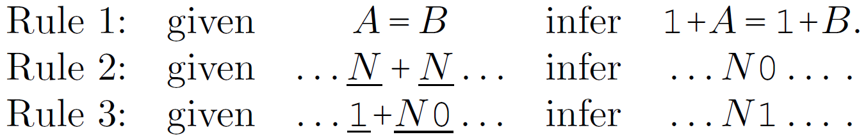
Example of a proof system: BinAd
Alphabet: {0, 1, +, =}
Axiom:
Inference rules:

Slide 4
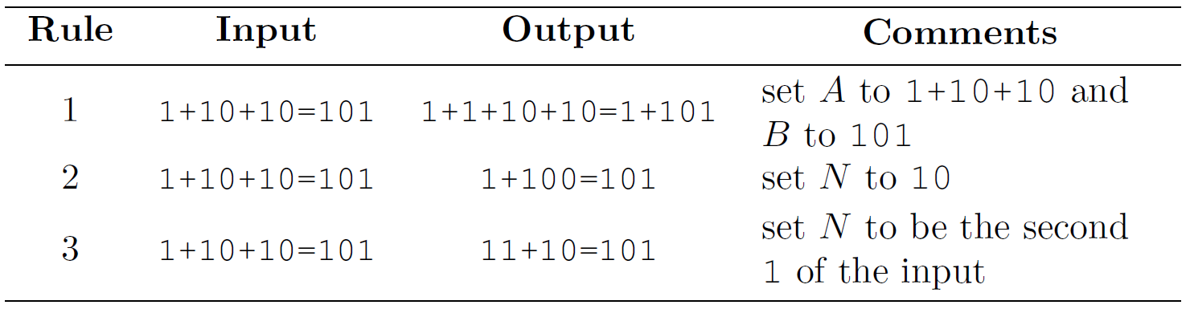
Examples of applying inference rules in BinAd
»{1+1+10+10=1+101
»Add one to each side of the equation.
1
»10+10=100.
»1+100=101
»11+10=101
»1+10=11.
Experiments: after importing binAd.py, try
>>> applyRuleTwo('1+1+1=11')
>>> isProvable('1+1+1=11')
>>> isProvable('1=0')
» {'10+1=11', '1+10=11'}
» ('provable', ['1=1', '1+1=1+1', '1+1+1=1+1+1', '1+1+1=1+10', '1+1+1=11'])
» ('not proved in first 109322 formulas generated', None)

Slide 5
Example of logical system: BinAdLogic
Use the obvious truth value: statement is true if it is mathematically correct (e.g. “1+1=10” is true; “1+1=1” is false)
Exercise: in BinAdLogic, is “10+100=110”
true?
provable?
Experiments:
>>> isTrue('1+1=10')
>>> isProvable('1+1=10')
>>> isTrue('10000=10000')
>>> isProvable('10000=10000')
BinAdLogic is consistent because all provable statements are true, and it is also complete because all true statements are provable.

Slide 6
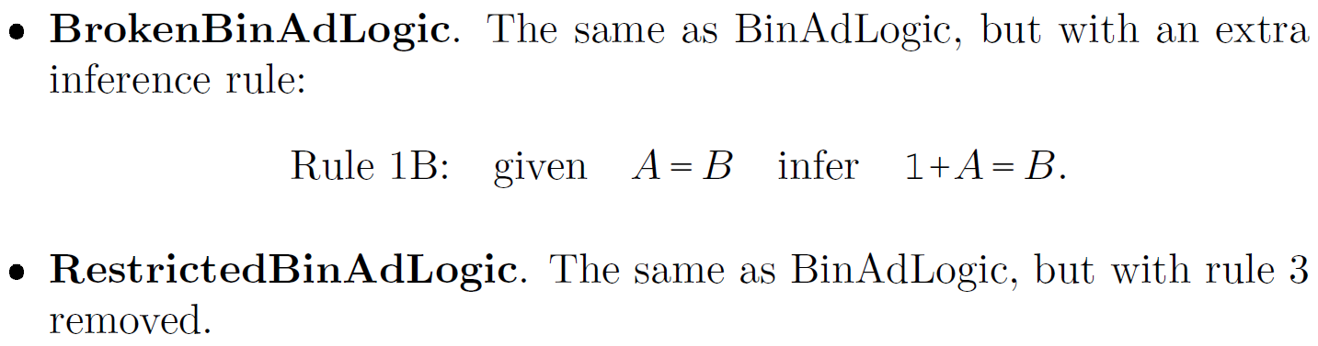
BUT in some logical systems, truth is not the same as provability
BinAdLogic
Examples:
Exercises:
Produce a BrokenBinAdLogic statement that is provable, but not true
Produce a RestrictedBinAdLogic statement that is true, but not provable
Think of a new truth assignment that “fixes” BrokenBinAdLogic

Slide 7
Broken binAd logic v2.0: Infer A = B + 1
i. Derive a statement S that is provable but not true in our understanding of binary arithmetic. »1=1+1.
ii. Provide a new interpretation for '=' that makes S true under the rules of binary arithmetic. »'=' has the same semantics as '≤'.
Restricted bidAd logic v2.0: Remove rule 2, N + N = N0
iii. Using this restricted version of binAd, produce a statement S that is true under the rules of binary arithmetic, but not provable. »1+1+10.

Slide 8
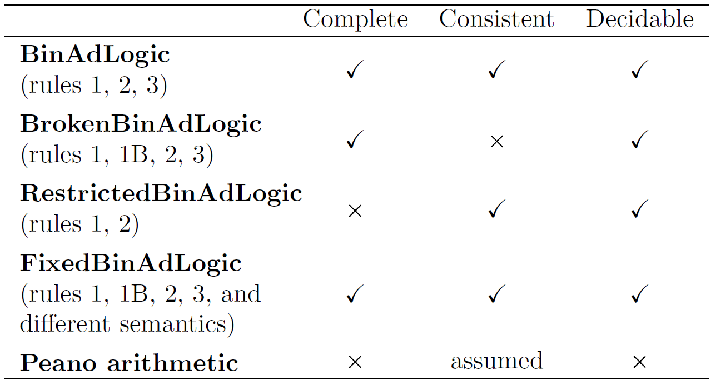
Consistency, completeness and decidability
A logical system is
consistent if all provable statements are true
complete if all true statements are provable
decidable if a computer program can decide the truth of statements
Truth values are not necessarily assigned by an algorithm.
Yes Yes Yes
Yes No Yes
No Yes Yes
Yes Yes Yes
No Hopefully No
will be explained soon!

Slide 9
Peano arithmetic (PA) is a logical system that describes integers, addition, and multiplication
Example:
NOT EXISTS x,y, 0''*x=y AND y=0'''''
Yes, these axioms do use an unary number system!
Meaning: there do not exist integers $x,y$ such that $2x=y$ and $y=5$
All variables in PA statements must be quantified in order to evaluate the truth of the statement (as above, where x and y are quantified with NOT EXISTS). PA statements with only quantified variables are called closed.

Slide 10
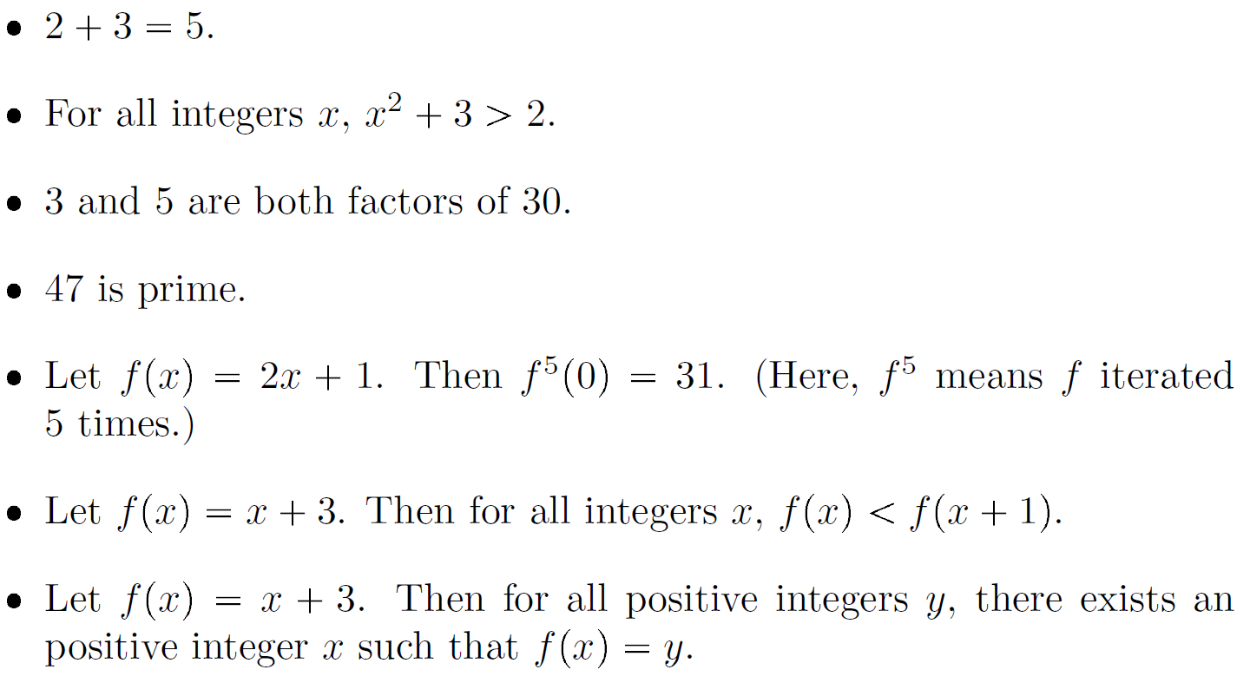
Peano arithmetic can express all the usual concepts of elementary number theory
We don’t study the details. Instead, take it on faith that Peano arithmetic can express the following statements:
ƒ⁵(0) = ƒ(ƒ(ƒ(ƒ(ƒ(0)))))
ƒ¹(0) = 2×0+1 = 1; ƒ²(0) = 2×ƒ¹(0)+1=2×1+1=3; ƒ³(0) = 2×ƒ²(0)+1=2×3+1=7; ƒ⁴(0)= 2×ƒ³(0)+1=2×7+1=15; ƒ⁵(0)= 2×ƒ⁴(0)+1=2×15+1=31
Of course, statements can be either true or false. This one is false.

Slide 11
Overview of Turing, Gödel, and the incompleteness of mathematics
Gödel proved mathematics is incomplete in the early 1930s
But this proof requires some challenging mathematics
Turing tried to extend Gödel’s results later in the 1930s
While working on that, Turing invented Turing machines and demonstrated unsolvable problems for those machines
Turing’s ideas yield a surprisingly simple proof of Gödel’s earlier result that mathematics is incomplete

Slide 12
Goal: prove that Peano arithmetic is incomplete (there exist true arithmetic statements that can’t be proved!)
Plan:
Show halting problem can be converted into Peano arithmetic (PA)
This immediately shows PA is undecidable, but doesn’t yet show it’s incomplete
Show that provable PA statements can be recognized
They can’t be decided, but they can be recognized
Analyze a strange program called godel.py
Exhibit a true, unprovable PA statement embedded in godel.py
So if a proof exists we could find it.
Provable Peano Arithmetic (PA) statement recognition algorithm: Let s be a PA statement, and let ∑ be the PA alphabet. Generate strings over ∑ in shortlex order, trying each string p to see if it is a proof of s. A provable s will be recognized, because a p that proves it will eventually be found. (See slide 15 for more on recognition.)
shortlex order: shorter strings before longer strings; strings of the same length based on some ordering of ∑, such as Unicode.

Slide 13
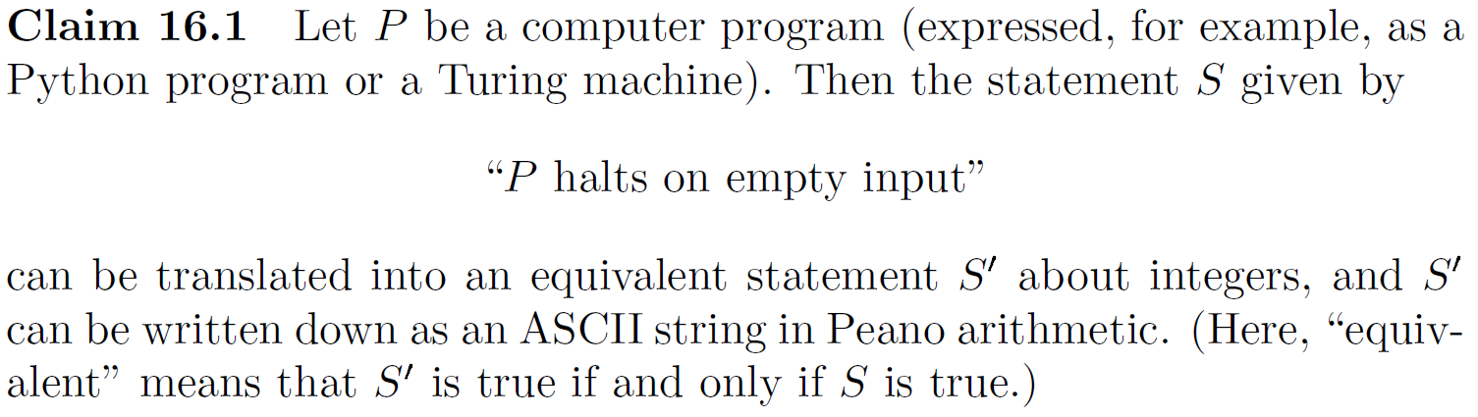
Show halting problem can be converted into Peano arithmetic (PA)
integer function that implements the transition function
Sketch of proof: Express as
there exists an integer $N$ such that $\text{Done}\left({\text{Step}}^{N}\left(m_{0}\right)\right)=1$
function that is 1 if machine has halted
initial machine state, expressed as binary integer
Step is a function that computes the next TM configuration after the current one (like following a transition arrow in a JFLAP diagram). Any automata configuration can be represented by a string, and every string could be interpreted as a binary number (e.g., as the concatenation of ASCII codes). Thus Step is a function that maps integers to integers.

Slide 14
Any TM configuration can be represented as a string. On example of such a is q3:AAG^TG, on WCBC p. 342, representing a TM in its q3 state, with AAGTG on the input tape, and T in the current cell. The program below is one way to convert a string into its integer equivalent, and would convert q3:AAG^TG into 2050239593063098951, ≈ 2,050,239.593 trillion.
DEV = True
def unicodeToInt(text):
if type(text) != str or len(text) == 0: return None
binary = '0b' #Python prefix for binary number
for symbol in text:
# ord() converts to unicode, bin converts unicode to binary, and
# '[2:]' omits the 0b prefix
binary += bin(ord(symbol))[2:]
if DEV: print(f'DBG: "{text}" in binary is: {binary}')
return int(binary,2)
if __name__ == '__main__':
print(f'Expected q3 = 7283, received: {unicodeToInt("q3")}')
result = unicodeToInt("q3:AAG^TG")
print(f'Expected q3:AAG^TG = ???, received: {result} ≈ {round(result/10**12,3)} trillion')
Assume there is an integer K ≥ 1 such that Step^{K}(m0) = 2050239593063098951, where m0 is the initial configuration, and step is the TM transition function described on the previous slide, mapping (symbol-read × state) to (symbol)written × new-state × direction). (Note that the output of step() is a TM configuration expressed as an integer.) Then if q3 is a halting state, Done(Step^{K}(m0)) == 1; otherwise, Done(Step^{K}(m0)) = 0.

Slide 15
$ python unicodeToInt.py
DBG: "q3" in binary is: 0b1110001110011
Expected q3 = 7283, received: 7283
DBG: "q3:AAG^TG" in binary is: 0b1110001110011111010100000110000011000111101111010101001000111
Expected q3:AAG^TG = 2050239593063098951, received: 2050239593063098951 ≈ 2050239.593 trillion

Slide 16
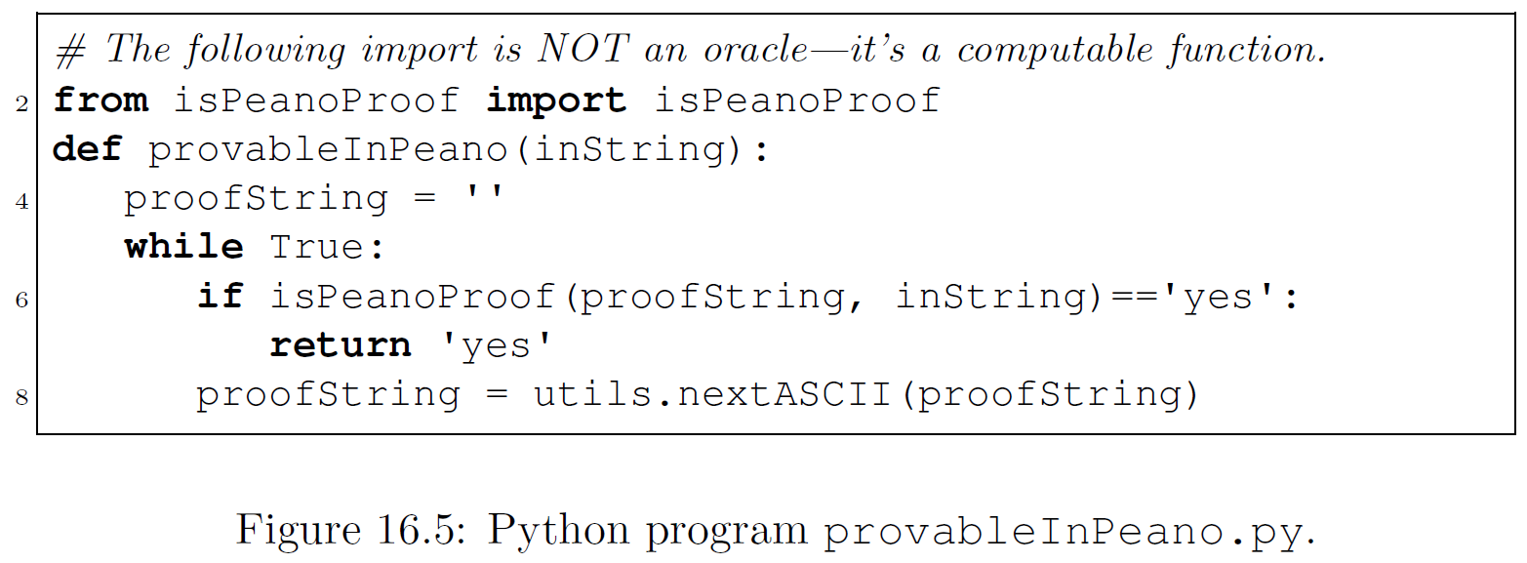
2. Show provable Peano artirthmetic (PA) statements can be recognized
This program recognizes provable PA statements:
Recognition by brute force. isPeanoProof generaters ASCII strings in shortlex order until isPeanoProof says one of the generated strings is a proof of the statement inString. Note this proof does not decide ProvableInPeano, because if inString is not provable, provableInPeano will never halt.

Slide 17
High-level design specification:
def isPeanoProof(proofString, proposition):
# proposition is what you are trying to prove,
# such as 1+1=10 in binAd,
# in Peano Arithmetic NOT exists x x*0=1
# proofString hopefully establishes that
# the prosition is true, starting with the
# axiom set, and applying inference rules
if proposition != proofString[-1]: return 'no'
for step in proofString:
if step not in PA_axioms
# and does not follow from previous step by
# a PA inference rule
#
and not_derivable(step): return 'no'
return 'yes'

Slide 18
Proof that Peano arithmetic is incomplete
import utils; from utils import rf
# The following two imports are computable functions, NOT oracles.
from isPeanoProof import isPeanoProof
from convertHaltToPeano import convertHaltToPeano #prog halts on empty input
# Non-constructive proof of incompleteness –
# ∃s(s is a true statement in Peano arithmetc AND s cannot be proven)
# Let P, a SISO Python program, be an instance of HaltsOnEmpty.
# P is a postive instance if P('') halts; otherwise, P is a negative instance.
# HaltsViaCompletePiano(rf('P.py')) results in a true statement in Peano
# arithmetic that cannot be proven.
def haltsViaCompletePeano(tmString):
haltInPeano = convertHaltToPeano(tmString) # EXISTS N s. t. Done(Step^{N}(m0)) = 1
notHaltInPeano = 'NOT ' + haltInPeano # NOT EXISTS N s. t. Done(Step^{N}(m0)) = 1
# Note that P either halts or it doesn't, so either haltsInPeano or
# notHaltsInPeano must be true.
proofString = ''
while True:
if isPeanoProof(proofString, haltInPeano)=='yes':
return 'yes' # P halts
if isPeanoProof(proofString, notHaltInPeano)=='yes':
return 'no' # P does not halt
proofString = utils.nextASCII(proofString)
# … But if there was always a proof of either true, then we could sovle the
# unsolvable halting problem!

Slide 19
This resembles the proof at the end of WCBC chapter 8, nondeterminism, which shows that the complement of a problem that is recognizable but not not decidable is not even recognizable.
Claim: The complement of a recognizable, undecidable decision problem is unrecognizable.
Sketch of proof: Given an undecidable decision problem $D$, suppose that $D$ and its complement are both recognizable. Then we can write programs that recognize both $D$ and its complement. Run both programs in a single nondeterministic program and we have a way of deciding $D$. Contradiction!
One deterministic alternative is to run the threads in parallel, one step at a time, until one of them terminates.

Slide 20
Chris Moore also offers a non-contructive proof at the hour mark in his lecture.
Suppose that everytime a program was going to run forever there was a proof that it was going to run forever. Note that this differs from a decidability problem, such as the halting problem. Instead of asking whether something is true of false, it asks if you prove something you already know to be true.
Let P be a Python program. You could decide the HaltsOnEmpty problem by initializing proofString to '', and doing two things in parallel:
• Run P('') for a step and see if it halts.
• Check to see whether the next proofString in a lexicographic ordering
of ASCII is a proof that P will not halt.
One of these things are guaranteed to happen, solving the unsolvable halting problem.
∴ There are true statements that cannot be proven

Slide 21
520 version of next two WCBC slides
import utils; from utils import rf
# The following import is NOT an oracle function. The function
# provableInPeano correctly recognizes provable strings, but does not
# decide them. See claim 16.4 p. 345
from provableInPeano import provableInPeano
# The following import is a computable function---NOT an oracle.
from convertHaltToPeano import convertHaltToPeano
def godel(inString):
godelProg = rf('godel.py')
# Constuct a Peano arithmatic predicate for godel('') halts
haltInPeano = convertHaltToPeano(godelProg)
# Constuct a Peano arithmatic predicate for godel('') does not halt
notHaltInPeano = 'NOT ' + haltInPeano
#provableInPeano is recognizable
if provableInPeano(notHaltInPeano) == 'yes':
# This is where godel() halts, if it does.
# Does godel('') halt on empty input, assuming Peano arithmetic consistency?
# »No, because godel('') only halts if you can prove it doesn't.
# »So assuming godel('') halts leads to an inconsistency.
return 'halted' # any value would do
else:
utils.loop() # deliberate infinite loop
Constructive proof:
1. notHaltInPeano is true because »assuming godel('') halts leads to a contradiction (inconsistency).
2. notHaltInPeano is unprovable because »if it was, godel('') would halt.

Slide 22
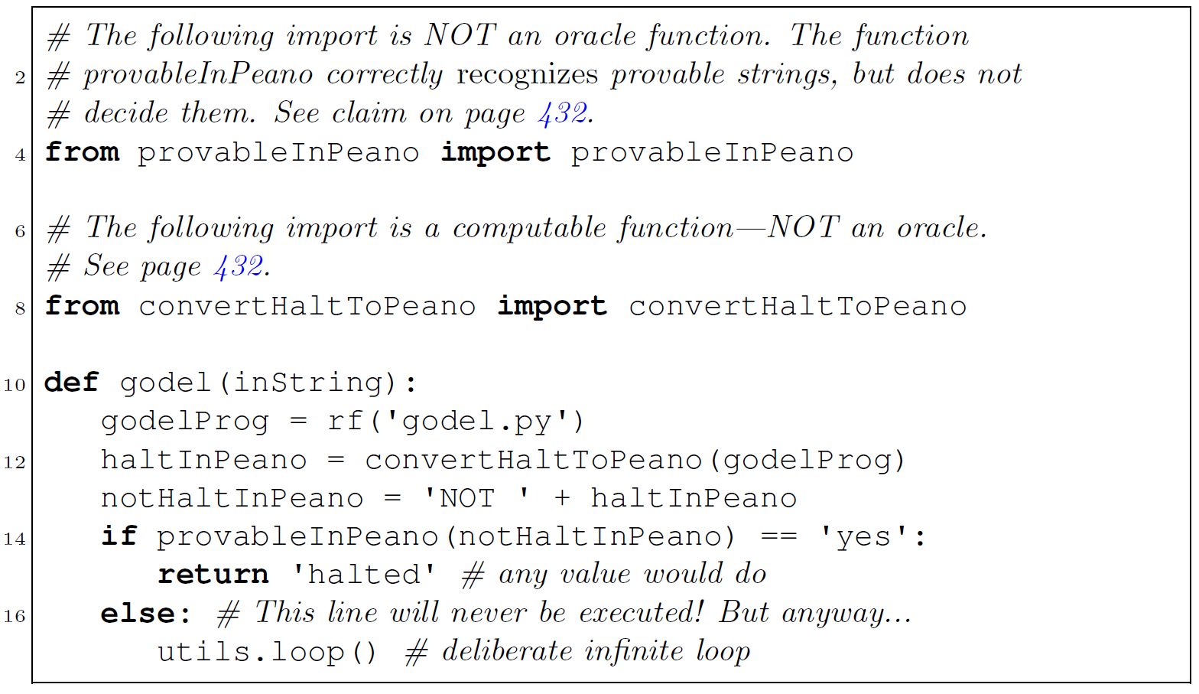
3. Analyze a strange program called godel.py
See step 2
See step 1
Note the meaning of notHaltInPeano:
“godel.py doesn't halt on empty input”
Exercise: what does this program do on empty input?

Slide 23
4. Exhibit a true, unprovable PA statement embedded in godel.py
See step 2
See step 1
Note the meaning of notHaltInPeano:
“godel.py doesn't halt on empty input”
Exercise: what does this program do on empty input?
»It loops at line 17…
…therefore, notHaltInPeano is »true but not provable.

Slide 24
Assume that Peano arithmetic is consistent, and that the TM M has the following high-level description:
If you can prove that M does not halt: halt
else: loop
Statement S = "M does not halt
Show that S is true but unprovable.

