Slide 1
17. Karp's 21 problems
Lecture slides for What Can Be Computed?

Slide 2
1972: dramatic moment in the history of theoretical computer science
SAT already known to be NP-complete
Proved by Cook (1971) and independently by Levin in Soviet Union
So, SAT is a “hardest” problem in NP
Presumably, therefore, SAT has some special property that makes it harder than most or all of the other NP problems
Karp’s 1972 paper dramatically refutes this, demonstrating 20 additional problems that are “equally hard” compared to SAT (polyequivalent to SAT)
Computer scientists conclude that NP-completeness is widespread, and therefore there are many important problems that will probably never be solvable in polynomial time ( or they all will be solvable in polynomial time)

Slide 3
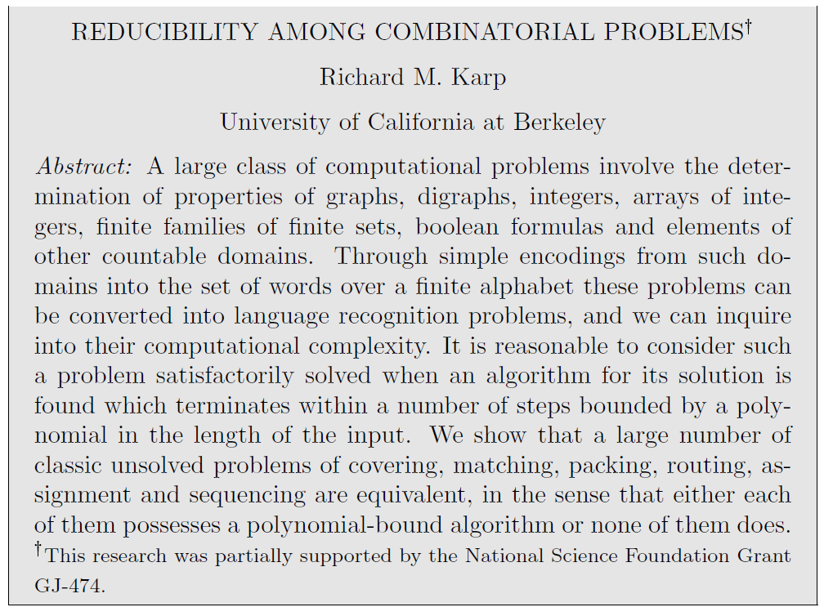

Slide 4
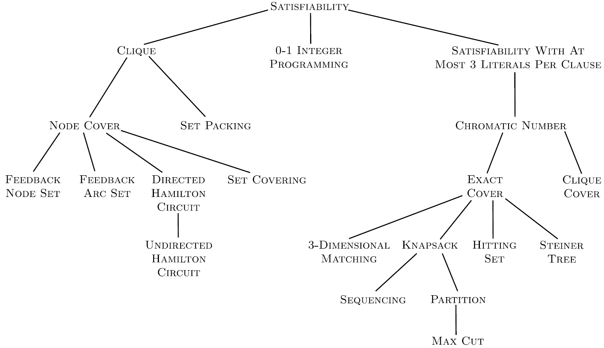





Karp’s reductions
We study only 5 of the 20 reductions

Slide 5
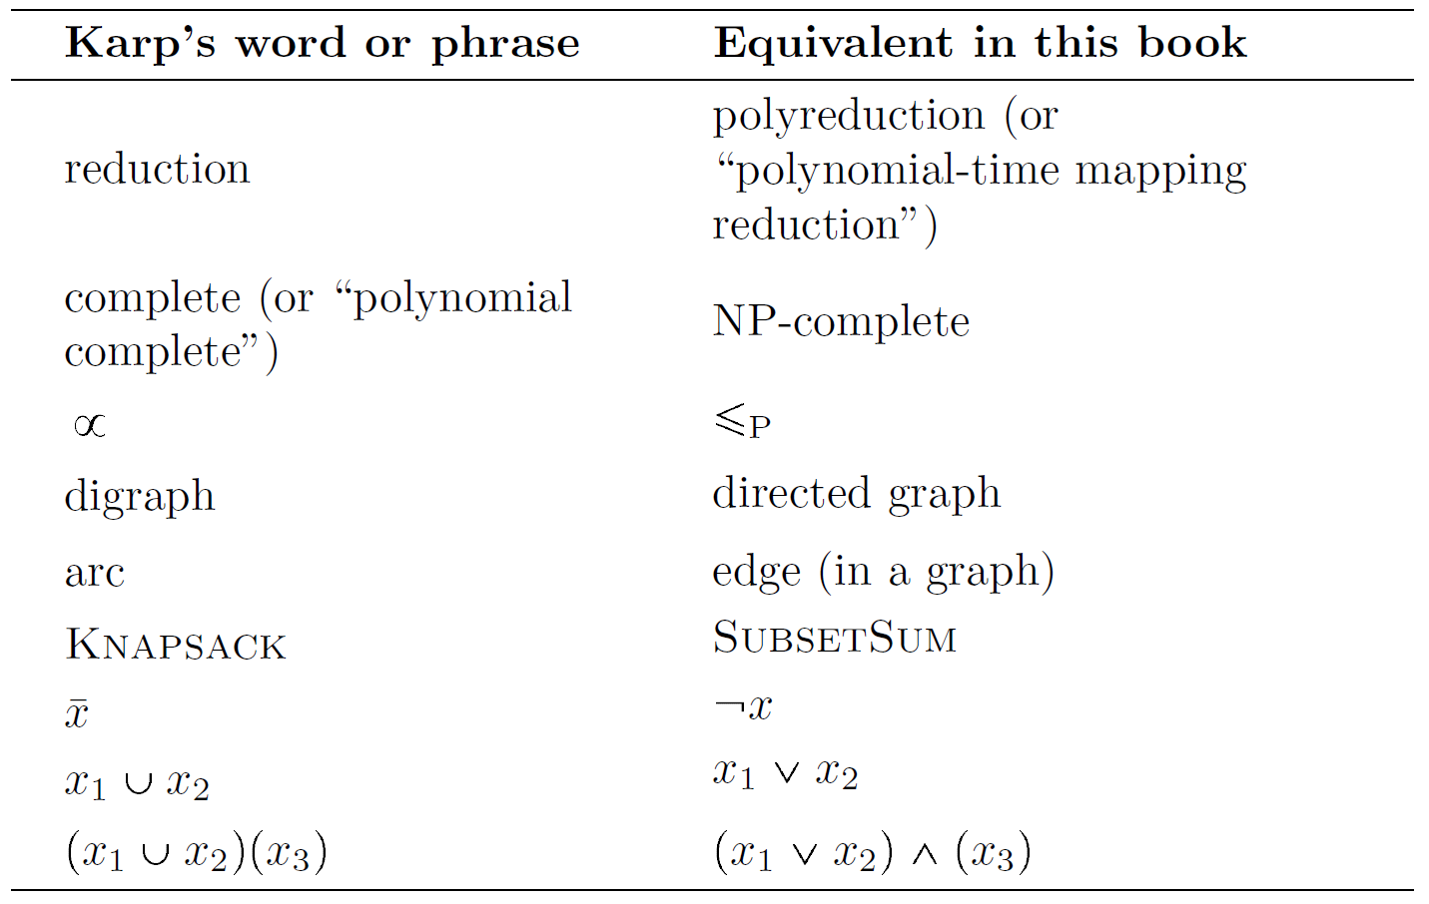

Slide 6
Karp's NP-complete definition:
L is polynomial complete if:
(a) L ∈ NP and
(b) SATISFIABILITY ∝ L
where ∝ means ≤p
Of the 4 definitions of NP-complete in chapter 14, which is this closest to?
1. Problem D ∈ NP-complete if D ∈ NP ∧ ∀C ∈ NP(C ≤p D
2. Problem D ∈ NP-complete if D ∈ NP ∧ SAT ≤p D)
3. Problem D ∈ NP-complete if D ∈ NP ∧ C ≤p D, where C ∈ NP-complete
4. Problem D ∈ NP-complete if D ≡p SAT, or D ≡p C, where C ∈ NP-complete

Slide 7
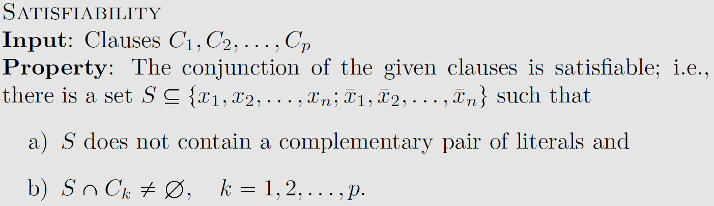
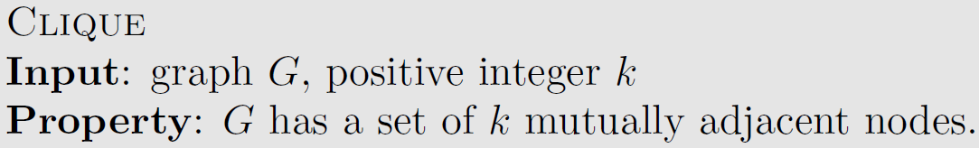
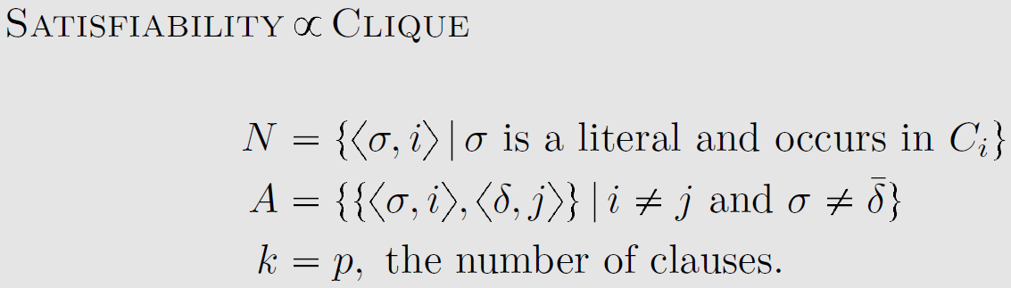
Karp’s definition of SAT
literal ≝ a variable or its negation.
a literal and its negation cannot be both be true
at least one literal in every clause must be true
Karp’s definition of Clique
Karp’s reduction from SAT to Clique
Ouch. This is very terse.
N: The nodes in the graph are labeled <σ,i> where σ is a literal and i is the index of a clause.
A: draw an edge between a pair of nodes except if they are in the same clause, or the edge connects a literal and its negation.
k is the size of the clique

Slide 8
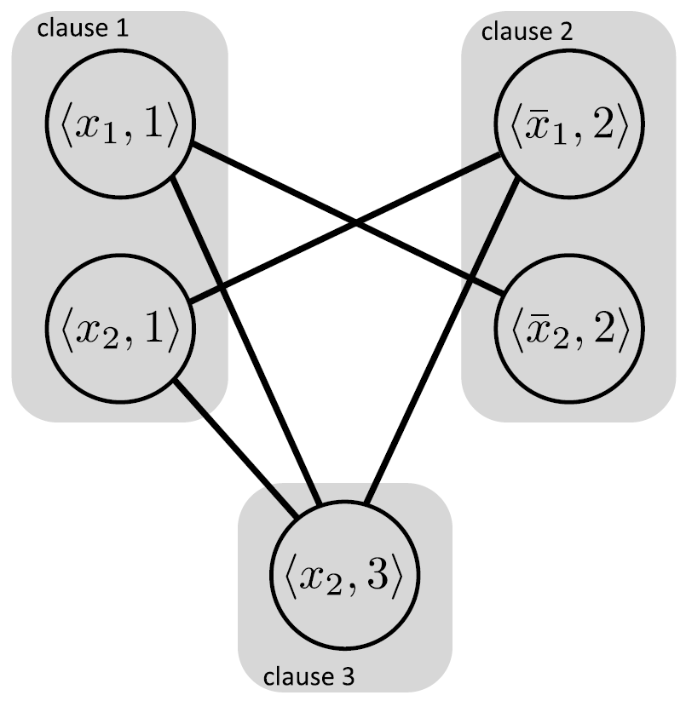

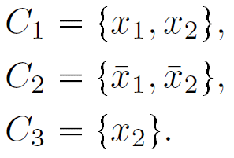
Example of $\text{SAT}≤_{P}\text{Clique}$
corresponding clique instance
SAT instance in our notation
Same SAT instance in Karp’s notation
Put edges between all pairs of nodes in distinct clauses, except complementary literals
Exercise: prove this maps positive to positive and negative to negative
Experiment:
>>> convertSatToClique((x1 OR x2) AND (NOT x1 OR NOT x2) AND (x2))

Slide 9
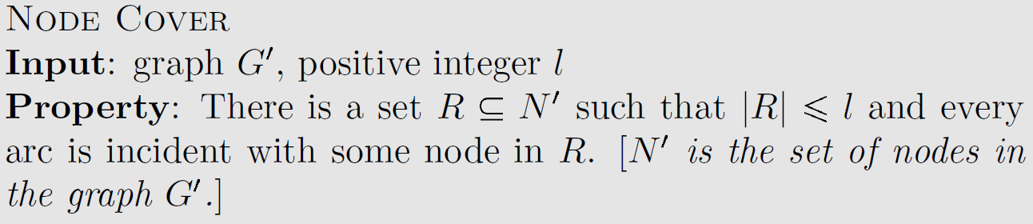
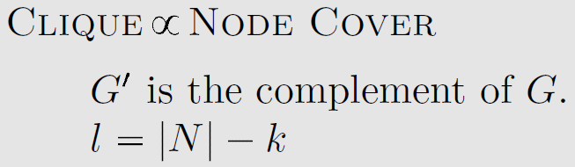
Karp’s definition of Clique
Each node in a clique is connected to all the other
nodes in the clique.
Karp’s definition of Node Cover
In other words, the node cover of a graph is a set of vertices that includes at least one endpoint of every edge of the graph.
Karp’s reduction from Clique to Node Cover
G' is a complement of G if G' has an edge everywhere
G doesn't, and vice versa.
|R|, the number of nodes to cover G' = the number of nodes - the size of the clique.

Slide 10
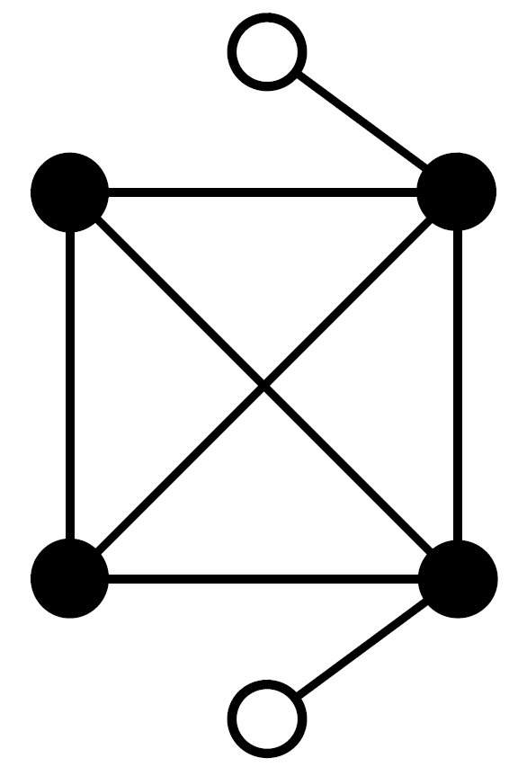
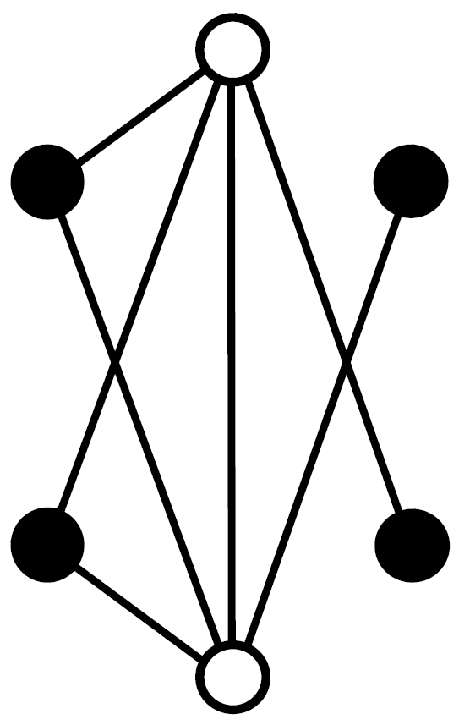
Example of $Clique≤_{P}\text{Node}\text{Cover}$
Exercise: prove this maps positive to positive and negative to negative
Clique ≝ a set of nodes such that every node in the set is connected to all the others. (Black nodes in G.)
Node cover ≝ a set of nodes including at least one end point of every edge in the graph. (White nodes in G'.)
Clique instance $G$ with $k=4$
Node Cover instance $G′$ with $l=6−4=2$

Slide 11
Node Cover ≤P Independent Set
IndependentSetD(g,n) ≝ ∃S( (S is a subset of the nodes in graph g) and (|S| ≥ n) and (no node in S is adjacent to any other node in S). In other words, there are no edges
connecting any two nodes in S.
For example, if g₁ = 'a,e a,b c,e d,e', then g₁,'3' is a positive instance of IndependentSet because there are no edges connecting nodes b, c, and d. But g₁,'4' is a negative instance. And if g₂ = 'a,e a,b c,d c,e d,e', then g₂,'3' is also a negative instance of IndependentSet, since the addition of the edge c,d means that b, c, and d are not disconnected from each other.
The diagram, taken from the previous slide, shows a node cover subset (white disks). Every edge in the diagram must have a white disk as one or both end points, so there can be no edge connecting two blacks disks.
∴ the black disks form an independent set.

Slide 12
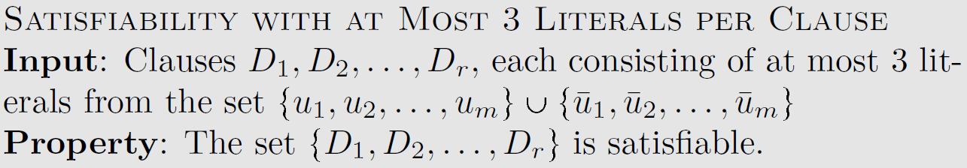
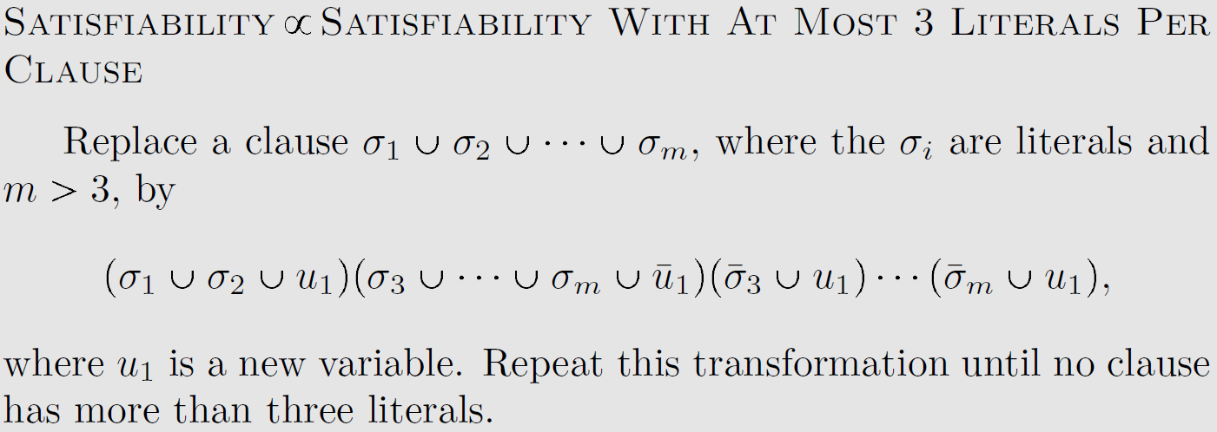
Karp’s definition of SAT
Karp’s definition of 3-SAT
Karp’s reduction from SAT to 3-SAT

Slide 13
Karp’s $\text{SAT}≤_{P}\text{3-}\text{SAT}$ reduction is almost the same as the one in Chapter 13
$$\left(x_{1}∨x_{2}∨x_{3}∨x_{4}∨x_{5}\right)∧\left(x_{6}∨x_{7}∨x_{8}∨x_{9}\right)$$
$$\left(x_{1}∨x_{2}∨x_{3}∨d_{1})∧({¬d}_{1}∨x_{4}∨x_{5}\right)∧\left(x_{6}∨x_{7}∨x_{8}∨x_{9}\right)$$
transform via clause-splitting
$$\left(x_{1}∨x_{2}∨d_{2})∧({¬d}_{2}∨x_{3}∨d_{1})∧({¬d}_{1}∨x_{4}∨x_{5}\right)∧\left(x_{6}∨x_{7}∨x_{8}∨x_{9}\right)$$
$$\left(x_{1}∨x_{2}∨d_{2})∧({¬d}_{2}∨x_{3}∨d_{1})∧({¬d}_{1}∨x_{4}∨x_{5}\right)∧\left(x_{6}∨x_{7}∨d_{3})∧(¬d_{3}∨x_{8}∨x_{9}\right)$$

Slide 14
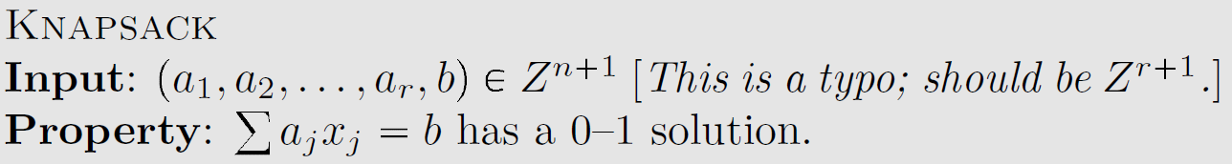
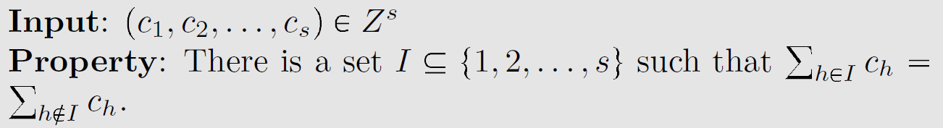
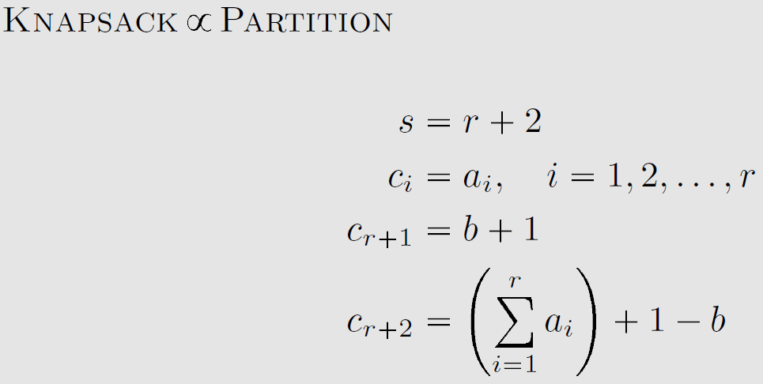
Karp’s definition of Knapsack
Karp’s definition of Partition
Karp’s reduction from Knapsack to Partition
Ouch. This is again very terse.
Why does it work?

Slide 15
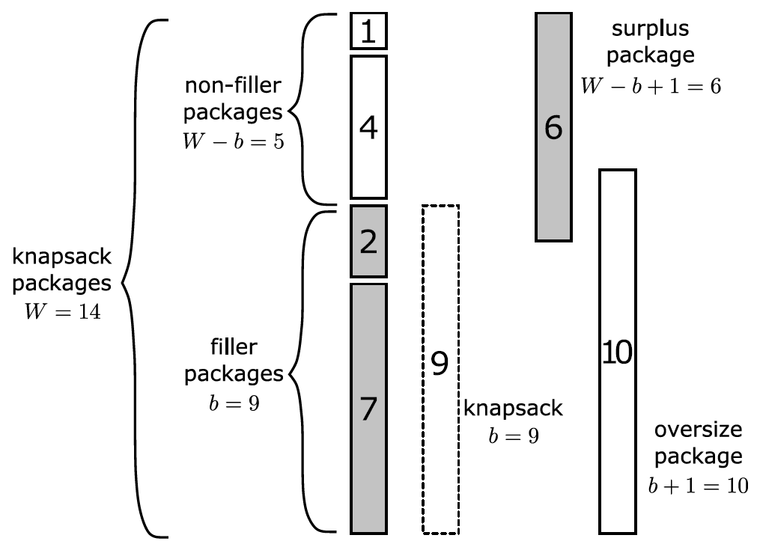
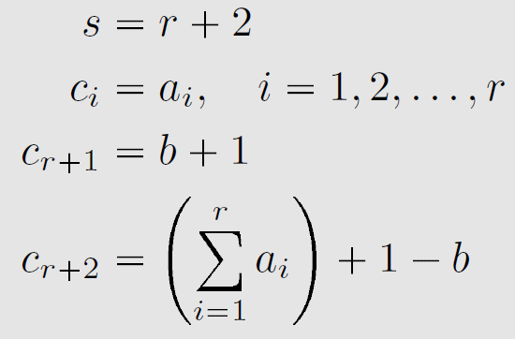
Example of $\text{Knapsack}≤_{P}\text{Partition}$
knapsack instance
Weights $1,2,4,7$
Knapsack size $9$
partition instance
Weights $1,2,4,7,6,10$
Exercise: prove this maps positive to positive and negative to negative
Karp’s notation

Slide 16
In other words:
W is the sum of all weights
b is the capacity of the knapsack (the target sum)
Cᵣ₊₁ = b + 1
Cᵣ₊₂ = W - b + 1
Total weight after adding Cᵣ₊₁ and Cᵣ₊₂ = W + b + 1 + W - b + 1 = 2W + 2
Cᵣ₊₁ + Cᵣ₊₂ = W + 2 > (2W + 2)/2 so Cᵣ₊₁ and Cᵣ₊₂ cannot both be in the same partition
Note that each partition must weigh W + 1.
Let partition Non-Filler be the partition containing Cᵣ₊₁. Then besides Cᵣ₊₁, the other items in Non-filler weigh »W + 1 - (b + 1) = W - b.
Let partition Filler be the partition containing Cᵣ₊₂. Then besides Cᵣ₊₂, the other items in Filler weigh »W + 1 - (W - b + 1) = b.
So after adding Cᵣ₊₁ and Cᵣ₊₂, the weights can be partitioned iff there is a subset of weights in C₀ - Cᵣ that sum to b

Slide 18
The rest of the paper: NP-hardness and more
Doesn’t explicitly define NP-hardness, but shows an awareness of it
Discusses possibility of problems lying strictly between P and NP:
Karp’s examples include graph isomorphism, primality, and linear programming
Since then, polynomial time algorithms have been found for primality and linear programming … and we seem to be close for graph isomorphism too
Modern examples would include integer factorization and discrete logarithm

