Slide 1
14. NP-completeness
Lecture slides for What Can Be Computed?

Slide 2
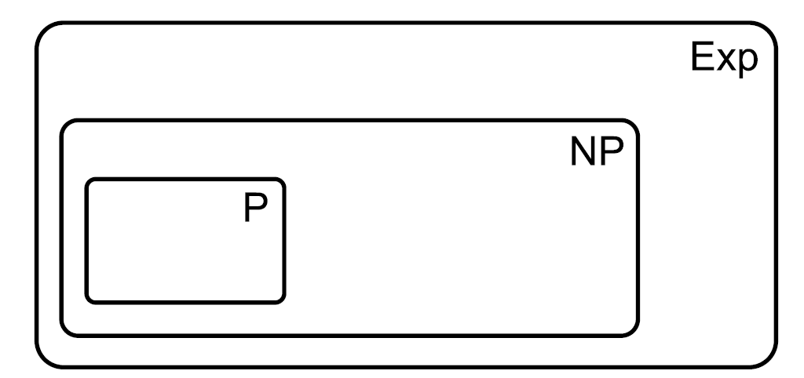
Recall definitions of P, NP, Exp
Diagram assumes P is a proper subset of NP, but that is an open question.
Remember, we restrict to decision problems in this chapter

Slide 3
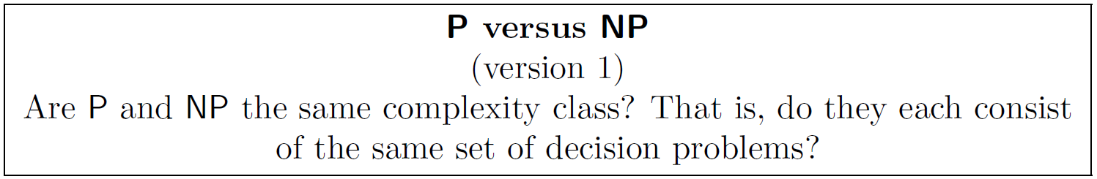
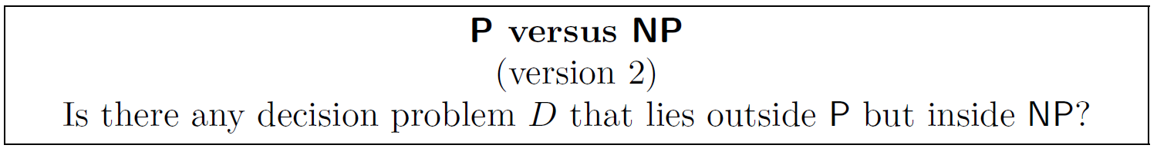
P versus NP: the most famous problem in computer science
Are there any computational problems in here?
If so P = NP
If so P ⊂ NP
Ultra-informal version of P vs. NP
Are all problems whose solutions are easy to verify also easy to solve? Is it really as easy to prove a new theorem as it is to verify that it is correct? To write a great book as it is to read a book and decide that it's great? To crack a password as to enter one?

Slide 4
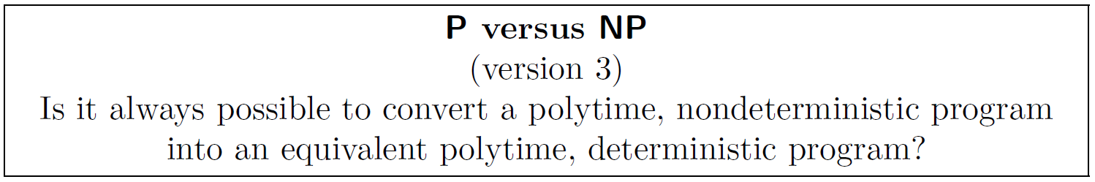
Can define in terms of determinism versus nondeterminism
“In P” means “can solve with polytime, deterministic program”
“In NP” means “can solve with polytime, nondeterministic program”
Nondeterministic running time ≝ ∞ if at least one of the threads do not halt; otherwise, the maximum number of computational steps in any thread. So nondeterministic polytime means that the maximum number of steps in any thread, not the number of steps in all threads, is a polynomial function of n.
If so then P = NP

Slide 5
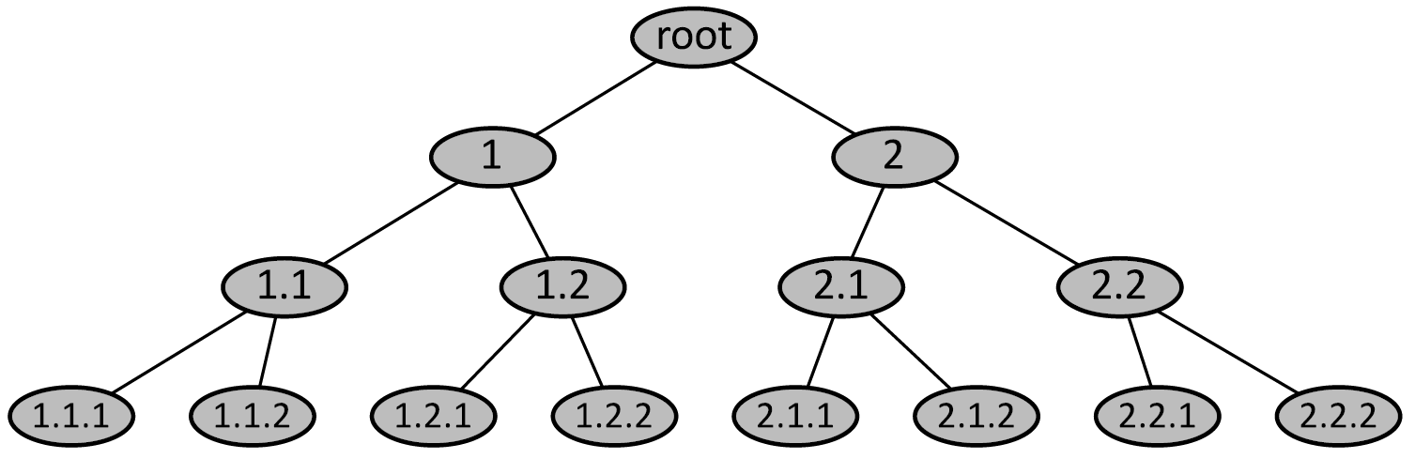
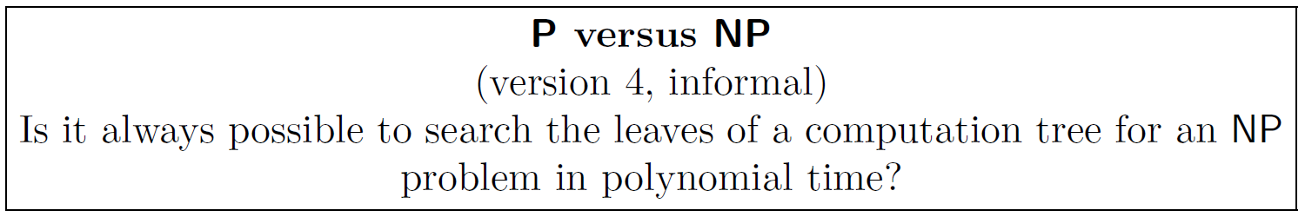
Interesting interpretation of P vs. NP in terms of computation trees
If so then P = NP
WCBC P vs. NP v5: Is SAT in P? (The propositional logic satisfiability problem)
WCBC P vs. NP v6: Is any NP-complete problem in P?
If so then P = NP

Slide 6
Interesting: we already encountered many polyequivalent problems
we proved these
can be proved, but we didn’t do it
These problems are “equally hard” (if we ignore polynomial factors in running time)
Thousands of other problems are known to be at this same level of “hardness”
We call this class of problems NP-complete

Slide 7
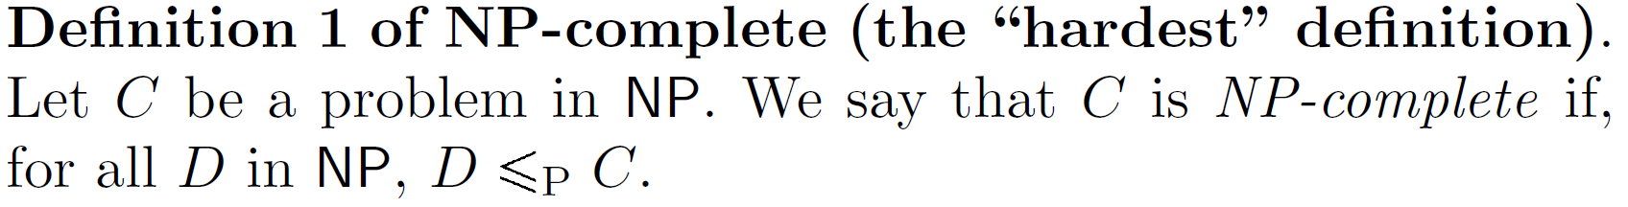
The classical definition of NP-complete problems defines them as the “hardest” problems in NP
Example:
DHC is NP-complete (although we haven’t proved that yet).
Given that DHC is NP-complete, the above definition tells us that all NP problems polyreduce to DHC! Strange, but true.
DHC — Directed Hamiltonian Cycle

Slide 8
Famous example: it was proved in the 1970s that all NP problems polyreduce to SAT (Cook-Levin theorem)
Because of this, we obtain an easier but equivalent definition of NP-completeness:
Exercise: Why is this definition equivalent to the earlier one?
»Definition 1 is equivalent to definition 2 because SAT ∈ NP-complete, so by definition 1, all NP problems are polyreducible to SAT. And since ≤P is a transitive relationship, if SAT ≤p D then All NP problems ≤p D, and thus D is NP-complete by definiton 1.

Slide 9
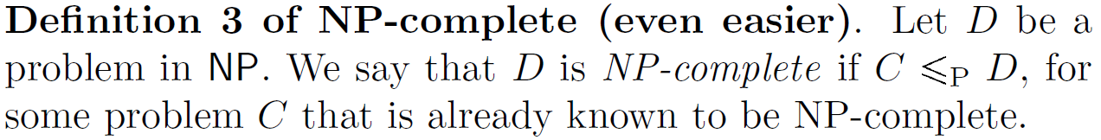
In fact, there’s nothing special about SAT in the definition of NP-completeness
Exercise: Why is this definition equivalent to the earlier ones?
»Because ≤P is a transitive relationship, the same reason why defintions 1 and 2 are equivalent.

Slide 10
NP-hard means “as hard as NP-complete, and maybe harder”
All undecidable problems, such as yesOnSome, are in NP-hard but NP-complete.
An NP-hard problem could be outside NP
For problems in NP, the concepts of NP-hard and NP-complete are equivalent
Example: nondecision variants of NP-complete problems are NP-hard (e.g. nondecision variants of TSP, UHC, SAT)
self-reducibility ≝ If D is the decision variant of a search problem F, and D is NP-complete, then F ≤p D.

Slide 11
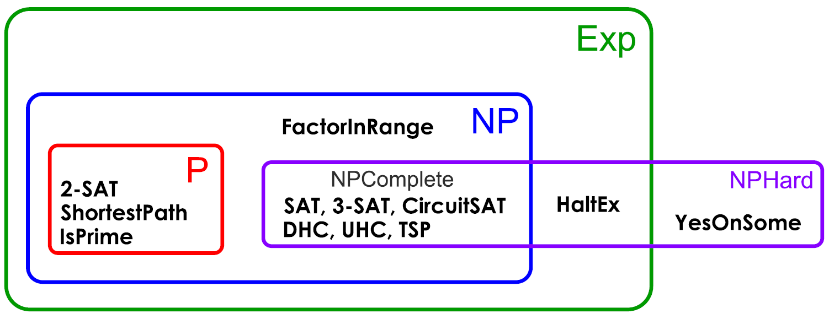
Summary of complexity classes, restricting attention to decision problems.
Undecidable problems like yesOnSome can be in NPHard!
To reduce SAT to yesOnSome, simply ask whether there are some inputs that satisfy a particular formula.
Important note: makes certain standard assumptions, such as P$≠$NP
Re: FactorInRange. Peter Shor discovered a polytime quantum algorith for finding the prime factors of an integer, but it has not been implemented on the huge composite numbers used in cryptography. No equivalent classical algorithm has been dicovered, and there is no proof that the problem is NP-complete.

Slide 12
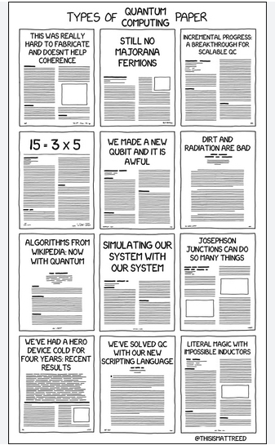
Quantum computing
per xkcd

Slide 13
YesOnSome(P) returns 'yes' if there is some I such that P(I) == 'yes'; and returns 'no' otherwise.
def ConvertSat_To_YesOnSome(SAT_instance):
'''
SAT_instance is a propositional logic formula in
Conjunctive Normal Form.
'''
yesOnSomeInstance =
f'''
def yos_instance(I):
formula = {SAT_instance}
# high level code
# 1. If I does not contain assignments for
# all the literals in formula, return 'no'
#
# 2. Use I to assign truth values to all the literals in
# formula
#
# 3. If formula evaluates to True return 'yes'.
#
# 4. return 'no'
'''
return yesOnSomeInstance

Slide 14
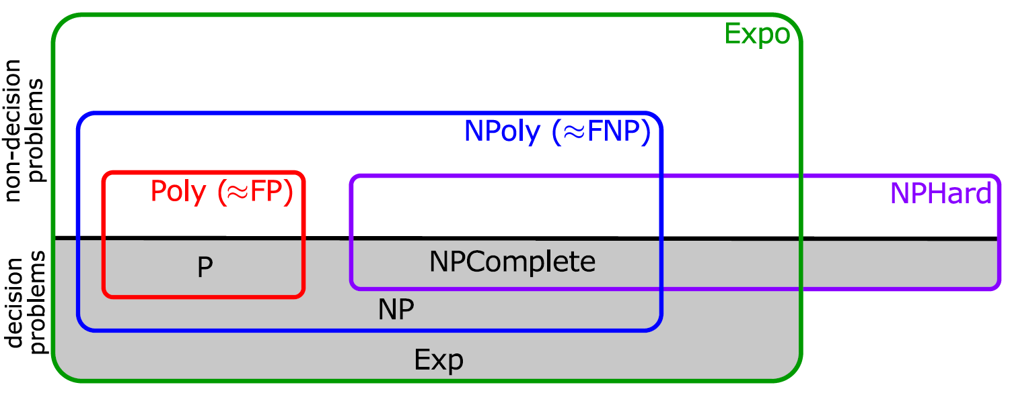
Summary of complexity classes, including nondecision problems
Important note: makes certain standard assumptions, such as P$≠$NP

Slide 15
And your knowledge of the complicated complexity classifiction of Factor, the problem of finding the prime factors of a number.

Slide 16
What if P=NP?
Most experts believe P$≠$NP.
If someone proves that P=NP, there could be dramatic consequences because of the ability to solve difficult search problems in polynomial time
Examples of possible consequences:
discover new drugs by solving NP-complete protein-folding problems
surpass human-level ability in many artificial intelligence tasks, such as face recognition, handwriting recognition, and speech recognition
some existing cryptographic algorithms could be cracked
WCBC opines that P = NP need not be so dramatic if, after unlimited optimization, the running time of the program is nᵖ, p ≥ 10

Slide 17
Our next goal: prove that CircuitSAT is NP-complete
The decision problem CircuitSAT: Given a circuit with one or more inputs, and one output, is it possible for the ouput to be 1?
Usually, we can prove a problem is NP-complete by polyreducing from another NP-complete problem
But, we need to get this process started by proving some particular problem is NP-complete according to the original definition
Cook and Levin did this for SAT in the 1970s, but we will do it for CircuitSAT instead
So, we need to show that for all decision problems $D∈\text{NP}$, we have $D≤_{P}\text{CircuitSAT}$.

Slide 18
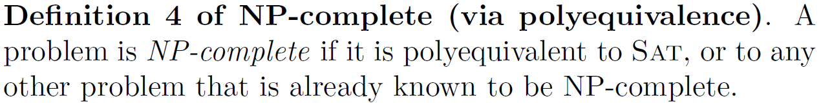
We can also define NP-completeness in terms of polyequivalence
Exercise: Why is this definition equivalent to the earlier ones?

Slide 19
Preliminary fact: polytime programs can be implemented by polysized circuits
Programs run on computers, which are made of circuits, so this is a reasonable claim
See book for detailed proof

Slide 20
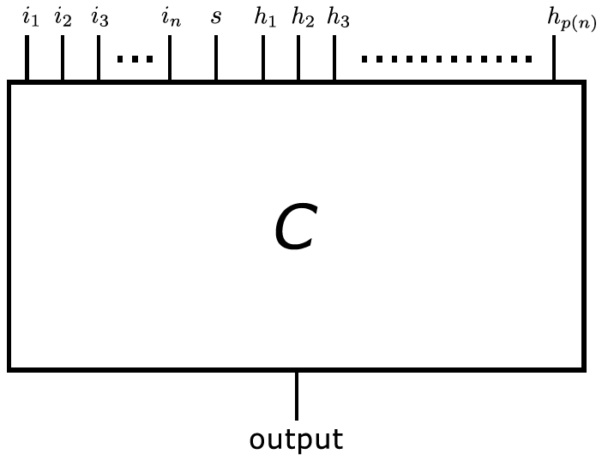
Sketch of proof that $D≤_{P}\text{CircuitSAT}$
$D∈\text{NP}$, so have polytime verifier verifyD.py
Using result from previous slide, convert verifyD.py to polysized circuit $C$:
Note that only one input bit needed for the solution s, since CircuitSAT is a decision problem.
size of the hint h is a polynomial function of n, the size of the problem instance.
problem instance i of size n.

Slide 21
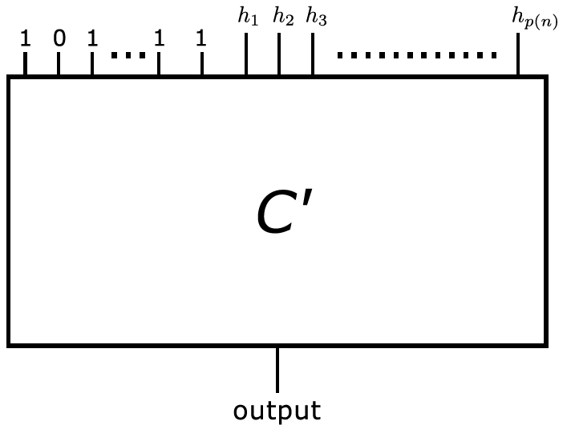
Sketch of proof that $D≤_{P}\text{CircuitSAT}$ (part II)
Given specific instance of $D$, convert $C$ to $C′$:

Slide 22
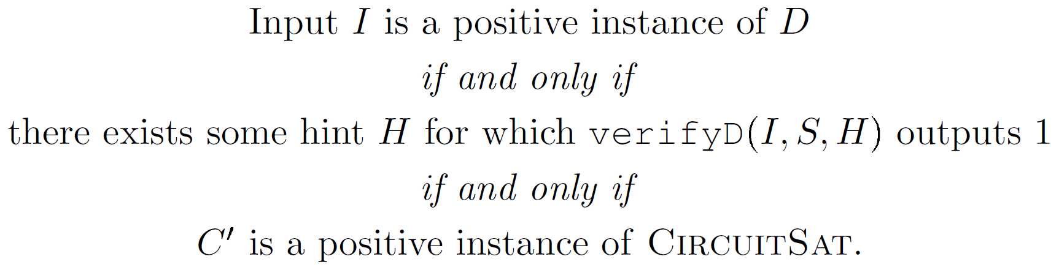
Sketch of proof that $D≤_{P}\text{CircuitSAT}$ (part III)
Observe equivalence between $D$ and $C′$:

Slide 23
NP-completeness is widespread
Thousands of NP complete problems are known, drawn from diverse areas of computer science, mathematics, engineering, biology, physics, etc. Examples include:
Computer science:
MaxClique, MaxCut, DeadlockAvoidance, CubicSubgraph
Applied math:
IntegerProgramming, TaskAssignment, MinimumBroadcastTime, SparseMatrixCompression
Pure math:
QuadraticDiophantineEquation, CosineIntegral
Biology:
MultipleSequenceAlignment

Slide 24
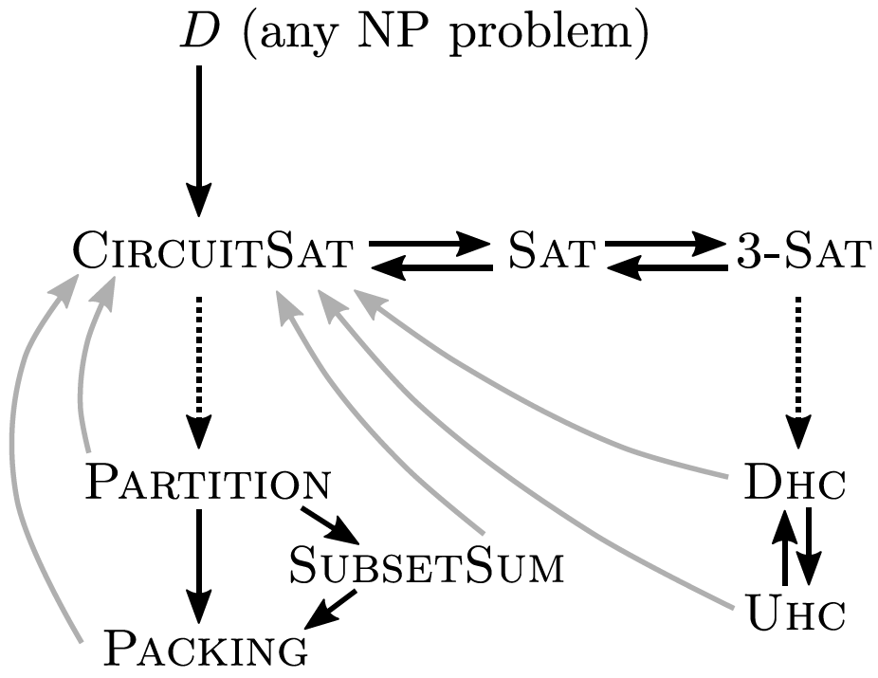
The web of NP-completeness
Arrows represent polyreductions
Solid black arrows: we proved
Dotted arrows: see other books
Grey arrows: follow from NP-completeness of CircuitSAT

Slide 25
Proof techniques for NP-completeness
To prove that problem $D$ is NP-complete, it’s usually easiest to use definition 3:
Choose a problem $C$ that is similar to $D$ or has a simple polyreduction to $D$.
Example (exercise): prove that HalfUHC is NP-complete
UHC (Undirected Hamiltonian Cycle) is the Traveling Salesman Problem), and is in NP-complete. Prove that HalfUHC ∈ NP-complete by showing that UHC ≤p HalfUHC (i.e., use definition 3). Note that if HalfUHC is NP-complete, it is NP-hard.

Slide 27
Show that HalfSAT ∈ NP-hard by proving that SAT ≤p HalfSAT.

Slide 28
Good news and bad news about NP-completeness
There are many NP-complete problems, but there seem to be some problems between P and NP-complete.
Examples: Factor, DiscreteLog
Don’t forget that some seemingly challenging problems are actually in P
Examples: IsPrime, MinCut, ShortestPath, LinearProgramming
Some NP-hard problems can be approximated efficiently
Examples: TSP, TaskAssignment
Some NP-hard problems can be solved efficiently for real-world inputs
Example: SAT
Some NP-hard problems can be solved in pseudo-polynomial time
Examples: Packing, SubsetSum, Partition, TaskAssignment
assigning tasks to
agents at minimal costs.
A function ƒ runs in pseudo-polynomial time ≝ running time of ƒ is a polynomial function of the numeric value of the input, not the number of bits in the input. For example, the running time of ƒ('101010') would be a polynomial function of 42.

