Slide 1
7. Turing reductions
Lecture slides for What Can Be Computed?

Slide 2
Review of important concepts from previous chapter (alter… and ignoreInput):
def alterGAGAtoTATA(inString):
(progString, newInString) = utils.DESS(inString)
val = universal(progString, newInString)
if val == 'GAGA':
return 'TATA'
else:
return val
What is the output of each of the following commands?
alterGAGAtoTATA(utils.ESS('def f(S): return S', 'CAGT'))»'CAGT'
alterGAGAtoTATA(utils.ESS('def f(S): return S', 'GAGA'))»'TATA'
alterGAGAtoTATA(utils.ESS('def f(S): return S+S', 'GA'))»'TATA'
alterGAGAtoTATA(utils.ESS('def f(S): return S+S', 'GAGA'))»'GAGAGAGA'
What is the output of the following sequence of commands?
>>> prog = rf('longerThan1K.py')
>>> utils.writeFile('progString.txt', prog)
>>> utils.writeFile('inString.txt', 'abcdefghij')
>>> ignoreInput(5000*'x') # param is a string containing 5000 x's
»'no'

Slide 3
A reduction (or Turing reduction) tells us we can use one problem to solve another problem
Informal example:
How would we use EndsInZero to solve MultipleOf10?
If we succeed, we have reduced MultipleOf10 to EndsInZero
Formal definition:
Let $F$ and $G$ be computational problems. We say $F$ has a Turing reduction to $G$ if we can write a Python program solving $F$, after first assuming the existence of a program solving $G$.
Notation is:
$$F≤_{T}G$$
F is no harder than G, and could be easier.

Slide 4
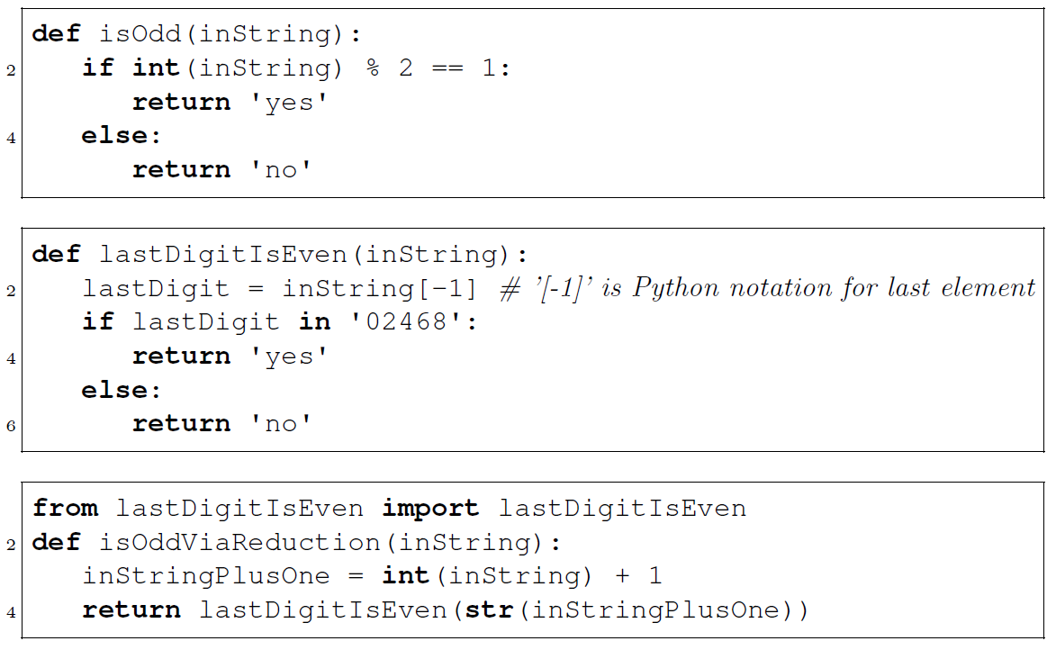
Example of a Turing reduction
Reduces isOdd to lastDigitIsEven
So those two problems are
equally easy.

Slide 5
Main use of reductions for us: prove that a problem is hard (e.g. uncomputable)
Previous example was a “reduction for easiness” as typically used by mathematicians:
Given $G$ that we know how to solve and $F$ that we don’t know how to solve
Show that there is a reduction $F≤_{T}G$
Now we can also solve $F$
However, theoretical computer scientists use the same kind of reduction for a different purpose: “reduction for hardness”
Given $F$ that we already know is uncomputable and $G$ that we want to show is uncomputable
Show that there is a reduction $F≤_{T}G$
Now we can conclude that G is also uncomputable
Because if G were computable then we could compute F, and we know that computing F is impossible.

Slide 6
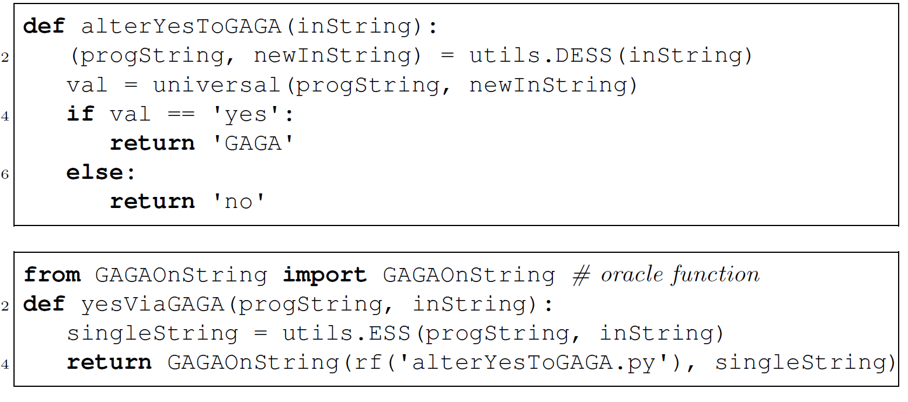
Our first reduction for hardness: YesOnString reduces to GAGAOnString
yes ≤T Gaga
if GAGAOnString() could actually decide if any SISO Python function returns 'GAGA':
1. then it could decide if alterYesToGAGA() returns 'GAGA'
2. alterYesToGAGA() only returns 'GAGA' if progString(inString) would return 'yes'
3. Based on 1 & 2, GAGAOnString() could decide YesOnString if it could decide if alterYesToGAGA() returns 'GAGA'
∴ GAGAOnString() cannot decide if any SISO Python function returns 'GAGA', because if it could it would do the impossible.
def ƒ(s) = return 'whatever'
yesViaGAGA(ƒ,'CAGT')
def ƒ2(s): if len(s) < 3: return 'yes'; else return 'TLTR'
yesViaGAGA(ƒ2,'CAGT')
yesViaGAGA(ƒ2,'')

Slide 7
Problem 7.11
Which of these return values could alterYesToNumChars() return at the line of code in question, without changing the validity of the proof: 'a'; 'aa'; 'aaa'; 'aaaa'
»All but 'aaa'; 'no' would work too, as would any string with a length other than 3.
import utils; from utils import rf
from universal import universal
def alterYesToNumChars(inString):
(progString, newInString) = utils.DESS(inString)
val = universal(progString, newInString)#progString(newInString)
if val == 'yes':
# return a string with three characters
return 'xxx'
else:
# return a string with two characters
return 'xx' #** THE LINE OF CODE IN QUESTION **
# numCharsOnString(P,I) is an oracle ("impossible") function that returns
# len(P(I)) – the number of symbols in the output of P(I)
from numCharsOnString import numCharsOnString
def yesViaNumChars(progString, inString):
singleString = utils.ESS(progString, inString)
val = numCharsOnString(rf('alterYesToNumChars.py'), \
singleString)
if val == '3':
return 'yes'
else:
return 'no'

Slide 8
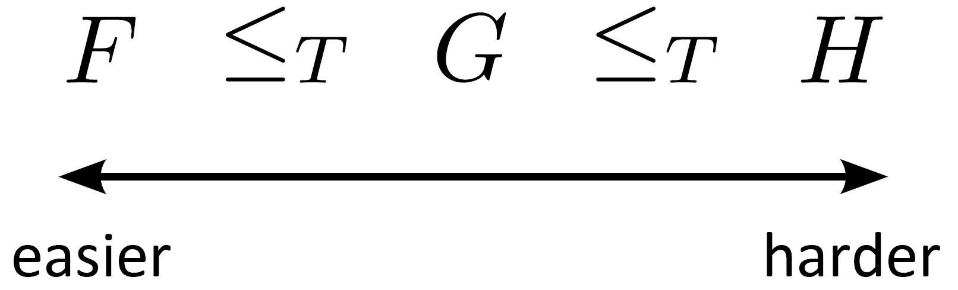
Think of Turing reductions as ordering problems according to “hardness”
Check your understanding: what do we know if $G$ is:
uncomputable? »H is uncomputable, but F could be.
computable? »F is computable, but H might not be.

Slide 9
WCBC problem 7.4:
F and G are general computation problems, D is a decision problem, F ≤T G, and D ≤T G.
• If D is undecidable then »G is uncomputable.
• If G is computable then »F is computable and D is decidable.
• If F is computable then »we can conclude nothing about G and D.

Slide 10
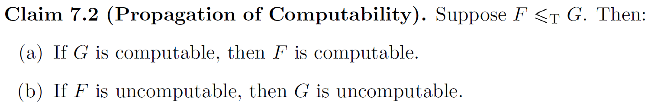
The ordering according to hardness has some obvious consequences

Slide 11
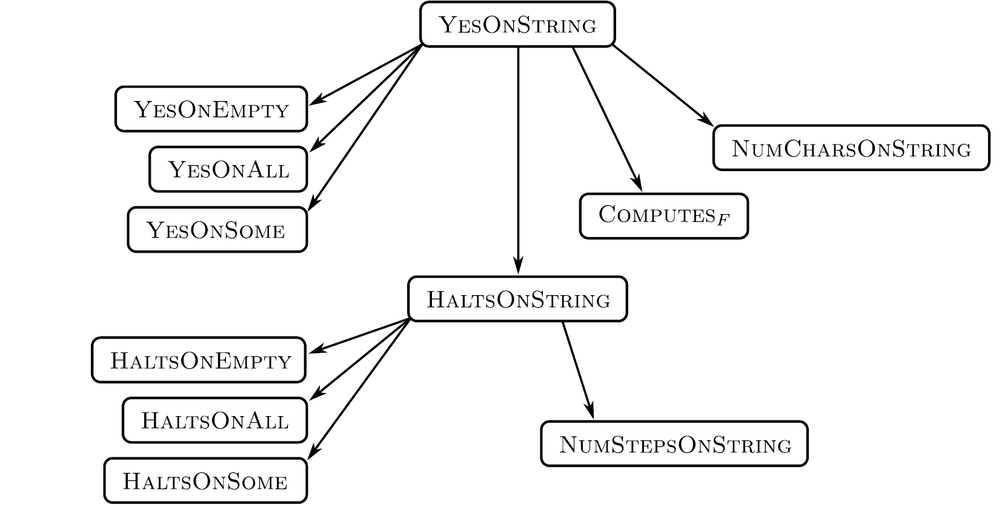
We can use reductions to prove that many problems are uncomputable

Slide 12
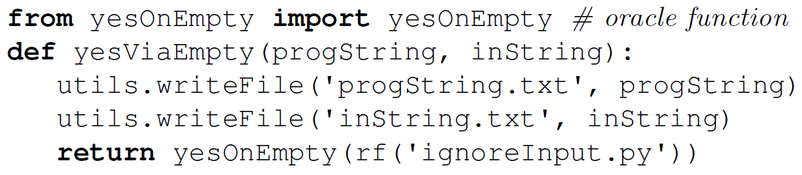
The “ignore input” trick can be used for many Turing reductions
from universal import universal
def ignoreInput(inString):
progString = rf('progString.txt')
newInString = rf('inString.txt')
return universal(progString, newInString)
def ƒ2(s): if len(s) < 3: return 'yes'; else return 'TLTR'
yesViaGAGA(ƒ2,'CAGT')
yesViaGAGA(ƒ2,'')
ignoreInput('') == ?? when it reads ƒ2 and 'CA' from the disk files?
Example: reduction from YesOnString to YesOnEmpty
Check your understanding: why is this a correct reduction?
»yesOnEmpty() would return 'yes' if ignoreInput('') returns 'yes', and 'no' otherwise; ignoreInput('') would return 'yes' if progString(inString) returns 'yes', given the writeFile calls in the body of yesOnEmpty(); and deciding if progString(inString) returns 'yes' solves the YesOnString decision problem.
ƒ('') == 'yes'

Slide 13
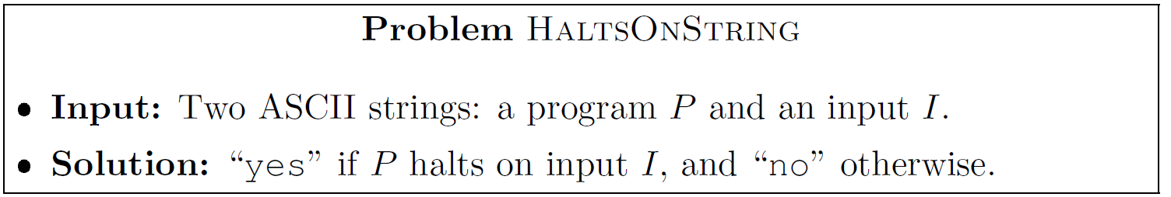
Several variants of the halting problem are famous¹ and important examples of undecidable problems
HaltsOnEmpty, HaltsOnAll, HaltsOnSome are defined similarly.
¹ Turing used a variant of the halting problem in his 1936 paper On Computable Numbers.

Slide 14
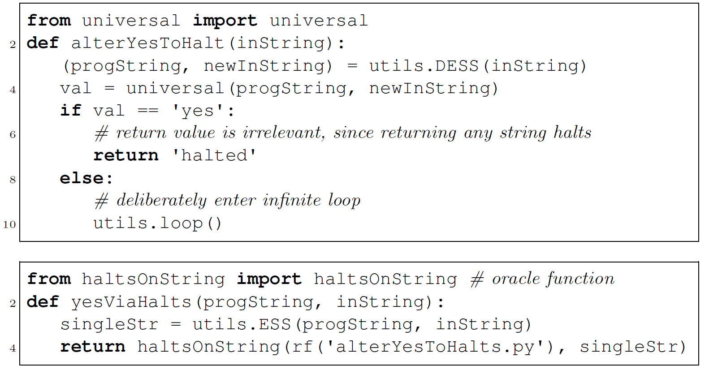
We can prove HaltsOnString is undecidable by reducing from YesOnString
Remember that haltsOnString just analyzes code, it doesn't run it, and always returns either 'yes' or 'no'.
What does alterYesToHalt do in each of these cases?
yesViaHalts('def f (s): return "maybe"', 'abc')
yesViaHalts('def g (s): if len(s) < 4': return 'yes', 'abc')
yesViaHalts('def g (s): if len(s) < 4': return 'yes', 'abcd')
yesViaHalts decides YesOnString because » by deciding if alterYesToHalt(singleStr) halts, haltsOnString() also decides if progString(inString) returns 'yes'.

Slide 15
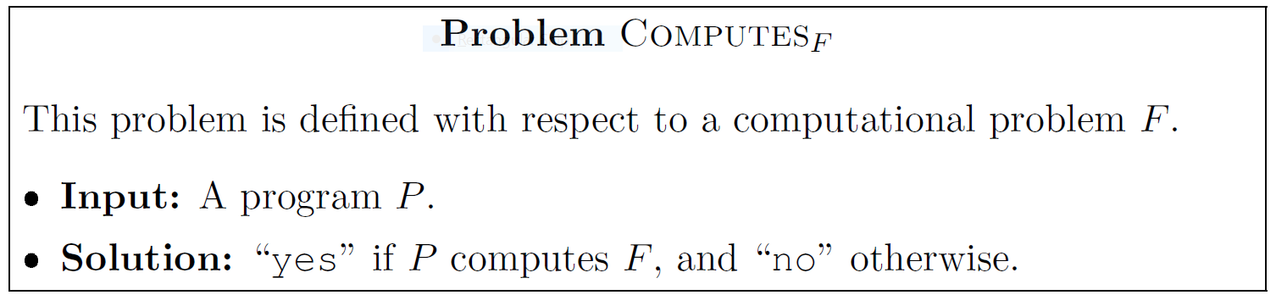
${Computes}_{F}$ is an important family of undecidable problems

Slide 16
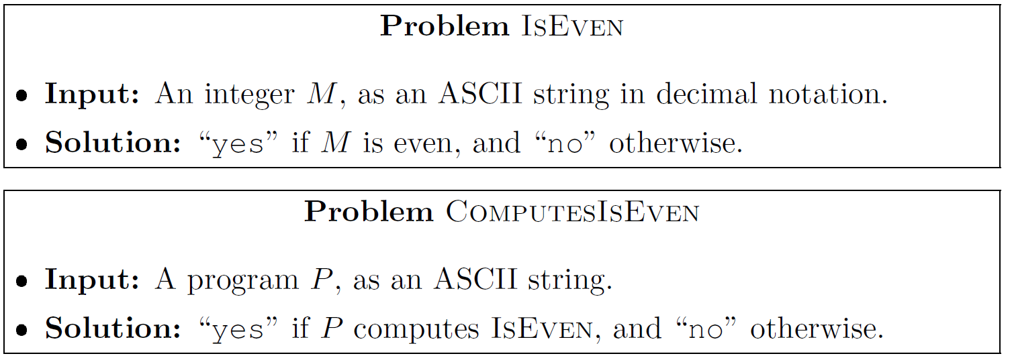
ComputesIsEven is an example from the family ${Computes}_{F}$
Note the crucial distinction between deciding if an input string has a property, and deciding if a program can decide if an input string has a property.
Decidable? »absolutely.
Decidable? » No.

Slide 17
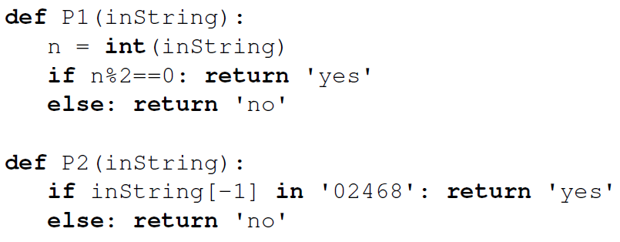
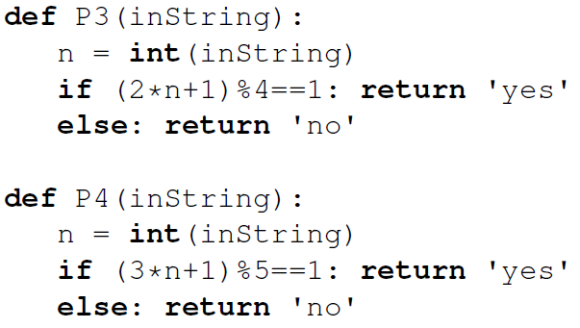
Test your code comprehension: which of the following are positive instances of ComputesIsEven?
P1 »positive; P2 »positive; P3 »positive; P4 »negative.
Note the extreme difficulty of this challenge, even for a very simple underlying problem such as IsEven
In fact, ComputesIsEven is undecidable

Slide 18
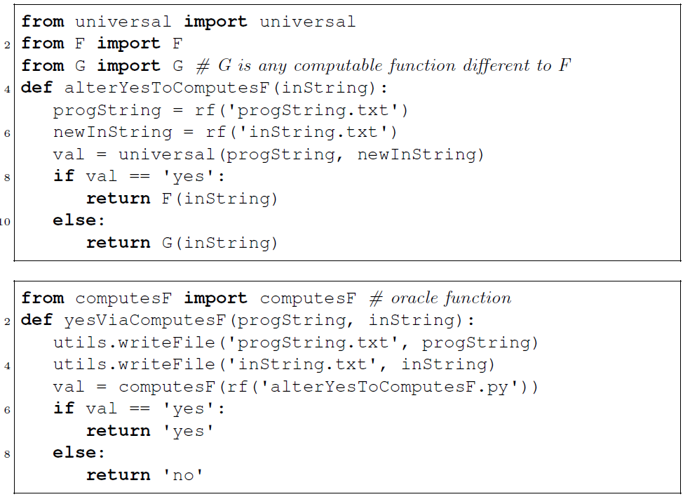
Proof that ${Computes}_{F}$ is undecidable for any computable problem $F$
reduction from YesOnString:
By deciding if alterYesToComputesF(singleStr) computes some function F, computesF(rf('alterYesToComputesF.py') also decides if progString(inString) returns 'yes'.
Note that alterYesToComputesF() behaves like ignoreInput() until it reaches the return statements.
F and G could be any non-identical computable functions on a string, such as finding the symbol inString with the smallest and largest ASCII values respectively.

Slide 19
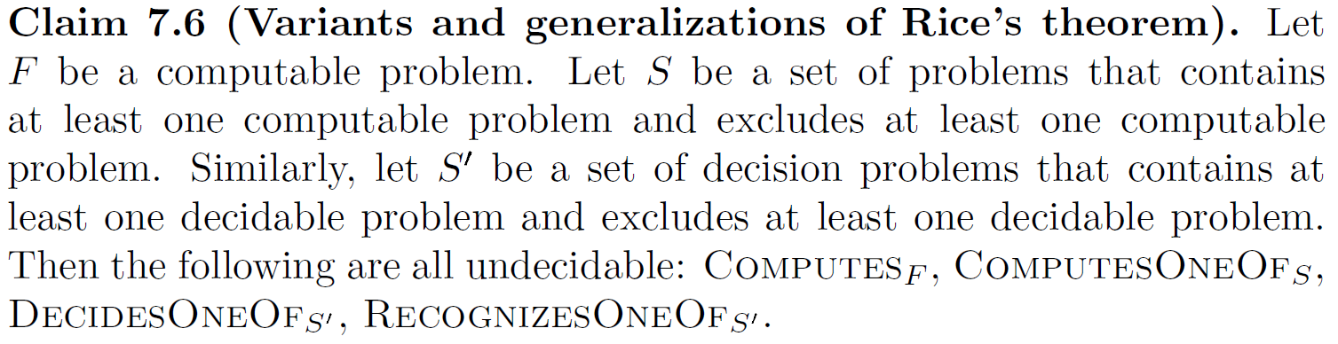
The previous result can be generalized in several ways (including Rice’s Theorem)

Slide 20
There are some famous uncomputable problems that aren’t about computer programs
Finding the roots of a polynomial equation with arbitarily large powers. This was the famous 10th problem of the German mathematician David Hilbert, in his program for 20th century mathematics. The impossibilty proof was a breakthrough in theory but a great practical disappointment.
Example 1: Diophantine equations
Example 2: Post correspondence problem
However, it turns out that when viewed in the right way, the above problems encode computer programs. So perhaps all uncomputable problems are “about” computer programs in some sense.

Slide 21
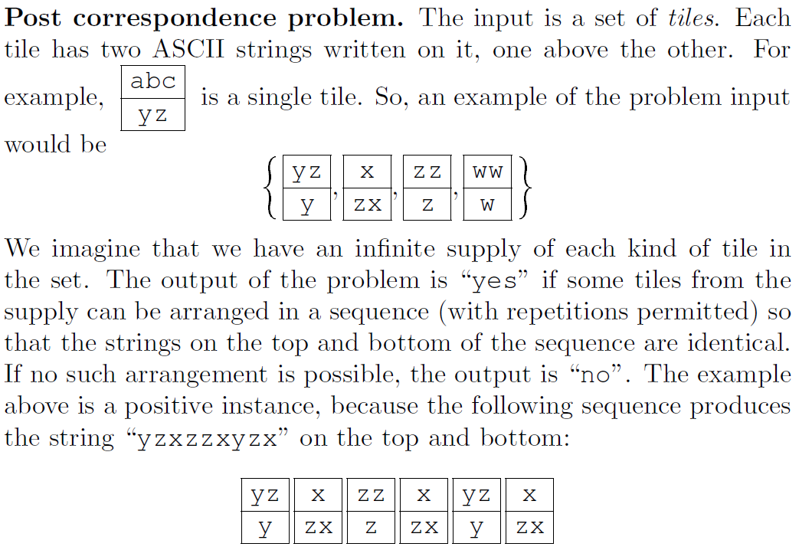
Definition of Post correspondence problem
See Chris Moore's lecture (lab #3) for other formalisms that imply computation, and thus can be used to define uncomputable problems.

Slide 22
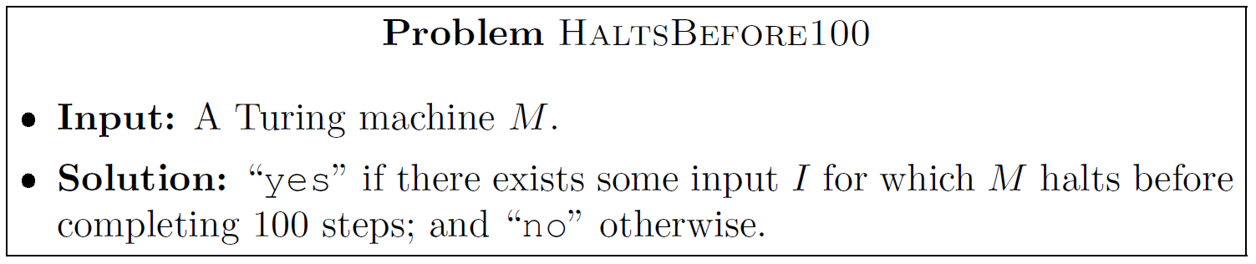
Not every question about programs is uncomputable
HaltsBefore100 is computable!
Can you see why?
HaltsBefore100 decision procedure, using the fact that a TM can move at most one cell per step.
Inputs = All possible inputs I, where |I| < 100
for i in Inputs:
run M on i
if M halted return 'yes'
return 'no'
Other examples of computable problems about programs:
How many lines in a given program?
How many states in a given Turing machine?
Are there any calls to the print() function in a given program?
Note that none of these problems ask what a program computes

Slide 23
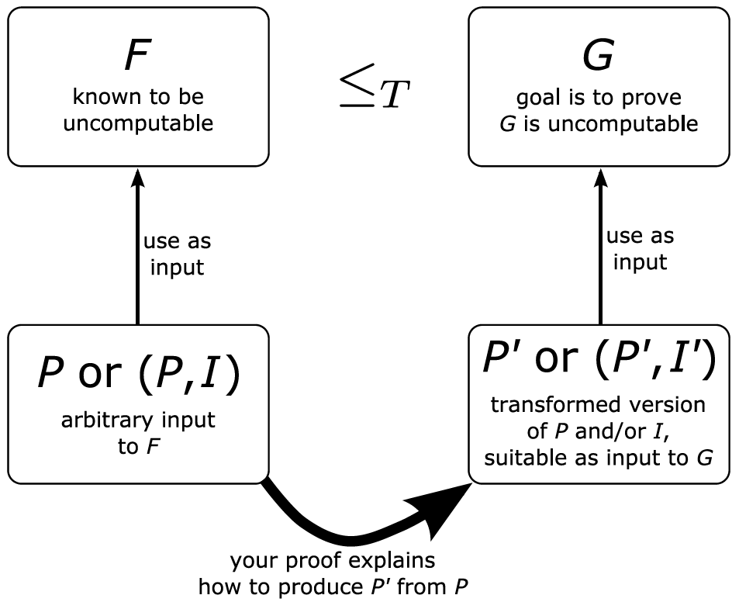
Proof technique 1 for uncomputability: the reduction recipe
Transform a membership question
in F into a membership question in G.
Is P or P(I) in the solution set of F?
Is P' or P'(I') in the solution set of G?

Slide 24
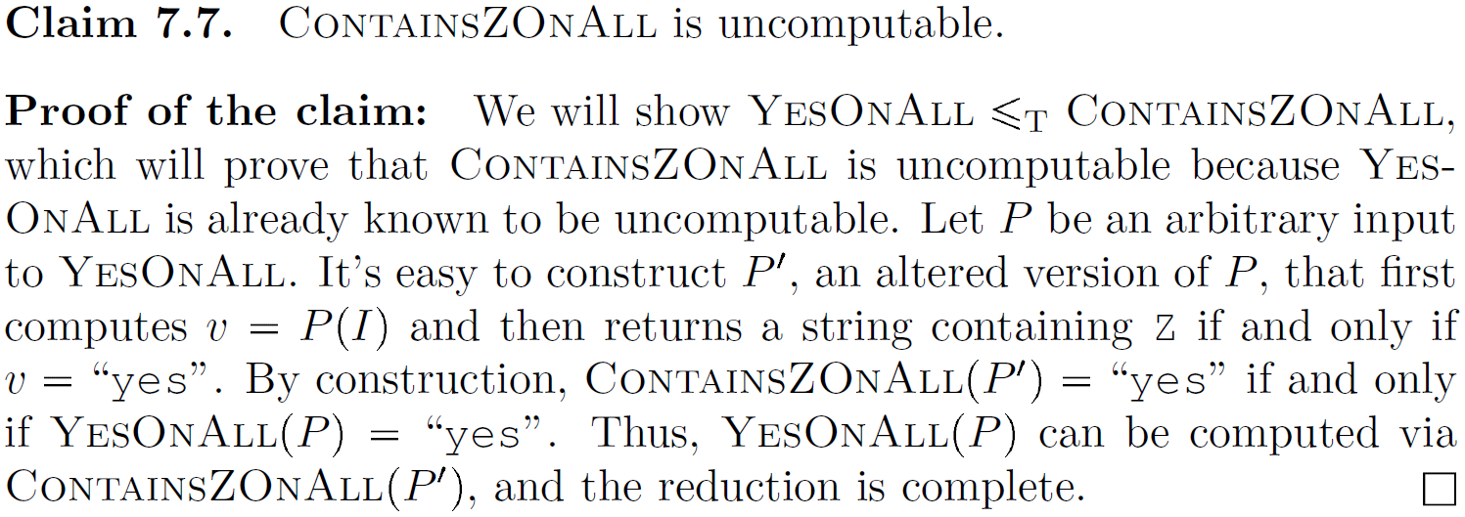
Example of the reduction recipe
1
1 this is the alters function in the Python proof technique.

Slide 25
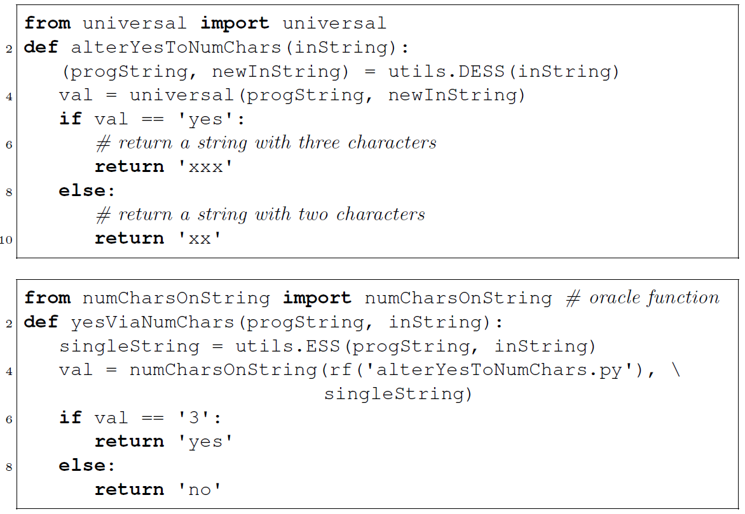
Technique 2: reduction with explicit Python programs
“alteration” program transforms output of $F$ to output of $G$
“reduction” program solves $F$ by invoking $G$’s program on the alteration program

Slide 26
WCBC problem 7.2:
IntOnString is a decision problem with input P and I, and with ouput 'yes' if P(I) is a string representation of a non-negative integer, and 'no' if it is a string representation of something else. Use Python to show that IntOnString is undecidable by a reduction from yesOnString().
»import utils
from universal import Universal
def alterYesToInts(inString):
'''Return non-negative int as string iff
progString(newInString) returns 'yes'
'''
(progString,newInString) = utils.DESS(inString)
val = universal(progString,newInString)
if val == 'yes': return '1'
else: return '-&'
def yesViaInts(progString,inString):
singleString = utils.ESS(progString,inString)
return intOnString(alterYesToInts(singleString))

Slide 27
Lab a. Use Python to prove that IntOnAllInts, defined below, is undecideable by a reduction from YesOnString.

Slide 28
IntOnAll is a decision problem with ouput 'yes' iff ∀I(P(I) is a non-negative integer if I is a non-negative integer). Use Python to show that IntOnAll is undecidable by a reduction from YesOnString().
def alterYesToInt(inString):
progString = rf('progString.txt')
newInString = rf('inString.txt')
»val = universal(progString, newInString)
if val == 'yes': return '123'
return 'abc'
def yesOnStringViaIntOnAll(progString,inString):
»utils.writeFile('progString.txt', progString)
utils.writeFile('inString.txt', inString)
return intOnAllInts(rf('alterYesToInt.py'))

Slide 29
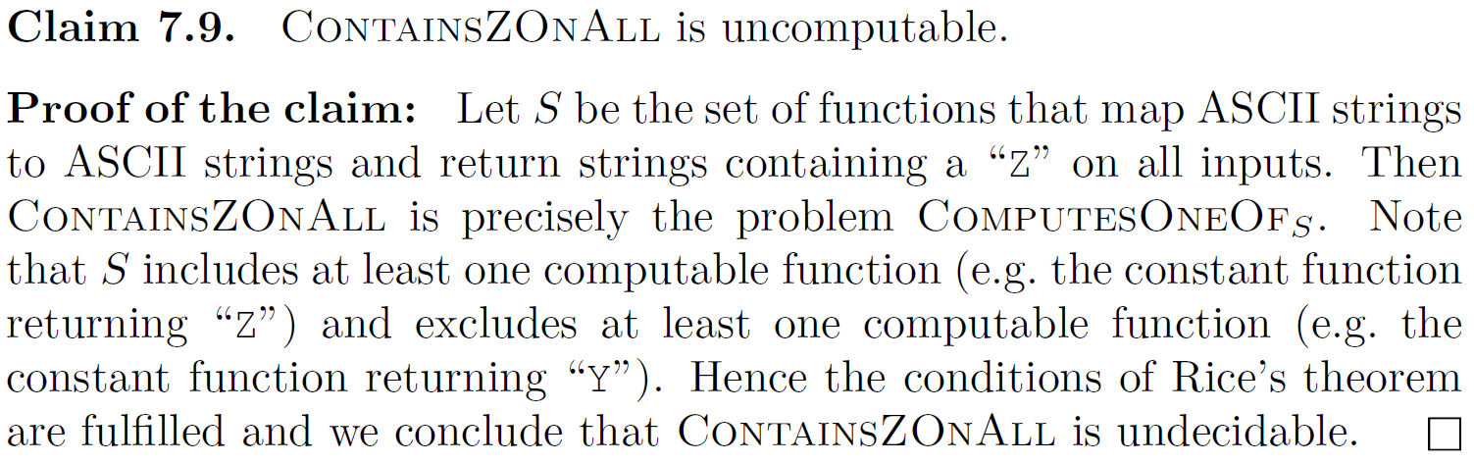
Technique 3: apply Rice's theorem

