Slide 1

Project CMP 430
Group – 03

Slide 2
Project Details:
Project concept : Learn Android App
Project Group : Group - 03
Members : Robert Guzman
Mohamed Irsath – Abdul Azeez
Miquel Liranzo
Johnny Maldonado
Project begin : 10/24/2020
Project end : 12/08/2020
Duration : 66 Days

Slide 3

Project was built with SDLC method such as.
Planning
Analysis
Design
Implementation
Testing/Security

Slide 4
Planning
Determine the Project - 10/24/2020 - 10/25/2020
- Duration 02 Days
Research - 10/25/2020 - 10/26/2020
- Duration 02 Days
Create Gantt Chart - 10/26/2020 - 10/26/2020
- Duration 01 Days
Duration - 5 Days

Slide 5
Gantt Chart
Purpose - To monitor the Workflow.
Project start - 10/24/2020
Milestone - 12/08/2020

Slide 6
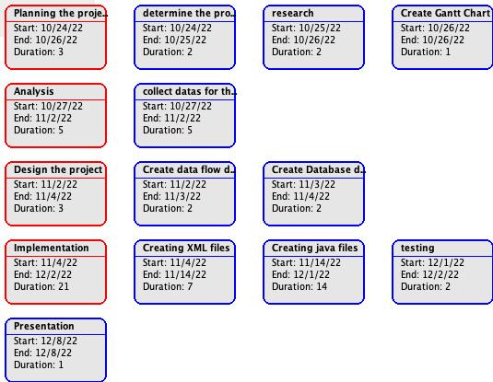
Pert - Chart

Slide 7
Design
OOP Design - Represent diagram with object and its perform
Data Base Design - Design the data base with required data and
its format
- Show relation between database data

Slide 11
Implementation
Coding - Code the program with programming
language – Java, XML, Sqlite
Testing/Debugging - Run the program and test for error.
- Identify static and dynamic error and fix it.

Slide 12
Back-End
Tasks for each Member
Mohamed Irsath Abdul Azeez:
I created data base with a table that collect the user Information and retrieve them. This will interact with
Login, signup activities for user check in. Also, I created the main page the view the chapter details as
recycle view with card layout. This, will show details as cardview layout.
I added floating button in which user can add details and a function of deleting.
I took a part in the team to implement codes. I assembled all code from peers, and I made the application
Functionable.

Slide 13
Front and Backend Engineering : Miguel Liranzo
TASKS: Settings, Background, Quizzes and Quiz Layout
Settings – Utilized built-in Settings Activity to grant users ability to choose their preferred background,
promoting repeat app usuage
Background – Chose the user image backgrounds with Android related theme, contributing to the
“Learn Android” environment
Quizzes – Created unique quizzes and answers to challenge users with questions that are not given during
class quizzes. Quiz questions are chosen randomly, and answers are shuffled around to remove
complacency
Quizzes Layout – Created a quiz interface with a modern aesthetic similar to other quiz-type apps that
users are familiar with, promoting ease of use

Slide 14
Frontend Engineering – Robert Guzman
TASK: Frontend design
Slide view – User interface for the convenient and facility to our consumers, Develop proper view of
Our app. Use proper images and asset to develop and match the layout to our app.
Login intent – added user and password design and layout for our app and our backend connect it
To the backend (Database/Firebase)
Intro page – added our intro page where the user can see what is our app about! Properly use buttons and intent to move to our homepage.
Button design – designed buttons with the best quality possible for our users
Text views- work on text views to bring the best possible images and details for our app to our user’s
Proper material and layout – With any app there’s a lot of design we ensure to use the best quality material and layouts for this project

Slide 15
Frontend Engineering – Johnny Maldonado
TASK: Login Design, Signup Design, Frontend Design
Login Design – Implemented background images, vector assets, appropriate border layouts. Adding proper density independent pixels (dp). Adding the proper text scale independent pixels (sp).
Signup Design – Allow for a user to sign up with by inputting username, email, and password. Added textview where the user can login if the user already exists.
Frontend Design – Designed a unique user interface for an effective user experience. Accomplished pair programming that helped deliver good design quality.
Accomplishment – Communication with frontend to have a well-developed project with the best possible design.

Slide 16
Challenges
Recycle view
Firebase Connectivity
App Permission
We faced challenges in creating recycle view, firebase during our code implementation.
We able fix this issue with the resources provided by professor.

Slide 17
Lesson Learned
Team work
Communication
Researching
Problem solving
How to face challenges
Creativity in designing

Slide 18
Security
Make sure the data is safe provided by admin

