Slide 1

Volatility Models in Option Pricing
Miguel Ribeiro
Master in Engineering Physics
Supervisors: Prof. Cláudia Nunes
Prof. Rui Dilão
Notes:
My name
Thesis title
Thank supervisors
Thank examination committee

Slide 2
Motivation
What is Volatility and why it is important
Notes:
Brief motivation for my work
why it is important
Some required background

Slide 3
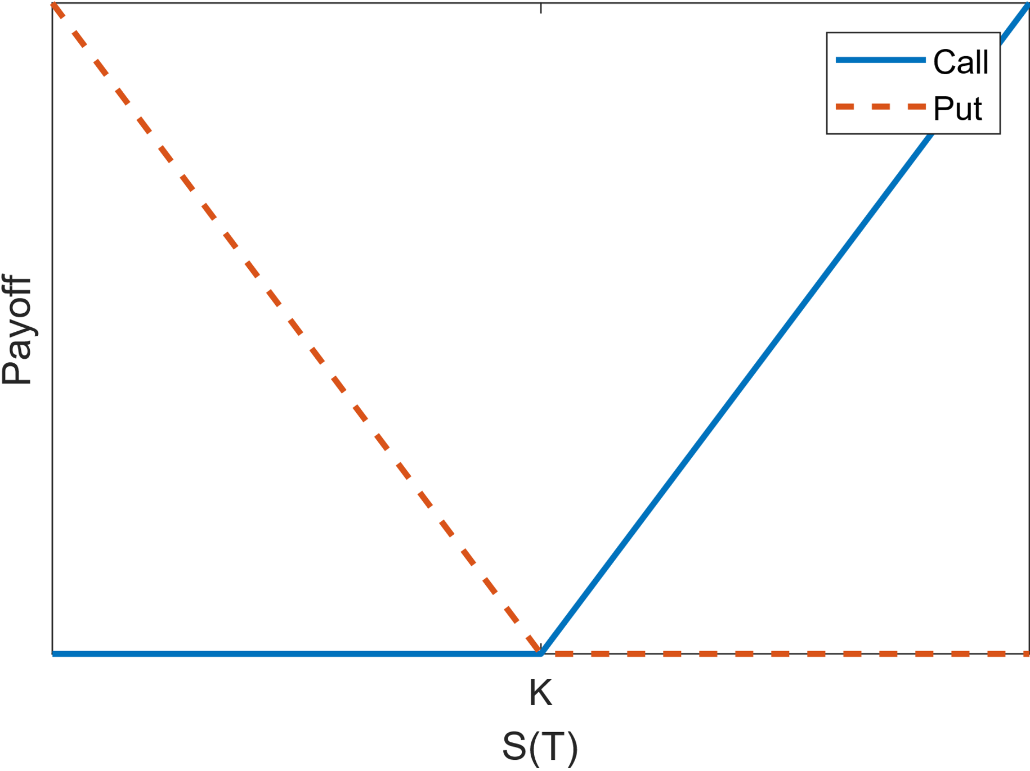
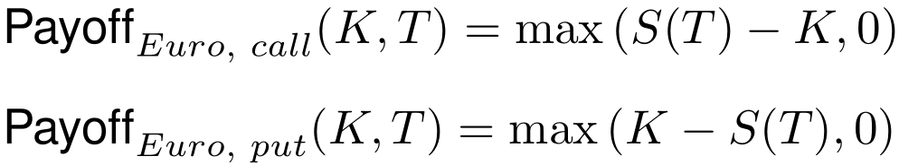
Motivation – Options
In finance, options are contracts that give us the option to buy or sell (call/put) an asset, called the stock S, for a fixed price, the strike price K, at a fixed future date, known as maturity, T.
The payoff of these contracts is given by:
No downfall, only profit:
We must find their price!
Payoff function of call and put type options
Notes:
Option: buy or sell (cal or put), stock, strike price, maturity
Payoff
Because payoff always positive, price, which we have to find

Slide 4
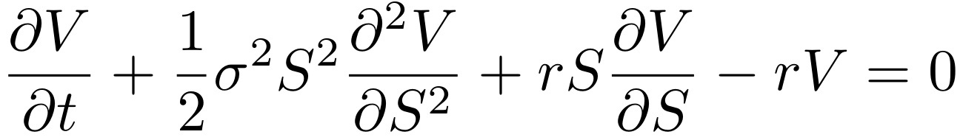
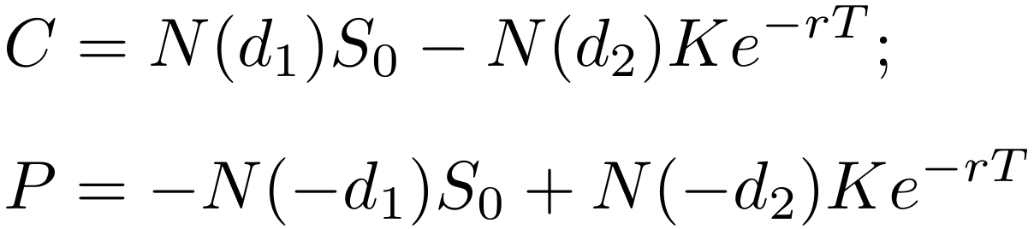
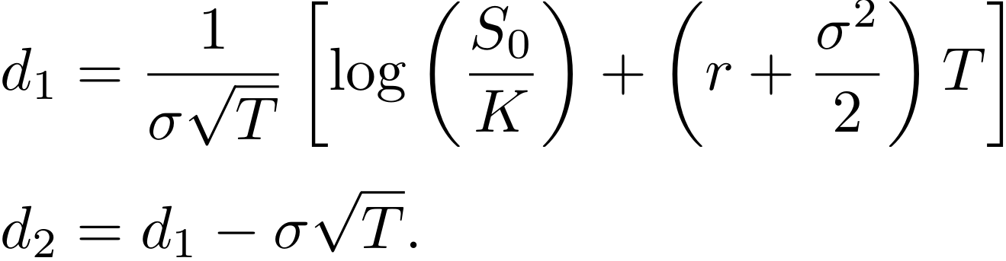
Motivation – Pricing Options
To price options we can use the Black-Scholes formula:
Solving this equation, we obtain the option price
Assuming that:
The stock price follows a Geometric Brownian Motion:
We have a constant interest rate, r, and no dividends
Volatility, σ, is constant!
Notes:
Black and Scholes formula, V is option price, sigma is volatility, r is interest rate
Solving with boundary conditions
Assumptions: GBM, interest rate

Slide 5
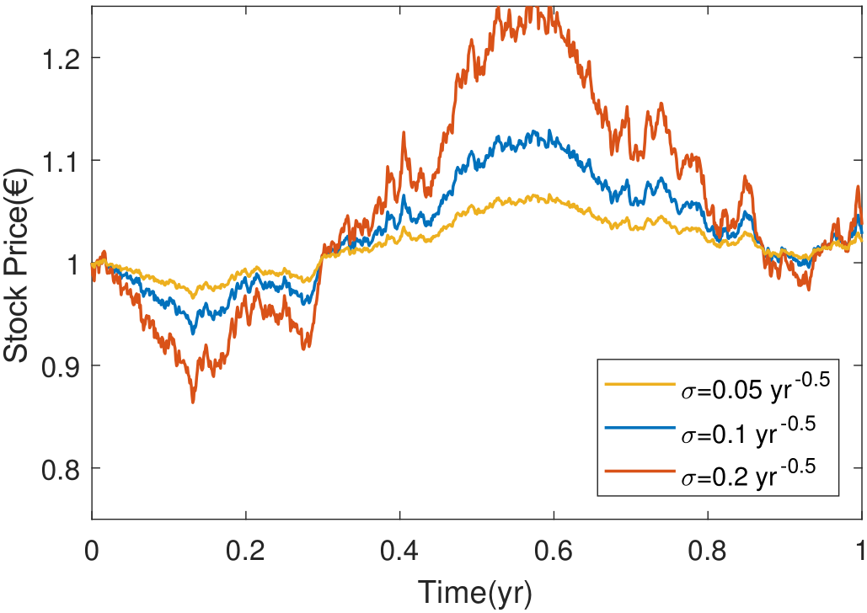
Motivation – Volatility
Volatility affects how erratically the stock prices move
Great impact on the stock prices
Volatility is not constant
Very difficult to estimate and forecast
We have to model it!
Example of three Geometric Brownian Motion processes with different volatilities

Slide 6
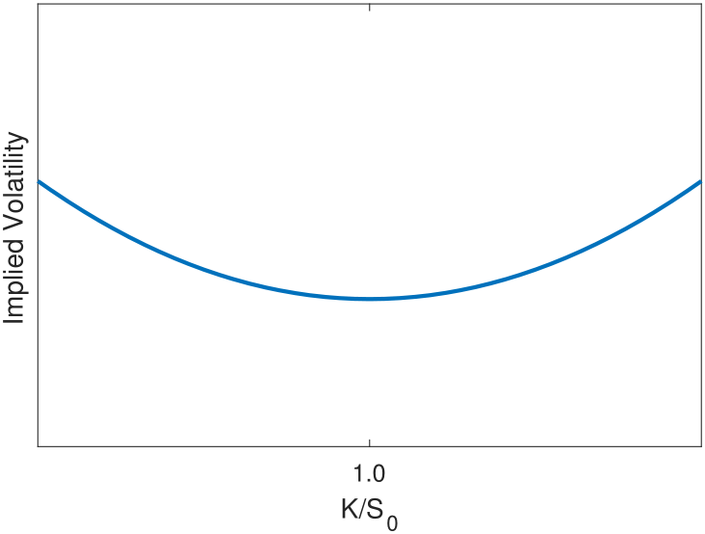

Motivation – Implied Volatility
Implied volatility is the volatility that, when input into the BS model, returns a value equal to the market price of a given option:
A Smile (or Skew) is observed in real options.
Option Price ⬄ Implied Volatility
Representation of the “Smile” phenomenon

Slide 7
Objectives

Slide 8
Objectives
Choose some of the most used volatility models
Study and use them to price real options
Compare them and find which performs best
Use the results to price more complex options numerically

Slide 9
Models
Dupire’s local volatility
Heston and Static/Dynamic SABR stochastic volatility
Notes:
Introduce the four models chosen

Slide 10
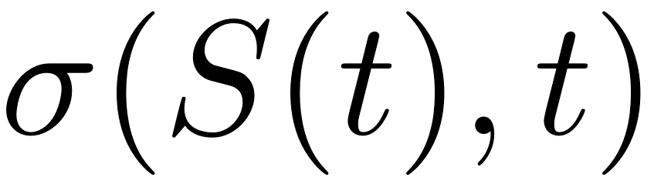
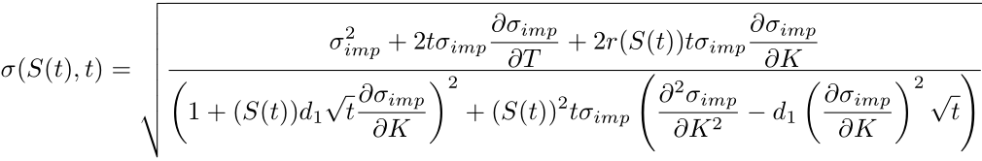

Models – Dupire’s Local Volatility
In Dupire’s model, we assume that volatility is a known function of time and the stock price, .
The stock price diffusion process becomes
with given by

Slide 11
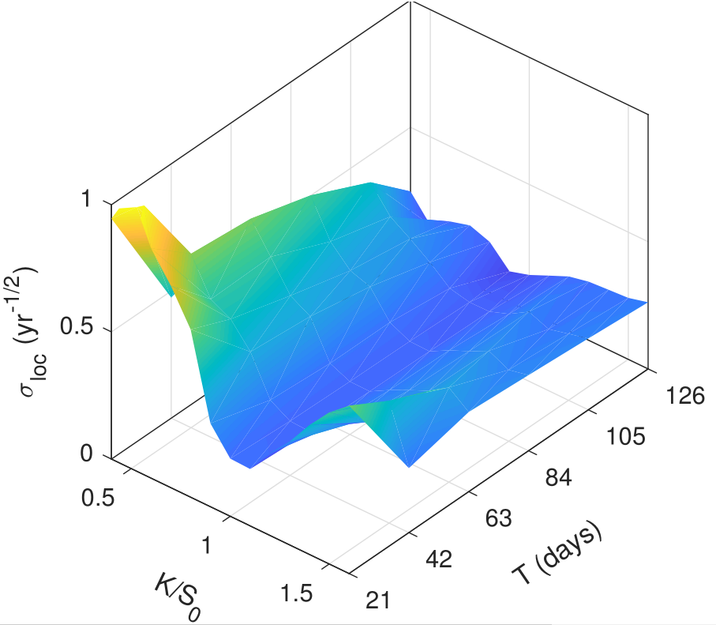
Models – Dupire’s Local Volatility
With this formula we can obtain the local volatility surface
We can sample from this surface to obtain the local volatility at each point of the diffusion process
Generated local volatility surface

Slide 12
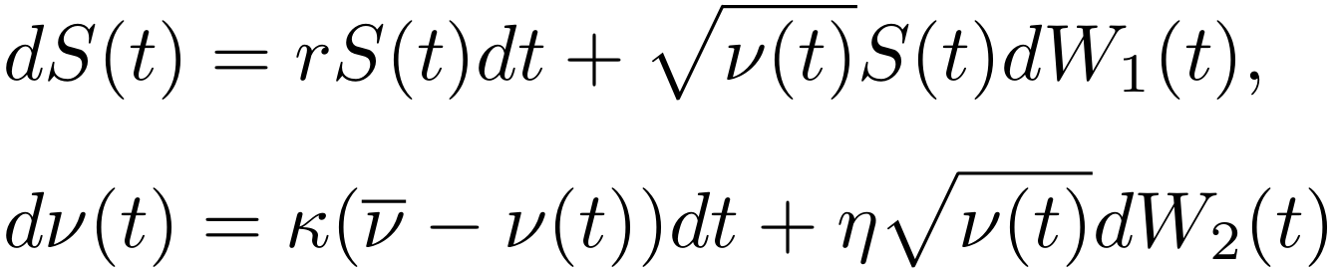
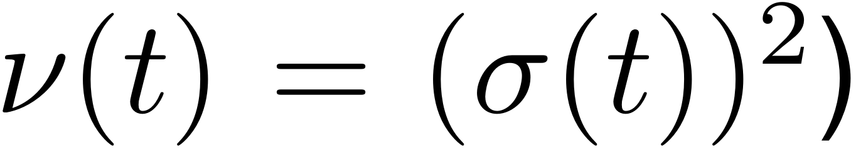





Models – Heston’s Stochastic Volatility
In Heston’s model, we assume that the volatility itself is stochastic, following the diffusion process
where and have a correlation of
We must calibrate this model (i.e. find the parameters that best fit the data)
Notes:
Parameters kappa, nu bar, nu zero, eta, and rho

Slide 13

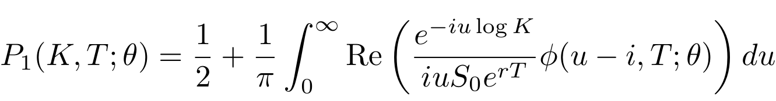
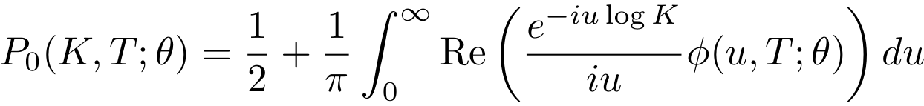
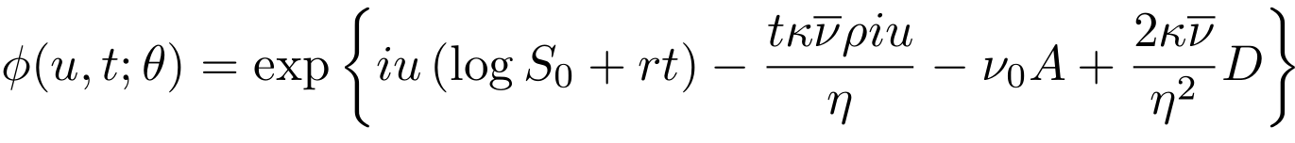
Models – Heston’s Stochastic Volatility
With Heston’s model, there is a closed-form solution which we can use in calibration
…
From this, we can directly price options under any parameter set
Calibration is now easy

Slide 14
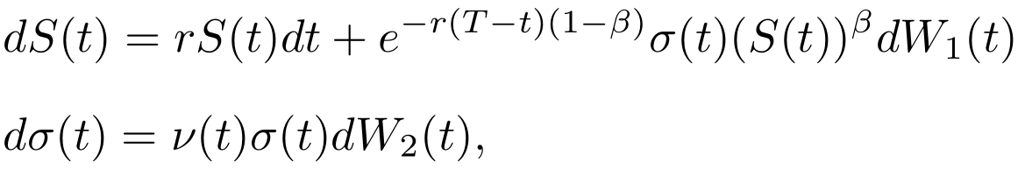


Models – Static/Dynamic SABR
As for Heston, we again assume that volatility follows a diffusion process, given by
where and have a correlation of
In Static SABR model, we assume and to be constant, in Dynamic SABR they are functions of time (e.g. two decreasing exponentials).
Static SABR only works for single maturities
We again have to calibrate these models
Notes:
Also stochastic volatility, like Heston
Parameters sigma zero, nu, beta, rho
We chose two decreasing exponentials to model nu(t) and rho(t), with extra parameters
According to authors, static sabr doesn’t work for multiple maturities

Slide 15
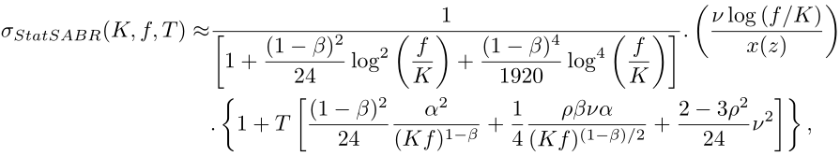
Models – Static/Dynamic SABR
As with Heston, we have closed-form solutions in SABR that make calibration easy
…
…
From this, we can directly price options under any parameter set
Calibration is now easy
Notes:
These formulas are incomplete, please check their full version in the thesis

Slide 16
Implementation

Slide 17
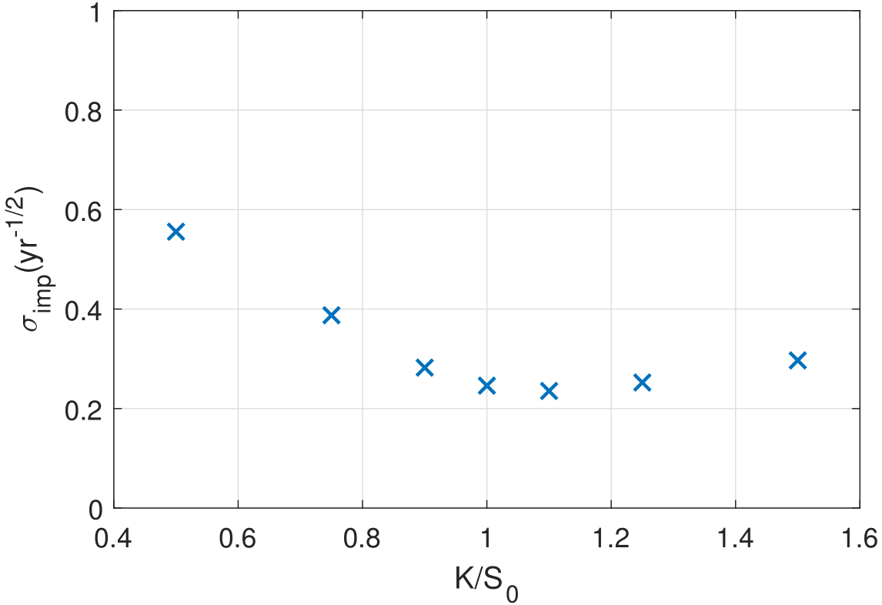
Implementation – Data & Calibration
We calibrated the stochastic volatility models using the data of real options with 7 different strikes over 4 maturities.
In the calibration we use a weighted MSE cost function, to measure how well each model forecasts the real data.
To minimize the costs we used the CMA-ES optimization algorithm.
After calibration, the costs can be used as comparison between the models.
Implied volatility data to be used on calibration
(with a maturity of 42 days)

Slide 18
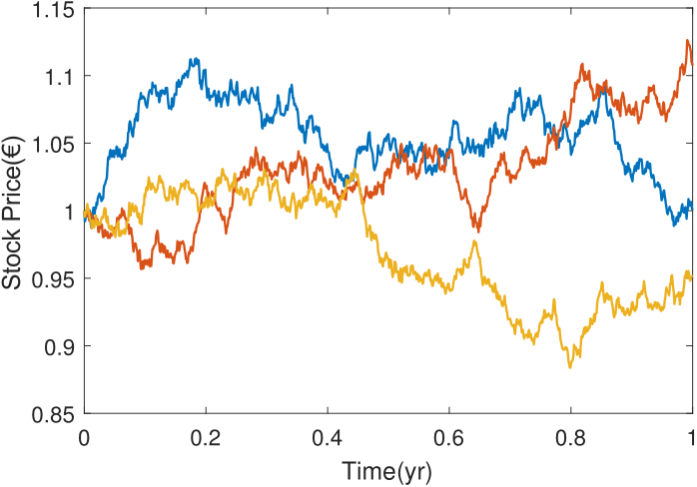
Implementation – Monte Carlo Method
All trained models were implemented in a Monte Carlo numerical pricer.
We can simulate stock prices under any of the trained models.
We simulate a large number of stock prices and average the option’s payoff for each of them to produce an estimation of the option price.
These simulations are repeated multiple times to obtain an average - simulated function - and respective confidence bands.
Example of three simulated stock price diffusion processes

Slide 19
Results

Slide 20
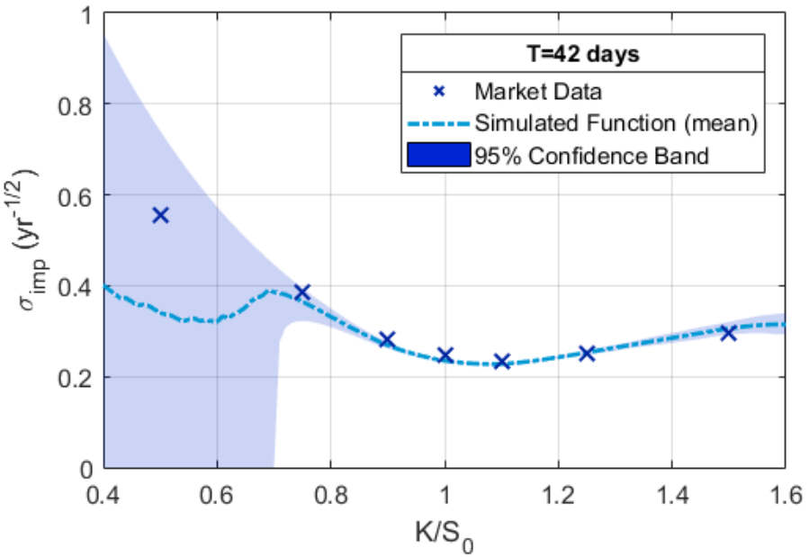
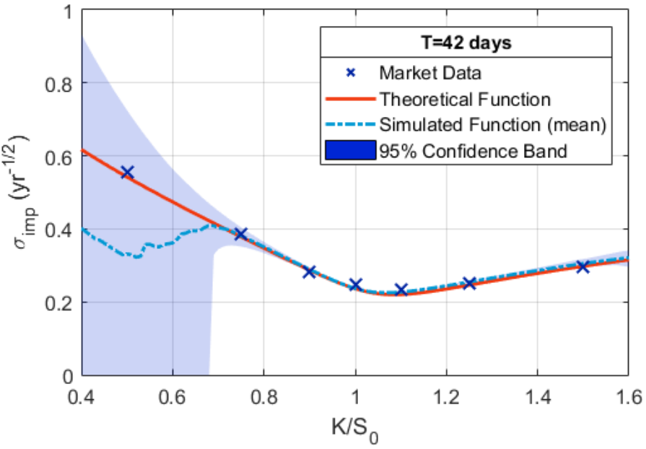
Results – Models (Dupire & Heston)
Dupire’s model
Heston’s model
Notes:
For simplicity, only shown maturity of 42 days

Slide 21
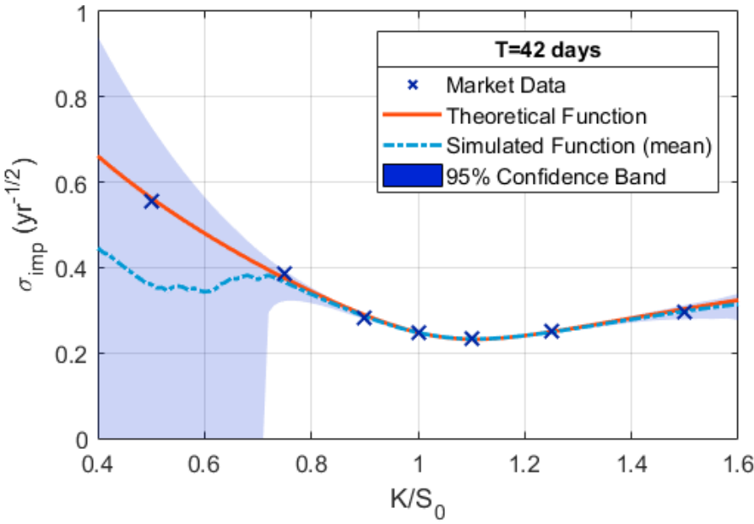
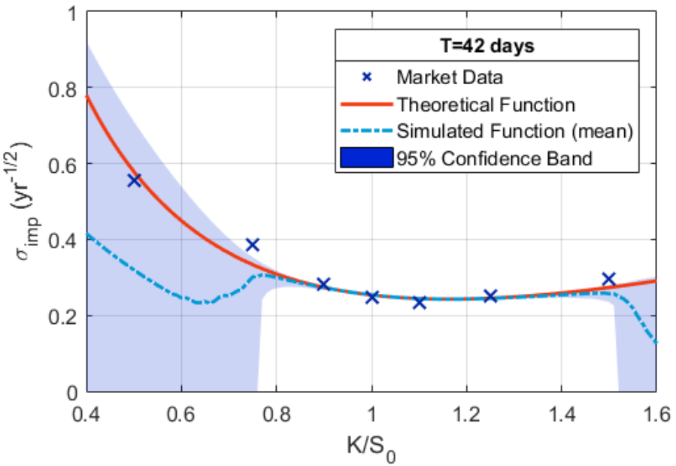
Results – Models (Static/Dynamic SABR)
Static SABR model
Dynamic SABR model

Slide 22
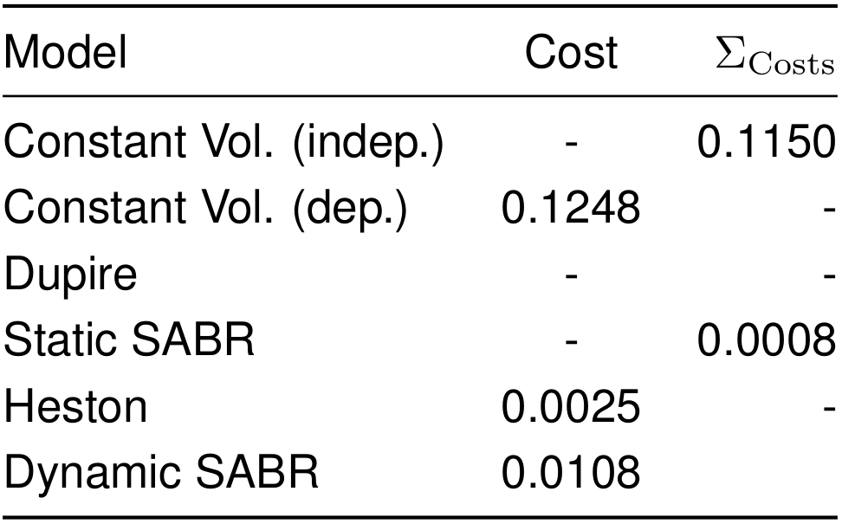
Results – Costs
To benchmark the models we also calibrated a simpler constant volatility model.
Great improvements over the constant volatility model:
Static SABR: 99.3%
Heston: 98.0%
Dynamic SABR: 91.3%
Possible overfit on the Static SABR model
Resulting costs after calibration

Slide 23
Results – Analysis
The closed form solutions of the stochastic volatility models followed the data very closely.
The simulations perform extremely well in the regions around S₀
But they perform very poorly for K<<S₀ due to the sensitivity of volatility to option price.
They also perform poorly for K>>S₀ at short maturities due to limitations of the Monte Carlo method.

Slide 24
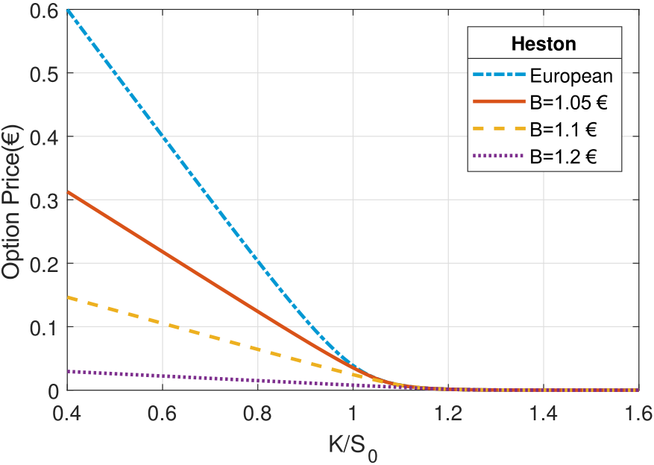
Results – Barrier option pricing
With the trained models we are able to price more complex options using a modified Monte Carlo algorithm.
Barrier options only become active when stock prices reach a given threshold.
Option prices decrease with the threshold (as is expected).
Barrier option prices (under Heston model)

Slide 25
Conclusions

Slide 26
Conclusions
All models show great improvement over the constant volatility model.
The calibrated stochastic volatility models can be used to price options directly, and perform quite well.
Of all models, Heston is expected to perform best.
The Monte Carlo pricing method should only be applied in the regions around S₀
This Monte Carlo pricing method can be applied to price different option types, such as Barrier options.

Slide 27
Thank you for your attention

Slide 28
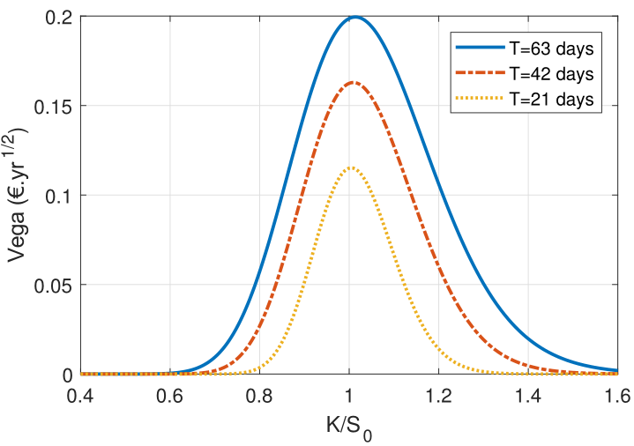
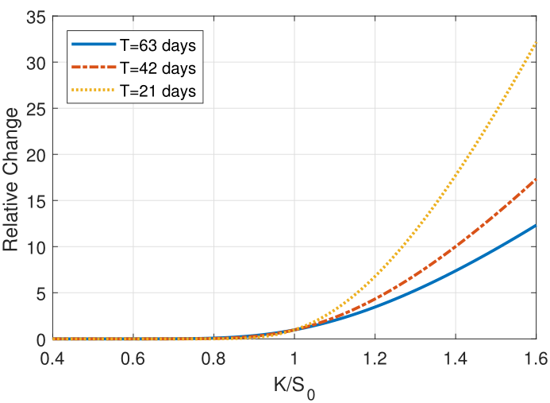
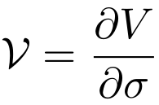
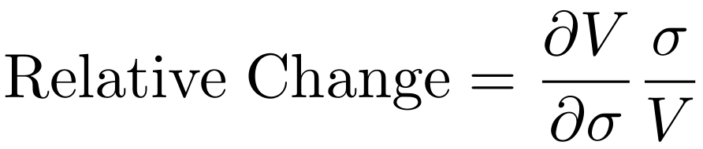

Volatility sensitivity to Option price

Slide 29
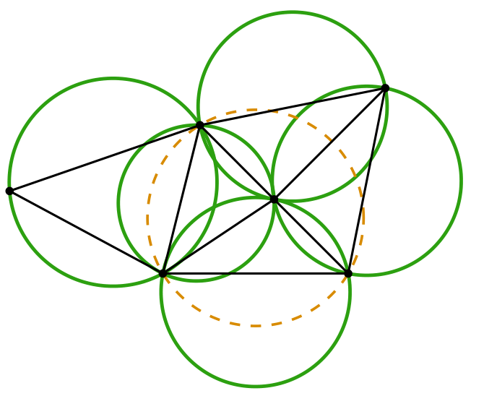
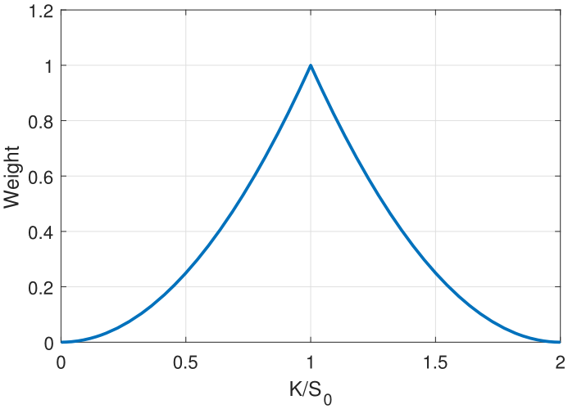
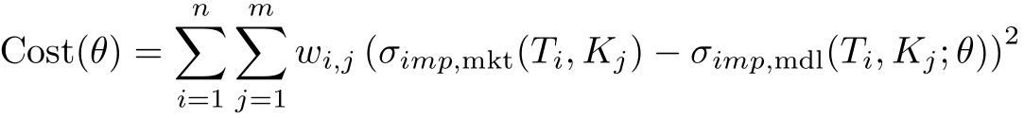
Training

Slide 30
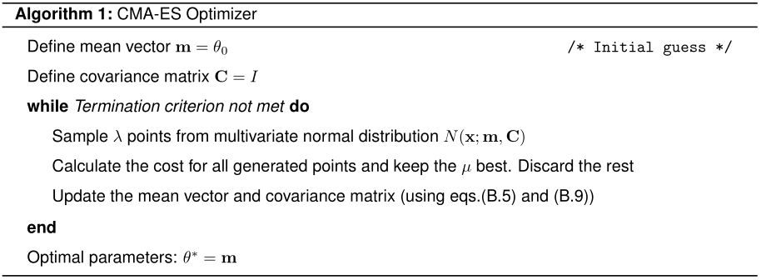
CMA-ES Optimization Algorithm

Slide 31
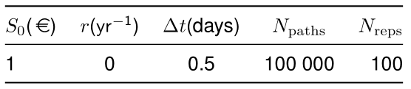

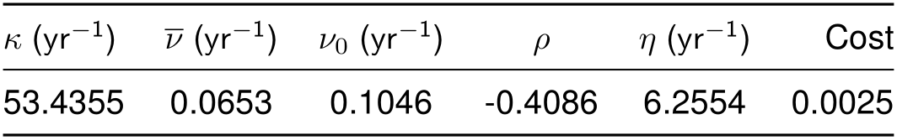
Parameters and fits

Slide 32
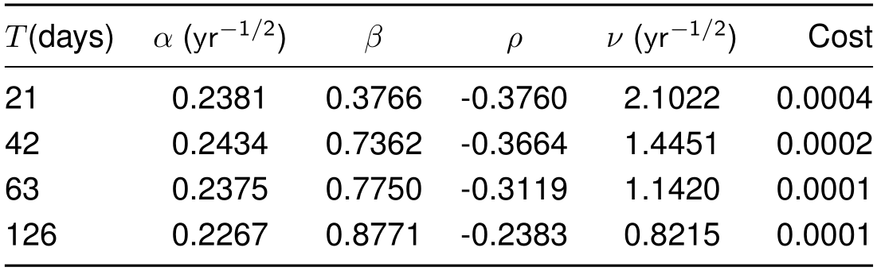
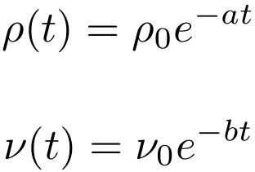
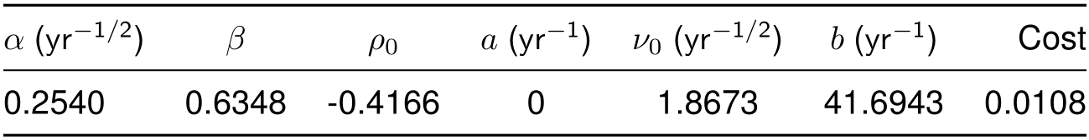
Parameters and fits

