Slide 1
Sensitivity Analysis on Least-Squares American Options Pricing
Miguel Ribeiro
MEFT nº79013
Advisors: Cláudia Philippart Rui Dilão Claude Cochet

Slide 2
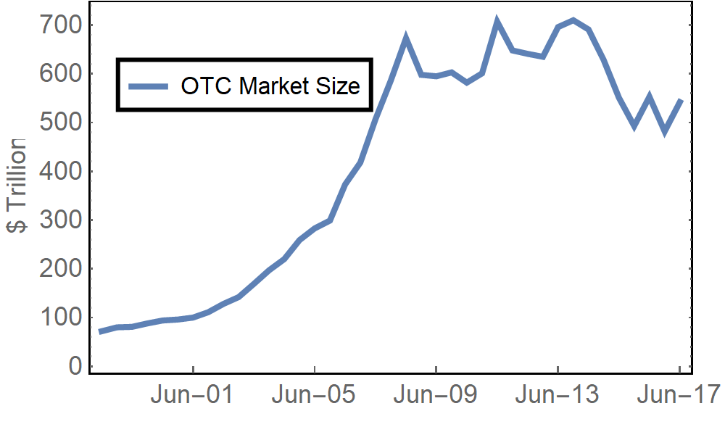
Derivatives
Contracts whose value depends on other simpler financial instruments.
Stock prices, exchange rates, …
Can take any form desirable.
Have grown greatly in recent decades:
Currently over $542 trillion
Crash after 2007 financial crysis
Size of OTC derivatives market since May 1996.

Slide 3
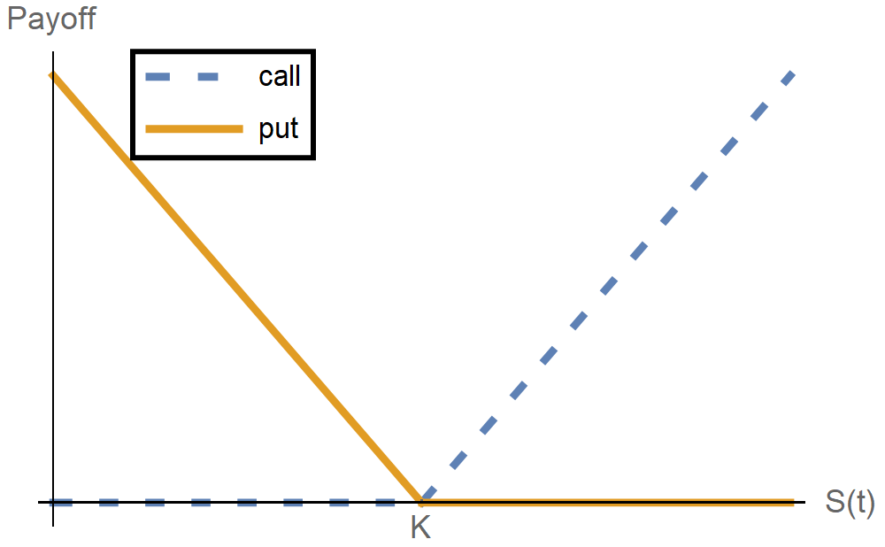
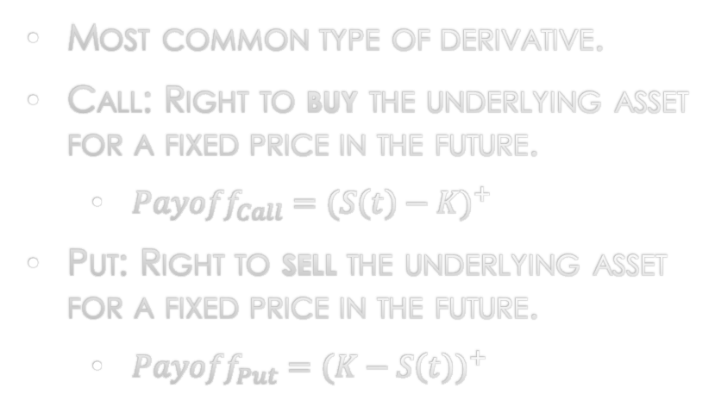
Call and Put Options
Most common type of derivative.
Call: Right to buy the underlying asset for a fixed price in the future.
${Payoff}_{Call}={(S\left(t\right)−K)}^{+}$
Put: Right to sell the underlying asset for a fixed price in the future.
${Payoff}_{Put}={(K−S\left(t\right))}^{+}$

Slide 4
Why options?
Options can provide:
Security to hedgers
Oprions fix the future price of the asset
Access to higher profits to speculators
Options magnify consequences

