Slide 1

Volatility Models in Option Pricing
Miguel Ribeiro
Master in Engineering Physics
Supervisors: Prof. Cláudia Philippart
Prof. Rui Dilão

Slide 2
Motivation
What is Volatility and why it is important

Slide 3
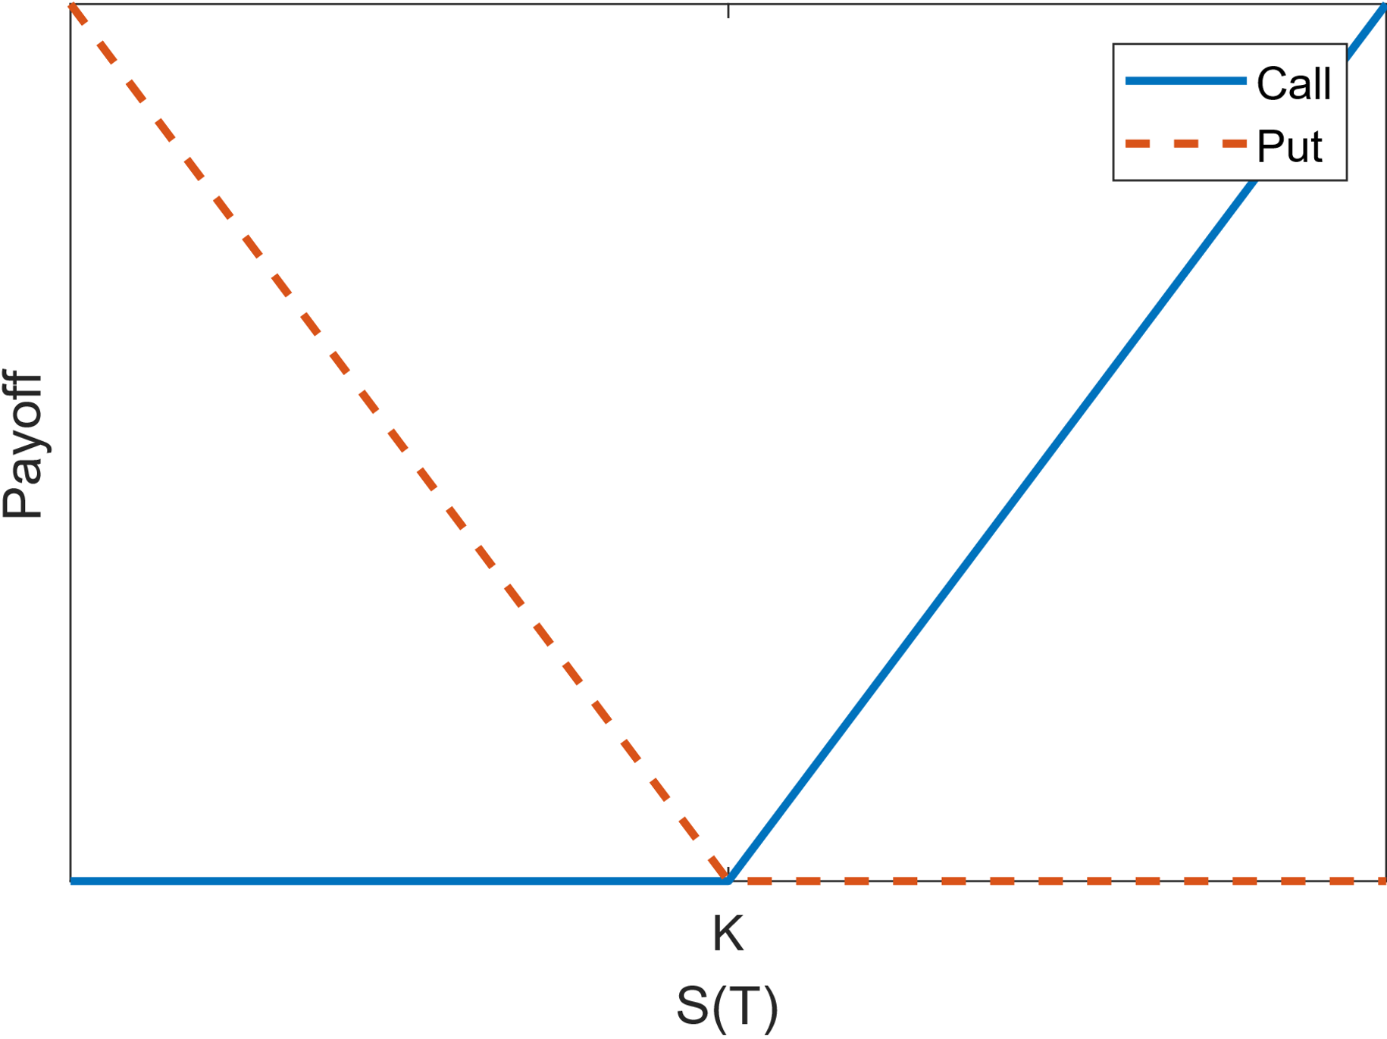
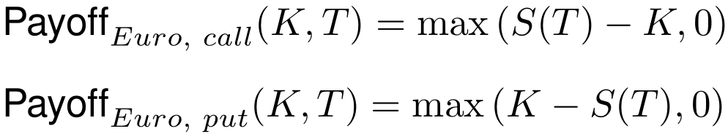
Motivation – Options
In finance, options are contracts that give us the option to buy or sell (call/put) an asset, the stock, for a fixed price, the strike price K, at a fixed future date, known as maturity, T.
The payoff of these contracts is given by:
No downfall, only profit:
We must find their price!
Payoff function of call and put type options

Slide 4
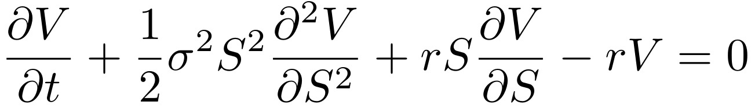
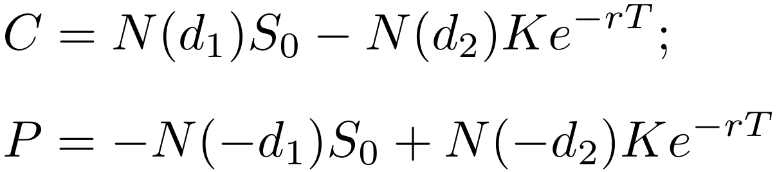
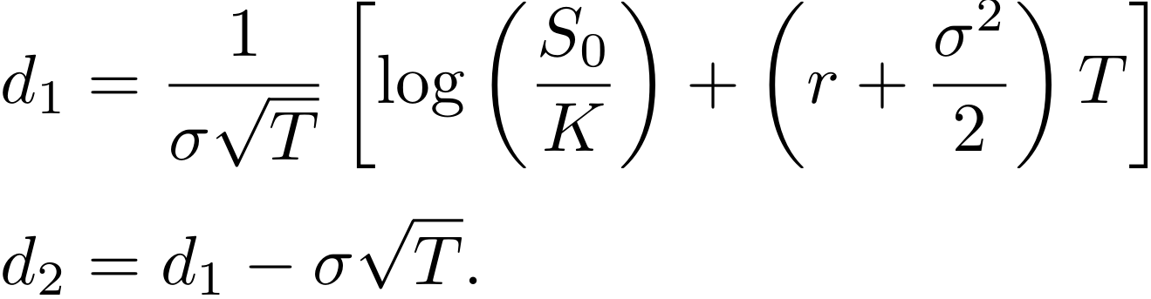
Motivation – Pricing Options
To price options we can use the Black-Scholes formula:
Solving this equation, we obtain the option price
Assuming that:
The stock price follows a Geometric Brownian Motion:
We have a constant interest rate, r, and no dividends
Volatility, σ, is constant!

Slide 5
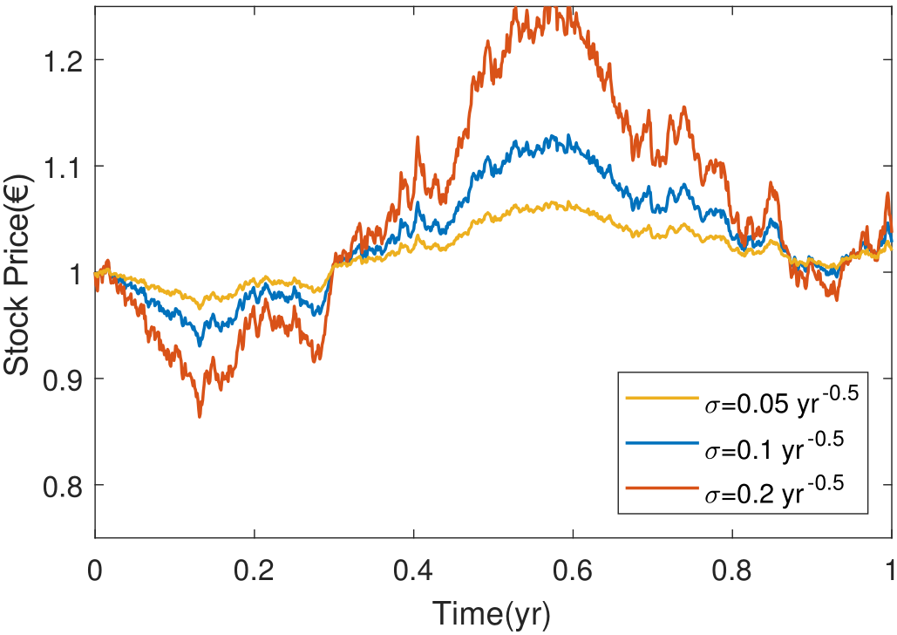
Motivation – Volatility
Volatility is not constant
Very difficult to estimate and forecast
Great impact on the stock prices
We have to model it!
Example of three Geometric Brownian Motion processes with different volatilities

Slide 6
Objectives

Slide 7
Objectives
Choose some of the most used volatility models
Study and use them to price real options
Compare them and find which performs best
Use the results to price more complex options

Slide 8
Models
Dupire’s local volatility
Heston and Static/Dynamic SABR stochastic volatility

Slide 9
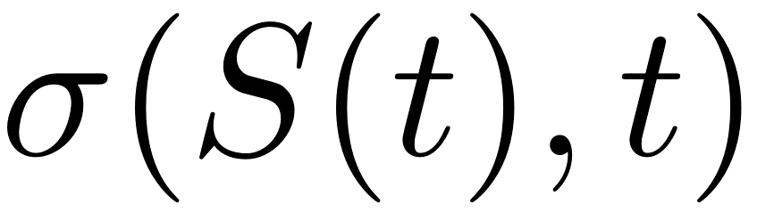
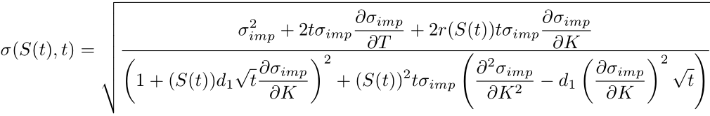

Models – Dupire’s Local Volatility
In Dupire’s model, we assume that volatility is a known function of time and the stock price.
The stock price diffusion process becomes
with given by

Slide 10
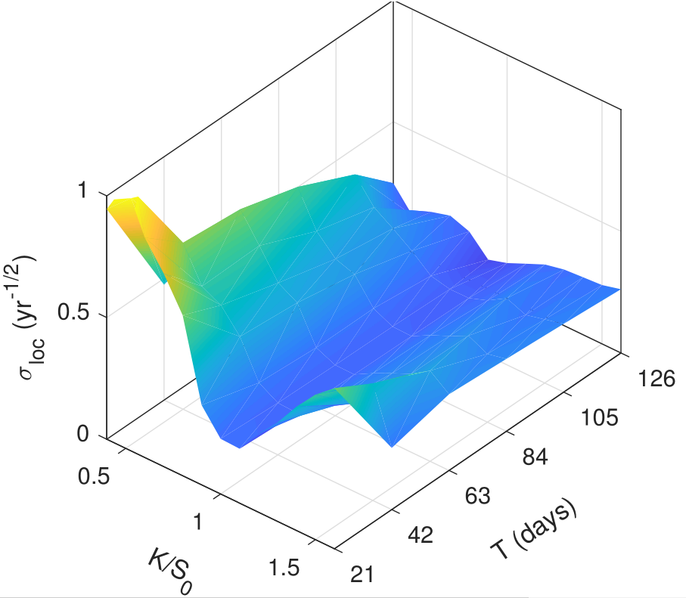
Models – Dupire’s Local Volatility
With this formula we can obtain the local volatility surface
We can sample from this surface to obtain the local volatility at each point of the diffusion process
Generated local volatility surface

Slide 11
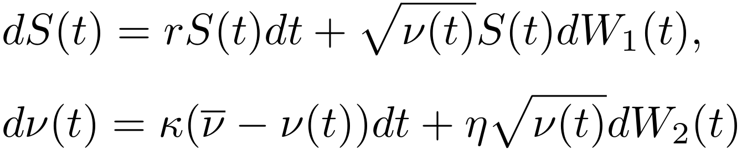
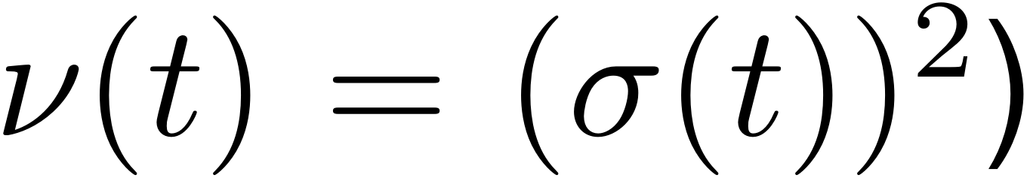



Models – Heston’s Stochastic Volatility
In Heston’s model, we assume that the volatility itself follows a diffusion process
where and have a correlation of
We have to calibrate this model (i.e. find the parameters that best fit the data)

Slide 12

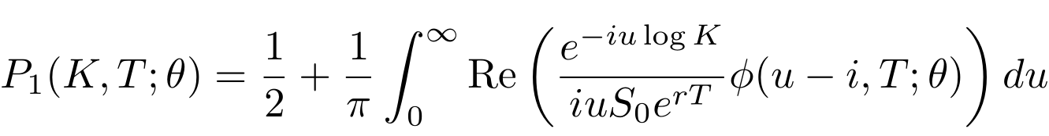
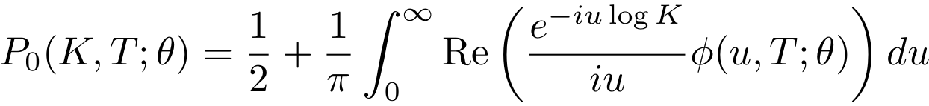
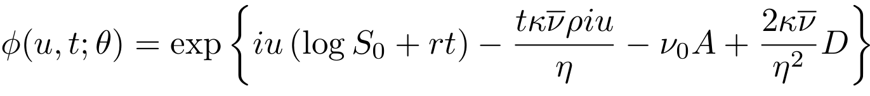
Models – Heston’s Stochastic Volatility
With Heston’s model, there is a closed-form solution which we can use in calibration
…
From this, we can directly price options with any parameter set
Calibration is now easy

Slide 13
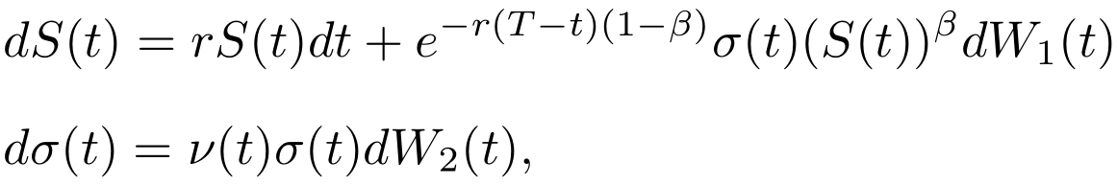

Models – Static/Dynamic SABR
As for Heston, we again assume that volatility follows a diffusion process, given by
where and have a correlation of
In Static SABR model, we assume and to be constant
Static SABR only works for single maturities
We again have to calibrate these models

Slide 14
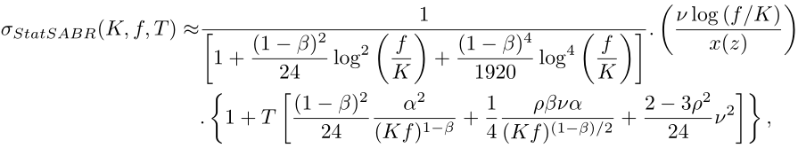
Models – Static/Dynamic SABR
As with Heston, we have closed-form solutions in SABR that make calibration easy
…
…
From this, we can directly obtain the implied volatility with any parameter set
Calibration is now easy

Slide 15
Results

Slide 16
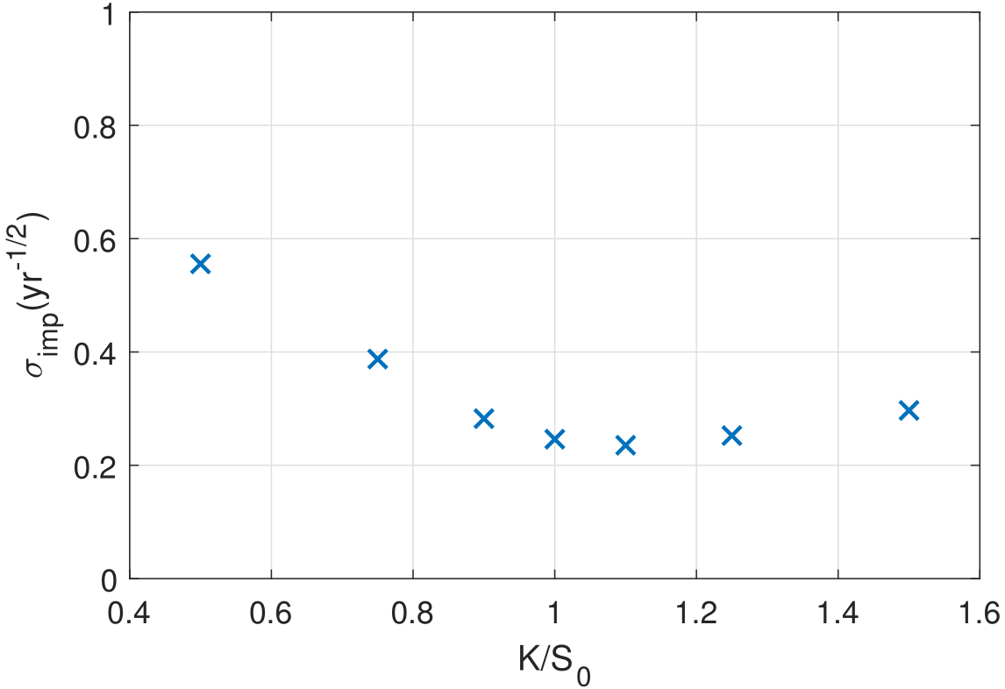
Results
We calibrated the models using the implied volatilities of real options with 7 different strikes over 4 maturities.
In the calibration we use a cost function, which we can use to compare the models.
The models were implemented in a Monte Carlo numerical pricer with the calibrated parameters to produce simulated results.
Implied volatility data to be used on calibration
(with a maturity of 42 days)

Slide 17
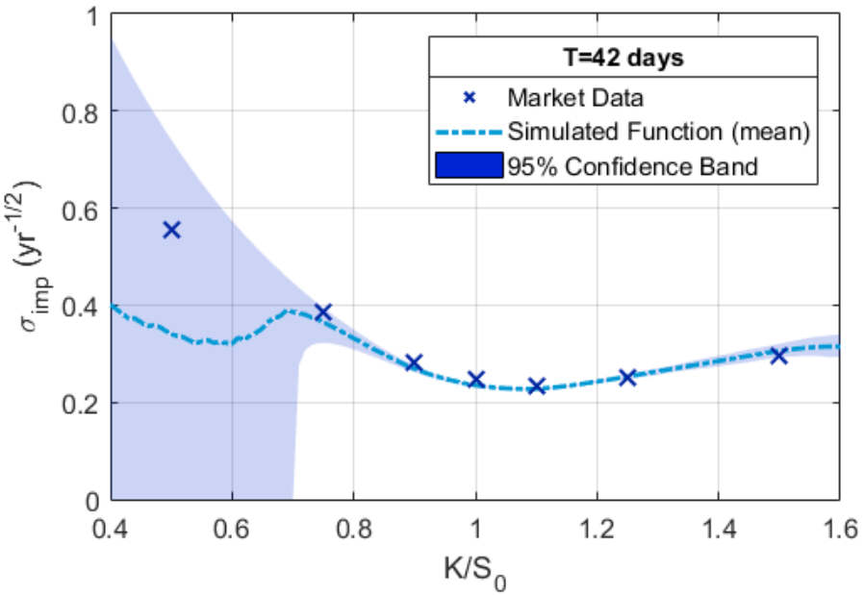
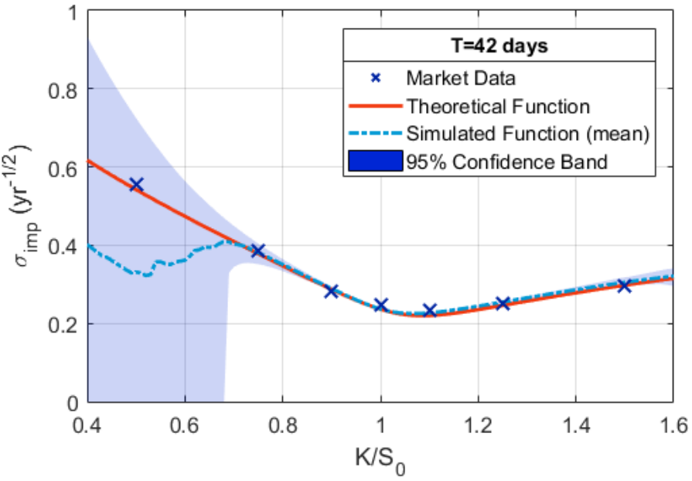
Results
Dupire’s model
Heston’s model

Slide 18
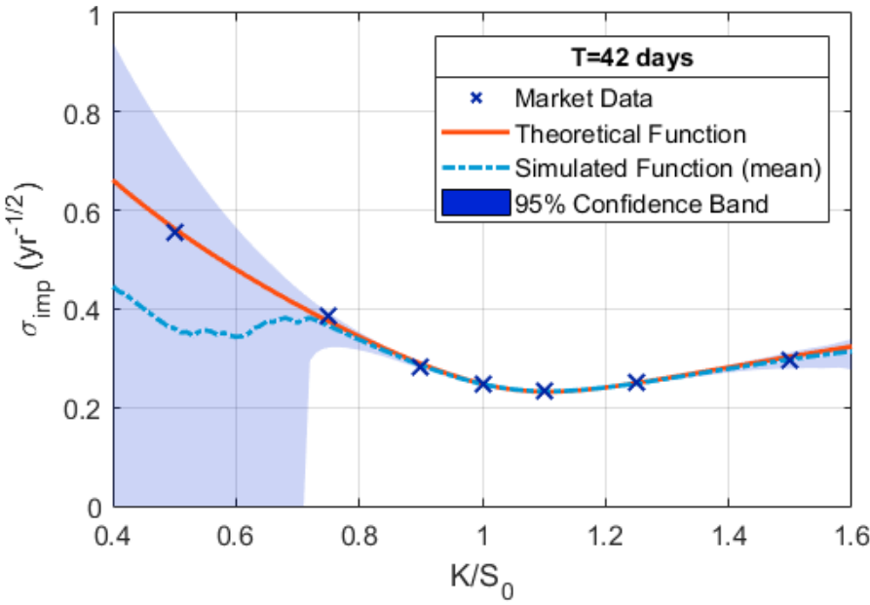
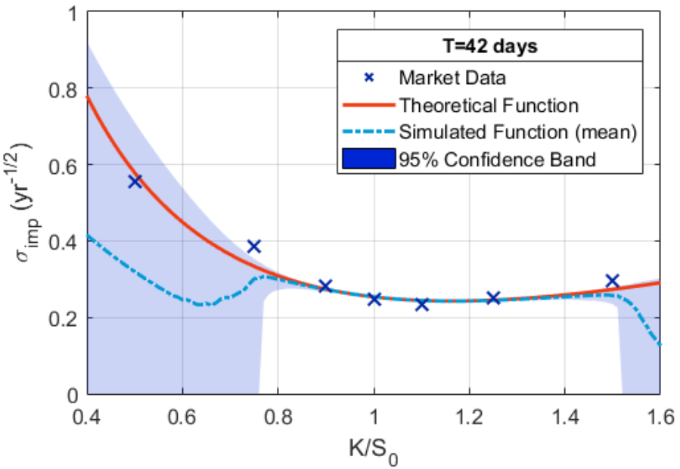
Results
Static SABR model
Dynamic SABR model

