Slide 1

Volatility Models in Option Pricing
Miguel Ribeiro
Master in Engineering Physics
Supervisors: Prof. Cláudia Philippart
Prof. Rui Dilão

Slide 2
Motivation
What is Volatility and why it is important

Slide 3
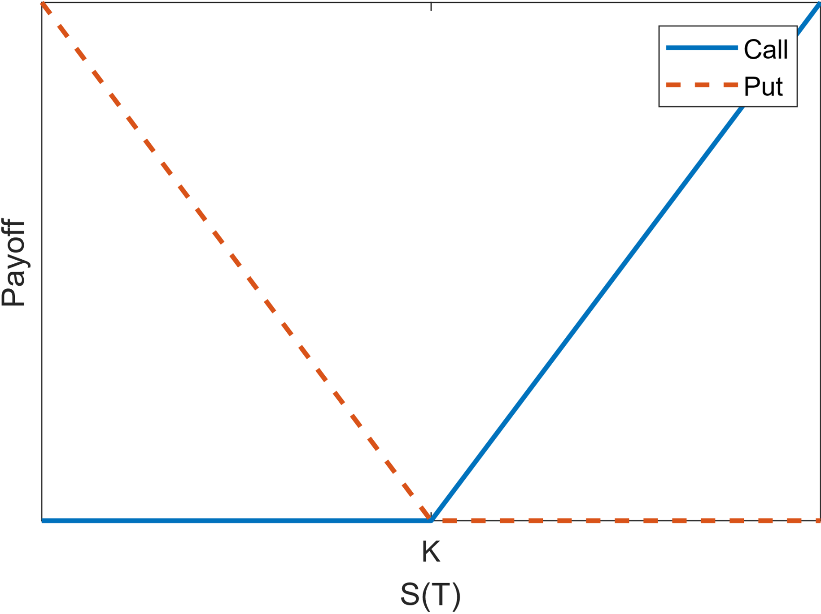
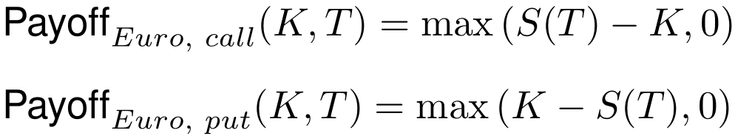
Motivation – Options
In finance, options are contracts that give us the option to buy or sell an asset, the stock, for a fixed price, the strike price K, at a fixed future date, known as maturity, T
The payoff of these contracts is given by:
No downfall, only profit:
We must find their price!

Slide 4
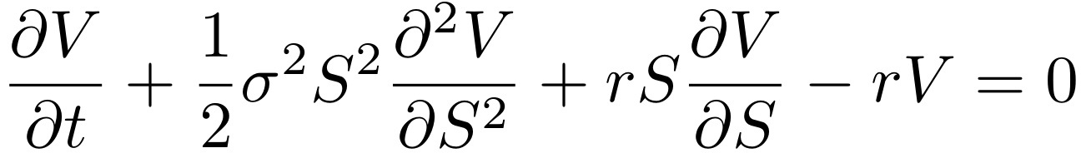
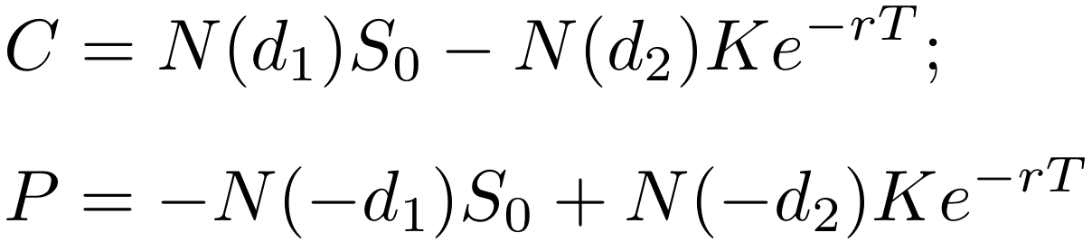
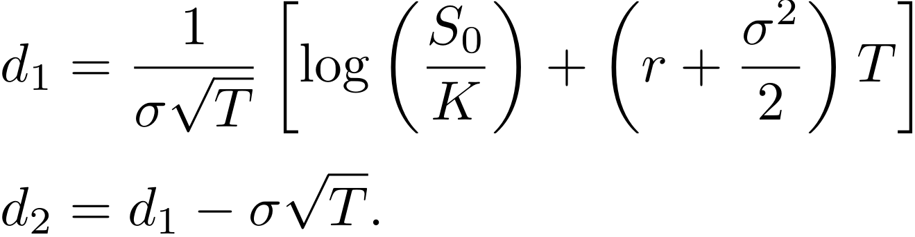
Motivation – Pricing Options
To price options we can use the Black-Scholes formula:
Solving this equation, we obtain the option price
Assuming that:
The stock price follows a Geometric Brownian Motion:
We have a constant interest rate, r, and no dividends
Volatility, σ, is constant!

Slide 5
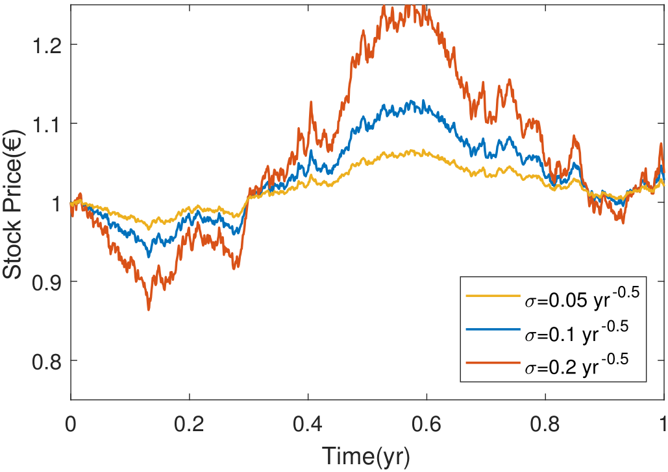
Motivation – Volatility
Volatility is not constant
Very difficult to estimate and forecast
Great impact on the stock prices
We have to try to model it!

Slide 6
Objectives

