Slide 1
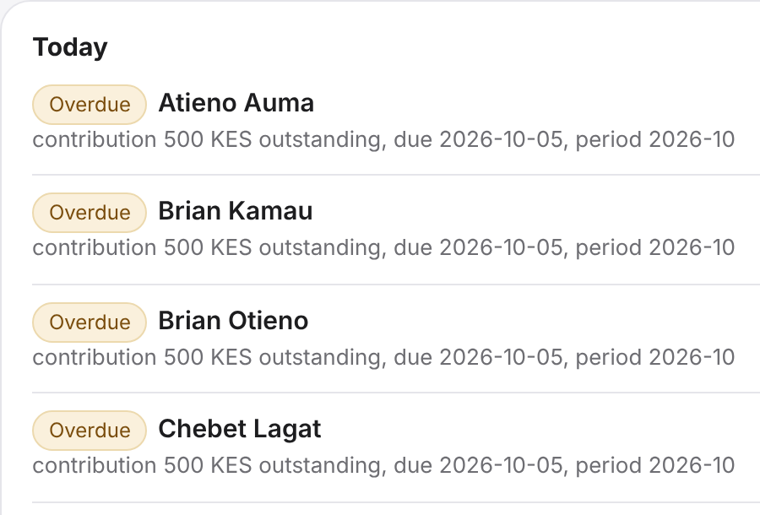
Umwayi-RM
The secretary that never decides
An open-source assistant for savings groups. A belief, a test, and an honest result.
Indie Developer track, Build for Your World
Solo entry by Miguel Shinyenyi, Nairobi
The real console, synthetic group
Notes:
0:00 to 0:10. One line: an open-source secretary for savings groups that turns voice notes and paper ledger photos into proposed entries, asks when it is unsure, and leaves every decision to the treasurer. Track: Indie Developer. Problem statement: Build for Your World. Say the data is synthetic.

Slide 2
Records live in notebooks and chats
1
2
3
Names collide
Months go missing
Totals disagree
Two members share a first name. Which one paid?
A payment is in a voice note, a chat message, or nowhere.
The notebook says one number and the group chat says another.
I have not interviewed treasurers yet.
The problem is a hypothesis. Everything you see is a synthetic group, built to show how the tool behaves.
Scale, as reported: news coverage of a Ministry of Co-operatives statement says chamas manage over Sh300 billion. That is a reported figure, not one I measured.
Notes:
0:10 to 0:25. Many savings groups keep records in a notebook and in messages. Zero interviews so far (H-14 closed with none, D-11). Say it is a hypothesis. Do not claim the problem is proven.

Slide 3
I believed rules would make an AI careful
I wanted an assistant that asks when it is unsure, not one that guesses.
So I measured it
4
prompts, same model
The belief
3
random seeds
Short rules, written from past mistakes, make an agent ask instead of guess.
The rule I would not bend
120
frozen test notes per prompt
The model proposes. Code owns the ledger.
Each seed: 16 ambiguous notes and 24 clear ones.
Notes:
0:25 to 0:35. Same story as the article 'A folder is not a brain until you measure it': I believed a folder of rules makes an AI careful, then I tested it. Four prompts: C0 bare, C1 placebo of equal length, C2 generic 'ask when unsure', C3 curated. Test split frozen before any run. Seeds 7, 8, 9.

Slide 4
The model proposes, the treasurer decides
INPUT
MODEL
CODE
PERSON
CODE
Voice note or
ledger photo
Agent proposes
Muse Spark Open
Checks schema,
quotes, ledger
Treasurer approves,
edits or rejects
Append-only
ledger
The agent never writes the ledger
Every proposal quotes its words
Nothing is sent, nothing moves
It writes proposals. Only approval changes state.
A check rejects a proposal whose quote is not in the note.
No money, no messages, no scores for members.
Meta models: Muse Spark Open on Baseten runs the agent loop, tools and reading. Muse Voice Transcribe handles voice. The Lab trace shows the model id.
Notes:
0:35 to 0:45. Code owns the ledger, balances and reconciliation; the agent only writes proposals; idempotent approval; citation and schema checks; an MCP server with risk-rated tools. Meta models: Muse Spark Open on Baseten for the agent loop, tool calls and reading; Meta Model API for voice transcription (muse-voice-transcribe-1.0). The trace in the Lab shows the model id.

Slide 5
A voice note becomes quoted proposals
THE TREASURER SPEAKS
Propose: Atieno Auma, contribution, 500 KES, 2026-10
“Atieno paid 500 for October. Chebet sent 500 as well.”
Evidence: “Atieno paid 500 for October”
Propose: Chebet Lagat, contribution, 500 KES, 2026-10
Example note, synthetic
Evidence: “Chebet sent 500 as well”
Proposals wait in an inbox. Nothing changes until the treasurer approves.
Illustration of the flow. The live demo shows the real run, with the model id in the trace.
Notes:
DEMO. 0:45 to 1:10. Record or type a note with the real console, with keys set. Show the transcript and the proposals, each with the quoted words. If the live run differs from this slide, show the live run. Voice: after the meeting, the treasurer speaks a note. The agent returns proposals, each with the words it came from.

Slide 6
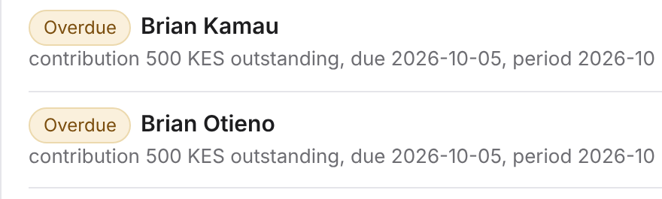
Two Brians: the agent asks
“Brian paid 500 for October.”
AGENT ASKS
Which Brian: Brian Kamau or Brian Otieno?
Real console. The synthetic group has two members named Brian, and both are overdue.
The treasurer answers and the run continues. On 48 ambiguous test notes the curated prompt never guessed. Neither did the generic one. The bare prompt guessed 7 times.
A first name is not an identity. When the agent cannot tell, it asks.
Notes:
DEMO. 1:10 to 1:30. Two members share a name. The agent does not guess. It asks. Show the question in the Today list or the inbox, answer it, and show the run continue. The screenshot is the real console with the seeded group.

Slide 7
A paper page becomes questions
ON THE PAPER PAGE
IN THE STORED LEDGER
FINDINGS, AS QUESTIONS
Zawadi Muthoni 500
Njeri Wambui 500
Njeri Wambui 300
Zawadi is on paper but not in the ledger. Add it?
Njeri: paper says 500, ledger says 300. Which is right?
Example rows, synthetic
Code compares both lists.
The agent reads the page. Code does the comparing. Differences are questions, not faults.
Illustration with example rows. The live demo uses a photographed page.
Notes:
DEMO. 1:30 to 2:00. Upload the synthetic ledger page photo. Findings: one row only on paper, one amount differs. Voice: code compares the page with the ledger and lists the differences as questions, not as faults. Needs the model keys; without them the page answers model_off.

Slide 8
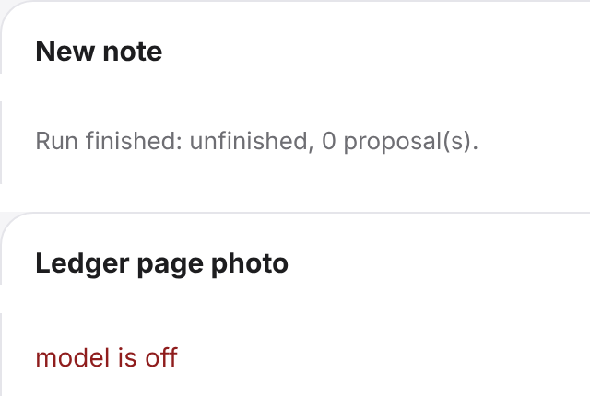
Approve twice, one entry. Model off, it works
Approve twice, one entry
1
Approving the same proposal again changes nothing. A test covers it.
State changes only on approval
2
Reject or ignore a proposal and the ledger stays the same.
Model off, the list still works
3
No keys: Today and manual entry run. Voice and photo answer “model is off”.
Real console with no keys set.
Notes:
DEMO. 2:00 to 2:25. Approve one proposal, then press approve again: one entry. Restart without keys: Today still lists overdue members. Voice: state changes only on approval, approving twice changes nothing, with the model off the balances still work. Also show Today with reminder drafts: copy only, nothing is sent.

Slide 9
Generic rules over-asked. Curated rules did not
Clear notes handled correctly, out of 72
7 of 48
ambiguous notes where the bare prompt guessed
0 of 48
for the placebo, generic and curated prompts
67 vs 24
clear notes handled, curated vs generic, of 72
Same model, frozen test split, 3 seeds, synthetic data. Source: docs/evals.
Notes:
2:25 to 2:45. Chart is built from the saved run files in docs/evals (h1-test seeds 7, 8, 9), summed over the 24 clear notes per seed. Bare 23/72, placebo 55/72, generic 24/72, curated 67/72. Guesses on the 16 ambiguous notes per seed (48 total): bare 7, all other prompts 0. Curated versus generic on guessing: 0 of 48 versus 0 of 48, a floor effect, so the restraint claim is not supported. Say n is small and the data is synthetic.

Slide 10
What held and what did not
Held
Did not hold
Curated rules kept clear notes moving: 67 of 72 handled, against 24 of 72 for a generic “ask when unsure” prompt.
Any added prompt cut guessing: 7 of 48 for the bare prompt, 0 of 48 for the rest.
Code-owned ledger, idempotent approval and the model-off path pass their tests.
Restraint claim: curated 0 of 48 against generic 0 of 48. A floor effect, so the two cannot be told apart.
A placebo prompt reached 55 of 72. Most of the gain may come from prompt length and form, not from the rules.
Archive claim (one seed): core plus archive 19 of 20, plain retrieval 20 of 20, truncation 13 of 20. Not better than retrieval.
Notes:
Optional 10 seconds in the video, or keep for Q and A. The point of the article carries over: a belief is not a result. Report the null results. H1 and H2 raw data are in docs/evals. H2 was rescored per docs/evals/h2-seed7-analysis.json (raw archive 17/20).

Slide 11
What is not proven, and what I need
Not proven
What I need
That treasurers prefer it to a notebook or to Chamasoft
That it reduces errors in real groups
Security and Data Protection Act compliance
That the rules help beyond this synthetic set and model
One pilot group for a month, and feedback from treasurers.
Open source, MIT licence.
github.com/Miguel-Shinyenyi/umwayi-rm
Built with Muse Spark Open
Miguel Shinyenyi, Nairobi
Notes:
2:45 to 2:50. Open source, built on Muse Spark Open. What is not proven: that treasurers prefer it, that it reduces errors, compliance. I am looking for one pilot group. Ask: one pilot group for a month and feedback from treasurers.

